Slide 1
Lecture 4: Ignatius of Antioch
12 September 2019

Slide 2
Introduction
Early Christian Communities
Ignatius of Antioch
  Martyrs
  Early Church Structure
  Docetism
Assignments

Slide 3
Review: Roman Imperial Dynasties
First Century
  Claudio-Julian
    Augustus
    Nero
  Flavians
    Vespasian
    Titus
    Domitian
Second Century
  Antonnines
    Trajan
    Hadrian
    Antonius Pius
    Marcus Aurelius
    Commodus
Third Century
  Severides
    Septimus Severus
  Decius
  Diocletian

Slide 4
Review: Roman Games
Romans loved blood sports
  Gladiators were sports stars of the Roman world
  Important part of criminal and slave trade was supporting circuses
Typical day at the Coliseum (60,000 spectators; note Circus Maximus held 250,000)
  Morning: animal fights
  Lunch: execution of criminals
  Afternoon: gladiators (featured event)

Slide 5
Ignatius of Antioch
Bishop of Antioch early Second Century
  One of the most important cities in Empire
  Other vitally important city was Alexandria
Arrested and found guilty of impiety; brought to Rome to be executed
  Probably not a Roman citizen; already tried and expected to die in arena, not by beheading
  Probably died c. 110 (Trajan was Emperor; Pliny was chief administrator in Asia Minor)
Obviously well known in the Christian community around Asia Minor and in Rome
Still honored by us in the Roman Eucharistic Prayer:
  …deign to grant some part and fellowship with Your Holy Apostles and Martyrs with Stephen, Matthias, Barnabas, Ignatius, Alexander, Marcellinus, Peter, Felicity, Perpetua, Agatha, Lucy, Agnes, Cecilia, Anastasia, and all Your Saints.

Slide 6
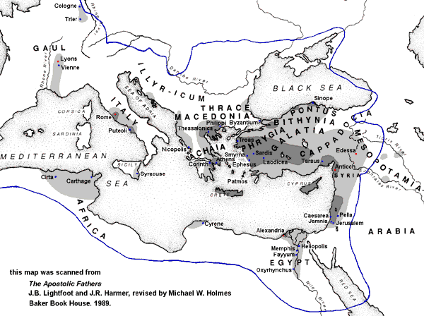
Early Spread of Christianity c. 150 www.ntcanon.org/mapsmall.shtml

Slide 7
Importance of Antioch
Along with Rome, the only city to be evangelized by both Peter and Paul
The first place that the followers of the Way were called Christians (Acts 11:26)
The first place that Christians called themselves Catholic (Ignatius, Smyrneans 8:2)
Antioch prides itself on having St. Peter as its first bishop
After Rome and Alexandria the largest and most important Church in 2nd through 4th C

Slide 8
Key Issues for Ignatius of Antioch
Martyrdom
Early Erroneous Christological Movements
  Docetists
  Judaisers
Church Structures

Slide 9
Roman Persecution of Christians
Christians were not killed because they practiced Christianity; killed because they refused to also practice Roman religion
Persecutions in 1st and 2nd C, with a few exceptions, were local and sporadic
  Jealousy of neighbors
  Persecutions increased during stressful times
Review Letters of Pliny and Trajan

Slide 10
Pliny-Trajan Letters
This particular translation is being a bit ‘too cute’ with Christ-niks
  But makes the point that you are reading translations, and translators intentionally or otherwise have their own ax to grind
Pliny’s problem
  Christians are stubborn and refuse to worship
  Infecting all levels of society
Trajan’s Response
  Very reasoned; model of good bureaucracy
  Discount anonymous charges
  Give every opportunity to obey
  Note final sentence reference to ‘our times’; distinction with evil days of Domitian

Slide 11
Christian Martyrs
Martyr comes from the Greek, ‘witness’
Possible Christian responses to persecution
  1. Intellectual: Apologies written to justify Christianity to Roman authorities
  2. But, if you believed that Jesus only appeared to be human (docetists), then there seemed little reason to be a martyr yourself
  3. Some did not have the courage when accused, and so apostatized
  4. Facing torture and death without apostasy; often even looking forward to martyrdom eagerly as a proof of solidarity with Jesus

Slide 12
Reaction of Christian Community to Persecution
Martyrs were (are) the heroes of the faith
Did not have to die to be a martyr; any one who suffered for the faith was a martyr
Living martyrs (confessors) had the highest standing in the Church
Church equally honored women and men who were martyrs

Slide 13
‘Voluntary’ Martyrdom
Bishops actively discouraged Christians from ‘volunteering’ as martyrs
If accused, then Christians should not renounce the faith, but should not flaunt it for purpose of being martyred
  This would be suicide, not in accordance with God’s will
Neither should Christians take up arms to defend themselves
  There is no recorded instance of any Christian rising in armed rebellion against the Romans
  In distinction to earlier Judaism or later Islam
See, for example, Clement of Alexandria, Stromata IV.10

Slide 14
Not All ‘Christian Sects’ Accepted Martyrdom as Witness to the Faith
Rejection of value of martyrdom was based on erroneous Christology
One of the earliest Christian heresies was docetism (from Greek word to seem or appear)
The belief that Jesus only appeared to be human; that he only appeared to suffer on the cross
  Jesus was divine, not truly man
  Since Jesus did not suffer, there was no value in martyrdom
Theological issue: impassability of God; nature(s) of Jesus Christ
  Greek philosophical concept

Slide 15
Docetic Example: Gospel of Peter
Early 2nd C Christian literature
Like Didache, discovered (Egypt) in 19th C, but fragments quoted by Church Fathers
Gospel of Peter is a non-canonical passion narrative
Very anti-Jewish
States that Jesus (always referred to as Lord and Son of God) hanging on the cross had no pain
Late 2nd C bishop of Antioch explicitly condemns Gospel of Peter because it is used by docetists

Slide 16
Judaisers
Jewish-Christians who saw themselves as Jews who believed Jesus was Messiah
But Jesus as Messiah was seen as a man or an angel, not God
Typically maintain Jewish practices
Example: Gospels of Nazareans

Slide 17
Why did Ignatius Oppose These Groups
Ignatius, like almost all Church Fathers, did not engage in academic debates
Primary concern as bishop was care of his flock
Groups with erroneous Christology were a threat to integrity and unity of Church
Most ‘doctrine’ developed by Church Fathers was in response to erroneous teaching
NB: Very difficult to fully describe the Truth; much easier to demonstrate what is not true

Slide 18
Letters of St. Ignatius
7 Letters written by Ignatius to communities in Asia Minor
The best Greek manuscript was edited by P. Th. Camelot, found in Sources chretiennes Vol. 10 (also available online in Thesaurus Lingae Graecae)
English translations, usually found in volumes with other Apostolic writers (ACW, ANF, LCC for example).
The CCC uses the Kleist translation, found in ACW 1.
Kenneth Howell’s new translation (2008) is particularly recommended. Kenneth J. Howell, Ignatius of Antioch, A New Translation and Theological Commentary (Zanesville, Ohio: CHResources, 2008).

Slide 19
Early Church Organizational Structures
Why is Ignatius interested in organizational structure: guarantor of Truth
Apostles
Bishops as successors to Apostles
Deacons as administrators for Bishops
Presbyters as council of elders to Bishop
Bishop as head of the Household (paterfamilia)
Primary Scriptural basis in Matthew, Acts of Apostles, Letters to Timothy and Titus

Slide 20
Key Issues for Ignatius
Opposition to docetism
Opposition to ‘Judaisers’
Church structure and unity
Personal perseverance (see especially Letter to Romans)
  Writing letters to Christian communities as he is being taken to Rome to be executed

Slide 21
Some things to look for
Early Baptismal Creeds (Eph 7.2; Mag 11:1; Smyr 1:1-2)
Eucharist as the flesh of Christ (Smyr 7.1, Phil 4, Rom 8)
The Cross as a fruitful tree with branches that bears incorruptible fruit (Tra 11)
Martyrs as the wheat of the Church (Rom 4)
Harmony of unity (Eph 4 and Rom 2.2)
What is true discipleship (Eph 3)
But note especially how all of these things are related to each other.

Slide 22
Character (χαραχτηρ)
Character is the deep impression indicating ownership of
  Impress or image on a coin
In Scripture and Church Fathers, used to indicate strong sense of unity and belonging
See Heb 1:3 and I Clem 33.4
But perhaps more interesting for reading Ignatius is IV Macc 15.4
Note Ignatius’ use of character in Mag 5.2; and beginning of Tral

Slide 23
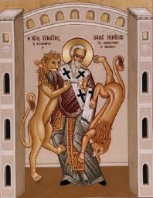
Martyrdom of Ignatius
Died during reign of Trajan c. 110 AD
By tradition he died a martyr in Rome
  In the Coliseum as part of lunchtime entertainment?
By tradition, after his martyrdom, his relics were returned to Antioch
  After Arab conquest of Antioch in 7th C, his relics were returned to Rome and placed in San Clemente
Feast Day, October 17

Slide 24
Assignments for Tuesday Discussion
Read all of Ignatius’ Letters
  The original hearers of Ignatius’ Letters would have been assembled as Church, probably in a liturgical setting to hear his letter read to them
Read sections from CCC
  2471-2474 (Bear witness to Truth)
  857-896 (Church is Apostolic)
Benedict XVI, General Audience, Ignatius of Antioch, http://www.vatican.va/holy_father/benedict_xvi/audiences/2007/documents/hf_ben-xvi_aud_20070314_en.html
Write 1-2 page paper on some aspect of Ignatius’ Letters
  Don’t forget thesis statement first
  Remember, references by paragraph and sentence number
Be prepared to discuss the Letters

