Slide 1
HT 501: Lecture 1
Introduction to Patristics
3 September 2019

Slide 2
Outline
Introductions
Syllabus Review
Why Study Patristics?
Relation of this course to other courses in seminary curriculum
How to read these texts
Clement’s First Letter to the Corinthians
Assignments

Slide 3
Timeframe for Course
Patristics or Patrology is the study of the writings of the Fathers of the Church
  NB: Subsection of earliest Patristics literature is often referred to as the Apostolic Fathers (Clement, Ignatius, Polycarp, Didache, Barnabas, Hermas)
Almost all Patristics studies begin c. 90 AD;
End date for Patristics is more variable; possibilities include:
  End of Roman Empire (also variable; 5th to 15th C)
  Death of Pope St. Gregory the Great (d. 603)
  Before/After St. Augustine (d. 430)
  Through 7th Ecumenical Council (787)
This class starts approximately 90 AD (death of the apostles and NT authors); ends with seventh ecumenical council, 787 AD

Slide 4
Structure of Class
Two parts and Augustine
  Constantine the Great marks dividing line (early 4th C)
Part I: Time of martyrs
Part II: Roman Empire becomes a Christian Empire
St. Augustine and careful reading and discussion of Confessions

Slide 5
Marking Sacred and Secular Time: B.C. and A.D.
Almost all journals and books in the last 20 years have gone to BCE and CE
  BCE = Before the Common Era
  CE = Common Era
I stubbornly hold on to B.C. and A.D.

Slide 6
Requirements
Class attendance and active participation.
Papers and discussion on primary source readings nearly every week
  Papers should be 1-2 pages; see handout for guidance on writing these papers
  Theme or thesis statement
  FOCUS ON PRIMARY SOURCES
  See rubric handout
Two Exams:
  Midterm will cover first part of semester (closed book)
  Final will cover second part of semester (closed book)
  Both midterm and final will include matching quotes to primary source authors; identification of terms and people; geography identification (midterm only)
Grade:
  1/3 papers and discussion
  1/3 midterm
  1/3 final

Slide 7
Texts for Class
Augustine. Confessions. Translated by Henry Chadwick. Oxford: Oxford University Press, 1992. OR Confessions. Translated by Maria Boulding. New York: New City Press, 1997.
Chrysostom, John On Wealth and Poverty. Translated by Catherine Roth. New York: St. Vladimir’s Seminary Press, 1999.
Hardy, Edward. ed. Christology of the Later Fathers. Philadelphia: Warminster Press, 1954.
Irenaeus. Irenaeus of Lyons. Translated by Robert Grant. London: Routledge, 1997.
Origen. An Exhortation to Martyrdom, Prayer, and Selected Works. Translated Rowan Greer. New York: Paulist Press, 1979.
Richardson, Cyril eds. Early Christian Fathers. New York: Touchstone, 1996.
Catechism of the Catholic Church

Slide 8
Web Site for Class
http://web.mit.edu/aorlando/www/Patristics/
Several files
  Word file of syllabus
  Web file (html) with links to web primary readings; other background resources of interest;
  Basic map of key historical regions (large pdf file)
  Lecture slides; posted day after each lecture, in a folder called Lectures; PowerPoint format

Slide 9
Sources
Primary Source: original works from the historical period under study
Secondary Source: later works written about earlier historical periods or works
Primary Source readings are the FOCUS in this class
  Different, multiple sources each week; should be focus of papers and presentations
  Reference ancient works using Book/Chapter/Paragraph numbering (e.g., Luke 1:1-4)
Read everything critically (includes secondary sources)
  What is author’s perspective
    Clement is late 1st C Roman, Greek-speaking, Christian with ecclesial authority primarily dealing with ecclesial issues
  What issues is the author addressing;
  How important is the historical circumstance to those issues
  Who is the audience
  What is genre of the work (homily, thesis, poem, letter, Biblical commentary, histiography)
Caution using Web Resources
  Anybody can put anything on the web and claim that it is ‘authoritative’
  Many ancient works, especially early Church Fathers, are available, but in older translations
  Maintenance of a web resource is still on an individual basis; no guarantee that information will be well maintained

Slide 10
Difficulty of Primary Source Readings
I know that this is a lot of material
I know that it is often very difficult to read
Therefore
  At the end of each class I will strongly suggest what should be read carefully, and what should be skimmed
  I will try to point out key themes
  It will serve you well to bring the next weeks’ readings with you
Remember when referring to primary source use Book.Chapter.Paragraph; NOT page number
  Would you refer to a Biblical passage by page number??

Slide 11
Original Language Texts
Primary languages for Patristics texts
  Greek
  Latin
  Syriac, Armenian, Coptic, Georgian (oriental)
Most common sources
  Patrologiae graeca (PG) and Patrologiae latina (PL) compiled by Benedictine monks, 16th C; edited in 19th C by J.P. Migne
  Corpus Christianorum: Series graeca (CCSG) and Corpus Christianorum: Series latina (CCSL) still in process, started in mid-20th C
  Corpus scriptorum christianorum orientalium (CSCO)

Slide 12
English Translation Series
Ante-Nicene Fathers (ANF), Nicene and Post-Nicene Fathers Series 1 and 2 (NPNF); late 19th C
Ancient Christian Writers (ACW), mid 20th C
Fathers of the Church (FC), mid 20th C, on-going
The Works of St. Augustine (WSA), begun late 20th C, on-going

Slide 13
Other Considerations in Reading Ancient Texts
Set aside many ‘modern’ American notions
  ‘Separation of Religion and State’
  ‘Progress, what’s new is best’
  ‘Individual rights’
Different connotations for common words; prophecy as an example
  Prophecy: both a way to know the Truth and results from the Truth;
  Not predicting the future as though looking into a crystal ball;
  But knowing the truth has implications for what can be expected in the future;
  More like our sense of science, cause and effect

Slide 14
Why Study Patristics?
Why study it?
  Shaped the way we think about the Truth of our Faith:
    Orthodox, right opinion or belief
    Developed the language to express the Truth
  Many ‘hot button’ items then are ‘hot button’ items now
    What is the authority of Scripture (for that matter, what is Scripture)
    Who should be a bishop or priest? What is their authority within the Church?
    What is relation of Christian morality to temporal justice?
    What does it mean to be a Christian in a secular world?
  See Instruction on the Study of the Fathers of the Church in the Formation of Priests, Congregation for Catholic Education, Rome 1989. Available at http://www.usccb.org/beliefs-and-teachings/vocations/priesthood/priestly-formation/upload/fathers.pdf

Slide 15
Tradition
From Latin, (trado, tradere, tradidi, traditum)
  Means to hand down
  N.B. traitor derives from same Latin root, to hand over
The theologians of this period saw themselves as handing down the Truth of what they had learned.
  As, in fact, so did Paul, 1 Cor 11:23; but of course he used the Greek word, παρεδωκα
The Truth for them, as for us, is found in Scripture. Key issues for them (and for us)
  What constituted the canon (from Greek word meaning the rule or measure) of Scripture
  How to properly understand Scripture

Slide 16
Relation to the Seminary Curriculum
Church History
  Impact of historical and political developments on Church (and vice versa)
Christology
  Christological controversies, Councils of 4th and 5th Centuries
Liturgy
  Study of early Christian liturgies (e.g., Hippolytus)
  Careful analysis of language of liturgy
Foundational and Systematic Theology
  Analysis, synthesis and occasionally critique, of what the Fathers taught
Scripture (Old and New)
  This is the basis for everything the Church Fathers taught
  See, for example, Benedict XVI Jesus of Nazareth

Slide 17
Criteria for Who Is a Church Father
Criteria first given by St. Vincent of Lerins (d. 450)
  Scholar specializing in Augustine
  Reflected on great theologians of the preceding centuries
Antiquity
Orthodox Doctrine
Holiness of Life
Ecclesial Approval

Slide 18
How to Read Patristic Texts
With very few exceptions, these works were occasional, addressing a particular circumstance (like Paul’s Letters)
  Almost all great theologians of this period were bishops
  Example: Augustine, The City of God
But all Patristic authors saw the Truth as a whole that affected all aspects of human life
  The source for Truth was Scripture
  Christian ‘philosophy’ provided the guiding principles for a way of life;
  Answer to the question what is a happy (blessed) life

Slide 19
Who Was Clement
Clement may have been associated with the household of Titus Flavius Clemens; may be located where Basilica of San Clemente is now
Clement may have been the Clement of Phil 4:3 (at least Irenaeus and later Fathers thought so)
Clement, bishop of Rome; died in 97 A.D. probably during persecution of Emperor Domitian;
“We honor Linus, Cletus, Clement,…”
By ancient tradition, Clement was arrested, sent to the north coast of the Black Sea to work in the mines
  Martyred by having an anchor tied around his neck
  Feast Day Nov. 23

Slide 20
Introduction to Clement's First Letter to Corinthians
Written late 1st Century; Written in GREEK
  Oldest non-Biblical Christian work
Major sections
  Introduction (Preface – 2.8)
  Thesis or Statement and Analysis of Problem (3.1-39.9)
  Solution (40.1-61.3)
  Conclusion (62.1-65.2)

Slide 21
Political Background: Domitian
Son of Emperor Vespasian, brother of Emperor Titus
Vespasian was Nero’s general during First Jewish War; when Nero murdered, he became Emperor
Titus took over for his father in the Jewish War; destroyed the Temple in 70 AD; became Emperor when his father died
Domitian took over for his brother; probably the Emperor associated with Revelations; he and Nero two of the most notorious Roman emperors

Slide 22
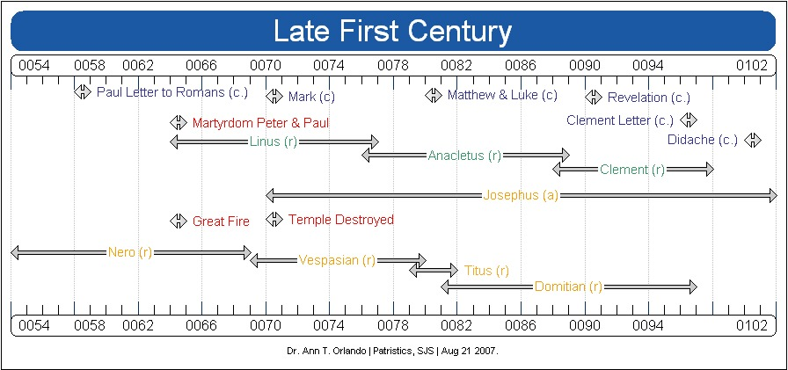

Slide 23
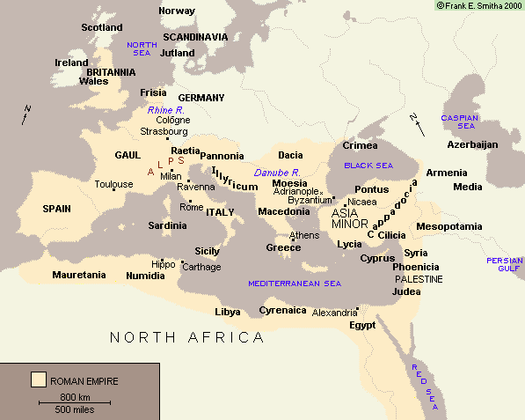
Map of Roman Empire www.fsmitha.com/h1/map18rm.htm

Slide 24
Brief Analysis of Clement’s Letter
What’s the occasion? In response to what? (1:1)
Christology
  Salvation from the cross of Christ (6.4)
  Jesus as scepter of God (16.2)
Truth as a way of life. (31:1-36:6)
Truth found in Scripture. (45:1-8)
  How does Clement use Scripture
  What is included in Scripture
Individual as part of a society. (37:1-44:6; 21:1-9)
Ecclesiology (40)
  First use of term laikos, laity (40.5)
Prayer for civil rulers. (61:1-3)
‘Prophecy’ of good/bad conduct as basis for future results. (58:1-59:2)

Slide 25
Prayerful Structure of 1 Clement
Prolog – 6
7 – 20 God’s order in Scripture and cosmos
20.12 Doxology
21 – 32 Household codes and salvation through Jesus Christ
32.4 Doxology
33 – 38 Following God’s will
38.4 Doxology
39 -43 Church community structure
43.6 Doxology
44 – 45 How ministers should be selected
45.8 Doxology
46 – 50 Commentary on Paul’s letter to Corinthians
50.7 Doxology
51 – 58 Asking pardon and interceding for sinners
58.2 Doxology
59 – 61 The elect and prayer
61.3 Doxology
62 – 65 Conclusion
65 Doxology

Slide 26
Subsequent Importance of Clement’s Letter
St. Irenaeus thought Clement was a disciple of Paul and 3rd bishop of Rome after Peter
St. Clement of Alexandria thought Clement’s Letter was (should be) part of Scripture
Clement was frequently used as a reference (precedence) in canon law in Middle Ages
Most modern pontiffs have referenced Clement in encyclicals or other writings
Divine office includes 12 readings from Clement

Slide 27
Issues with Translations
All translators have guiding principles, for example
  Be as close to original translation as possible
  Render a most readable translation suited to expected audience
  Maintain commonly accepted (beloved) previous translation
  Emphasize some historical or doctrinal aspects
Translator or editor footnotes
  Primarily Biblical
  Primarily historical, philosophical and/or doctrinal
Example: Augustine, Conf. I.1.1

Slide 28
Assignment
Read Clement’s Letter and think about a thesis statement and how you might write a short paper on, for example,
  Use of OT
  Ecclesiology
  Morality
Be prepared to share your thesis statement in class on Thursday
Benedict XVI, General Audience March 7, 2007, Clement of Rome (required)

