Slide 1
Furniture Plymouth, MA
23 December 2014

Slide 2
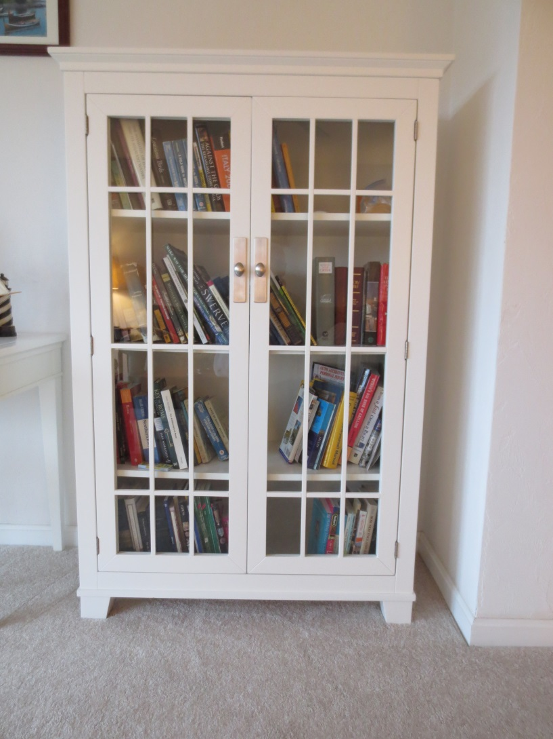
White Bookcase Quantity: 2
Crate and Barrel White Bookcases
Purchased new 2007
W = 39”
D = 16.5
H = 58.5

Slide 3
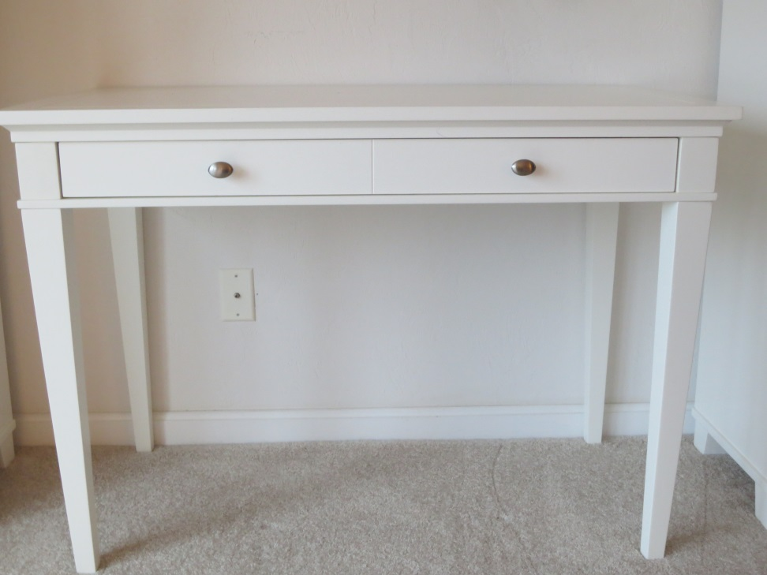
White Desk Quantity: 1
Crate and Barrel White Desk
Purchased new 2007
W = 42”
D = 22
H = 30

Slide 4
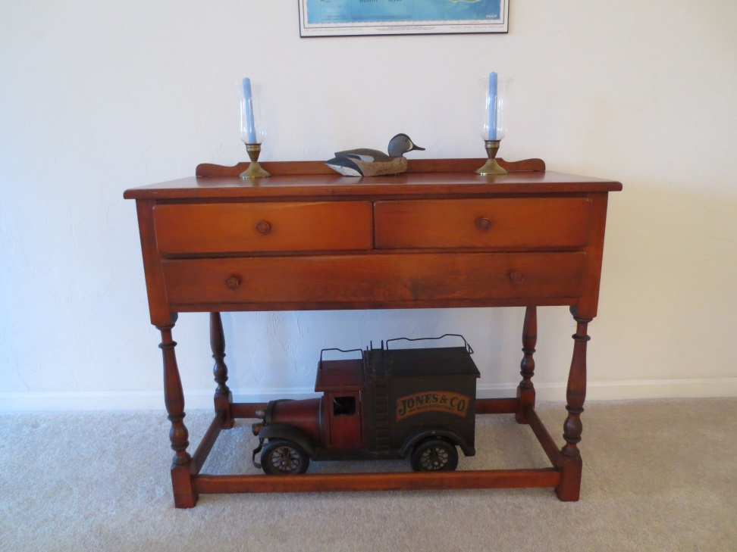
Small Sideboard
Purchased Used
W = 42”
D = 17.5
H = 32

Slide 5
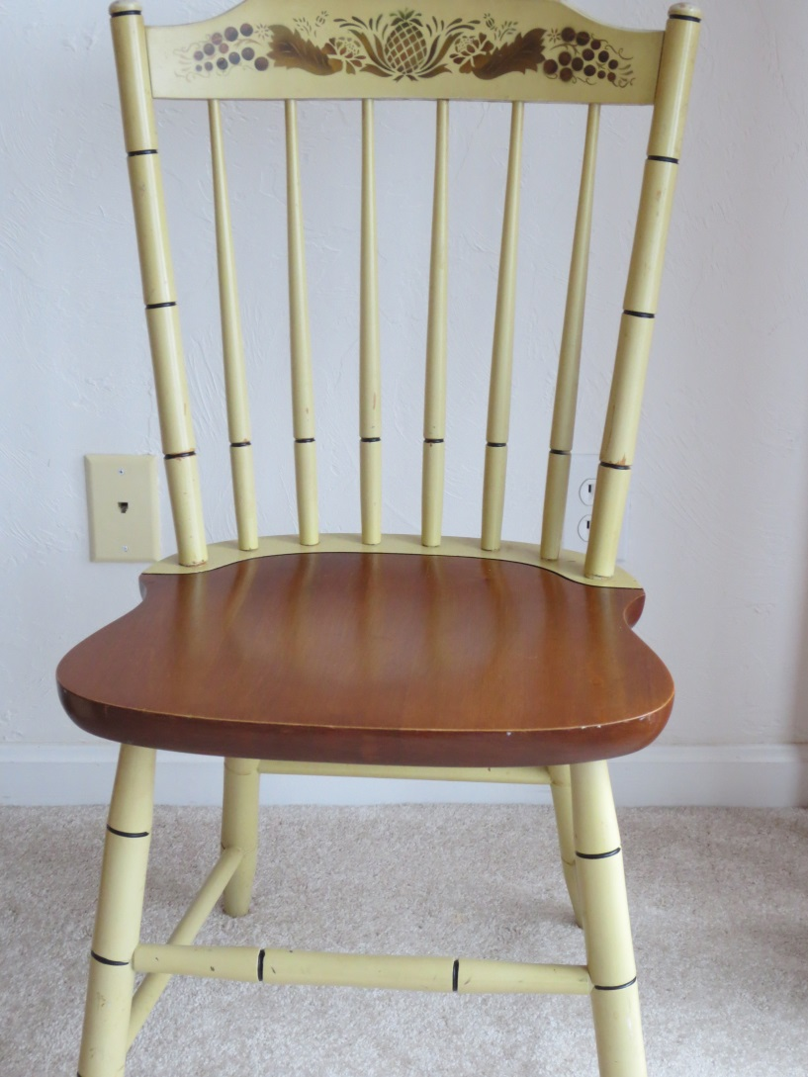
Light Hitchcock Chairs Quantity: 4
Purchased Used
Solid Maple, some painted

Slide 6
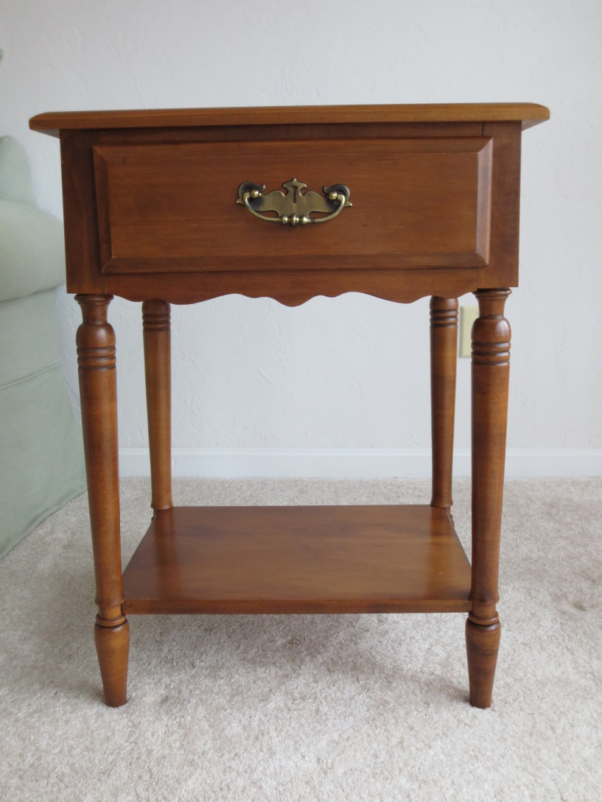
Maple End Tables Quantity: 2
Solid Maple
Purchased new 1981
W = 20”
D = 15
H = 27

Slide 7
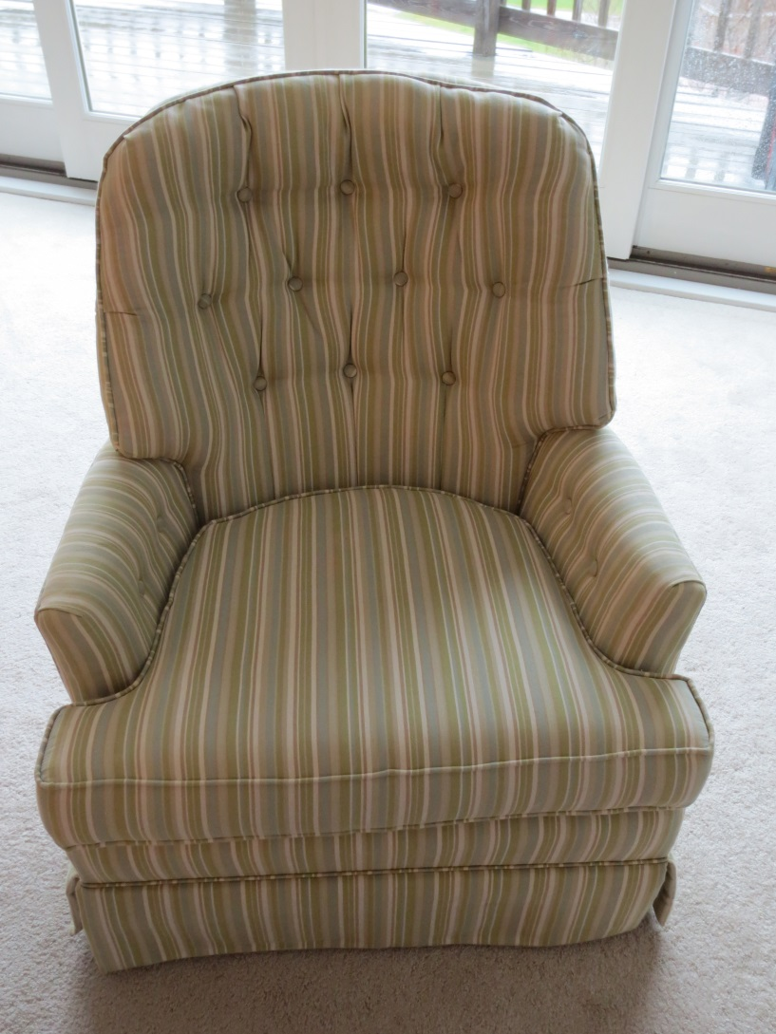
Upholstered Chairs Quantity: 2
Purchased new 2008
W = 28”
D = 27
H = 36
Chairs swivel and rock

Slide 8
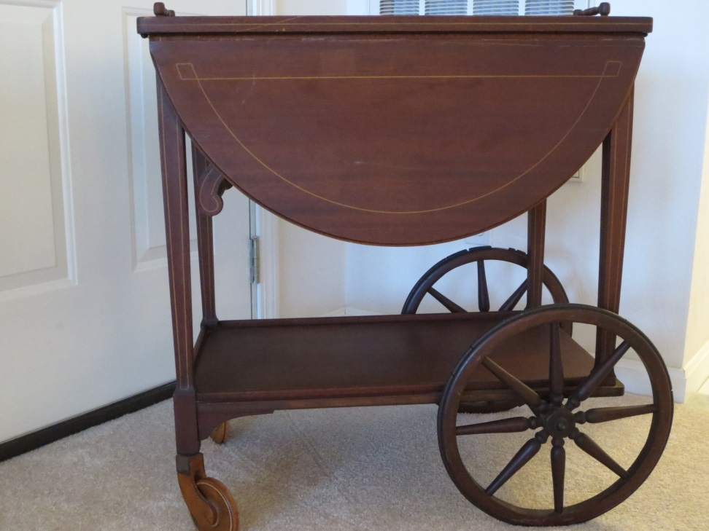
Antique Tea Cart Late 19th C
Purchased used
W = 27”
D = 17
H = 29

Slide 9
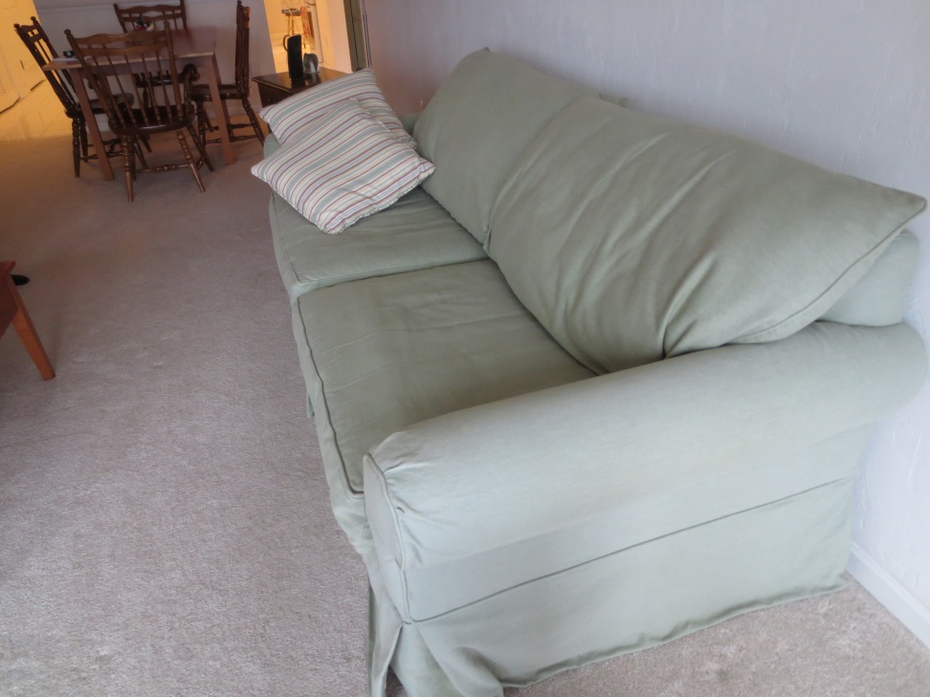
Sleeper Sofa
Jordan’s Furniture
Purchased new 2007
W = 79”
D = 39
H = 32
Queen-sized sleeper sofa

Slide 10
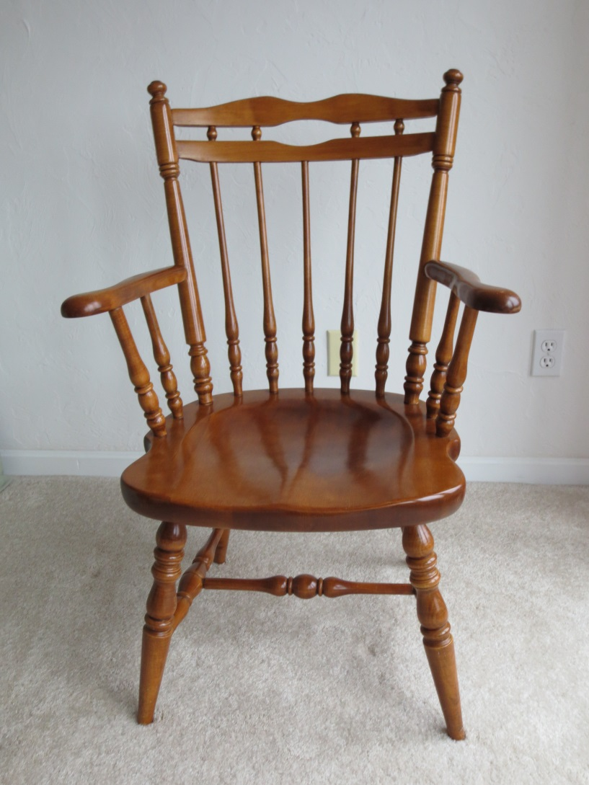
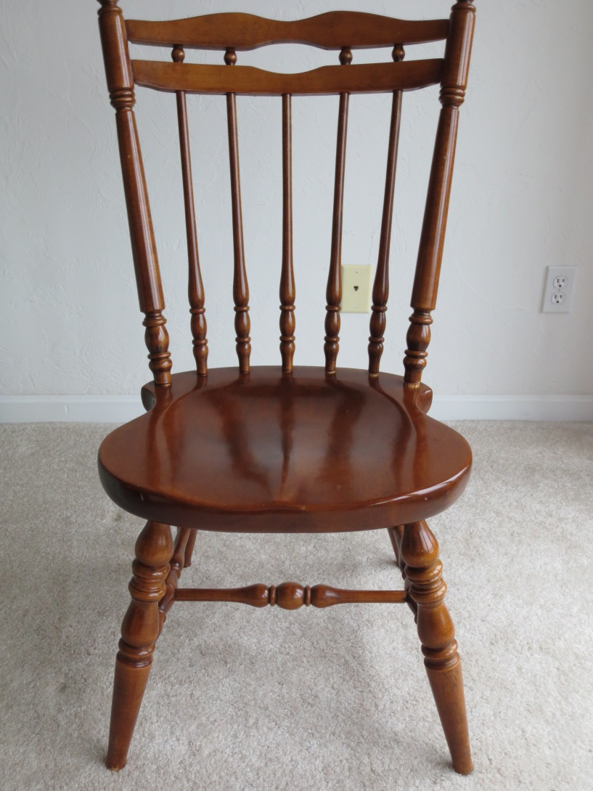
Six Maple Dining Chairs 2 w Arms; Purchased New 1981

Slide 11
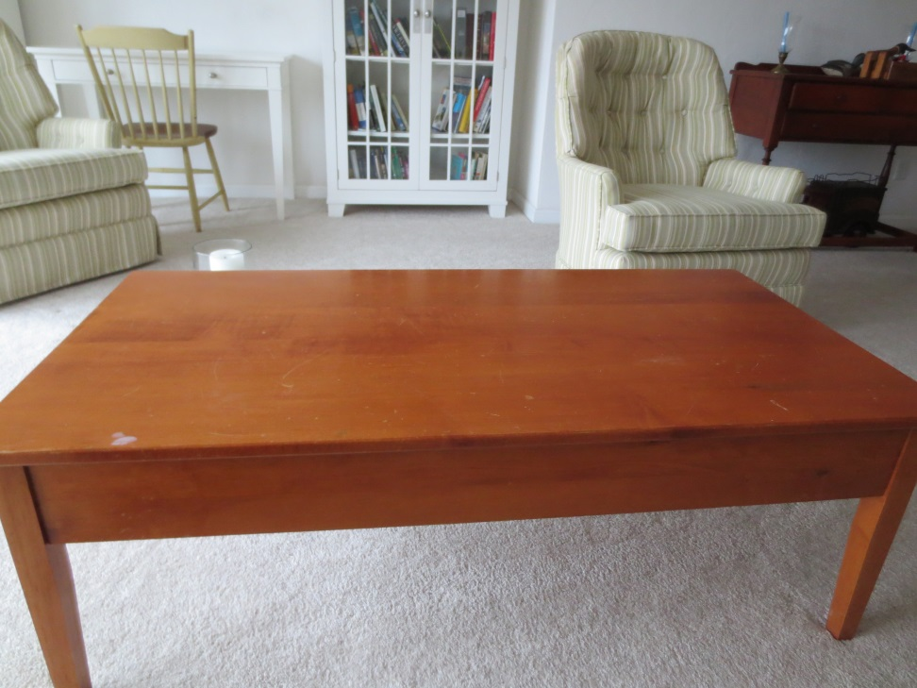
Coffee Table
Purchased used
W = 48”
D = 24
H = 17

Slide 12
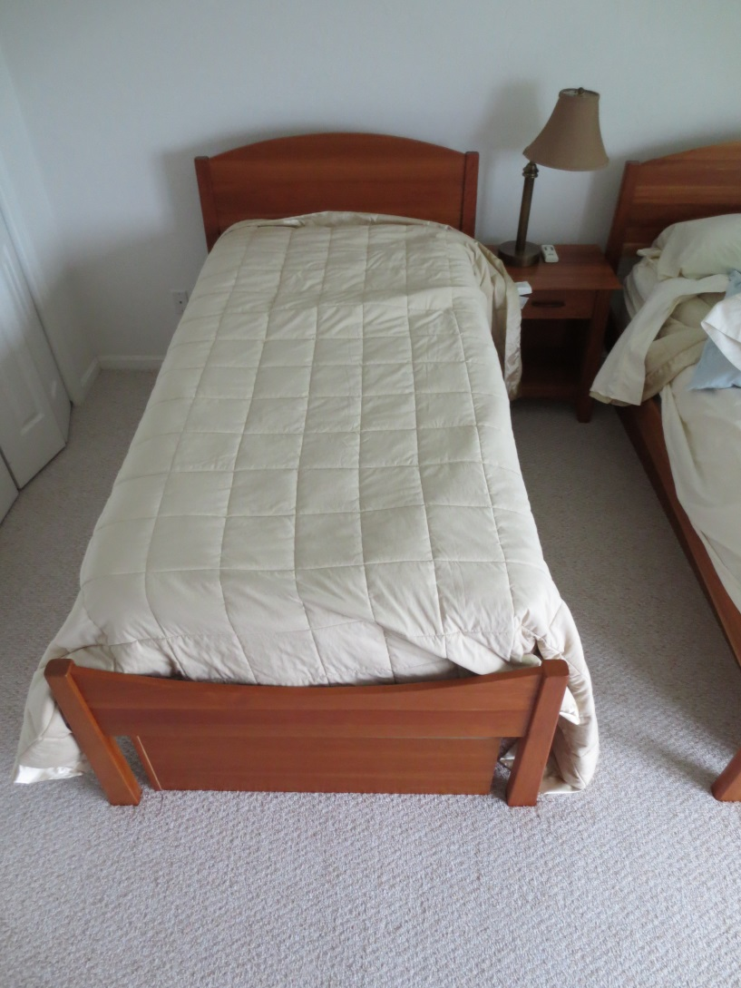
Twin Bed Quantity = 1
Woodforms Twin bedframe
Cherry
Cabinet storage underneath
Purchased new 2007

Slide 13
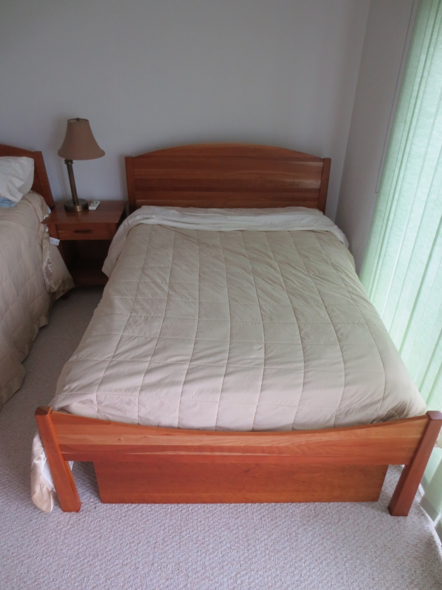
Full Bedframe Quantity = 1
Woodforms Full bedframe
Cabinet storage underneath
Cherry
Purchased new 2007

Slide 14
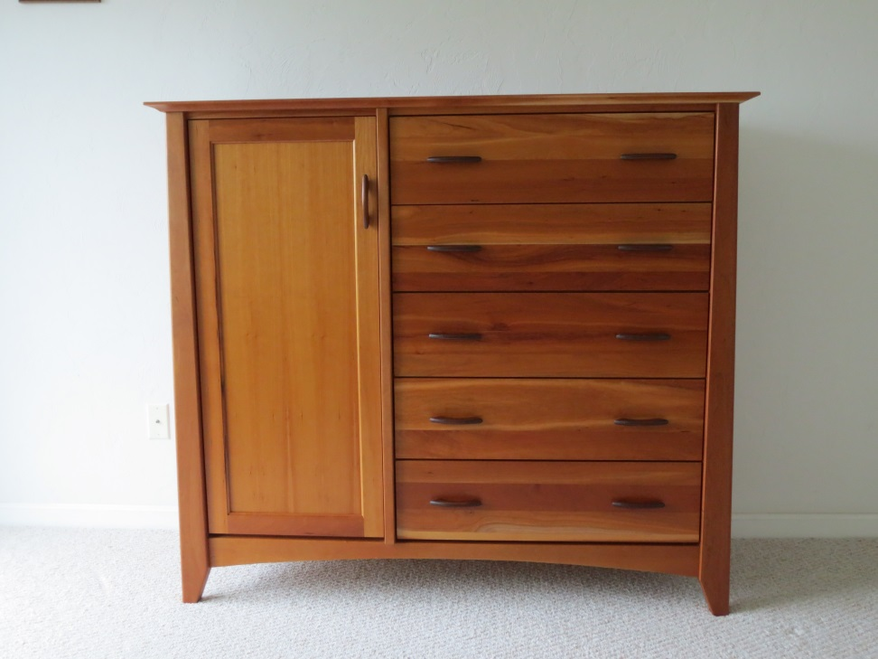
Gentleman’s Chest
Woodforms
Cherry
Purchased new 2007
W = 55”
D = 19
H = 49

Slide 15
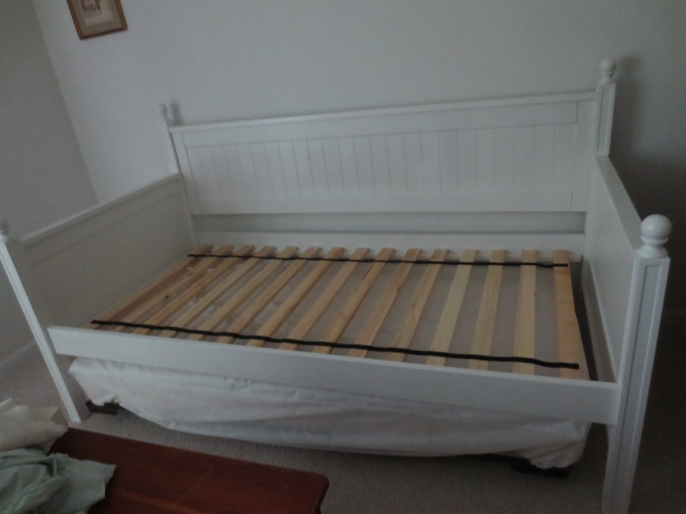
Daybed with Trundle
Jordan’s Furniture
Purchased new 2007
W = 82”
D = 42
H = 45

Slide 16
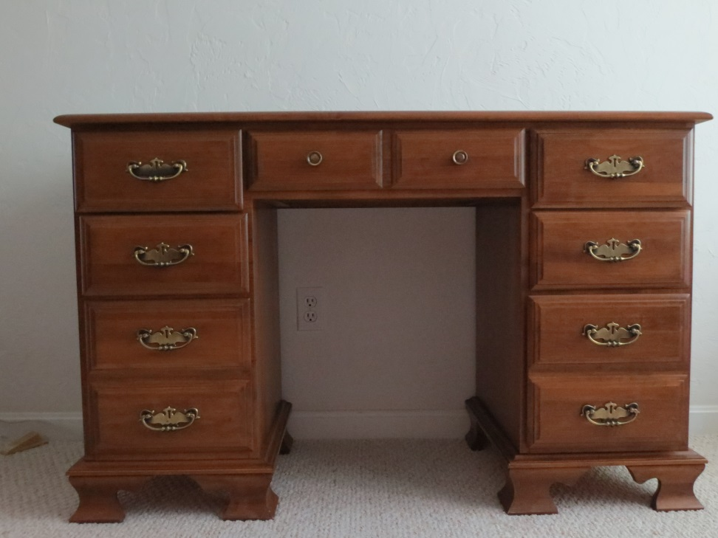
Maple Desk
Purchased new 1981
W = 48”
D = 20
H = 30

Slide 17
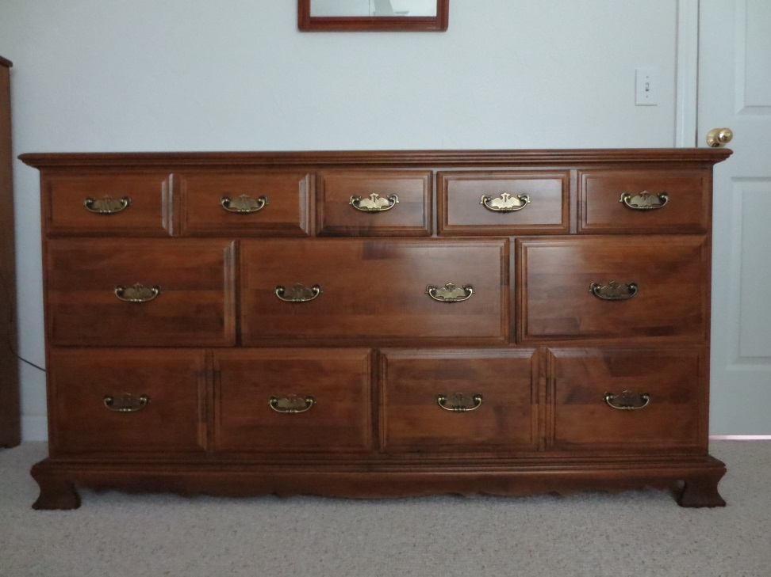
Maple Dresser
Purchased new 1981
W = 63”
D = 18
H = 32

Slide 18
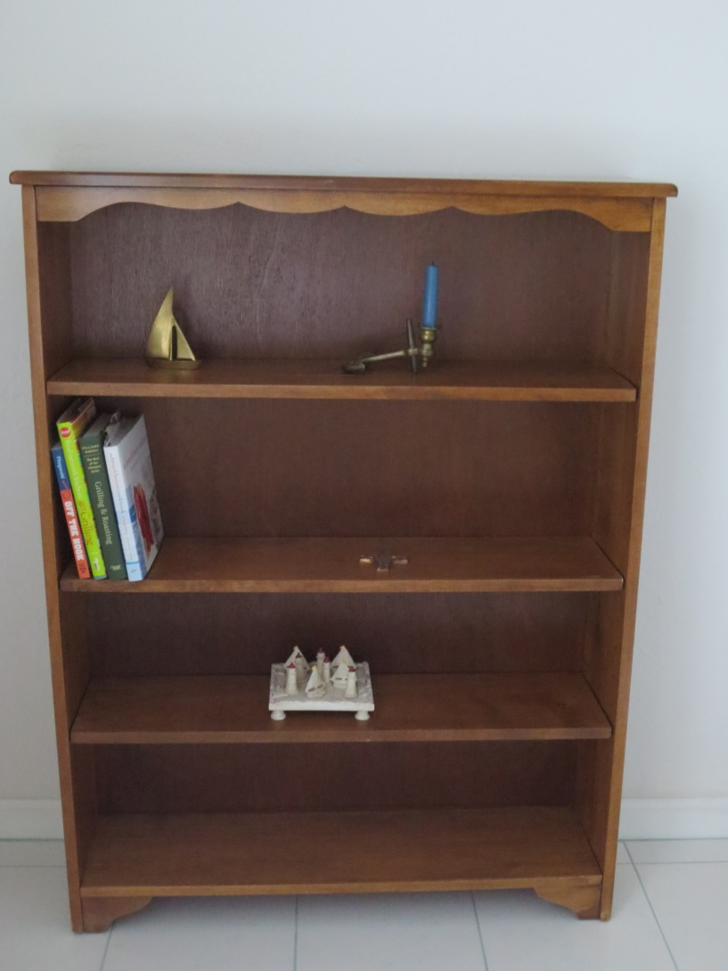
Maple Bookcases (2)
Purchased new 1981
W = 37”
D = 9.5
H = 48

Slide 19
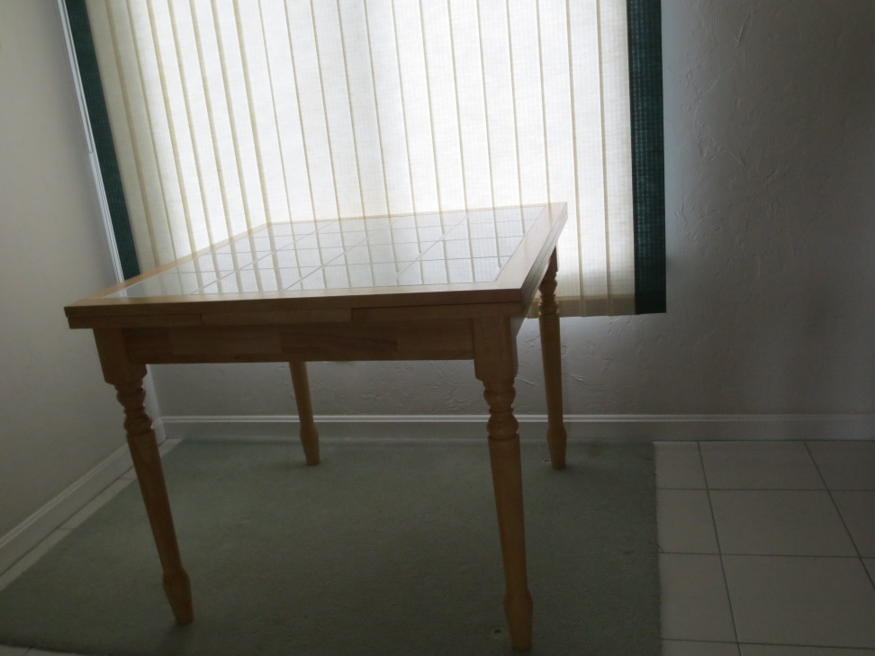
Expandable Kitchen Table
Purchased new 2007
W = 36” (expands with 2 pull-out leaves to 66”)
D = 36
H = 30.5

Slide 20
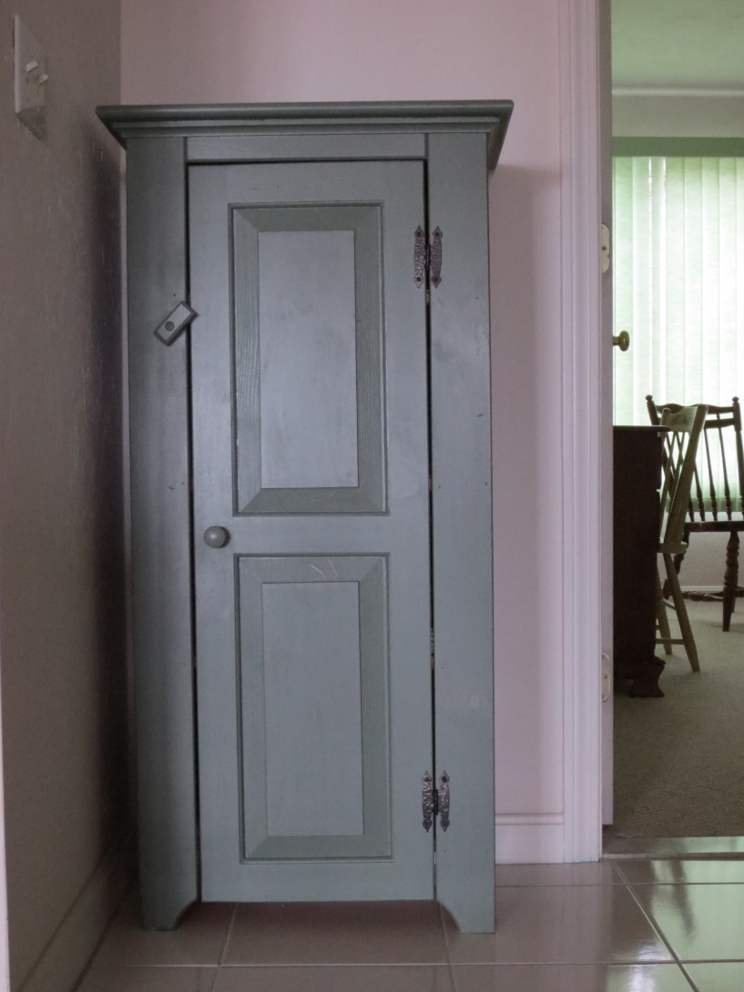
Pie Cabinet
Purchased used 2008
W = 23”
D = 13
H = 46

Slide 21
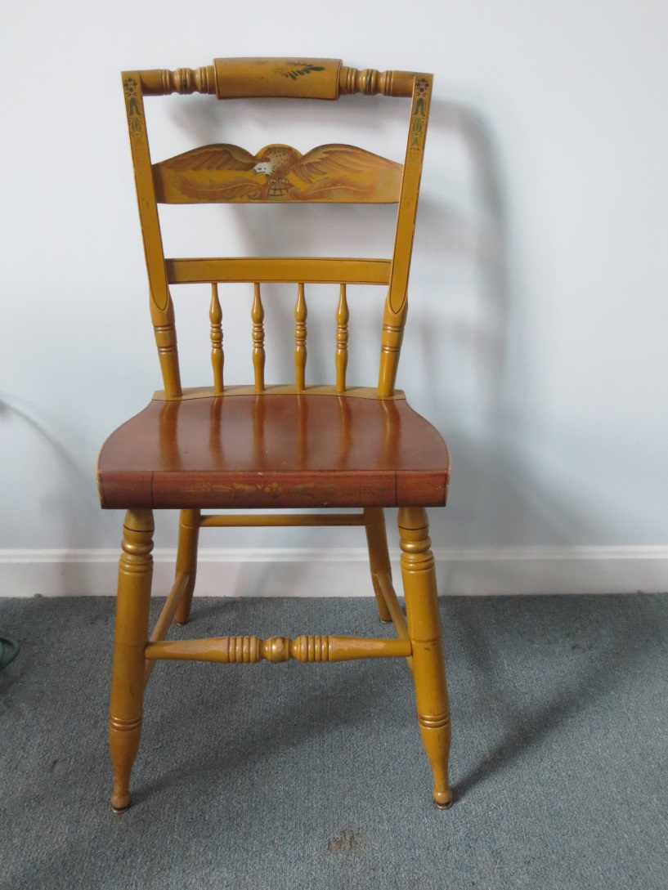
Dark Hitchcock Chairs Quantity = 2
Purchased used 2008
Maple, some painted wood

