Slide 1
Class 7 Early Byzantium and the West, 6th C
Dr. Ann T. Orlando
25 September 2018

Slide 2
Roman Emperors and Councils
Constantine (r. 313 – 335)
Council of Nicaea
Opposed Arians
Theodosius I, Great (r. 379-395)
Council of Constantinople
Opposed Arians
Arcadius (son of Theodosius) and Eudoxia in East (r. 395-408)
Conflicts with John Chrysostom
Theodosius II (r. 408-450)
Son of Arcadius
Council of Ephesus
Opposed Nestorians
St. Pulcharia and Marcion (r. 450-457)
Pulcharia daughter of Theodosius II
Council of Chalcedon
Opposed Monophysites
Justinian (r. 527-565)
Attempts to reconquer Western Roman Empire
Second Council of Constantinople
Reaffirm Chalcedon
Constantine Pogonatus (r. 668-685)
Third Council of Constantinople
Opposed Monothelites
St. Irene (r. 797-803)
Second Council of Nicaea
Opposed Iconoclasts

Slide 3
Council of Ephesus and Nestorians
Although Council of Ephesus condemns Nestorian Christology (complete separation of Christ’s divinity and humanity), not all follow Council
Mary not Theotokos
Opposed Orthodox Patriarch and Emperor in Constantinople
Distinct Nestorian Church established in Mesopotamia and Persia
Theodore of Mopsuestia seen as founding theologian
Nestorius as founding patriarch
Syriac is liturgical language
Nestorian Christianity affected development of Christianity further East, including India

Slide 4
Syriac Christian Faithful to Chalcedon and Rome (but not politically to Constantinople)
Melkite (Syriac for king) Christians are theologically in agreement with Chalcedon
Politically support Constantinople, in 5th – 8th C
After schism, remain in union with Rome, although continue to follow a Byzantine liturgy

Slide 5
Further Divisions Between Orthodox (Byzantine) and those in Communion with Rome
Maronite
St. Maron (d. 408) friend of St. John Chrysostom founds a monastery near Antioch (if he existed??)
Orthodox Christians associated with this region form a strong regional identity and militia
In 7th C Byzantine army (Justinian II) attacks them and Byzantine army is defeated. St. John Maron appeals to Rome and is accepted into communion with Rome by Pope Sergius I
Eventually, Maronite Catholics (in communion with Rome but at odds with Constantinople) migrate to Lebanon
NB Melkite Christians and Maronite Christians have at times been hostile toward each other

Slide 6
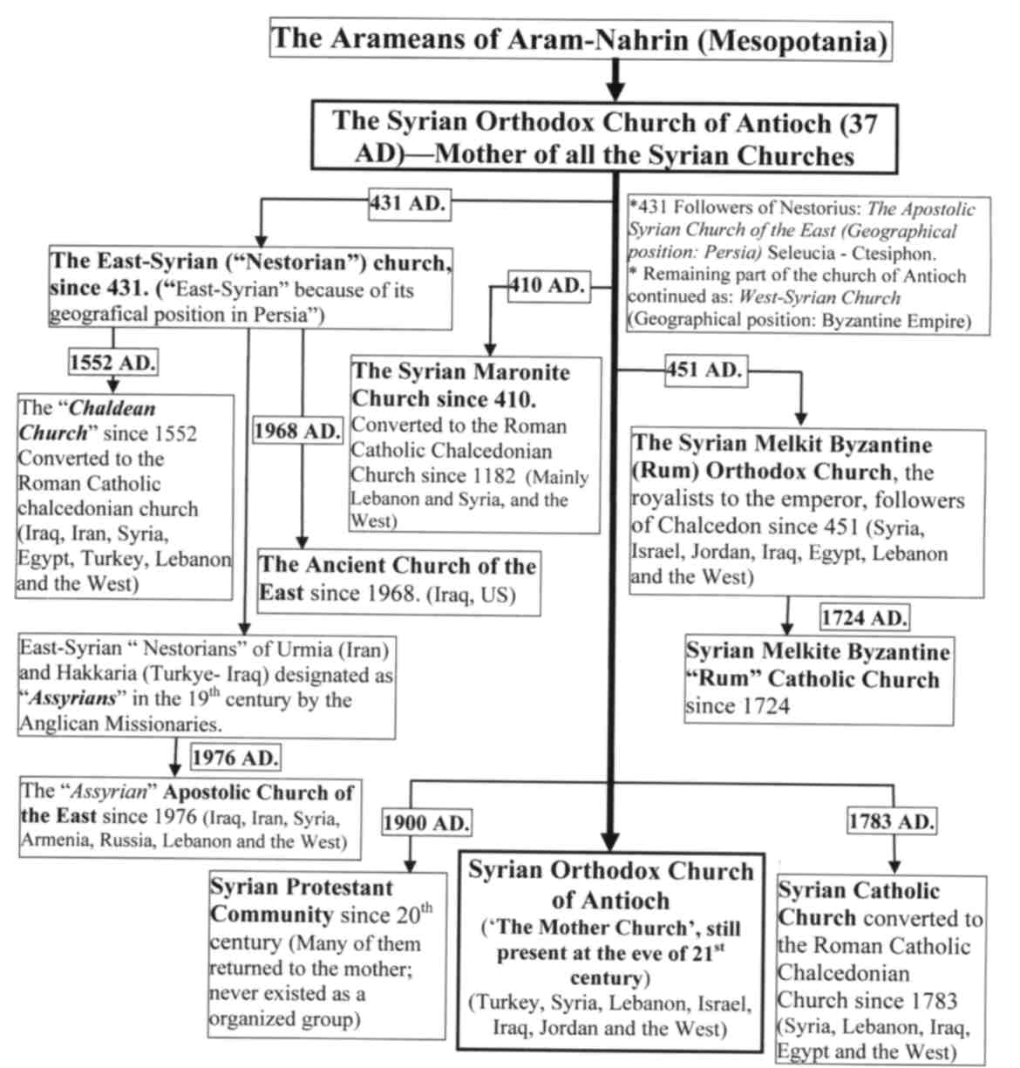

Slide 7
Council of Chalcedon, 451
Called by St. Pulcharia and Marcian
Establishes the Christological formula that Pope St. Leo the Great suggested
Primarily bishops from the East, with a representative from Rome
Dioscursus and much of the Alexandrian Church refuse to accept Chalcedonian Christology
Politically this remained a divisive issue in the East until rise of Islam
Theologically it remains a divisive issue to the present day; Coptic Christians

Slide 8
Leo and Papal Primacy
Sermon 3, delivered on the anniversary of his election to pontificate
Peter’s work is continued in his successors (heirs)
Priesthood conferred from Christ through Peter
Council Chalcedon by tradition acclaimed on hearing Leo’s Tome, ‘Peter has spoken through Leo.’

Slide 9
Chalcedonian Divisions among Christians
Refusal is partly theological, but also in opposition to political control from Constantinople
Alexandrian (Coptic) Christians who refused to accept Chalcedon
Egyptian
Ethiopian
Numerous Syriac Christian Churches develop based on Patriarchate of Antioch
Syriac Orthodox (non-Chalcedonian)
Jacobite
Assyrian Eastern Church

Slide 10
Acacian Schism (484-519)
To try and bring monophysites back into union with Constantinople, in 484, Patriarch of Constantinople, Acacius, with Emperor Zeno, creates an edict of union (Henotikon)
Affirms Christ’s divinity, but makes no mention of His humanity
Rejected by Pope Felix II in 485
He excommincates Acacius
Division between Rome and Constantinople stands until 519
Pope St. Hormisdas reaches an agreement with Emperor Justin I, excommunications are lifted
But monophysites (Alexandria) reject renewed union of Rome and Constantinople

Slide 11
Second Council of Constantinople, 553
Called by Emperor Justinian (nephew of Justin I) to try and reunite non-Chalcedonian Christians, especially Egyptian Christians
To try and appease Alexandrians, Council condemns both Origen and Theodore of Mopsuestia
Justinian’s wife, Theodora, tries unsuccessfully to push theology more toward monophysite theology

Slide 12
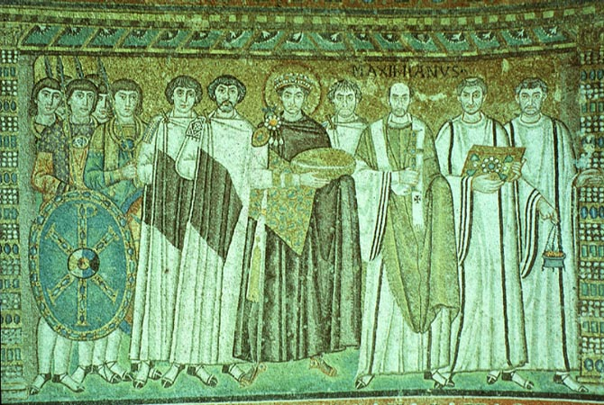
Eastern Reaction to Barbarian Invasions: (St. ?) Justinian the Great (482-565)
Justinian manages to reconquer most of Western Mediterranean from Vandals, Visigoths and Ostrogoths
Reworked Roman Law; basis for law in East until Fall of Constantinople, 1453
Rebuilt Ravenna as capital of Western Empire to oppose Theodoric
Boethius (480-524)
Consolation of Philosophy
Justinian considered a saint in East
His wife, Theodora, is another story
Proculus’ Secret History
http://employees.oneonta.edu/farberas/arth/arth212/san_vitale.html

Slide 13
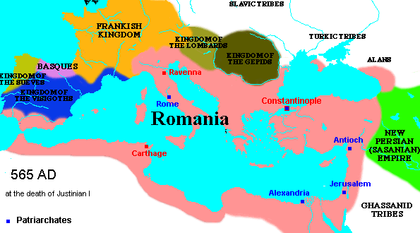
Byzantine Empire
Some historian begin the ‘Byzantine’ Empire with Justinian
Byzantine is a 19th C term
Greek-speaking, Eastern Roman Empire
Endure until 1453
Greatest enemy rises in the 7th C from the Arab deserts: Islam

Slide 14
Why Justinian’s Efforts to Reconquer Failed
Political/religious resentment toward Constantinople in Alexandria and Antioch
Theological (and therefore political) divisions in Syria and Egypt
Bubonic Plague
Outbreak in 541
Killed about 1/3 population of Constantinople and Eastern Mediterranean

Slide 15
Cassiadorus (490-583)
Roman senator and supporter of Theodoric
Captured by Justinian's general (Belisarius)
Retired and established a monastery on his estates (possibly influenced by Benedict)
Wrote extensively on theological and contemporary events
Was especially complementary of Goths
Among his treatises support for legal procedure that states that a cleric accused of a civil crime must be tried by his bishop

Slide 16
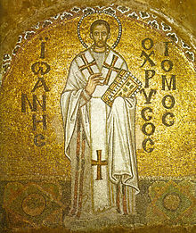
Ecclesial Importance of Hagia Sophia
Cathedral Church for most important Eastern Bishop, the Patriarch of Constantinople
Original built by Constantine
Rebuilt by Justinian after an earthquake in 537
Many important theologians were associated with Hagia Sophia; Greek Fathers and Doctors of the Church
St. Gregory Nazianzus (325-389, Feast Day Jan 2)
St. John Chrysostom (347-407, Feast Day Sept 13 )

Slide 17
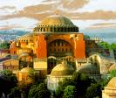
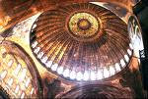
Later History of Hagia Sophia
Conquered by Turks in 1453, converted to a mosque; mosaics covered over
Changed to a museum by Ataturk in 1935, mosaics start to be uncovered
Why such importance deal that Benedict XVI might pray there on his journey to Turkey?

Slide 18
“Caesaropapism”
Society in which head of government is also head of Church
Notice that all these early (eastern) councils are called by Emperors
Constantine considered a saint in the East, “equal to Apostles”
Revived civil Roman law includes canonical law in East
Theodosian Code (Theodosius II), 438, takes 312 as the beginning of legal precedents
Justinian Code, 534
This will be the Church-State model in Byzantium until 1453 (in Russia until 1917)

Slide 19
A Different Development in West: Pope Gelasius
Pope 492-496; West being overrun with barbarians
Only civil authority with continuity to Roman Empire was Church
Eastern Emperor (Anastatius) claims authority in West, but has no military capability to back it up
Gelasius’ Letter to Anastatius is a landmark in defining balance of power relation between altar and throne
Two authorities in world: consecrated priests and royal power
Each has its own sphere of operation and respect
Priests have greater responsibility; emperor should obey priests
This view was never accepted in East; however became the basis of operation for Middle Ages in West
Pope Leo III crowns Charlemagne Holy Roman Emperor in 800
Note: Papacy is only real continuing link between East and West from 476 onwards
Gelaisus’ Letter will be used by Papacy throughout Middle Ages to justify Papal stance with respect to Western Rulers

Slide 20
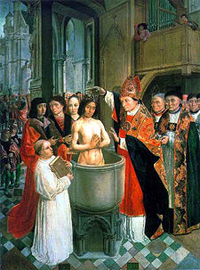
Another Development in the West: Beginning of Catholic Christianity Among Franks
Conversion of Chlodwech (Clovis) 496 in Rheims as a Catholic Christian
Becomes a Catholic because attributes his victories against other tribes to St. Martin of Tours
Baptized by St. Remigius bishop of Rheims (437-533; Feast Day 1 October),
Emperor Anastasius so pleased to have an orthodox German leader, he makes Clovis a consul
Clovis is beginning of Merovingian dynasty in France
After Clovis, there are close ties between Frankish king and the papacy
Clovis’ kingdom divided among his sons
History of Franks written by St Gregory of Tours (538-594)

Slide 21
St. Fortunatus (530 – 607)
Christian poet and hymnist
Born in Italy, but spent most of his life in Poitiers
Associated with monastery (convent) of St. Radegunde
This was politically a very important monastery; St. Radegunde was in frequent communication with Constantinople
Fortunatus was a close friend of St Gregory of Tours
Eventually became bishop of Poitiers
His two most famous poems/hymns are “Pange Lingua” and “Vexilla Regis”

Slide 22
Assignment
Pope Gelasius, Letter to Emperor, http://www.fordham.edu/halsall/source/gelasius1.asp

