Slide 1
Lecture 10: Franks and Early Europe
Dr. Ann T. Orlando
4 October 2018

Slide 2
Introduction
Merovingians
Germanic Control of Italy
Carolingians
Eighth Century political and military situation

Slide 3
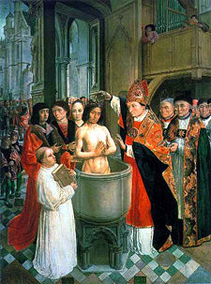
Beginning of Christianity Among Franks
Conversion of Chlodwech (Clovis) 496 in Rheims as a Catholic Christian
Clovis is beginning of Merovingian dynasty in France
Baptized by St. Remigius bishop of Rheims (437-533; Feast Day 1 October),
History written by St Gregory of Tours (538-594)
After Clovis, there are close ties between Frankish king and the papacy
Clovis’ kingdom divided among his sons

Slide 4
Merovingian Dynasty (496-741)
Real power was with wealthy land owners, especially Mayor of Palace,
Attached to king by oaths of loyalty and promise to provide troops
Bishops take an increasingly secular role; judicial and military
Also large land owners
Custom develops that the king appoints bishops
Merovingian kings become weak and ineffective rulers
Transition from Roman system to early feudalism

Slide 5
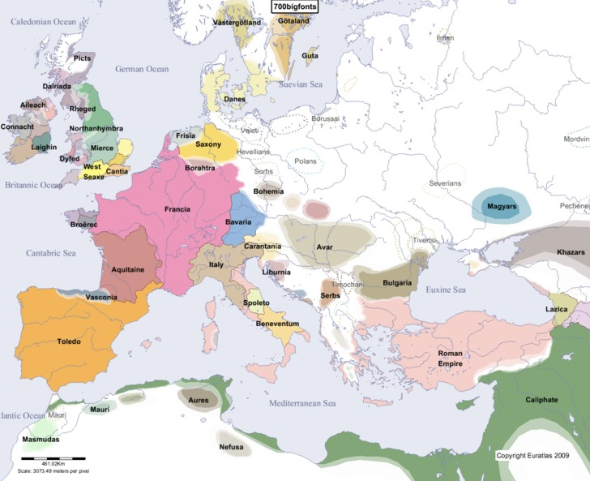
Franks and Papacy Have Common Enemies
Arabs
Muslims
Other Germanic Tribes
Lombards
Byzantines (sometimes)
Beginning of separation of ‘Orthodox’ East and ‘Catholic’ West

Slide 6
Muslim Armies in Western Europe
Umayyad Muslim armies advance against weak Visigoths in Spain in 711
By 720 had crossed the Pyrenees and captured most of southern France
Most of southern France remained under Muslin control until 750
Many of the Visigoth (Arian) Christians supported Umayyads over Catholic Franks

Slide 7
Lombards
German tribe, originating in Scandinavia (c 1C AD)
Migrated and settled slowly southward across Germany
Becoming Arian Christians
After defeat of Ostrogoths by Justinian (6th C), invaded a defenseless northern Italy
In mid-Eighth Century, invaded central Italy, threatening papacy

Slide 8
Relation between Papacy and Byzantines in 7th and 8th C
Even though Germanic tribes usually controlled Italy, Byzantine still claimed it
Papacy supported this claim
Byzantine emperors (and Popes) come to see papacy as its temporal legate in West
Papacy (and Byzantine emperors) recognize Rome as having ecclesial primacy
When Lombards threaten papacy, the Papacy asks for imperial support; but no Byzantine troops come in support

Slide 9
Rise of Carolingians: Charles Martel (The Hammer)
Largest land owners, and Mayor of Palace, in early 8th C was family of Charles Martel (688-741)
Charles became increasingly powerful
Defeat of some neighboring tribes (Saxons)
Alliances with others (required conversion to Catholic Catholicism)
Establishing bishops and monasteries as internal political allies
Charles Martel stopped the Muslim army at Tours in 732
The Battle of Tours is considered one of the most important battles of European history

Slide 10
Pepin the Short and the Beginning of Carolingians
In early 8th C Merovengians recognized as leaders of Franks, but were also considered weak and inept
Charles Hammer’ son, Pepin (Pippin) the Short (714-758), asks Pope Zachary if incompetent rulers should rule, Zachary says no
Pepin overthrows last Merovingian ruler, Childric the Stupid;
Pope Stephen II goes to France to anoint Pepin king (note: St. Boniface anointed him first)
Pepin invades Italy and rescues the Papacy from Lombards and threats from Muslims in Sicily

Slide 11
Papacy and ‘European’ Politics
After victory over Lombards, Pepin gave central Italy to the Pope in 754; beginning of Papal States (lasted until 19th C)
Problem: Constantinople had a claim to Italy, and it thought the Papacy supported that claim
Papacy justifies its land holdings with one of most famous forgeries of all time: Donation of Constantine
This document claimed that Constantine gave control of Western Empire to Pope
Accepted as genuine until 15th C
Basis for Papal claims to political power in Europe
King nominates bishops, but appointed by Pope

Slide 12
Kings and Ecclesial ‘politics’
After ‘restoring’ Papal States, Pepin asks for right to appoint bishops in his lands
Compromise is that Pepin will submit episcopal nominees, Pope appoints them
The issue of who appoints and controls bishops will be the most contentious issue of Middle Ages in Europe

Slide 13
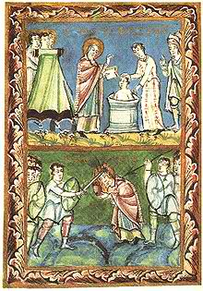
Franks Encourage Continuing Missionary Activities
Boniface, aka Winifred, 672-755
Influenced by Irish monasticism
Goes to Rome in 717 to get approval of Pope Gregory II; gets mission to preach north of Rhine
May have crowned Pepin the Short, Charlemagne’s father
Martyred in northern Holland, 755
Feast Day June 5

Slide 14
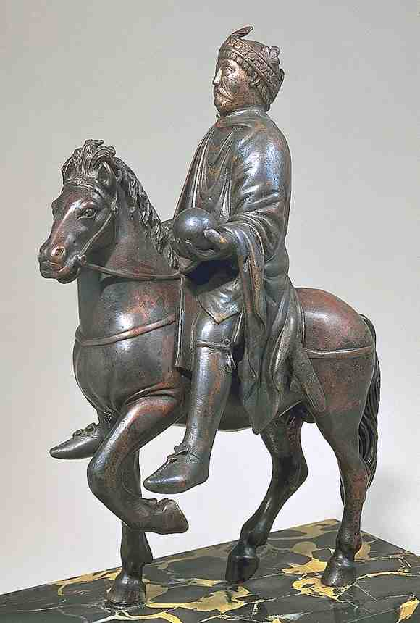
Charlemagne (747-814)
Born (in Aachen?) in 747 to Pepin the Short and his wife, Bertha the Big Foot
Assumed power when Pepin died in 768
Continued many of the policies of his father and grandfather (Charles Martel)
Died in Aachen in 814

Slide 15
Charlemagne’s Wars with other Germanic Tribes
At request of Pope Adrian I, Charlemagne invaded northern Italy
Defeated the Lombards in 774, forced conversion of Arian Lombards to Catholic Christianity
Returned property as promised by his father (Pepin) to papacy
Continued Frank’s campaign north against Saxons in 796
Forced (violently) conversion of pagan Saxons to Catholic Christianity
Attacked and conquered Avars and Slavs in Eastern Europe
Forced conversion to Catholic Christianity

Slide 16
Charlemagne’s Wars with Muslim Armies
Southern France
Continued to ‘mop-up’ Muslim enclaves in Southern France, especially around Provence and Aquitaine
Northern Spain
Invited by Muslims in Barcelona to protect them against the Muslims in Cordoba
Some success in Catalonia
Defeated by Basques in 778 (Song of Roland)
Western Mediterranean
Recaptured Balearic Islands, Corsica and Sardinia

Slide 17
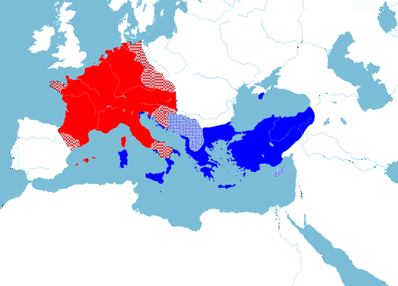
Spheres of Political and Military Influence in early 9th C
Byzantines
Northeastern Mediterranean
Southern Italian coast and Sicily
Claims to all old Roman Empire
Religious ally: Patriarch of Constantinople
Franks (Europe)
Central Europe, northern Italy
Religious ally: Papacy
Arabs (Turks in later centuries)
Southern Mediterranean, Spain
Religious Ally: Islam
At various times for the next 600 years these three groups will play off one against the other

Slide 18
Early 9th C Western Relations with Byzantium
Major political issues from Byzantium’s perspective
Donation of Constantine
Coronation of Charlemagne by Pope
Contributing to weakened position of Byzantium
Muslim invasions
Iconoclast controversy in East
Empress Irene
Efforts made to arrange a marriage between Irene’s daughter and Charlemagne’s son, but not effective
Major theological issues
Libri Carolini
Filioque

Slide 19
Libri Carolini
Four books written on Charlemagne’s orders to refute 7th Ecumenical Council (Nicaea II)
Libri Carolini Condemned by Adrian I (who had sent legates to Nicaea II)
Apparently the result of poor translation form Greek to Latin, as well as concerns that it might support a return to ‘pagan’ worship of idols
Also, intended to rebuff Empress Irene and Byzantine pretentions to ‘speak’ for all Christendom

Slide 20
Filioque
Filioque means ‘and the son’ as found in Latin versions of the Creed
The Holy Spirit proceeds from the Father and the Son
First used in Spain in 6th C (mistranslation from Greek
The Greek, original, Nicene-Constantinople Creed has the Holy Spirit proceeding from the Father
Augustine in De Trinitate refers to the precedence fo the Holy Spirit both ways in discussions of transcendent and immanent Trinity
Charlemagne’s court accepts and promulgates the filioque as the official and correct version of the Creed
For an excellent treatment of the history and theology of this, see “The Joint Catholic Orthodox Statement on the Filioque,” http://www.scoba.us/resources/orthodox-catholic.html

Slide 21
Pope Leo III (r. 795-816)
Succeeded Adrian I
Adrian had tried to maintain a balance between Franks and Byzantines
Adrian supported Irene and Seventh Ecumenical Council on Iconoclasm
Leo III sides completely with Charlemagne
Attacked by Adrian’s (Byzantine/Roman) supporters
Crosses Alps to find safety with Charlemagne, returned to Rome under safety of Charlemagne's troops
When Charlemagne visits Rome in Fall of 800, Leo III crowns him Holy Roman Emperor on Christmas Day
Did Charlemagne know and approve?
Makes Papacy ‘king-maker’ in Europe
Makes papacy politically and militarily dependent on Western rulers

Slide 22
Carolingian Renaissance: Aachen (Aix-la-Chapelle)
Capital Located on Rhine near boundary with Saxons
Charlemagne impressed by Byzantine architecture in Ravenna
Commissioned a cathedral and palace in a ‘Byzantine’ design
Most important piece of architecture in Europe at the time
Charlemagne established a court and educational center in Aachen
Drew scholars (monks) from around Western Europe

Slide 23
Impact of Charlemagne’s Rule
Enforced Latin, Roman liturgy
Established centers of learning for clergy and monks (although he could not read)
Set up European-wide system of administration
Establish precedent of Western Holy Roman Empire
Cemented special relationship between Pope and France

Slide 24
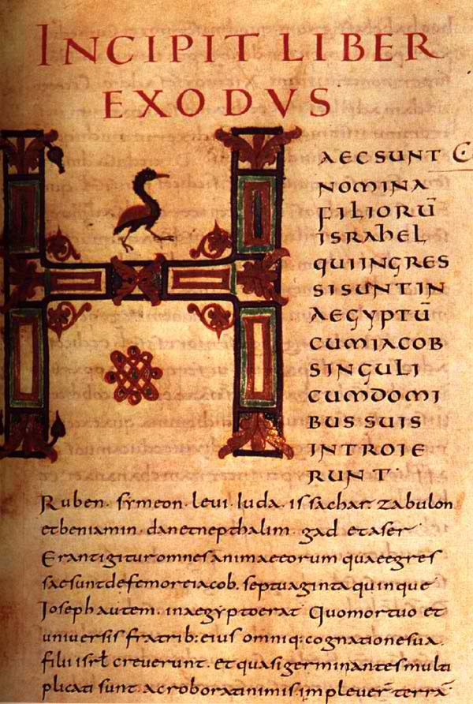
Monastic Scholarship in Charlemagne’s Court
Charlemagne established a center of learning that drew monastic scholars from across Europe
Alcuin of York (735-804)
Advises Charlemagne on religious and educational matters
Established cathedral schools and libraries
Attempt to revise and standard liturgy, and Latin in liturgy
Theodulf of Orleans (760-821)
Wrote (?) Libri Carolini
Author of many poems and hymns, including “All Glory, Laud and Honor”
Development of Carolingian script
Capital and lower case letters
Easy to read letters
During this period, various synods at Aachen establish format of monastery
Chapel and Cloister
Refectory, Dormitory, Larder, Cellar

Slide 25
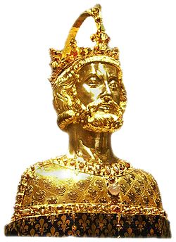
After Charlemagne
Kingdom divided among his three sons at Treaty of Verdun
Sons are weakened rulers, creating a power vacuum
Lingering problem: who’s in charge politically, Pope or King
Viking invasions begin during Charlemagne’s lifetime, and increase throughout Europe in 8th C
Note, Charlemagne considered a saint in region around Aachen
The name for ‘king’ is derived from ‘Charles’ in many Eastern European languages

Slide 26
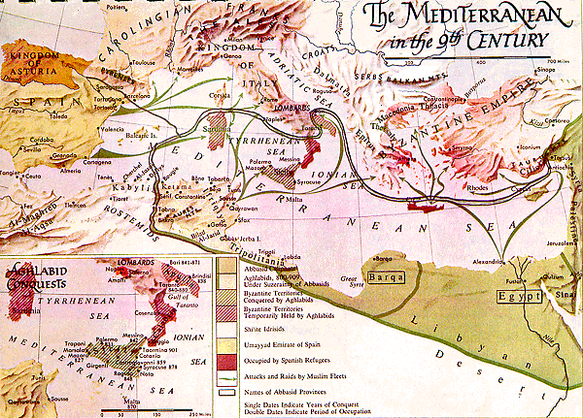
Mediterranean 9th C

Slide 27
Readings
Donation of Constantine
Read all carefully
What land, rights, powers, symbols of office does Constantine give?
From what you know already of Church history and history of doctrine, why might you be suspicious of this document?
Einhard, Life of Charlemagne
Read all
Pay special attention to relations with Eastern Empire, Islamic Empire, Pope

