Slide 1
Lecture 12 Middle Byzantium and Vikings
Dr. Ann T. Orlando
11 October 2018

Slide 2
Introduction
Major Phases in Byzantine History
Great Schism
Pressure from Turks
Byzantine Intellectual and Spiritual Advances

Slide 3
Overview of Byzantine History
Early Byzantium
Begins with Constantine or Justinian
Irene and her successors conclude this phase (830s)
Middle Byzantium
Begins with Basil I
Concludes with Sack of Constantinople (1204)
Final Phase
Begins with expulsion of Latins (1261)
Fall to Turks (1453)

Slide 4
Seventh, Eighth, Ninth Century Eastern Roman Empire
Pressure from Rise of Islam
Intense military pressure
Loss of Alexandria, Antioch, Jerusalem
Pressure from Consolidation of Independent Western Europe
Papal ties to Franks
Charlemagne as ‘Holy Roman Emperor’
Theological Pressure
Iconoclast controversy
Monothelete controversy

Slide 5
Basil I (811-886)
Also known as Basil the Macedonian
From Thrace, not part of imperial or prominent family
May have spent time as a slave in Bulgaria as a boy
Managed by ability to rise at court in Constantinople, eventually becoming the most important minister
Leads a coup which makes him emperor in 867

Slide 6
Key Accomplishments During Basil’s Reign
Complete revival of Byzantine law
Wins victories against Arabs in Asia Minor
Reestablishes Byzantine footholds in southern Italy and Sicily
Negotiated this with Louis II, great-grandson of Charlemagne
Enhances diplomatic ties with Rome
But also advances Orthodoxy (and Byzantine control) to Bulgaria against objections from Rome
When he dies, he leaves behind a strengthened Byzantium and a dynasty which will last over 200 years

Slide 7
‘The Great Schism’ (not to be confused with the Great Western Schism)
Tensions between Catholic West and Orthodox East had been developing for centuries before 1054
Liturgical (unleavened bread at Eucharist)
Lingual (filioque)
Geographical (contested areas in Balkans)
Political (Western Holy Roman Emperor, ecclesial relation between Pope and Patriarch)

Slide 8
Events of 1054
In 1054 legates representing Pope Leo IX went to Constantinople and Patriarch Michael Cerularius to resolve differences
Papal legates insisted on primacy of Rome, denying ecumenical patriarch title to patriarch of Constantinople
Cerularius excommunicates papal legates; legates excommunicate him
As a result
Catholic West and Orthodox East accuse each other of heresy and schism
Latin suppressed in Greek East; Greek suppressed in Latin West

Slide 9
After 1054
Some unsuccessful efforts during the Middle Ages at reunification for political and military reasons
First Crusade, 1098
Second Council of Lyon, 1274
Council of Florence, 1439
Mutual excommunications lifted by Pope Paul VI and Ecumenical Patriarch in 1965

Slide 10
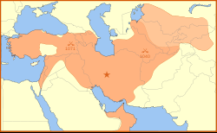
The Seljuk Turks
‘Turks’ nomadic tribes from central Asia
Mongols migrate northeast in 6th-7th C AD
In 13th C dominate all of northern Asian landmass from Korea to eastern Europe
In 11th C Seljuk Turks spread from central Asia and overrun Arab lands
Also place great pressure on Byzantium
In 1095, Byzantine Emperor asks the Pope to send Western troops to defend Christian East; beginning of Crusades

Slide 11
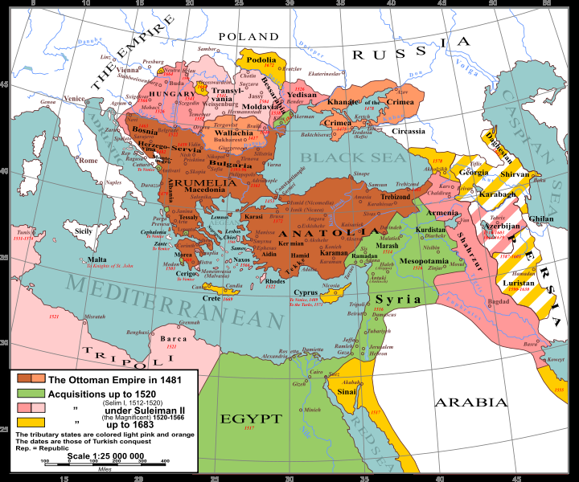
Ottoman Turks (c. 1225-1918)
In 13th C Ottomans (pushed by Mongols) invade Seljuk-controlled area
Ottomans completely replace Seljuk Turks and Arabs further West
Conquer Constantinople in 1453, ending Byzantine Empire
Threaten Vienna in 1532 and 1683
Threaten to recapture Spain, defeated at naval Battle of Lepanto in 1571
Force in southern Mediterranean and Balkans until end of WWI
Throughout, great animosity between Turks and Arabs (e.g., Lawrence of Arabia)

Slide 12
Middle Byzantine Advances
Manuscript preservation and reproduction
Most ancient Greek works that have survived, survive from this period
Rules for Iconography developed in form known today
Mount Athos established in 10th C
Hesychasm, from Greek for ‘quiet’
Very apophatic type of spirituality
Life-long effort to master quiet entry into the mystery of God by complete removal from the world and society
Can be anti-intellectual

Slide 13
Icons
Icon is from Greek word meaning image or symbol
Something that points to something else
Icons become special aid to prayer and meditation in Eastern Christianity
Spirituality of icons is one of ‘opening a window’ for the meditation on mysteries of the faith
Mystery is from Greek, meaning things hidden
Icons are very stylized; not intended to be exact or realistic representations

Slide 14
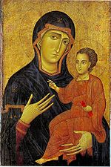
Mary in Iconography
Most famous of all icons of Mary is the Hodegetria, “She who Shows the Way”
Supposedly original painted by St. Luke
First appears in Constantinople in 5th C, immediately after Council of Ephesus
In 15th C, becomes known as Our Lady of Perpetual Help in West

Slide 15
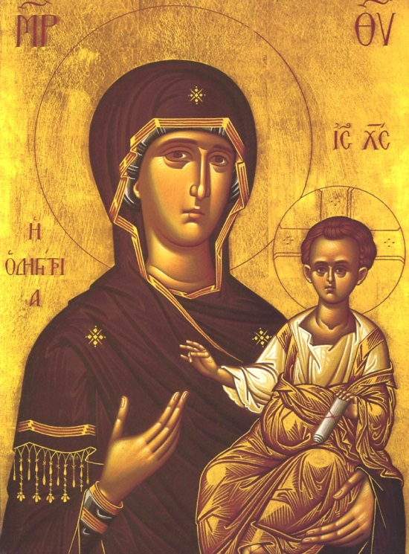
Important Symbolic Elements in the Hodegetria
Mary’s hand points to the Way, Jesus
Mary looks to us, as our mother
Mary’s cloak has three stars, representing her perpetual virginity
Child Jesus’ scroll shows wisdom (Jesus is Wisdom)
Greek over her shoulder is ‘Hodegetria’
Greek at upper corners represent ‘Mother of God’

Slide 16
Early Medieval Nordic Peoples
Collection of small kingdoms around the Baltic and North Sea
Social organization focused on ‘king’
Commanded respect not through territorial holdings but through fighting abilities (not primogeniture)
Ability to Attract warriors to his banner
Weather and terrain made sea travel primary means of communications and war
Kings ‘buried’ with their ships

Slide 17
Viking Religion
Complex pagan religion
Completely untouched by classical thought
Basis for Germanic mythologies
Viking mythologies based on conflicts between gods and giants and human entanglement with them
Odin, leader of gods
Thor, most important (strongest) god
Loki, fire-god, most cleaver
Ostara (Easter), goddess of vernal equinox

Slide 18
Viking Epics
Written down in 10 – 12th C
But orally transmitted for several centuries prior
Most important are Icelandic Sagas (segja, old Norse to say or tell)
Early English Beowulf also an example
Legends of King Alfred the Great focuses on English defense against Vikings
NB Many English words are derived from old Norse; especially words associated with seafaring

Slide 19
Viking Raiders
Combination of sea power and social stature based on fighting fueled war or pirate raids
Viking boats ideally designed for both open seas and river passage
Population expansion and improved navigation techniques led Vikings to explode out of Baltic in 9th to 10th C
Particular targets were Irish and Scottish monasteries
They were rich and their wealth was portable
Raids extended throughout Europe into western Asia
Raids included fleets of several hundred ships

Slide 20
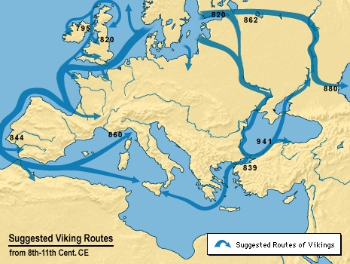
Extent of Viking Conquests darkwing.uoregon.edu/%7Eatlas/europe/static/map16.html

Slide 21
Viking Settlements
After raiding not all Vikings sailed home, some areas became trading colonies
West to Iceland and Greenland
Dublin in Ireland
Western France (Normandy)
Sicily (conquered from Muslims)
Along Volga in Russia
Other names for Vikings: Northmen, Scandinavians, Rus

Slide 22
Viking Conversion to Christianity
Slow process; Scandinavian countries among the last in Europe to be converted
In Western Europe (France, Ireland) by 10th C
In Russia to Eastern Orthodoxy
Prince Vladimir of Kiev converts to orthodox Christianity in 989
Orthodox missionaries to Slavs and Eastern Vikings introduce Greek letters
Kiev is ‘capital’ of Russian orthodoxy until transfer to Moscow in 13th C

Slide 23
Medieval Russian History
Vladimir’s son, Yaroslav (d.1054)
Establishes Kiev as a great Christian city
Monasteries on Greek orthodox model
Orthodox spirituality encouraged, including liturgy and icons
Establishes Russian law based on Justinian’s code
Vladimir’s descendents
Rule until 17th Century (Boris Godunov)
Look to Byzantium not only for religious but cultural and social models

Slide 24
13th C Threats to Russia: Sweden and Teutonic Knights
Teutonic Knights are commissioned in Holy Land as an order of Crusading German knights in 1190
Germanic off-shoot of Templers
Become closely associated with German ruler
In 13th C Teutonic Knights engaged in conversion of Baltic peoples (forcibly) to Christianity
Teutonic Knights and Sweden attack Russia
Soundly defeated by Russians led by Alexander Nevsky in 1242 (Battle of Lake Peipus)
Nevsky honored as a saint in Russia

Slide 25
Moscow becomes ‘Third Rome’
Moscow originally established as a monastery in early 12th C
Town grew up around monastery
In 1326 metropolitan of Russian Orthodox Church transferred seat from Ukraine to Moscow
When Constantinople fell in 1453, Russian Church claimed title of ‘Third Rome’ for Moscow
Tsar head of the Church
Until 1917

Slide 26
Assignment
“The Conversion of Vladimir,” 988 http://www.dur.ac.uk/a.k.harrington/christin.html
Field trip: Museum of Russian Icons, Clinton, MA (optional)

