Slide 1
Lecture 15 Crusades I
Dr. Ann T. Orlando
23 October 2018

Slide 2
Introduction
Pilgrimages
Seljuk Turks
Military and political stimulus for Crusades
‘Success’ of First Crusade

Slide 3
Early Christian Pilgrimages
During time of martyrdom, clandestine meetings at tombs of martyrs and apostles
St. Helena pilgrimage to Jerusalem c. 327
Egeria 4th C
Jerome and Paulina established a ‘Latin’ colony in Jerusalem to assist pilgrims early 4th C
By end of 4th C
Well defined ‘itineraries’ for pilgrim routes to Rome and Holy Land in organized groups, including clerics and troops for protection
Houses, hospitals, run by monks and nuns to along the way to assist pilgrims

Slide 4
Importance of Medieval Pilgrimage
Penitential
Sanctioned by priest at beginning and end of pilgrimage
But so popular rules made that priests could only go on one overseas pilgrimage in his lifetime
Economic
Trade between large areas
‘Tourist’ money for destinations
Adventure (tourism)
Pilgrimage was one of the few reasons someone was allowed to travel from home district

Slide 5
Medieval Western Pilgrimages
10th C saw significant increase in pilgrimages from West to Holy Land
Example: Great German Pilgrimage of 1064 included about 10,000 people
Political/military environment
‘Taming’ of Vikings
Recognition by Byzantium and Fatamid Egypt that Western pilgrims were good for economy
Peaceful coexistence between Byzantines and Arabs
Pilgrimage and Cluny
Monks of Cluny greatly encouraged pilgrimages among monks, clerics and lay people
Established Cluniac houses of hospitality along pilgrim routes
Cluniac monks organized many pilgrim groups each year of more than 1,000 from many stations in life

Slide 6
Pilgrimages to Canterbury
Site of murder and burial of St. Thomas Becket in 1170 on orders (probably) of English King Henry II
Pilgrims (especially Normans) from all over Europe journeyed to Canterbury
Insignia: ampullae (containing water and blood)
Chaucer, Canterbury Tales
St. Thomas Becket’s relics destroyed on orders of King Henry VIII in 1538

Slide 7
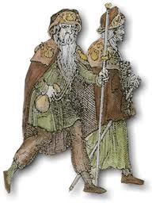
Santiago de Compostela
Pilgrimages since 9th C, Believed to be burial site of St. James Major
By 11th C 500,000 pilgrims travelled there per year
In 1122 Pope Calixstus II offers a special indulgence for pilgrims to Compostela
Cluniacs built hostels all along the Way of St. James from France
Insignia: scallop shells
Pope Leo XIII accepted authenticity of remains of St. James in Compostela in 1884

Slide 8
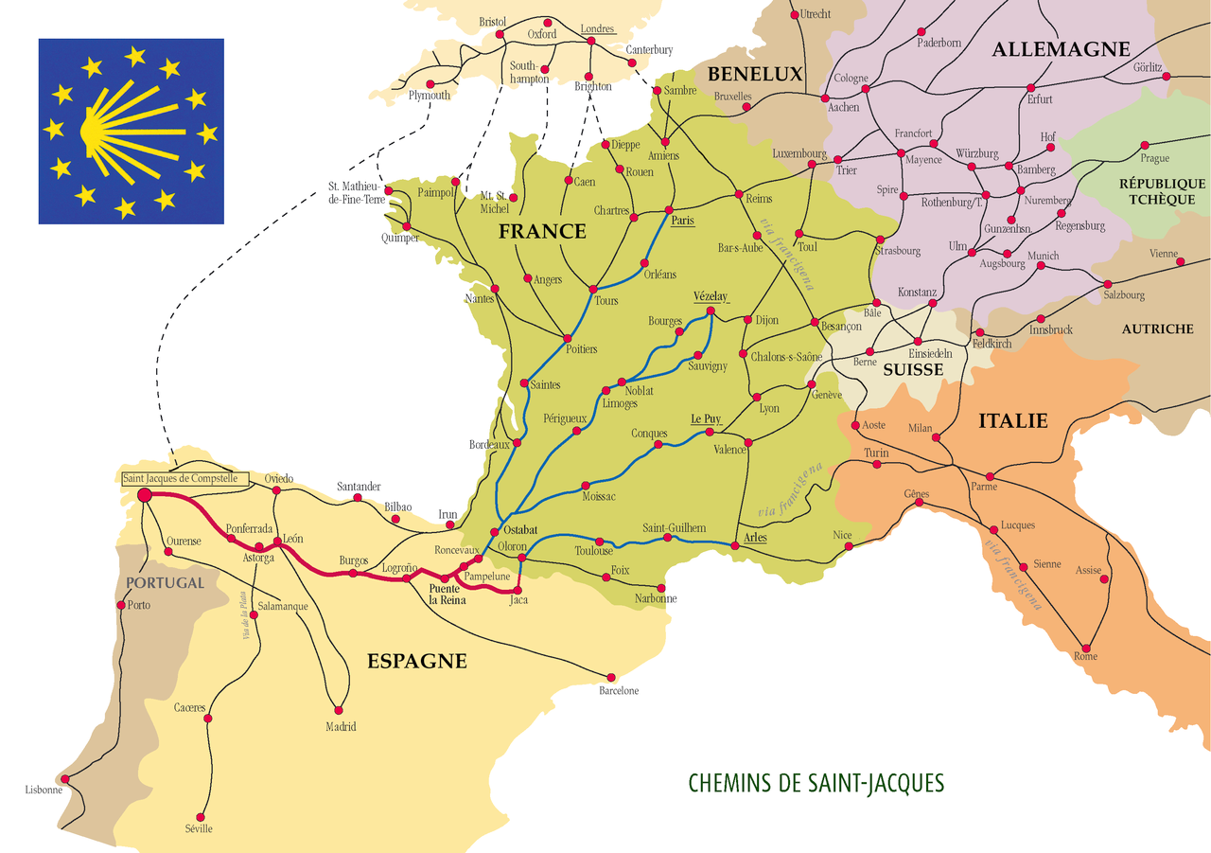
Route to Santiago

Slide 9
Most Important Pilgrimage Site: Holy Land
Relies on ‘peaceful’ relations with Byzantine Empire and Arab caliphs
Western pilgrims mostly peaceful, bring significant economic benefit
Trade between eastern Mediterranean, and silk route to China
Pilgrims spend money

Slide 10
Mongol Empire
Mongols
‘Turkish’ nomadic peoples from northeastern Mongolia
United by common language, Mongolian
Buddhist (Dalai Lama is Mongolian for ‘All Encompassing’; was established by Mongols in 17th C)
Genghis Khan (1162-1227)
Forms Mongols into powerful political and military force
Begins conquests of Asia into Europe (Russia, Hungary)
Successors put tremendous pressure on Russia
Kiev is attacked and sacked 1240
Mongols establish ‘Pax Mongolia’
Extensive trade access across all of Asia
Marco Polo (1254-1324)

Slide 11
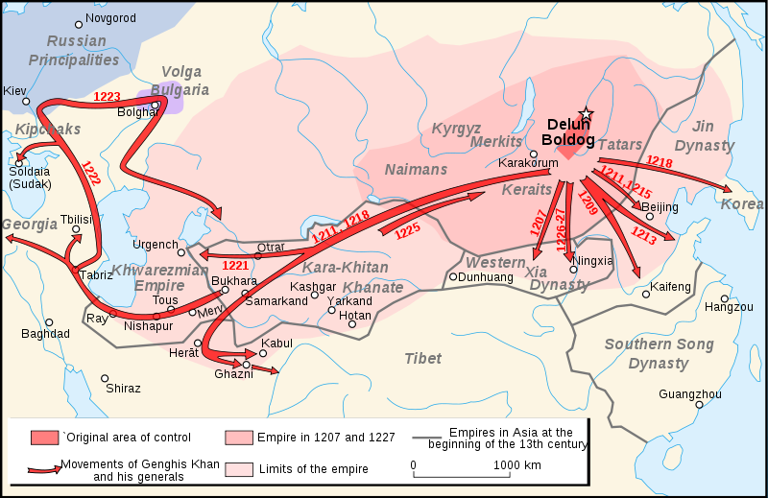
Mongol Expansion

Slide 12
Seljuk Turks
To escape Mongol advances, move West into Persia in 10th C
Establish an imperial court in Esfahan
Omar Khayyam (1048-1131)
Brilliant mathematician and astronomer.
Revised calendar, now basis of Islamic calendar
Philosopher
Poet: Rubaiyat of Omar Khayyam

Slide 13
Disorder Within Muslim Lands
Seljuks (Sunni Muslims) push west, conquering Persia, Mesopotamia, into southern Asia Minor
Fatimids rise to power in Egypt in 10th C
Ismaili Shia (dualists)
Conquer much of Syria
Destroy Church of Holy Sepulcher in 1009
Very harsh treatment of Jews and Christians
Arab kingdoms reeling from Seljuk and Fatimid conquests, except for descendants of Ummayads in Spain
NB still more Christians that Muslims living in msot fo these lands

Slide 14
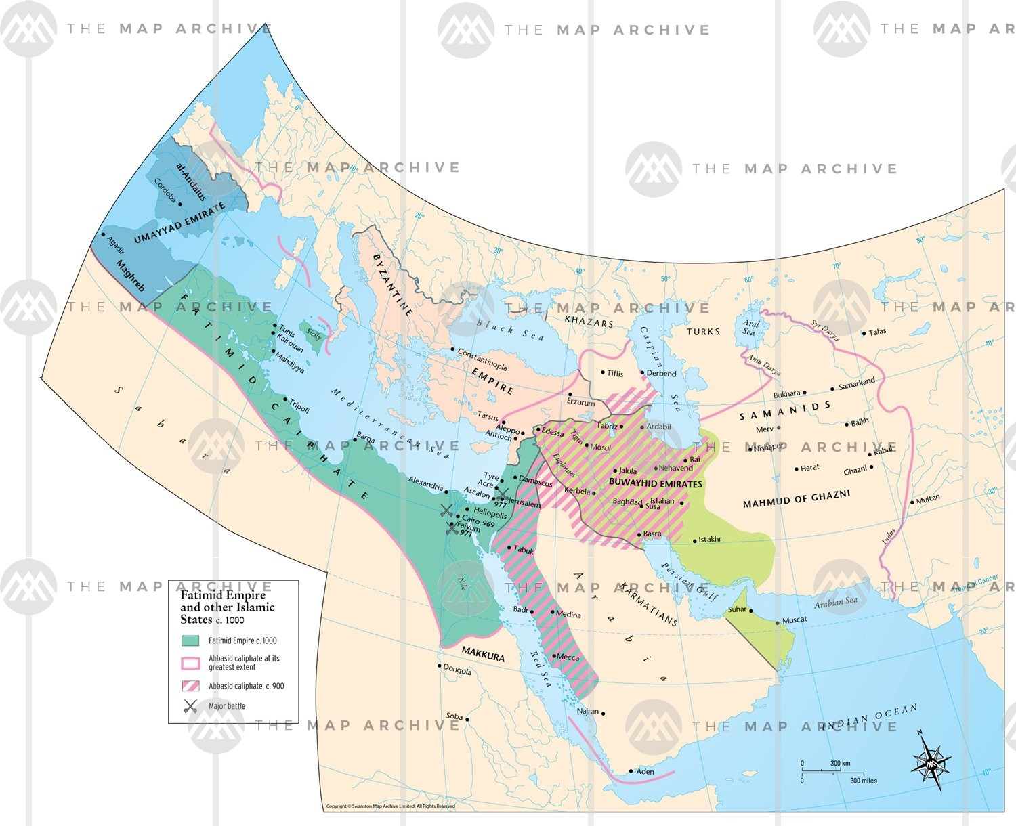

Slide 15
Byzantine Political and Military Stimulus to First Crusade
New invaders from East: Seljuk Turks
Replace Arabs as rulers of southeastern Mediterranean
Hostile to Christian pilgrims to Holy Land
Threaten Byzantine empire
Economic threat resulting from reduced Western pilgrimages
Battle of Manzikert (1071),
Terrible defeat for Byzantine army
Eastern Emperor Alexius Comnenus appeals to Pope for military assistance
Pope Gregory VII plans military assistance (crusade), but cannot organize it because of investiture controversy

Slide 16
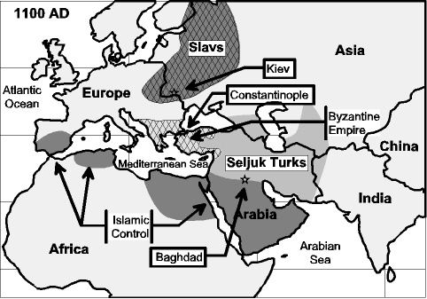
Political/Military Power Map

Slide 17
Pope Urban II (r 1088-1099)
Urban (given name Oto) was born in France and was archdeacon in Rheims
Decided on a monastic vocation, entering Cluny and eventually became the abbot of Cluny
Gregory VII named him cardinal-bishop of Ostia
Despite interference from HRE Henry IV, Urban continued Gregory VII’s reforms
Henry IV tries to establish a rival Pope to counter Urban

Slide 18
Urban Calls First Crusade
The Byzantine emperor, Alexius, asked Urban for military help against the Seljuk Turks
Concerned about the stability of Constantinople and safety of pilgrims, Urban called for a military campaign to win the Holy Land from the Turks
First Crusade called by Pope Urban II in 1095,
‘Battle’ cry of Deus Vult, “God Wills It”
Soldiers ‘take the cross’ as emblem
Urban’s success in calling First Crusade significantly strengthens papacy

Slide 19
The Crusades: A Military Pilgrimage
Needed because the Seljuk Turks captured much of Holy Land from Fatimids and route to Holy Land in 11th C
Initially driven by desire to secure places of pilgrimage in Holy Land
Crusades preached and followed as a type of pilgrimage
Not called crusades at the time, but the taking of the cross
Byzantine Empire, because it had asked for military assistance from papacy, assumed that the crusaders would return eastern lands to Byzantine control

Slide 20
The Crusade Before the First Crusade: People’s or Pauper’s Crusade
Motivated by Urban’s call for a campaign, a German monk, Peter the hermit, organized a pilgrim-crusade in 1096
Mostly composed of paupers, poor knights, beggars; an army/mob of about 40,000
Financed by robbery, especially from Jews who were often murdered
Reached Constantinople, then Asia Minor.
Destroyed by Turks, either killed or taken as slaves

Slide 21
First (Prince’s) Crusade
Organized and led by well-trained German and French knights and princes
But no one person in charge
Armies met in Constantinople in 1098
Byzantines eager to move Westerns out
Byzantine scouts led Crusaders into Asia Minor, and then abandoned them
Crusader army spent nearly a year fighting its way to Jerusalem
Assisted by the fact that the Turks were also opposed by other Arab peoples
Jerusalem captured in 1099

Slide 22
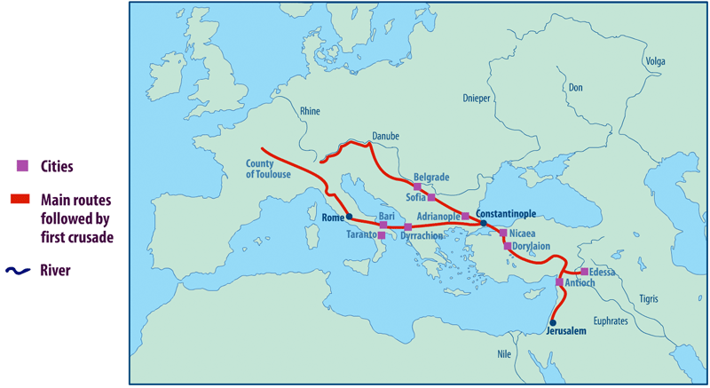
European Route and Conquests During First Crusade http://www2.div.ed.ac.uk/courses/Animated_Maps/Divinity2/images/C1still.gif

Slide 23
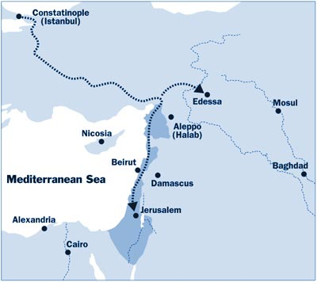
Land Captured by First Crusade

Slide 24
First Crusade Captures Jerusalem 1099
Crusader army, disorganize and divided by factions, none-the-less managed to capture Jerusalem
Blood bath by some victorious crusaders, murder of nearly every man, woman, child
Arabs, rightly, deeply angered, pointing out that Arab armies had not committed such atrocities against Christians in 7th C capture of Jerusalem
Established maximum extent of Christian rule, Outremer (Overseas)
Saladin recaptures Jerusalem 1187

Slide 25
Aftermath of First Crusade
Distrust and antagonism between Western Crusaders and Byzantines
‘Kingdom of Jerusalem’ an occupier force
Bitter resentment by both Islamic and Christian natives
Long, uncertain supply lines to Western Europe
Most crusading soldiers expect to return home, not colonize Holy Land

Slide 26
Assignments
Pope Urban II, Speech on First Crusade, available at http://www.fordham.edu/halsall/source/urban2-fulcher.html
Hitchcock, Ch. 6

