Slide 1
Lecture 19: Lay Investiture, Papal Powers and 14th C
Dr. Ann T. Orlando
8 November 2018

Slide 2
Introduction
Review
  What is Lay Investiture
14th C: Famine, War, Plague
Philip IV, the Fair (France)
Avignon Papacy

Slide 3
14th C
Historical Review
Natural Disasters
Avignon Papacy and Great Western Schism
Interminable Wars
The end of one era and the beginning of another

Slide 4
Review of 13th C
Papacy
  Begins with Innocent III: height of papal civil power
  Ends with Boniface VIII: Humiliation and ‘fall’ of papacy
Crusades
  Begins with IV Crusade
  Crusade IX ends with capture and ransom of King (St.) Louis IX
‘Nationalism’
  Begins with relatively weak national rulers
  Ends with ‘national’ rulers asserting power over Church and lands

Slide 5
14th C Famine
12th and 13th C were period of population growth (warm Middle Ages); agriculture could not keep pace
  In 1300 population of Europe 70 to 100 M
  Fuels growth of cities
Severe Famine in early 14th C (1315-1320)
  Cold, rainy weather
  Agriculture could not feed large population
  10 – 25% of population starves to death
Conditions in cities
  Poor sanitation
  Concentration of fleas and rats

Slide 6
The Black Death
Increased trade led to less desirable imports
Plague started in Asia; Spread to Europe in 1347
Approximately 1/3 of Eurasians died
  In Europe on top of 10-25% who had already died of starvation
  Total loss of population in Europe between 1300 and 1400 about 50% to famine and sickness
Young more susceptible than old
Effected every country in Europe between 1347-1348; sporadic outbursts throughout 14th C

Slide 7
Impact of Black Death
‘Jews poisoned the wells’
  Jews seemed to be less effected by Black Death
  Cleanliness (?)
  Reduced contact with larger population
Enhanced economic opportunities for laborers who survived
  Tax revolts
  Demands for end of feudalism
European population would not recover until early 19th C

Slide 8
Review: Earlier Relationship Between Western Civil and Ecclesial Leaders
Constantine ‘donates’ much of Rome to the Pope (4th C)
Papacy and bishops become important civil as well as spiritual leaders, especially after fall of Western Roman Empire
  Pope Gelasius
  Pope St. Gregory the Great
  Donation of Constantine
  Crowning of Charlemagne

Slide 9
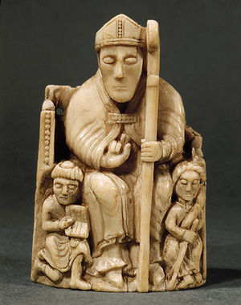
Lay Investiture: Who Appoints the Bishops, Pope or King
Bishops in secular society
Well educated
Well (most) respected within communities
Almost always magistrate in ‘civil’ proceedings; sometimes magistrate in criminal proceedings
Often international (e.g. Anselm)
Often in control of vast wealth with no legitimate heirs
http://www.metmuseum.org/toah/images/h2/h2_17.190.229.jpg

Slide 10
Pope and HRE
Pontificate of Gregory VII (1073-1085)
  Church reform; Gregory had been a monk at Cluny
  Opposed simony (sale of religious offices)
Assertion of Papal primacy, Dictatus Papae;
  Emperor cannot invest bishops with symbols of office, or participate in election of Pope
Henry IV refuses to accept Dictatus Papae
  Pope Gregory VII excommunicated Emperor Henry IV;
  Henry repents at Canossa and is forgiven
But in 1084 Henry IV’s army attacks Rome and drives Gregory VII into exile
  Psalm 44 “I have loved justice and hated iniquity therefore I die an exile”

Slide 11
Pope and HRE (cont.)
Concordat of Worms (1122)
Compromise resolves (temporarily) issues between Pope and Holy Roman Emperor
  Agreement between Pope Calixtus II and Henry V
  Pope selects bishops and abbots, and invests them with symbols of spiritual office
  Emperor can invest bishops and abbots with lay responsibilities and be present at installation

Slide 12
Political Developments in England
Anglo Saxons initially able to fend off Viking raiders
  King Alfred Great, d. 899 being most famous
William the Conqueror from Normandy 1066 defeated Anglo-Saxons at Battle of Hastings
Established Norman rule in England
  Because local barons were defeated, setup a strong national governing system in England
Henry II (1133-1189) of England, born in France, married Eleanor of Aquitaine after her marriage to Louis VII was annulled
  By this marriage and his inheritance of Normandy, Henry II claimed all of Western France
  Set stage for sporadic battles and wars between England and France;
  Normans in England claimed much of France
  Culminated in the Hundred Years War, 1339-1453

Slide 13
Henry II and
St. Thomas Becket
Henry II attempts to gain control of clergy through the Constitution of Clarendon
  King can try clergy for crimes
  King must approve all newly appointed bishops
Henry II appoints his close friend, Thomas Becket, Archbishop of Canterbury
As Archbishop, Thomas opposes secular control of ecclesial domains and authority
Thomas Becket murdered by knights of Henry II in 1170 in Canterbury Cathedral;
  Henry forced to do public penance by Pope Alexander III
Canterbury instantly becomes an important pilgrimage site
  Chaucer, Canterbury Tales
  Until Becket’s body destroyed by order of Henry VIII in 1538

Slide 14
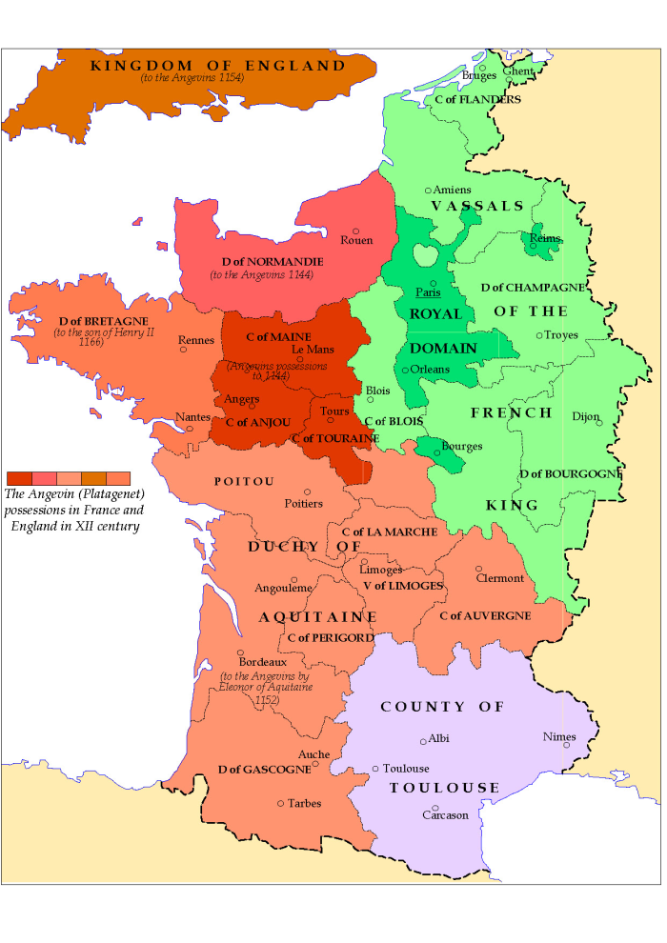
France c. 1150

Slide 15
Medieval French Monarchs
After Carolingians, Hugh Capet becomes king, beginning of Capetians, 987
Philip II wins back much of the territory claimed by the English king
St. Louis IX leads the eighth and ninth Crusades

Slide 16
Philip IV, the Fair (1268-1312)
Set on establishing France as a unified nation with centralized authority in the king
Expelled clerics from involvement in civil legal proceedings; using newly trained lay lawyers
Taxed Church property to help fund war with England
Expels Jews from France to collect their property
Similar to suppression of Templars with Pope Clement V
When his son Charles IV dies in 1328 without heir, beginning of Hundred year’s War with England

Slide 17
Boniface VIII (r. 1294-1303)
Recall that in 13th C after Innocent III. Papacy is a state of turmoil
Boniface bitterly opposed to renewal efforts of Franciscan Spirituals
Called the first Jubilee Year in 1300
  Rome needed the money
  But also very well organized and managed which significantly enhanced Boniface’s stature around Europe
Issued Clericis Laicos (1296) forbidding taxation of clerics or church property without consent of the pope

Slide 18
Pope and French King
Controversy with Philip
  Philip the Fair of France refuses to acknowledge ultimate Papal authority
  Boniface responds with ‘The two swords of religious and political power belong to Pope’ Unam Sanctam
  Philip burns the encyclical
  Boniface prepares to excommunicate Philip, when Philip’s supporters capture Boniface VIII; parade him sitting backward on a horse
  Boniface dies shortly thereafter
French select next Pope, Clement V. This begins the ‘Avignon Papacy”; under French control

Slide 19
Implications of the Controversy
Boniface VIII is usually taken as the last of the Popes who could claim (unsuccessfully) strong and direct temporal authority over secular rulers
But the papacy itself continues to be an important international secular authority
  Primary diplomatic conduit to Byzantium (15th C)
  All European rulers are Catholic (16th C)
  Papal States (19th C)
And bishops continue to be important ‘national’ leaders, sometimes putting them at odds with Rome
  Concilliar Movement

Slide 20
Papal Status as of 1303
Pope Boniface VIII
  Unam Sanctam
  Philip IV of France ignores Encyclical;
  Captures Boniface and humiliates him
  Boniface dies 1303
Boniface’s successor
  Tension between Roman families and French over who should be Pope; political/economic driver is control over Papal States (from Pepin the Short in 750)
  Clement V was elected through French influence and lived in France, beginning of Avignon Papacy

Slide 21
Avignon Papacy
During this period (1309-1377), Papacy dependent on France
Cutoff from Papal States, popes needed money for their court
Some of Popes in this period were guilty of nepotism as well as simony
Practice of selling indulgences

Slide 22
Indulgences
From CCC Definition of Indulgence
  The remission before God of the temporal punishment due to sin whose guilt has already been forgiven. A properly disposed member of the faithful can obtain an indulgence under prescribed conditions through the help of the Church which, as the minister of redemption, dispenses and applies with authority the treasury of the satisfactions of Christ and the saints.
Mini-history of indulgences
  Traces to time of martyrs when martyrs because of their suffering could offer lapsed their ‘reserve’ of graces
  After Constantine, penances were modified for people who were already suffering illness OR who had holy family members who had suffered
  Theory of indulgences developed in detail by Albert the Great and Thomas Aquinas

Slide 23
Reaction Against Avignon
Catherine of Sienna (1347-1380)
  Mystic who was very popular; educated by Dominicans
  Tertiary Dominican
  Able to end warring family factions in Italy
  Pressured Pope Gregory XI to return to Rome, which he did in 1377
  Declared a doctor of Church in 1970
Bridget of Sweden (1303-1373)
  Mother of Queen Catherine of Sweden
  After becoming a widow, moved to Rome, founded an order (Brigittines) devoted to poor of Rome and politics of returning Pope to Rome

Slide 24
Intellectual Reactions Against Scholasticism
Blessed Duns Scotus, Franciscan (1265-1308)
  Man comes to knowledge only by illumination from God
  Divine will takes precedence over divine intellect; known as voluntarism
William of Ockham, Franciscan (1285-1347)
  ‘Ockham’s razor’ there should be no hypotheses that are not directly necessary;
  Nominalism; that is, universals do not exist
  Man is saved by direct action of God’s grace without any intermediary action
    Morality is only known from Revelation, not natural law
  Attacked wealth of clergy

Slide 25
Assignments
  Boniface VIII, Unam Sanctam, available at http://www.fordham.edu/halsall/source/b8-unam.html
  Dante, Divine Comedy, Inferno, Canto XIX, http://www.italianstudies.org/comedy/Inferno19.htm
  Catherine of Sienna, “Letter 44 to Pope Gregory XI,” available at http://medieval.ucdavis.edu/20C/Catherine.html

