Slide 1
Lecture 20: 15th C Great Western Schism
15 November 2018
Dr. Ann T. Orlando

Slide 2
Introduction 14th C
Historical Review
Natural Disasters
Avignon Papacy and Great Western Schism
Interminable Wars
The end of one era and the beginning of another

Slide 3
Review of 13th C
Papacy
Begins with Innocent III: height of papal civil power
Ends with Boniface VIII: Humiliation and ‘fall’ of papacy
Crusades
Begins with IV Crusade
Crusade IX ends with capture and ransom of King (St.) Louis IX
‘Nationalism’
Begins with relatively weak national rulers
Ends with ‘national’ rulers asserting power over Church and lands
Great Saints
Begins with Frances and Dominic
Ends with Thomas and Bonaventure

Slide 4
Introduction
Review Troubled 14th C
More Troubled 15th C
15th C Papacy
15th C Political and National Movements

Slide 5
The 14th C
Famine
Black Death
Avignon Papacy
100 Years War

Slide 6
Great Western Schism
Gregory XI returns to Rome
Urban VI succeeded Gregory XI (1378)
Managed to alienate both French and Romans
Cardinals who had elected Urban abandoned him and elected a new pope, Clement VII who moves back to Avignon
Everyone in Western Europe chooses sides
France, Scotland back Clement
England and HRE (Germany and Spain) back Urban
Italian city states changed sides frequently
Rival Popes needed funds
Simony
Sale of indulgences

Slide 7
Conciliar Movement
In 1394 theologians at University of Paris suggest a council to elect Pope
Council gathers at Pisa in 1409, and both Popes are asked to resign
Takes steps against simony and selling indulgences
Elects Alexander V
Now there are three Popes: Rome, Avignon, Pisa
Another Council at Constance in 1414-1418
Haec Sancta: Council of Bishops pre-eminent over Pope
‘…the Reformation of the Church of God in its head and its members…’
Elect Martin V, end of Great Schism
Pius II (1458-1464) issues Execrabilis, that no council is over the Pope, repudiates Council of Constance

Slide 8
Early Reformers
John Wycliffe, Wyclif, Wycliff (1324-1384)
Englishman, denounced Papal control over Church property
Church as spiritual not a political society
Emphasis on Scripture and priesthood of all believers
Opposed to idea of indulgences (not just selling)
Lollards remained active in England promoting Wycliffe’s theology
Wycliffe condemned by Council of Constance, 1415
John Hus (1369-1415)
Bohemian, influenced by Wycliffe
Did not accept priesthood of all believers; otherwise in general agreement with Wycliffe
Condemned and burned at stake by Council of Constance
Leader of Bohemian national movement

Slide 9
Popular Devotion in Northern Europe
Beguines
Begin in 13th C as a loosely connected group of reclusive religious women in Netherlands
Beguine houses spread throughout Europe, but no vows
Sometimes accused of heresy and suppressed, but then rehabilitated
Julian of Norwich (1342-1416) may be associated with the later Beguine movement

Slide 10
Popular Northern devotions (cont.)
Devotio Moderna
Begun in Netherlands by Gerharde Groote (1340-1384)
Call to simpler more personal from of Christian life and meditation
Little emphasis on ecclesial Church and ritual
Brethren of Common Life lay community founded by Groote, communities spread throughout Europe
Thomas a Kempis (1380-1471), Imitation of the Life of Christ
During the Reformation many of these communities break from the Church and are basis of pietism movements

Slide 11
15th C Papacy
After Council of Constance (1414-1418), Martin V elected Pope (r. 1417-1431)
End of Great Schism
Called Council of Basel-Ferrara-Florence (1431-1439)
Allowed payment of annuities (a way around usury)
Tried to end Christian traffic in slavery
Eugene IV (r. 1431-1447)
Concluded Council of Florence with reunion of Eastern Orthodoxy in return for sending troops to defend Byzantines from Ottoman Turks
Greatly enhanced prestige of Papacy
Nicholas V (r. 1447-1455)
Reworks and strengthens much of infrastructure of Rome: water, sewer, fortifications
Starts Vatican Library
Plans to pull down and rebuild St. Peters after loss of Hagia Sophia in Constantinople
Pius II (r. 1458-1464) issues Execrabilis, that no council is over the Pope, repudiates Council of Constance
Sixtus IV (r. 1471-1484) known for nepotism; leads to his nephew becoming Pope Julius II
Alexander VI (Borgia) (r. 1492-1503)

Slide 12
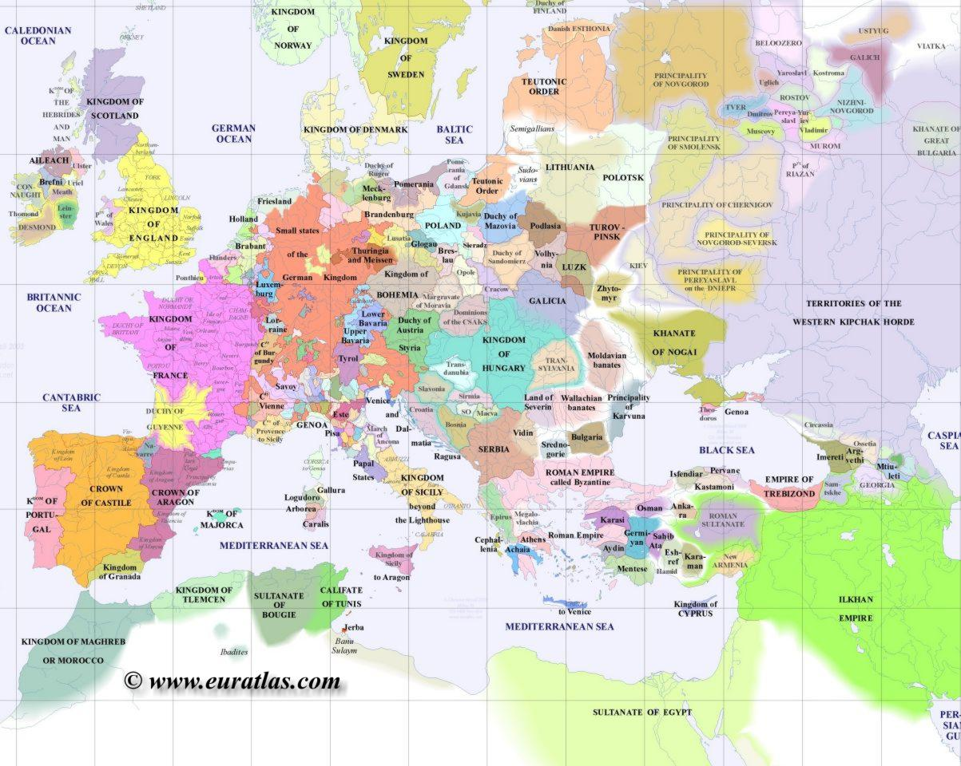
Map of Europe 1300

Slide 13
Political Situation: France
Philip IV (Fair) 1285-1314
Enemy of Boniface VIII, Jews, Templars
Strengthen French throne
Philip IV son, Charles IV, succeeds to throne
Continuation of Capetian line disputed after Charles IV dies (1328) without heir,
Most direct successor in Capetian line in King Edward III of England
French Barons instead look to Philip VI and beginning of Valois line
Caused 100 Year’s War

Slide 14
100 Years War
Hundred’s Year War Between England and France 1339-1453 over rights of succession to French Throne
Strong overtones of French nationalism
St. Joan of Arc, 1412-1431
Rallied French behind Charles VII (Valois line); crowned in Rheims
Captured and burned as a heretic by English Inquisition
French kings ultimately prevailed, final battle at Castillon in 1453
Finally broke the link between English (Norman) and French thrones

Slide 15
Political Situation: England
Edward I 1272-1307
Annexed Wales and Scotland
Edward III 1327-1377
Sees himself as proper successor to French throne
Starts 100 Years War with France
Henry V, Battle of Agincourt 1415
War of Roses (civil war) 1455-1485
Henry VII and House of Tudor finally successful

Slide 16
Political Situation: Holy Roman Empire
14th C period of weakened HRE (German monarchy), elected by duchies (Bohemia, Saxony, Luxemburg, Bavaria, Moravia, Austria)
Three families vie for power: Bohemia, Luxemburg, Hapsburg
Sigismund last of Luxemburg’s to rule all of Germany; called Council of Constance
Eventually Hapsburg rule dominates
Maximilian I (Hapsburg) 1493-1519
Son marries Spanish heiress (Joanna the Mad, daughter of Ferdinand and Isabella)
Their son in Charles V

Slide 17
Political Situation: Spain
Throughout 14th C and 15th C Christian kingdoms of northern Spain fight against Muslims
Queen Isabel of Castile and King Ferdinand of Aragon succeed in expelling Muslims from Spain in 1492
Charles V (their grandson) becomes king of Spain in 1516

Slide 18
Political Situation: Eastern Mediterranean
Mongol expansion in 13th and 14th C in Asia pushes Ottomon Turks Westward
Ottomon Turks succeed Seljuk Turks for control of Persia and Syria
Mehmed II captures Constantinople 1453
Other than a few priests, West sent no aid to Constantinople after Council of Florence
Day before final battle, Eastern Church repudiates Council of Florence
Hagia Sophia becomes a mosque when Mehmed II enters and prays toward Mecca
Suleyman Magnificent becomes sultan 1520
Ottoman expansion is checked by Austrians at Battle of Vienna 1533 and by Spanish at Battle of Lepanto 1571

Slide 19
Political Situation: Italian City-States
In 13th C most important cities were Venice and Genoa
Navy
Trade
In 14th and 15th C other powerful city-states rise: Florence
Banking to replace infrastructure of international banking and credit run by the Church
Deep animosity between the papacy and some Florentines (especially the Medici family)
NB ‘Italy’ is a geographic entity, but not a unified political entity until late 19th C

Slide 20
The Medici Family
Powerful Florentine family
Power based on banking
Subterfuge to evade usury laws
Adroitly developed ‘banks’ managed by family members throughout much of Europe
Usually managed to back the ‘winning’ side in Papal-Imperial-French-Italian city state rivalries
Cosimo the Elder (1389-1464)
Established Medici family as economic and political powers in Florence
Humanist, patron of arts
Lorenzo the Magnificent (1449 – 1492)
Grandson of Cosimo the Elder
Brother Giuliano assassinated on Easter in 1478 in Pazzi Chapel; Archbishop of Pisa (present at the time) complicit in the assignation (executed in his Easter vestments)
Lorenzo went to war with Pope Sextus IV; ends with an uneasy peace between Medici and papacy
Lorenzo’s son Giovanni became Pope Leo X (r. 1513-1521)
Lorenzo educated Giuliano’s son, who later became Pope Clement VII (r. 1523-1534)
…and his granddaughter, Catherine (1519-1589) becomes Queen of France

Slide 21
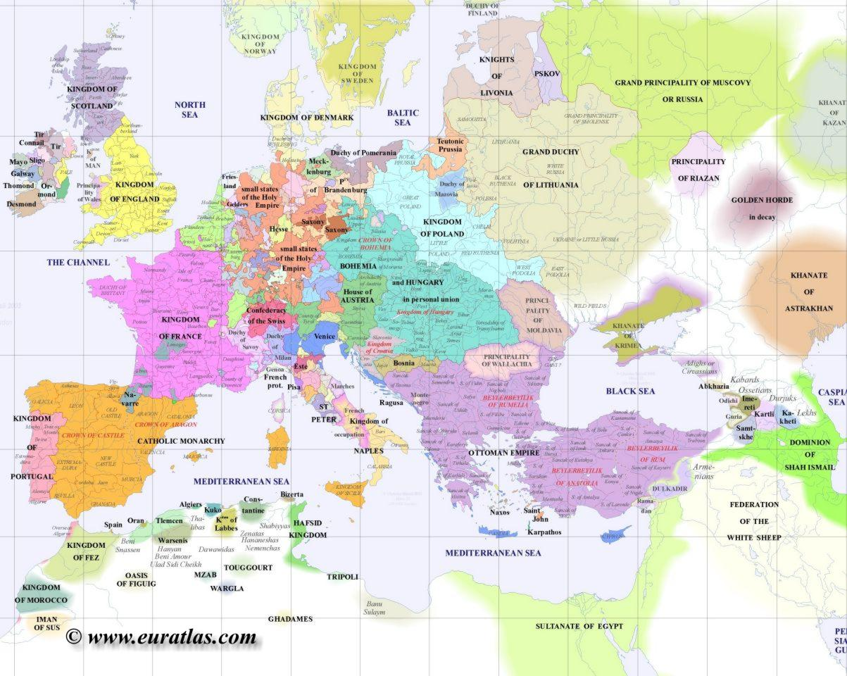
Europe 1500

Slide 22
Assignments
Council of Constance, http://www.fordham.edu/halsall/source/constance1.html
Boccaccio, The Decameron, http://www.fordham.edu/halsall/source/boccacio2.html

