Slide 1
Lecture 21: Fall of Byzantium and Early Renaissance
Dr. Ann T. Orlando
27 November 2018

Slide 2
Introduction
The End of the Roman Empire (Byzantium)
Early Renaissance
Scholarship

Slide 3
Byzantine Politics After Restoration, 1261
New ruling house established, Palaeologos (Palaiologus, Palaeologus)
Threatened by Mongols, others displaced by Mongols
Internal divisions and civil wars

Slide 4
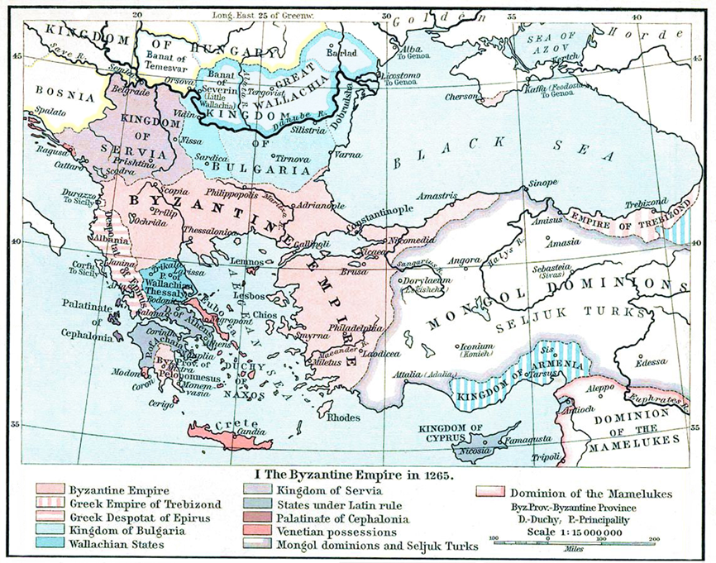
Byzantium Late 13th C

Slide 5
Ecumenical Patriarch after 1261
During Latin occupation, Patriarch exiled in Nicea
But recognized by Orthodox (Greek and Russian) as legitimate ecclesial authority
Increasingly, Ecumenical Patriarch, not Byzantine emperor, seen as source of Orthodox life
Ecumenical Patriarch receives funds from Russian churches

Slide 6
Byzantium in 14th C
Throughout the 14th C the Byzantine ‘empire’ lost ground to the new wave of Ottoman Turks
Mongol expansion in 13th and 14th C in Asia pushes Ottoman Turks Westward
Ottoman Turks succeed Seljuk Turks for control of Persia and Syria
Several efforts by the West against the Turks either couldn’t get organized or were soundly defeated in Eastern Europe
West also disorganized because of Avignon papacy and Great Schism
A Byzantine Emperor (Manuel II, 1399) even traveled as far as England looking for support

Slide 7
Orthodox Spirituality: Palamas vs Barlaam
(St.) Gregory Palamas (1296-1359) was a monk on Mt Athos, revived Hesychasm
Translated Augustine into Greek
Made Hesychasm the dominant form of Orthodox spirituality
Barlaam
Byzantine monk in Calabria
Studied Aristotle and Aquinas
Opposed Hesychasm and Palamas
Palamas and others had him anathematized
Barlaam converted to Catholicism; spent time at Papal court in Avignon
Taught Greek to Petrarch

Slide 8
Byzantium 15th C
In 1437 a desperate Emperor John VIII Palaeologus along with Patriarch Joseph of Constantinople travelled to Italy to get military support
Agreed to a formula of union at Council of Florence, acquiescing to Latin demands
Russians refuse to accept it, as did many in Constantinople
Last Western effort to save Constantinople defeated in Eastern Europe, 1444
Nonetheless, in the desperate hopes for a new Western military effort, the last Byzantine Emperor, Constantine XI Palaeologos officially proclaimed union with Latins in Hagia Sophia in 1452

Slide 9
Fall of Constantinople, 29 May 1453
Mehmed II captures Constantinople 1453
Other than a few priests, West sent no aid to Constantinople
Day before final battle, Eastern Church repudiates Council of Florence
Many of Mehmed’s troops were Christians
Genoese opened the gate to recover dying prince, allowed the Turks (Janissaries) to enter
Hagia Sophia becomes a mosque when Mehmed II enters and prays toward Mecca
Suleyman Magnificent becomes sultan 1520
Ottoman expansion is checked by Austrians at Battle of Vienna 1533 and by Spanish at Battle of Lepanto 1571

Slide 10
Janissaries
Christian boys taken as slaves from parents
Forcefully converted to Islam and trained as elite soldiers
Regiment was most loyal to the Ottoman sultan

Slide 11
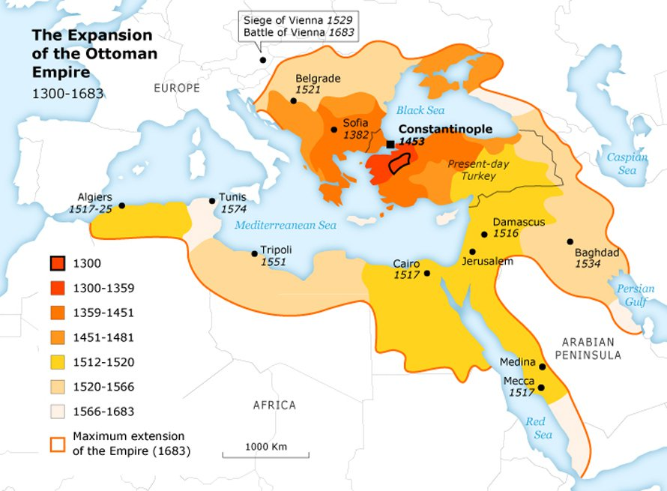
Ottoman Conquests

Slide 12
Migration of Greek Clerics and Scholars
Migration from 14th – 15th C
East to Moscow; after the Fall, Moscow refers to itself as ‘Third Rome’
West to Italy
Welcomed at flourishing city-state courts of Urbino, Venice, Florence, Naples, Rome
Fuel Western scholarship outside of university system

Slide 13
Renaissance = Rebirth
Name given by 19th C historians
Begins in Italy in 14th C, extends to mid-16th C when it becomes Baroque
Renaissance is said to begin when Petrarch reads Confessions when he ascends Mt. Ventoux, April 26, in 1336
Catholic Intellectual and artistic movement
Michelangelo (1475-1564) is usually considered both a Renaissance and a Baroque artist
Rejects the Aristotle of the schoolmen
Embraces rhetoric and language over philosophy
Embraces a certain pragmatism about human life and society

Slide 14
Humanism
Starts in Italy as part of Italian Renaissance
Although outside universities, very much a Catholic-oriented intellectual movement
Therefore, not to be confused with later atheistic humanism
Wants to get back to the original religious and classical sources, ad fontes
Funding for intellectuals, scholars, artists comes from wealthy princes, merchants
Medici’s
Popes
In art, man becomes the ‘measure of all things’ Protagoras of Abdera ( c. 480-410 B.C.)
Examples in architecture

Slide 15
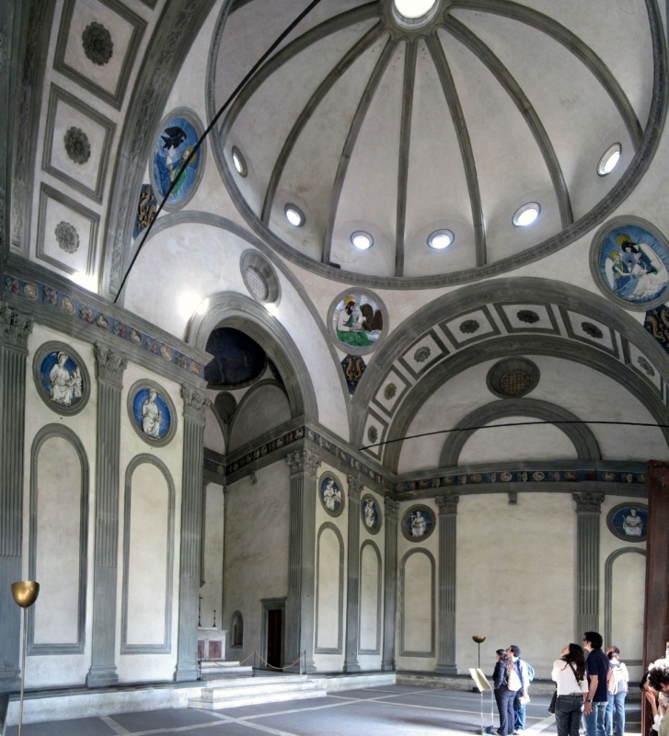
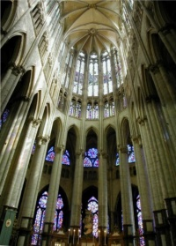
Architecture Gothic and Renaissance
Beauvais Cathedral
So large, collapses twice, in 13th C and 16th C
http://archive.cyark.org/cathedral-of-beauvais-info
Pazzi Chapel, Florence
Brunellesci 15th http://reference.findtarget.com/search/Pazzi%20Chapel/

Slide 16
Renaissance and Language
Rejection of ecclesial, scholastic Latin
Development of vernacular literature
Italian: Dante (1265-1321), Petrarch (1304-1374), and Boccaccio (1313-1375)
English: Chaucer (1343-1400)
French: Rabelais (1483-1553)
Study of works in original languages (ancient Latin, Greek, Hebrew)
Bible
Classical Greek and Roman literature

Slide 17
Petrarch (1304 – 1374)
‘Father’ of Renaissance
Family wanted him to study law, but he preferred studying the classics
Spent time a minor court official in Avignon
Became a wandering poet
Returning to Italy he gathered around himself a ‘school’ in Florence
Dedicated to literature and the classics
Emphasis on writing in Italian
Secular subject matter
Boccaccio his most famous student

Slide 18
Leonardo Bruni (1370-1444)
Important scholar and civic official in Florence
Especially influenced by arrival of Byzantine (Greek) scholars
Bruni translated many important Greek works into Latin, Xenophon’s Histories, as well as Plato
Wrote In Praise of Greek

Slide 19
Lorenzo Valla (1407-1457)
‘Adjunct’ professor of ancient Latin
Find employment in court of Naples
At the time, Naples is in a feud with papal states (Pope Eugene IV)
Papacy using Donation of Constantine to justify its claims
Through critical analysis, Valla demonstrates it is a forgery
Valla obtained an appointment to Curia by Nicholas V (Vatican Library)
Wrote a treatise, “On Pleasure,” among the first pro-Epicurean and anti-Stoic works since antiquity

Slide 20
Nicolo Machiavelli (1469-1527)
Public life fell in and out of favor with the Medici’s as they went in and out of power in Florence
Basis of political theory is that power makes an authority legitimate, not ‘goodness’
Legitimacy of law is wholly dependent on ability to enforce law
Prince’s virtues are those qualities which ensure his ability to effectively wield power
Most likely the ‘prince’ that Machiavelli is advising is the illegitimate son of Alexander VI and sometime cardinal; known for his cruelty

Slide 21
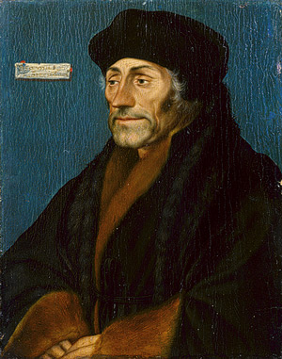
Erasmus of Rotterdam (1469-1536)
Dutch, Augustinian canon regular
Humanist who encouraged return to Bible and early Fathers of Church as a way to reform
Scripture as the philosophy of Christ
Optimistic about man’s ability to know and understand; ancient maxim that if one knows what is right, one will do it
Detailed textual work on Bible and Augustine
Most famous scholar of his time
Erasmus portrait by Hans Holbein the Younger, http://www.metmuseum.org/toah/works-of-art/1975.1.138

Slide 22
New Technologies in 15th C
Printing Press
Last great information leap forward was codex rather than papyrus in 3rd C and Carolingian Script of 8th C
15th C development of Printing Press allowed rapid communication by ‘instantly’ creating multiple copies of a work
Guttenberg assembled multiple technical advances to create an efficient press; Bible printed 1454
Spurred increase in literacy;
Also removed production of manuscripts from monasteries to secular world
European Voyages of Discovery

Slide 23
Assignments
An account of the Fall of Constantinople, https://apps.carleton.edu/curricular/mars/assets/Thomas_the_Eparch_and_Joshua_Diplovatatzes_for_MARS_website.pdf
Petrarch, Ascent of Mt Ventoux, available at http://www.fordham.edu/halsall/source/petrarch-ventoux.html
Leonardo Bruni, In Praise of Greek
Lorenzo Valla, Discourse on the Forgery of the Alleged Donation of Constantine (extra) available at http://history.hanover.edu/texts/vallapart2.html

