Slide 1
Lecture 22: Monks, Money, and Alms
Dr. Ann T. Orlando
29 November 2018

Slide 2
Introduction
Not really about money…but it is about impact of monasticism on Medieval European economies
Wealth centered on land
Monasteries as administrators of large landholdings
Monasteries as resource developers (engineers)
Agriculture
Water control
New land creation
Monastic economic system
Monastic charity

Slide 3
Money in the Middle Ages
Silver and copper coins (gold very rare)
Denarius in Latin-based countries
Pfenning in Germanic-speaking countries
Minted locally with approval of primary authorities
Money-changers very important to keep track of correct exchange between numerous local currencies
Monasteries often used as local mints
Skill to make coins
Reputation for ‘balanced scales’
By 11th C, coinage an important part of European economy
Increased trade
Development of urban areas
Poor were defined as those who had no coins at all
Francis’ Rule

Slide 4
Land as the Source of Wealth
Romans defined wealth in terms of land
Immediate survival depended on prosperity of land holdings
Excess (farming, mining, timber, building materials) could be sold for ‘luxuries’
Medieval European economy likewise based on productive land
Coins had little intrinsic value
Coins facilitated barter
But intangible spiritual ‘products’ also a basis of European economy
Tangible land assets and intangible spiritual assets inter-traded
Example: Founding of Cluny, sale of indulgences, sale of relics

Slide 5
The Business of Relics
The ‘business’ of relics was linked to pilgrimages
Usually the pilgrim destination was the site of a martyr’s or saint’s body
Thus, having important relics was also important to local economy
Relics could be extremely valuable
Traded, bought, stolen

Slide 6
Example: Stealing Bodies of Sts Benedict and Scholastica
Abbey of Fleury, founded 651, near Orleans
Joint Benedictine and Columban Rule
Prominent in Frankish politics
In late 7th C a raiding party from Fleury goes to Monte Cassino
Under the pretense of praying all night at the tombs, monks from Fleury disinter Benedict and Scholastica’s body
The fact that the stealing monks were able to return safely, was taken (in Fleury) as an indication that Benedict and Scholastica really wanted to be there
Abbey renamed St Benoit sur Loire
Becomes an important economic and educational center during Charlemagne’s reign

Slide 7
Medieval Monasteries and Initial Land Acquisition
It seems that most research has focused on Cistercians
Cistercian emphasis on work
Records available
Monastery created when land was available
Donation or Wills (in exchange for spiritual benefits)
Monks as pioneers of ‘new’ land
Monastery is comprised of built-in productive workforce
Motivated ‘strong’ young men (and women)
Organized as a tightly run corporate body
Monks (workers) are ‘free labor’ and require only subsistence from their labors
Excess (profits) are entirely returned to monastery as a whole (corporation)

Slide 8
New Productive Land
Cistercians become adept water management engineers
Develop techniques to drain swampy areas throughout England and Europe to build monasteries
Irrigation, damming, ponding and stream channel diversion to support
Agriculture,
Mills,
Mining (salt and iron) activities,
Bridge building

Slide 9
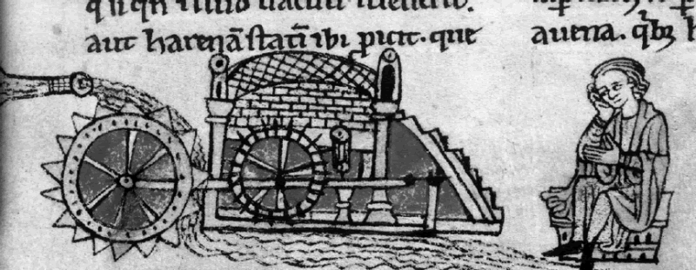
Key Device: Vertical Waterwheel
Undershot waterwheels well known
Cistercians revised and improved overshot vertical waterwheel
Including tidal based wheels
In 12th C English survey (Domesday Book) listed over 5600 waterwheels in England

Slide 10
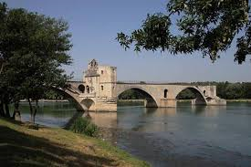
Example: Brothers of the Bridge
Specialized monastic orders were formed across Europe to oversee the construction of roads and especially bridges
Among most famous was ‘Brothers of the Bridge’ in France
Founded by St. Benezet (d. 1185)
Loosely followed Benedictine Rule
Responsible for several key bridges across Rhone, especially Avignon
At bridges, often a hospice for travelers as well as a place to collect tolls and provide for bridge maintenance

Slide 11
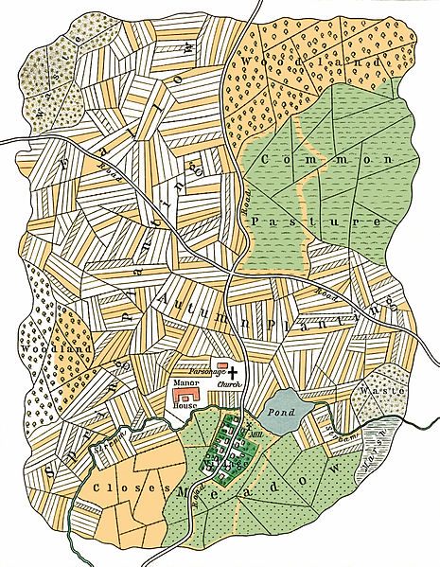
Monastic Acquisition of Additional Land: Pawning
Pawning is developed as an exchange of money (gage) for use of land for a period of years (usually 6)
Lower level knights or others in need of money pawned a portion of their land to monasteries in exchange for funds
Especially common during Crusades when knights had to pay their own way
Expectation was that land could be recovered with ‘booty’ obtained from a successful crusade
But land had to be redeemed within a set period or became property of monastery
Monastery received ‘payment’ based on production of land while it was pawned

Slide 12
Monastic Grange System
Through pawning and donations monasteries obtain lands not connected to monastery
Could be a days journey or more away
A second class of monks developed to work the granges: conversi

Slide 13
Choir vs. Conversi Monks
Originally used to distinguish those dedicated to monastery as children (oblates) and those who joined as adults (conversi)
Conversi considered lay brothers; often illiterate, occasionally with criminal backgrounds or outcast from society
Did take vows of poverty, chastity and obedience
Conversi sent to work the granges; did not have to return to monastery for office (choir)
From an economic labor perspective, monastery had two classes of workers
Choir monks; well educated; management; white collar
Conversi; uneducated; laborers; blue collar

Slide 14
Excess Monastic Land
Monasteries acquire more land than they can work by conversi
Sale and rent land out to farmers
Vif gage (live gage): payment based on a percentage of production of land
Mort gage (dead gage): payment based fixed amount, regardless of land production

Slide 15
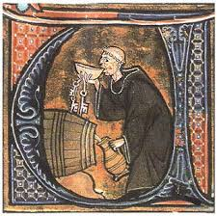
Excess Monastic Production
Monasteries produce much more than they can consume
Excess is available for trade and sale
Several important developments
Grading system for merchandise (English wool and French vineyards)
Relationship with lay traders and merchants

Slide 16
Economic Tools
International houses of marketing and commerce
Letters of credit
‘Virtual money’, money on account for bookkeeping
Libra (pound)
Double entry bookkeeping
Franciscan is first to write rules of double entry bookkeeping in 15th C

Slide 17
Reactions against Monks
The mort gage system looked like usury
Monks taking advantage of their tax-free status to gain an economic advantage
Third Lateran Council tried (unsuccessfully) to legislate against monastic economic abuses
Vatican II reforms conversi system

Slide 18
But Money also Funded Monastic Charity
Monasteries were the only institutional source of relief for
Poor
Sick
Travelers
During Reformation, when monasteries were dissolved and lands confiscated, poor had no where to turn
Riots in England and Germany among rural poor

Slide 19
The Almonry
Large room or even separate building within the monastery for distribution of alms
Almoner was the monastic official responsible for gathering food and clothes for distribution to poor
Anything leftover from monks meal
For 30 days the meal of a dead monk given to poor, who were expected to pray for the dead monk
Almonry also sometimes served as an orphanage for poor boys (and girls)
After the black death, laws passed by large landowners to discourage giving alms to ‘able-bodied’

Slide 20
The Infirmary and Hospital
Infirmary was for care of sick monks; hospital for care of lay sick
Infirmarian was charged with developing cures (herbalists)
One of the greatest infirmarians: St. Hildegard of Bingen (1098-1179), Doctor of the Church, Benedictine
Cuasae et Curae, multi-book work describing causes, cures and prevention of numerous diseases
Modern genetics: Gregor Mendel (1822-1884), Augustinian monk who followed in a long tradition of monastic herbalists

Slide 21
The Trinitarians: Rescuing Captives
The Trinitarian Order was founded at end of 12th C in Spain
Approved by Pope Innocent III
Founded by St. John Matha
Vision during Mass that he should work to ransom captives captured during Crusades
Trinitarian houses (men and women) become prominent in 13th C throughout Europe
Conduit for large sums from families trying to ransom captives and Muslims
Hospitals to care for captives and pilgrims
King Louis IX takes Trinitarians with him on crusades

Slide 22
Lay Economic ‘monks’: Guilds
A guild is an association of artisans, usually associated with urban centers
Guild has a ‘Rule’ for joining guild and conduct of members
Guilds usually had an important role in maintenance of local churches

Slide 23
Assignments
Guild Rules, http://sourcebooks.fordham.edu/source/guild-sthhmptn.asp

