Slide 1
Lecture 25: Mary in the Middle Ages
4 December 2018

Slide 2
Introduction
Mary in the Greek East and influences in West
Chartres Cathedral
Advent Liturgy
Mary and the Saints

Slide 3
Brief Review of Eastern Devotion to Mary
Based on Luke and John
St Gregory of Thaumaturgas (3rd C) has a vision of Mary and John the Baptist
Reinforced at Council of Ephesus (431)
Feast of Dormition officially declared as 15 August at end of 6th C by Emperor Maurice and Pope St Gregory the Great
Most important icon in Constantinople was image of Mary painted by St. Luke

Slide 4
Eastern Influences in West
It is likely that representations of Mary found in Byzantine art in Italy influenced Romanesque (Cluny) representations of Mary
Returning pilgrims encouraged a devotion to Mary
St. Bernard of Clairvaux profoundly influenced by Eastern understanding of Mary
In Divine Comedy, Dante the pilgrim is shown a vision of Mary by St. Bernard
By 12th C, almost all great churches were devoted to Mary

Slide 5
Our Lady and Chartres Cathedral
One of the most beautiful of all the gothic cathedrals was dedicated to Mary
After Chartres, most of the great cathedrals were dedicated to Mary
Chartres was important place of pilgrimage
Our Lady’s tunic
Seat of Wisdom statue

Slide 6
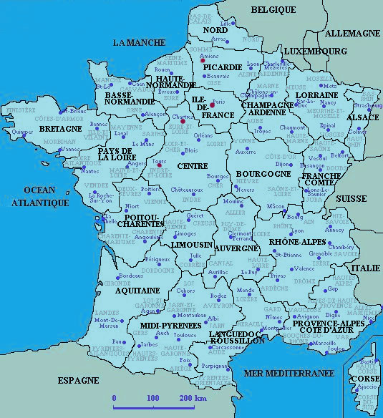
Map of France

Slide 7
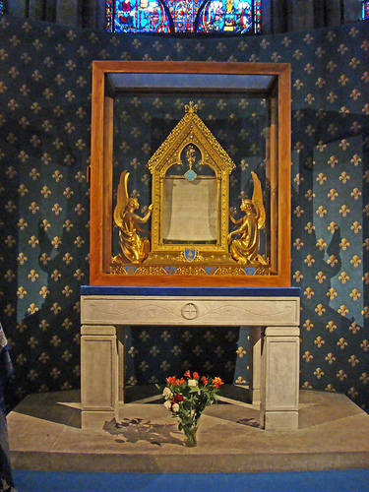
Our Lady’s Tunic
Chartres possesses the most important Marian relic in Europe: the Sancta Camisa
According to legend, Mary wore the tunic at the Annunciation and at the Nativity
Chartres came into possession of the tunic through Charlemagne’s grandson, Charles the Bald in mid-9th C

Slide 8
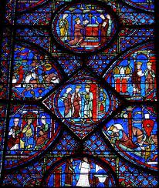
How Charlemagne Acquired the Tunic
According to The Pilgrimage of Charlemagne (mid-12th C) (aka The Merry Pilgrimage)
Charlemagne went on a pilgrimage to Jerusalem
Returning through Constantinople, the Emperor Nicephorus and Empress Irene gave the Sancta Camisa to Charlemagne to honor him as HRE
Upon his return, Charlemagne had the tunic in a reliquary in Aachen
NB There is also a 11th C legend that Alfred the Great (849 – 899) went on a pilgrimage to Jerusalem
The Life of Charlemagne, Chartres

Slide 9
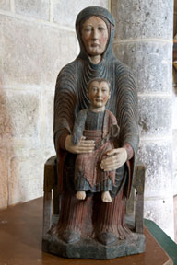
Sedes sapientiae
Mary, the Seat of Wisdom
St. Peter Damien (d. 1073) referred to Mary this way, comparing her to the throne of Solomon
Famous early Medieval wooden statue of Mary seated, holding Jesus at Chartres
Became a common statue throughout Medieval France and Spain

Slide 10
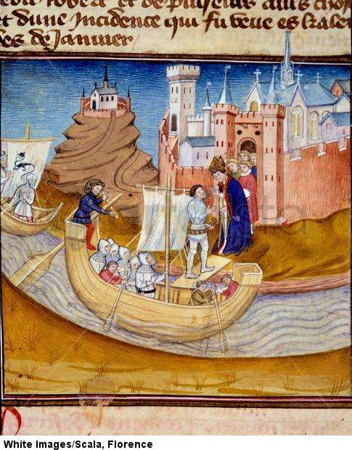
Importance of Bishop of Chartres
Chartres located on a high plateau over-looking the Eure River
Christianized as a result of conversion of Clovis
Chartres quickly became an important ecclesiastical center
Important economic center (equal or more so than Paris) in the 5th – 10th C
Pepin the Short refers to the Church of Mary and its bishop as being strong allies against Merovingians
In 911 Chartres attacked by Vikings led by Rollon;
According to legend, the bishop brought the Sancta Camisa to the ramparts, upon seeing it, the Vikings were converted to Christianity
Rollon became the first duke of the new province of Normandy
Normandy remained under the patronage of the bishop of Chartres throughout the Middle Ages
14th C Manuscript of Rollon Conversion at Chartres

Slide 11
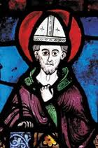
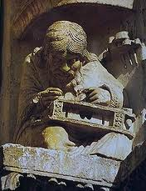
Importance of Chartres Cathedral School
Begun (according to legend) by Alcuin of York under Charlemagne
Specialized in the quadrivium: arithmetic, geometry, music, astronomy
Mathematics
Commentaries on Boethius and his commentaries on Pythagoras and Plato’s Timaeus
Key scholar was Bishop was Fulbert (970 - 1028)
Encouraged use of Arabic numerals
Encouraged careful astronomical observations
Bishop Fulbert at Chartres
Pythagoras at Chartres

Slide 12
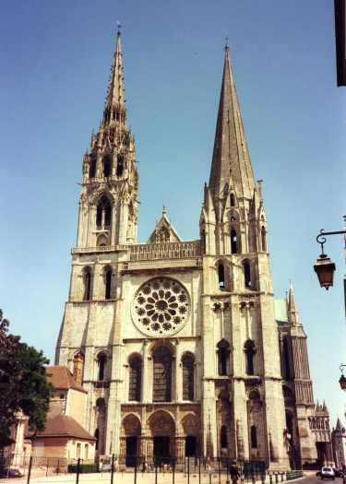
Bishop Fulbert and the Fire of 1020
In 1020 the cathedral completely destroyed by fire; but the Sancta Camisa was saved.
Fire broke out on eve of Mary’s Nativity
Fulbert collected money, hired architects and assisted in design of new cathedral
Died before completed
Another 11th C fire destroyed some of Fulbert’s original design
Chartres was the most important ‘Gothic’ Cathedral
Architecture (flying buttresses)
Statues
Stained glass

Slide 13
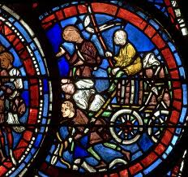
Rebuilding of Chartres and the “New Fashion of Prayer”
Rebuilding Chartres became an act of spiritual penance for those engaged in the work.
Recognized at the time as a new type of spirituality and prayer
Known as ‘the legend of the carts’
Mary of Mercy was petitioned to intercede for
The forgiveness of sins
The return to health
Safety of travelers and crusaders
A new type of ‘pilgrimage’ and the story of the carts
People from across Europe came to Chartres to work on the Cathedral
Usually bringing own tools and arriving in carts
Participants included rich and poor, men and women
Chartres became a monument to these ‘working’ pilgrims
Common man/woman personal history within the over-all context of salvation history
Mary of Mercy became the queen of history
Carts of Workers at Chartres

Slide 14
Floor an Windows Plan of Chartres

Slide 15
Early History of Advent
First indication of Advent as a special liturgical season is from St. Gregory of Tours (538-594) in his life of St. Martin (316-397)
It seems from the mid-5th C a time of fasting and prayer was observed in Frances from St. Martin’s Feast Day (Nov 11) until Christmas
The observance of Advent varied by location and bishop to between 5 and 7 weeks.
Early Advent liturgies developed at Charlemagne’s court
Pope St. Gregory VII seems to have been the first to formalize Advent at 4 weeks.

Slide 16
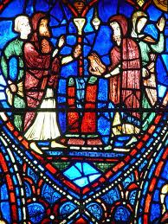
St. Fulbert and the Liturgy for Mary
From 10th C (at least) four Marian feasts celebrated at Chartres:
Mary’s Nativity (Sept. 8); Annunciation (March 25); Purification (Feb. 2) and Assumption (15 August)
In Chartres, celebrated as a Marian cycle summarizing salvation history
Fulbert and his disciples wrote offices, hymns and homilies
Fulburt first to use Protevengelium of James liturgically for Mary’s Nativity
NB Mary’s nativity is mentioned in the Qur’an
Joachim and Anne Bring Mary to Temple

Slide 17
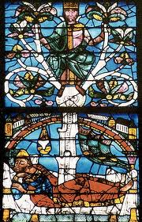
Chartres and the Advent Liturgy
Seems to have been a special cycle of Marian liturgies at Chartres between he nativity and the beginning of Advent
Advent was (is) a time to especially consider history from Creation to the Parousia
First Sunday: Adam to Noah
Second Sunday: Noah to Moses
Third Sunday: Moses to Christ
Fourth Sunday: Nativity to Parousia
Expanded at Chartres to include an emphasis on Virgin and her role in salvation history
Tree of Jesse

Slide 18
Chartres Cathedral in Later French History
In later Middle Ages, Chartres reduced in importance compared to Paris
Associated too closely with Carolingians rather than Capetians
Charter school did not develop into a university
During the French Revolution, Chartres Cathedral was attacked, but not seriously damaged
However, the Sedes sapientiae was destroyed
Bronze Center of Labyrinth, along with the bells was taken and melted for Napoleon’s canons
During WWII
Glass removed from Cathedral
Nearly destroyed in summer of 1944 by Americans, fearful that Chartres was being used by German Army
Currently, massive cleaning and restoration underway; but very controversial. See NY Times article Sept. 1, 2017.

