Slide 1
Lecture 3 Early Christian Martyrs
Dr. Ann T. Orlando
11 September 2018

Slide 2
Outline
Review of Roman History
Roman religion
Roman persecution
Martyrs

Slide 3
First Century Roman Empire after Augustus
Series of relatives of Augustus become Emperor, ending with Nero, murdered 68 AD (Claudio-Julian line)
Succeeded by Vespasian, general in Judea
Vespasian, Titus, Domitian known as the Flavians
Coliseum built by Vespasian

Slide 4
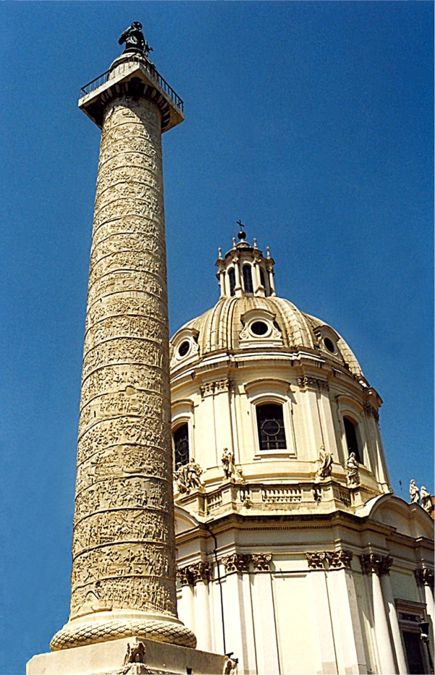
Second Century, “Five Good Emperors”
After Domitian, Nerva and then
Trajan, 98-117
Hadrian, 117-138
Antonius Pius, 138-161
Marcus Aurelius, 161-180
Policy of adopting a suitable successor, not relying on a relative
Policy of appointing excellent administrators for provinces (Pliny the Younger in Asia Minor)
The Empire was peaceful and prosperous
www.edupic.net/Images/SocialStudies/trajan's_column01.jpg

Slide 5
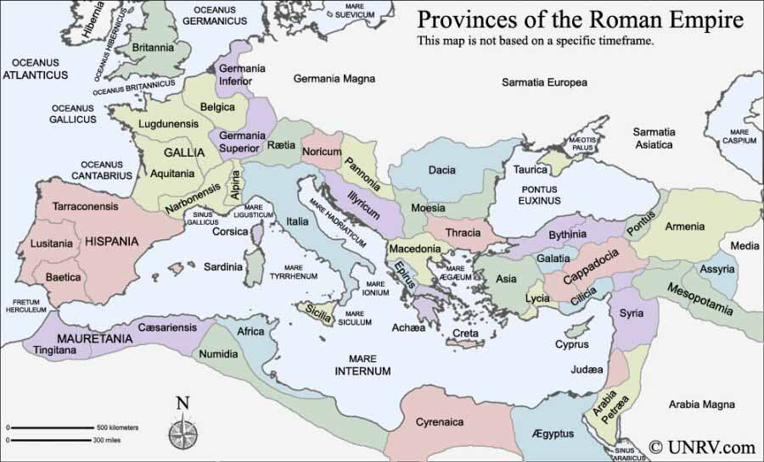
Roman Provinces www.unrv.com/roman-empire-map.php

Slide 6
Third Century, Turmoil and Famine
Marcus Aurelius’s son, Commodus (180-192), was vicious, paranoid
Strangled in his bath, then stabbed; end of Antonnines
After a period of civil war, Septimus Severus (193-211) becomes Emperor
War against Persians
Revamped Roman military and law
Died in York, England; succeeded by sons Caracalla (211 – 217) and Geta
Series of Severides and other generals of brief reign throughout Third Century
Decius (249-251), major Christian persecution
Attempt to re-unify Empire with renewed adherence to ancient religion
Made people buy a libellus to prove they had sacrificed to gods
Diocletian 284-305
Greatest persecution of Christians

Slide 7
Roman Religion
Roman religion was a public, civic obligation;
NOT primarily a way to have a personal relationship with Divine
Anyone who did not offer public sacrifice for the good of the state was considered an atheist
Impiety was a sin against both gods and the family
Nero started Cult of Roman Emperor as god in his lifetime
But Nero and Domitian are only two emperors Roman Senate did not deify
Rome links its gods with Greek gods through Virgil’s Aeneid
‘mystery religions’ became very popular in 1st through 3rd Century Roman society (Cults of Mithra; Isis and Osiris; Dionysius)
Romans very tolerant of other beliefs
A wealthy paterfamilia would sometimes set aside space for slaves and clients for their own mystery cults
San Clemente

Slide 8
Roman Family
Roman household was composed of paterfamilia (father) and clients (wife, children, slaves, business associates dependent upon him)
Father had complete control of clients until he died
Adoption, including adult adoption, was common among wealthy families
All sons treated equally as heirs (no primogeniture)
Exposure of unwanted infants, at discretion of father
Duty (fortitude) to family and state was one of the most important Roman virtues
Family was a state within a state
Notes:
Mark Nero on timeline

Slide 9
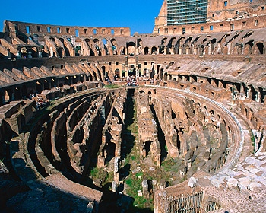
Roman Games
Romans loved blood sports
Gladiators were sports stars of the Roman world
Important part of criminal and slave trade was supporting circuses
Typical day at the Coliseum (60,000 spectators; note Circus Maximus held 250,000)
Morning: animal fights
Lunch: execution of criminals
Afternoon: gladiators
wwwdelivery.superstock.com/WI/223/1397/PreviewComp/SuperStock_1397R-33003.jpg

Slide 10
Christian Responses to Persecution
1. Intellectual: Apologies written to justify Christianity to Roman authorities
2. Facing torture and death without apostasy; often even looking forward to martyrdom eagerly as a proof of solidarity with Jesus
3. But, if you believed that Jesus only appeared to be human (docetists), then there seemed little reason to be a martyr yourself
4. Some did not have the courage when accused, and so apostatized and/or paid others for their libelli

Slide 11
Martyrs
Real desire to prove the totality of Christian faith (e.g., Origen On Martyrdom)
Those who died were (still are) considered heroes of the faith
Pilgrimage to place of burial
Remembering their sacrifice in “Acts”; Peter (Quo vadis); Polycarp; Perpetua and Felicity; Justin Martyr
Those who suffered but did not die (also known as confessors) were popularly considered able to forgive sin of apostasy
Problem for 3rd C bishops

Slide 12
1. Response to Persecution: Apologies
Type of literature that often had the form of a legal defense
It was intended for a highly educated pagan (i.e., philosophical) audience; often drew heavily on philosophical concepts to explain Christianity
Tried to establish antiquity and respectability of Christianity
It tried to show that Christianity was not to be feared, but encouraged good citizenship
St. Justin Martyr wrote two Apologies; Tertullian wrote an Apology

Slide 13
2. Response to Persecution: Martyrdom and Christianity
Martyr comes from Greek word for witness
Did not actually have to die to be a martyr, but to suffer for faith (slavery, prison, mines)
Note: Romans tried to avoid creating Christian martyrs; accused were given several opportunities to offer sacrifice
In 3rd Century, Roman authorities started issuing a receipt, or libellus to those who sacrificed; authorities also attacking Christianity as such, destroying Scripture

Slide 14
3. Response to Persecution: Docetists (Gnostics)
Heavily influenced by Platonism
Believed that Jesus was God, and therefore could not suffer
Physical was not important; one should try to rise above the physical to the spiritual
Martyrdom had little value
Knowledge (gnosis) of faith was a secret revealed by God to individual, not taught and open to all
Docetists were bitterly fought by ‘orthodox’ Christians, especially bishops

Slide 15
4. Christian Response to Persecution: Apostates (or Lapsed)
Very often, after persecution subsided, apostates wanted to return to Church
Some sought forgiveness from martyrs
Some Churches refused to allow them to return; Church only for pure: Donatists
Some wanted them to be rebaptized
Church needed a uniform policy
Papacy guided the Church through several controversies, always on the side of forgiveness

Slide 16
Controversies About Martyrs Within Church
Martyrs in life and death were considered heroes of the Church with great personal spiritual power
Martyrs as the ultimate followers of Christ
Popularly believed that they could forgive sins, especially the sin of apostasy
What is relation of bishops and martyrs for authority in Church?
What of bishops who apostaze? What is the validity of their baptisms?
Should the Church encourage martyrdom?
Official stance by most bishops was not to actively seek it, but if pushed, not to deny the faith

Slide 17
‘Voluntary’ Martyrdom
Bishops actively discouraged Christians from ‘volunteering’ as martyrs
If accused, then Christians should not renounce the faith, but should not flaunt it for purpose of being martyred
This would be suicide, not in accordance with God’s will
Neither should Christians take up arms to defend themselves
There is no recorded instance of any Christian rising in armed rebellion against the Romans
In distinction to earlier Judaism or later Islam
See, for example, Clement of Alexandria, Stromata IV.10

Slide 18
Bishops and Martyrs
Who has authority: bishops, not martyrs; so Cyprian
Only bishops can forgive sins and re-admit apostates to communion in Church
Martyrs should not be called heroes (see Letter 27)
Apostate bishops
Led to Donatist controversy
Worth of minister does not determine validity of sacrament (so Augustine)

Slide 19
Earliest Christian Hymn
Earliest known hymn not found in New Testament is Φῶς Ἱλαρόν (Phos Hilaron, or Joyful Light)
Documented in Apostolic Constitutions (c. 310)
By tradition, written by bishop and martyr St. Athenogenes
According to Roman Martyrology, he composed the hymn as he was being led to martyrdom by fire c. 305
Athenogenes and 10 Companions Feast Day July 16

Slide 20
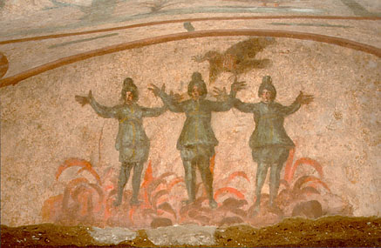
Catacomb Fresco of Martyrs in Fire
From St. Priscilla catacomb, outside Rome
C. 305

Slide 21
Issues Surrounding Canon of Christian Scripture
The OT (Septuagint): in or out?
Relation of creator God to Father of Jesus Christ
How can there be suffering if the creator God is a good God? (theodicy problem)
Is God anthropomorphic; as OT might indicate?
Relation to Judaism
What is in NT?
Paul primary or Gospels
What literature about Jesus is sacred
What writings of early believers is in/out (e.g., First Letter of Clement, Epistle of Barnabas, Shepherd of Hermes)
Answers to these questions determined which books considered authoritative by various Christian groups
In this era many Christian groups selected books to support their theology; Canon is from Greek word for rule or measure

Slide 22
Establishment of the Christian Canon
By early 4th Century, most orthodox Christians accepted canon of Scripture
Septuagint basis for OT
NT as we currently have it
But how to interpret what is there
Literal (historical, moral??)
Allegorical (philosophical??)
Both the canon and its interpretation will be revisited during the Reformation

Slide 23
The Latin Bible (Vulgate)
Pope Damasus (d. 384) asked Jerome to provide a unified Latin (Vulgate from vulgar) translation
For two centuries non-Greek speaking Christians had used the ‘Old Latin’ Bible
Pope Damasus also encouraged translation of liturgy to Latin for Western use
Jerome spent years and travelled widely to analyze the best texts
Studied in Origen’s library in Caesarea
Bethlehem ‘home base’ for Jerome
Controversy between Jerome and Augustine over correct text of Old Testament: LXX or Hebrew
Jerome used a combination
Reasons Augustine wanted LXX as basis for Old Testament
Maintain Church unity with the East
LXX used in New Testament

Slide 24
Assignments
CoG I.35, V.16, VIII.27, XXII.9-10
CoG X.25, XVIII.41-44, XX.28
Hitchcock, Ch. 2 and 4

