Slide 1
Lecture 4
Constantine the Great and Theodosius the Great
Dr. Ann T. Orlando
13 September 2018

Slide 2
Introduction
Review of Third Century
Importance of Constantine
Social and Ecclesial Changes Precipitated by Constantine
Theodosius

Slide 3
Review of Third Century
Increased pressure on Rome from Persia and northern barbarians
Political instability; murder and succession of generals as emperors
  Between Decius and Diocletian, average reign < one year
Empire-wide persecution of Christians under Decius
Many Martyrs; also many lapsed
Order and stability restored under Diocletian

Slide 4
Political Situation in early
Fourth Century: Diocletian
Diocletian becomes emperor in 284.
  Very strong ruler
Decides that best way to protect Empire is to divide it between two Augusti (East and West) supported by two appointed Caesars (Augusti in waiting)
  Modeled on Five Good Emperors of Second Century
Unleashes worst persecution of all; Great Persecution 303 - 311
Manages to retire and force his co-Augutus, Maximian, to retire with him (305)
  Leads to renewed tensions in Empire
  Briefly returns to power in 308 to try and restore order

Slide 5
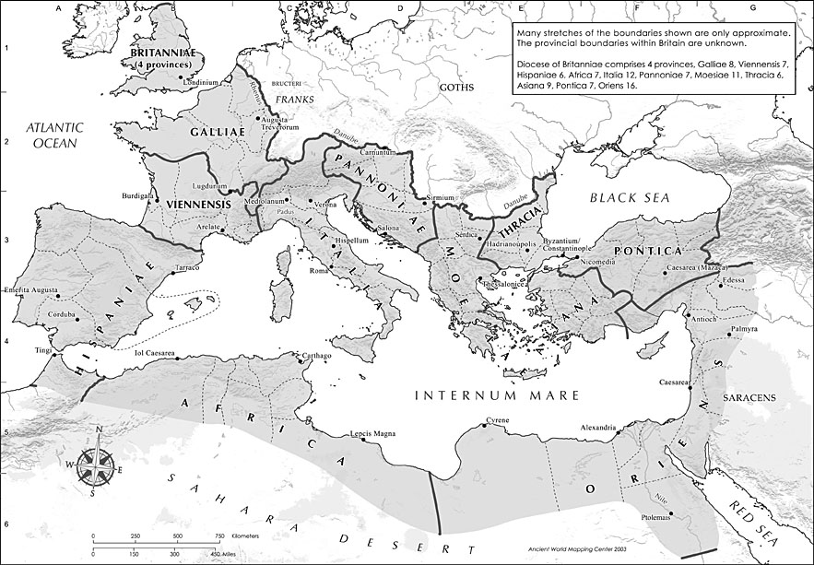
Map of Roman Empire: Diocletian’s Divisions http://www.unc.edu/awmc/awmcmap45.html

Slide 6
After Diocletian
A few problems with Diocletian’s plan:
  Both Augusti and both Caesars headed their own armies and areas of influence
  Except for Diocletian himself, the three other members of this tetrarchy saw this scheme as a way to take over the Empire when Diocletian died
When Diocletian retires, political intrigues and battles break about among the successors:
  Constantius, Augustus, controlled England and Gaul, father of Constantine
  Severus, Caesar, ruled Rome
  Maximius, Caesar in Greece
  Galerius, Augustus, in East
When Constantius dies, his troops proclaim his son, Constantine, Augustus (c. 310)

Slide 7
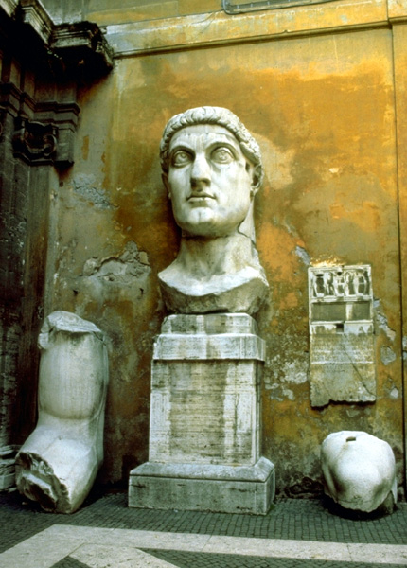
(St.?) Constantine the Great (c. 280-337)
Key battle in Constantine’s take-over of entire Empire was battle of Milvian bridge over Tiber in Rome against Maxentius, son of Maximian in 312.
  Constantine credits his victory to a vision he had in which he was told to go into battle with the Christian symbol
  Troops carry chi-rho on their shields
By 313 Constantine has captured all of the Empire and officially declared that Christianity was to be tolerated (Edict of Milan)
http://harpy.uccs.edu/roman/constant.jpg

Slide 8
Importance of Constantine
Victory of Constantine most important event in political-ecclesial history
Signaled beginning of the end of old Roman religious system
Signaled the beginning of the Church as a political force

Slide 9
Constantine and Church in Rome
Before he leaves Rome after Milvian Bridge victory, he ‘gives’ most of Rome to the Pope
  That is, he gives the land and buildings of his enemies to Pope
  Most important of these is the Lateran Palace (St. John Lateran)
  Eighth Century Donation of Constantine
Church overnight becomes the most important landholder in Rome
  Converts some pagan temples into Christian churches (for example, Pantheon)
  But most Christian Churches built in a basilica model
  Builds new Churches, especially at site of martyrdoms with money from Constantine (for example, Vatican)

Slide 10
Constantine the Great and the Church Beyond Rome
Builds Churches, with his mother Helen, in Holy Land (Church of Holy Sepulcher in Jerusalem, Church of Nativity in Bethlehem)
Moves against the Donatists in North Africa
Calls Council of Nicea to resolve the Arian controversy: The Nicene Creed
Establishes ‘New Rome’: Constantinople
Dies in 337 (after murdering his wife and eldest son); baptized by an Arian bishop shortly before he dies
  Considered a saint in the East
Initial reaction of Church is that the Christian kingdom has arrived

Slide 11
Major Social Changes in 4th C Due to Constantine and his Successors
Christian clergy given tax relief
Christian clergy could use the imperial post system (cursus publicus)
  Communicating Documents
  Transportation for clergy around empire if on Church business
Churches could receive legacies
Sunday as a day of rest
Christian could not charge another Christian interest on a loan (sin of usury)
Crucifixion prohibited
No branding of prisoners because mars image of God

Slide 12
Constantine and the Bishops
Constantine recognized the important social (and soon political) organization of bishops
Declares the office of bishop to be an ordo, a separate legal class
By decree bishops could act as judges in their diocese (Roman administrative province)
  Marriage
  Inheritance
  Contracts
Increasingly even pagans used ‘ecclesial’ courts
Bishop’s ruling considered pro sanctis, ‘as sacred’
  Very limited ability to appeal

Slide 13
Bishops Become Most Important Leaders in Society
Oversee construction of new public church buildings
  Usually on a basilica model
  Basilica was a large Roman public administrative building
  Few pagan temples were converted to churches
Building projects, largely funded by Roman government, gave bishops control over most local civic public works projects
  Bishops become important local economic sources of patronage (jobs)

Slide 14
Major Issues Within the Church
Who are heroes now that there are no longer martyrs?
How to deal with new members who may be joining Church because it is politically expedient?
What is relation between bishops and civil rulers?
  Evolves very differently in the East and West

Slide 15
Nicaea
Council of Nicaea called by Constantine in 325
  to resolve Arian controversy and
  bring unity to Church, and
  therefore unity to Empire
Virtually all Eastern bishops and some Western bishops attended
Bishop Alexander of Alexandria succeeded in routing the Arian bishops

Slide 16
Political Impact of Nicaea
Establishes precedent of the emperor engaging in ecclesial affairs
Constantine seen not only as a ‘bishop’ but as ‘another apostle’
  Constantine ‘presides’ over Council
  Constantine said to approve the Creed

Slide 17
Arianism after Nicaea
Continued to be a very potent heresy
Also, politically well connected: Constantine may have been baptized by an Arian bishop
His son, Constanstius, d. 360 took side of Arians;
  Sent Arian missionaries to Germany
  Alaric and the Goths who sacked Rome in 410 were Arian Christians
His cousin, Julian the Apostate, d. 363 tried to return the Empire to paganism
Of the claimants to Empire after Julian
  Valantinian I in West, pro-Nicene (although his mother was an Arian)
  Valens in East was a semi-Arian
Finally ‘settled’ with Theodosius the Great,
  Council of Constantinople, 381, promulgates Nicene-Constantinople Creed,
  What we now have
  Note structure of CCC

Slide 18
So Who Was Julian the Apostate?
Nephew of Constantine the Great
Constantine was succeeded by his sons Constans, Constantius and Constantine (Julian’s cousins)
Constantius consolidated power through intrigue and murder, including the murder of Julian’s father and older brothers
Julian as a boy sent to study in Athens
  may have known Sts. Basil Great and Gregory Nazianzus there;
  pretended to be a Christian
After his studies, he commanded Roman troops in Gaul
When he becomes emperor he tries to restore paganism
Dies in battle against Persians

Slide 19
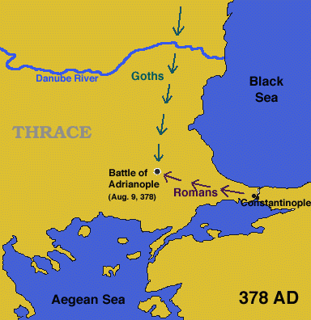
Classic Battle: Adrianople
Between Roman troops under Emperor Valens and Goths
  9 August 378
Roman army is completely destroyed
  Valens disappears in the carnage
  Most of the 40,000 Roman troops are lost
Often thought to signal ‘beginning of end’ of Roman Empire
  Last Western Emperor 479
  Last Eastern Roman Emperor 1453
Still studied today by military historians
Artifacts from battle are still being discovered
http://www.thenagain.info/WebChron/Mediterranean/Adrianople.html

Slide 20
(St.?) Theodosius the Great
While Constantine promoted Christianity, Theodosius also moved against Roman pagan institutions
Born in Spain in 347, succeeds emperor Valens, reigned 379-395
  Last Roman emperor of full (Western and Eastern) Empire
  His sons Arcadius and Honorius succeed him in the East and West, respectively
  Baptized in 380 an Orthodox (Nicene) Christian

Slide 21
Theodosius and the Pagans
First Roman emperor to reject title pontifex maximus , that is chief priest and defender of Roman religion
Declared Nicene Christianity the official religion of the Roman Empire in 380
Outlawed Manichaeism and pagan sacrifices 391

Slide 22
Pontifex Maximus
Pontifex: priest of high ranking college of priests in Rome
  Responsible for Roman calendar
  Responsible for family ‘civil’ law such as adoptions and inheritance
  Recording events (births, deaths)
Pontifex Maximus: Leader of the pontifex college of priests
  Elected office
  With Julius Caesar, also becomes a political office
After Constantine, the Bishop of Rome starts to use title of pontifex, circa end of 4th C

Slide 23
Theodosius and the Bishops
Called the Second Ecumenical Council, First Council of Constantinople
  Placed St. Gregory Nazianzus as presider
  Reinforced Nicaea
  Expanded decrees on Holy Spirit (proceeds from the Father)
Engaged in several controversies with St. Ambrose
When Theodosius dies in Milan, Ambrose gives the funeral oration

Slide 24
Election of Pope Damasus
(r. 366-384)
Civil and economic importance of Papacy in city of Rome dramatically increases after Constantine
Election of the pope becomes a civil and economic matter as well as religious
Riots break out with much blood shed between Damusus’ supporters and those of his rival, Ursinus
Damasus election affirmed by emperor (Gratian and Theodosius)

Slide 25
Importance of Pope Damasus
Tasks Jerome to translate Scripture to Latin
Undertakes the translation of liturgy to Latin
Asserted Papal primacy from Jesus (Matt 16:16) through Peter
  That is, importance of Bishop of Rome beyond Apostolic Succession
First organization of papal archives

Slide 26
Ambrose and Theodosius
Burning of Jewish synagogue in Callinicum in Mesopotamia
  Theodosius wanted Christian community to pay to rebuild synagogue
  Ambrose wrote scathing sermon saying not right for Christians to build synagogues
  Theodosius backed down
Theodosius massacred people of Thessalonica because they had rioted and killed Roman administrators
  Ambrose excommunicated Theodosius
  Theodosius publicly repented

Slide 27
Eastern Roman Emperors
Constantine (East and West)
  Council of Nicaea
Theodosius I, Great (379-395) (East and West)
  Council of Constantinople I
Arcadius (son of Theodosius) (395-408)
  Conflicts with John Chrysostom
Theodosius II (408-450)
  Son of Arcadius
  Council of Ephesus
St. Pulcharia and Marcion (450-457)
  Pulcharia daughter of Theodosius II
  Council of Chalcedon

Slide 28
The Ecumenical Councils
Nicaea I, 325, called by Constantine the Great
  Condemned Arianism
  Son of one substance with the Father
  Nicene Creed
Constantinople I, 381, Called by Theodosius the Great
  Affirmed divinity of Holy Spirit
  Modified Creed; what we have now
Ephesus, 431, called by Theodosius II
  Condemned Nestorius, Patriarch of Constantinople
  Jesus was not two separate persons, but one person both human and divine
  Mary as ‘Theotokos’ Mother of God
Chalcedon, 450, called by Empress Pulcharia at request of Pope St. Leo I (the Great)
  Condemned monophysites: single nature
  Christ has two natures: human and divine (Leo’s Tome
Second Council of Constantinople, 553, Called by Justinian
  Condemned Theodore of Mosuestia
Third Council of Constantinople, 680
  Called by Emperor Constantine Pogonatus
  Condemned Monothelete and Pope Honorius

Slide 29
Assignments
CoG V.24-26, XIX.4-8 (required)
Hitchcock, Ch.3
Tanner on early councils, pp 41-80. (optional)
Prepare paper and discussion (required) due next Tuesday

