Slide 1
Lecture 9: Rise of Islam
2 October 2018

Slide 2
Introduction
Review of historical situation in 7th C
Rise of Islam
Western Efforts to oppose Islam
Eastern Efforts to oppose Islam
Review Readings

Slide 3
Historical Situation in Early 7th C in West
City of Rome is a desolate ruin with poor sanitation and filled with very poor people; under direct authority of Pope
Pope St. Gregory the Great rebuilds sanitation and water supply
Feeds the hungry
Bishops are often the only real source of civic administration and civil justice
Monasteries centers of education
Irish and Roman missionaries have some success in converting pagan and Arian tribes
Visigoths rule Spain; Vandals rule North Africa; Lombards rule northern Italy; Byzantine control of Southern Italy and Sicily, Franks rule Western France; Anglo-Saxons in England; Alamani in Germany

Slide 4
Historical Situation in Early 7th C in East
Partially unified politically under control of Byzantine Emperor from Egypt to Danube
But monophysites in Egypt and Nestorians in Syria undermine religious (and therefore political) unity
Primary contact between East and West is through the Pope
Nearly all pontiffs spend time in Constantinople during their earlier ecclesial careers
Ecclesial authorities are subordinate to civil
Eastern Empire will see itself as the continuation of ancient Roman Empire until the fall of Constantinople in 1453

Slide 5
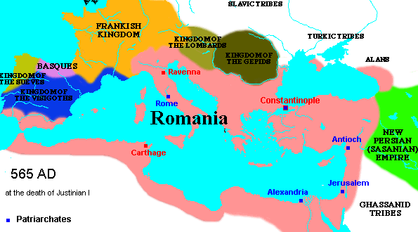
Mediterranean at death of Justinian

Slide 6
Persian-Byzantine War Early 7th C
Extensive warfare between Byzantium and Sassanid Empire 602-628
With support from Jews in Antioch and around Jerusalem, the Sassanid army conquered Jerusalem in 612
Constantinople nearly captured in 626
By 628, Byzantine forces had retaken most of lost territory, including Jerusalem
But…both Byzantium and Persia left in a weakened political and military situation

Slide 7
Early 7th C Arabia
Mix Christians, Jews, pagans
Ancient pagan pilgrimage site at Mecca
Wealthy kingdom of Saba (Sheba) in present day Yemen
Ruined by destruction of the Marib dam in 575 AD
First dam built c. 1700 BC
Tribes of Arabia hostile to each other

Slide 8
Muhammad 570 - 632
Muhammad (570-632)
Born and raised in Mecca
Wealthy trader and merchant
Had a series of visions that led to monotheism
Opposed by many in Mecca
The flight from Mecca to Medina (622) is beginning of Muslim calendar
Medina welcomes Muhammad
He encourages monotheism
Resolves disputes among Arab tribes
Founded a religious and political movement aimed at uniting all Arab tribes.

Slide 9
Key Points of Islamic Theology
Qur’an is revealed word of God (must be in Arabic, a translation is not really the Qur’an)
Islam means submission, specifically submission to will of Allah
God is one, no Trinity
Mohammed is greatest prophet, although prophets of Old Testament and Jesus are also important
Jews and Christians are considered people of The Book
Images are an affront to Allah
Idolatry is an affront to Allah

Slide 10
Key Points of Early Islamic Society
Political and military movement to unite Arab tribes in the Dar al-Islam (House of Islam)
Opposing Dar al-Islam, is House of War
Shari’a “Islamic Law”; based on Qur’an; rules for how the community of Muslims should live
Jews and Christians living in Dar al-Islam should be tolerated as long as
Pay special tax
Do not proselytize
Do not foment overthrow of Dar al-Islam
Pagans are not tolerated

Slide 11
Two Major Branches of Islam
After Muhammad dies, the leader of Dar al-Islam is termed the caliph
Sunni
Caliph should be by a virtuous Muslim who followed the sunna (practice) of Mohammed as recorded in the hadiths (traditions)
Authority was with ulama or imam, wise men but not infallible, who preached the Qur’an
Defense of Qur’an through rational argument
Shia
Caliph should be through the family of Mohammed, first through his son-in-law Ali then Ali’s son Hussein
Hussein ibn Ali (killed at Karbala in 680), his followers became known as Shia
Authority was found in infallible imams as interpreters of the Qur’an

Slide 12
Five Pillars of Islam (Sunni)
Faith (Shahada) Expressed through the fundamental statement of faith: “There is no god but Allah, and Muhammad is His prophet.”
Prayer (Salat) Praying 5 times a day in a prescribed manner
Charity (Zakat) All things belong to God, and wealth is therefore held by human beings in trust.
Fasting (Sawm) Fasting is especially observed during the holy month of Ramadan.
The Pilgrimage to Mecca (The Hajj)

Slide 13
Early Islamic Political Leadership
First four caliphs, Rashidun, rightly guided
Umayyads (Damascus, Cordoba)
Abbasids (Baghdad)
Fatimids (Cairo)
Like Hellenistic kingdoms after Alexander and then the Romans, Arab Muslims found territory too large to rule consistently by one power

Slide 14
Early Muslim Expansion in Two Movements
Under first four caliphs (632-656)
Conquest of Arab tribes in Egypt, Syria and Iraq, including Jerusalem and Alexandria
Common cultural background of conquered peoples
Early conflict with Byzantine Empire and Sassanid Persian Empire
Under Umayyads (692-750)
Expansion West and East against non-Arab lands
Destruction of Persian Empire
Threat to Constantinople
Conquest of Latin North Africa, Spain and incursions into France
In Ninth C. Muslim armies would conquer (briefly) Sicily, southern Italy, Crete

Slide 15
Early Islamic Culture
New Capital Cities
Damascus, old city but new capital
Baghdad
Cairo
Cordoba
Dome of Rock, first great Islamic building, on Temple Mount in Jerusalem, 692
Muslims believe this is the site of Muhammad’s night journey
Inscriptions are earliest written record from Qur'an
Entreats readers to recognize that God is One and not Three
Arabic becomes the common language
Replaces Greek in Southern Mediterranean,
Replaces Persian in Mesopotamia and Iran
Replaces Latin in North Africa and Spain as common language

Slide 16
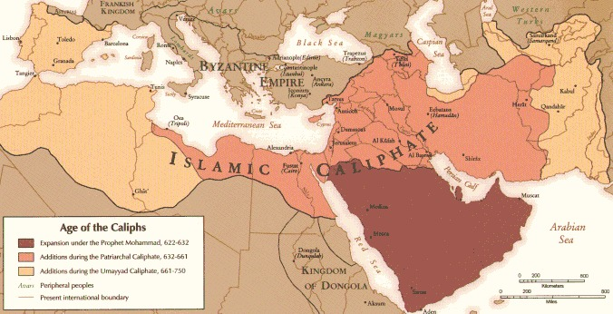
Rise of Islam 7th C

Slide 17
Reasons for Arab Military Success
Both Byzantine and Persian Kingdoms exhausted from fighting each other
Internal unrest in Persia resulting from loss to Byzantines in early 7th C
Constantinople has at best contentious control over Mesopotamian (Nestorian) and Egyptian (monophysite) Christians

Slide 18
Military Defense Against Muslim Armies
Western Cavalry
Development of stirrup, molded saddle and armor
Stirrup came to Western Europe via Hungary from India
Effective edge to Charles Martel and his grandson Charlemagne in battles against Muslims
Eastern Greek Fire
Naval weapon of exploding incendiary ‘bomb’
Effective Byzantine edge in early battles for Constantinople

Slide 19
Heretical Eastern Theological Responses to Islam
Monothelite Controversy (7th C)
Christ had one will (divine)
Iconoclasm (8th C)
Destruction of images
Both heresies developed and pushed by Byzantine Emperors to encourage political and military unity

Slide 20
Monothelete Controversy
Patriarch of Constantinople, Sergius proposes ‘monothelete’ Christology or that Christ had one will
To try to bring Monophysites back under imperial control against Arabs
Approved by Emperor Heraclius and his successor, Constans II
Pope Honorius (625-638) seems to go along with this
Chalcedonian Christology vigorously defended by
Maximus Confessor
Pope St. Martin I
Eventually Eastern Church returns to Chalcedonian formula in Third Council of Constantinople (680)

Slide 21
St. Maximus the Confessor (580 -662)
Argued forcefully against the monothelite Christology (and its variant, monoenergeria, or one action)
Through Christ assuming full human nature meant a full human will and action as well as a divine will and action
Strong support for Chalcedonian Christology
Attended First Lateran Council in 649 called by Pope Martin I to refute monotheolitism
Was persecuted and tortured by Emperor Heraclius
Died in exile in 662

Slide 22
Pope St. Martin I (r. 649 – 655)
Born in a wealthy Roman family
Joined the Order of St. Basil
As pope, called the First Lateran Council to refute monothelite Christology
Pope Martin was captured by troops of Emperor Constans II and brought to Constantinople as a heretic
Branded
Tortured
Died in exile from his wounds
Feast Day 12 November, remembered as a martyr

Slide 23
Iconoclast Controversy
Byzantine Emperors Leo III (717-741), Constantine V (741-763)
Supported “image breaking” iconoclasm as a way to attract Muslims to Christian orthodoxy
Historical Note: Emperor Leo III dropped all military support of Papacy against Lombards, forcing Pope Stephen II into an alliance with Pepin the Short (Charlemagne’s father)
Monks vehemently opposed iconoclasts
St. John Damascene (675-749)
Monk at St. Sabas near Jerusalem
Strong theological defense of icons
Differentiated types of worship and honor
Eventually Eastern Church officially embraces honor of icons at Seventh Ecumenical Council, Second Nicene Council (787)

Slide 24
Assignments
Maximus the Confessor, from Letter II, available at http://www.vatican.va/spirit/documents/spirit_20010328_massimo-confessore_en.html
John of Damascus, In Defense of Icons, available at http://www.fordham.edu/halsall/source/johndam-icons.html

