Slide 1
Class 10: The Jesuits
Dr. Ann T. Orlando
6 February 2019

Slide 2
Introduction
Ignatius Loyola
Founding of Jesuits
Relation to Papacy
Education
Arts

Slide 3
Ignatius Loyola (1491-1556); Founder of a New Order
Minor courtier and officer in army; 1521 severely wounded defending Pamplona from French
During recovery in Loyola started reading New Testament and Lives of Saints (nothing else to read!)
Once recovered, traveled to Montserrat where he left his sword and gave away his clothes to poor
Lived in a cave near Manresa; had a series of enlightening visions
Briefly went to Holy Land
Decided to return to school, study for priesthood; first at Alcala then at Salamanca
Imprisoned by Inquisition several times for teaching without being licensed
Traveled to University of Paris to continue studies
Shared rooms with Francis Xavier, Peter Faber
Gathered a group of six, Company of Jesus, and Ignatius directed them in Spiritual Exercises
Traveled to Rome and put themselves at disposal of Pope; approval of order given by Pope Paul III in 1540
Lived in Rome remainder of his life as Director General of Jesuits, by now a world-wide order
Canonized with Francis Xavier by Pope Gregory XV in 1622

Slide 4
Jesuit Spirituality
Like Luther, Ignatius was overwhelmed by the profound sense of his own sin
Like Luther, does not believe that being a monk is a guarantee of salvation
But unlike Luther, believes that salvation is found by devotion to society of Church and her mission
Devotion includes attacking corruption
Society includes those below and saints above
Emphasis on engaging mind and emotions
Emphasis on critical self-analysis
Call to action and commitment

Slide 5
The Jesuits
NOT founded to counter Reformation; but charter put Jesuits on front lines against Reformers
Initially sent to Palestine as missionaries
Education very important in Jesuit mission
Children and adults
Jesuits very focused on work among people
Jesuit life-style in many ways opposite that of a monastery
Focus on action in world, rather than contemplation in monastery

Slide 6
Key Points of Jesuit Charter (1541)
Vow not to accept ecclesiastical dignities;
Special relationship to Pope
Increased probations.
The novitiate is prolonged from one year to two,
A third year, which usually falls after priestly ordination.
Candidates at first admitted to simple vows only, solemn vows coming much later on;
The Society does not keep choir;
It does not have a distinctive religious habit;
It is also said to have been the first order to undertake officially and by virtue of its constitution active works such as the following:
foreign missions, at the pope's bidding;
the education of youth of all classes;
the instruction of the ignorant and the poor;

Slide 7
Jesuits and Papacy
Jesuits become the Pope’s ‘Marines’
Missionaries on voyages of discovery
Intellectual leaders in Vatican
Supported new learning, new artistic techniques, in service of renewed Catholic spirituality
Spearheaded a new Catholic confidence
Saints
Religious Art
Penance
Indulgences (properly understood)

Slide 8
Jesuit Education
First school (college) opened in Messina, Sicily in 1548
In Europe by 1560, Jesuits were running 30 primary schools and had established the Roman College (Gregorian)
Jesuit educational mission
Education, in broadest sense, becomes primary mission
Established new educational institutions at all levels
Purpose of these institutions was to train men for a career in the world
Academic research was a hallmark of Jesuit education (e.g. St. Peter Clavier)
Major Jesuit colleges have printing press and extensive library
World-wide

Slide 9
The Parisian System of Education
System being developed in Paris, which Ignatius and other members of the Company experience
But Jesuits make it their own and so completely propagate it around the word that ‘the Paris system’ formed the basis for modern education
Elements of the Parisian system
Students divided into classes
Progress based on a graduated system
Active learning: writing and speaking
Standardized program of instruction
See letter 24 describing colleges to be established in Germany

Slide 10
Jesuits and the Arts
‘Hands’ approach to education extended to crafts and arts
Jesuits become intellectual sponsors of Baroque artistic movement
Expressed in society
Encouraged a heightening of religious feeling and sentiment
Jesuit colleges important in performance arts, especially theater
Opportunity for young students to learn poise, diction and how to ‘act’ in society

Slide 11
Baroque Art
In some ways fueled by Jesuit spirituality
Emphasis on emotions and physical
Church of Gesu, first Baroque Church
Also fueled by reaction against Protestant views
Importance of Saints
Importance of images for devotion

Slide 12
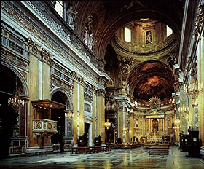
Church of the Gesu
Located on site that Ignatius of Loyola selected for his Roman headquarters
Dedicated in 1584 after 40 years of construction and 6 architects including Michelangelo
Mother Church for Jesuits
Model for Jesuit churches throughout the world

Slide 13
Baroque
Massive urban renewal of Rome
Spectacular building projects, most of them religious
Primary artists
Francesco Borromini (1599-1667)
Gianlornezo Bernini (1598-1680)

Slide 14
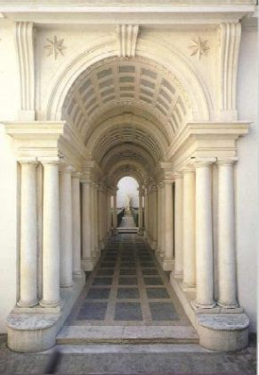
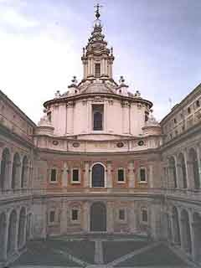
Borromini’s Rome

Slide 15
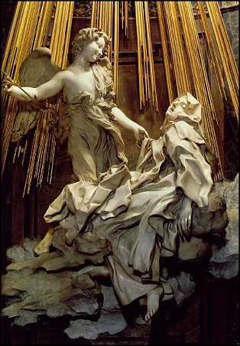
Bernini’s Rome
Fountains
Sculptures
Churches

Slide 16
The Ultimate Statement of Baroque: St. Peter’s
Note the list of great artists who worked on new St. Peter’s:
Alberti
Bramanate
Della Porta
Michelangelo
But the final driving force to bring the entire monumental work to completion: Bernini

Slide 17
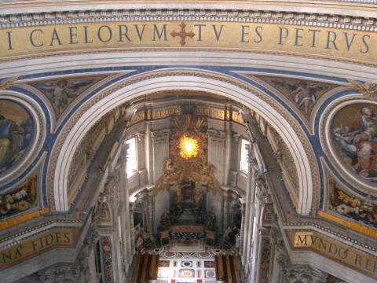
From Cupola Looking to Chair of St. Peter

Slide 18
Assignments
1. Ignatius Loyola Spiritual Exercises, Rules to Have True Sentiment in the Church available at http://www.fordham.edu/halsall/source/loyola-spirex.html

