Slide 1
Class 12: Voyages of Exploration
Dr. Ann T. Orlando
13 February 2019

Slide 2
Introduction
We still can’t get out of 16th C
Portuguese and Spanish Voyages of Discovery
Economic and Scientific Impact
The ‘Black Legend’

Slide 3
European (Iberian) Voyages of Discovery
“The discovery of America, and that of a passage to the East Indies by the Cape of Good Hope, are the two greatest and most important events recorded in the history of mankind.” Adam Smith, Wealth of Nations, 1776
Driven by economics,
Reduce time and cost of overland spice trade with Orient
Reduce interactions with Ottoman Turks
In 16th C Spain and Portugal leading European naval ‘super powers’
Most other Western European countries preoccupied with wars and Reformation
Renewed strength after expulsion of Muslims from Portugal and Spain
Spanish dominance starts to wane with defeat of Spanish Armada, 1588
Real economic driver was how to sail all the way to China from Europe

Slide 4
History of Spice Trade
Recall that spice and silk road from Mediterranean to China had been important economic route since Roman Empire
Traditional terminus at Antioch
Pax Mongolia and Marco Polo
Early reason for voyages: by-pass Turkish control of trade routes to China; spice road completely dominated by Ottomans
And their European allies, Venice and Genoa

Slide 5
Portuguese Voyages of Discovery
Prince Henry the Navigator (1394 - 1460)
Encouraged exploration of West Africa
Significantly improved navigation instruments
Established school of maritime studies
Vasco de Gama rounds Cape of Good Hope 1487
Portuguese explore much of southern Africa, especially Congo and Angola
Early 16th C Portuguese voyages to India, Japan China
Magellan’s expedition circumnavigates globe 1519 - 1522

Slide 6
Christopher Columbus (1465 – 1506)
No educated person since antiquity thought the earth was flat (see ST Ia Q1 a1)
Further, people from antiquity knew precisely the circumference of the earth
Problem: 16th C ships did not have the technology to make the voyage
Columbus erroneously thinks he gets the advantage of prevailing winds and currents
“To this land I gave the name San Salvador, in honor of our Blessed Lord." Christopher Columbus, 12 October 1492
Makes four voyages, erroneously thinking he was in India
Thought he was in India because he knew latitude, but had no way to know longitude
Brings missionaries on second voyage to convert the ‘Indians’

Slide 7
The Black Legend
Why are most people taught that ‘everyone’ thought the world was flat until Columbus’?
Because English-speaking propagandists (American and British) engaged in a systematic campaign to vilify Spain and the Catholic Church
Washington Irving’s story of Columbus
British global dominance replaces Spain in 18th C
American wars against Spain and Mexico in 19th C
Other components of the Black Legend propaganda
The Spanish inquisition was the most barbarous political/religious evil in history
Spanish horribly mistreated Indians and black slaves
Spaniards are stupid and lazy; it took an Italian to actually make the voyage
NB this propaganda continues to support an English-speaking agenda, and many aspects of ‘the Black Legend’ continue to be taught in schools and repeated

Slide 8
Spanish Voyages of Discovery
Cortez conquers Mexico, 1519-1521
Pizarro conquers Peru, 1532
By 1600 Spanish had
Thriving large communities throughout Mexico, Central and South America
Mexican Royal and Pontifical University founded in 1551
Established footholds in much of North America (California, Arizona, New Mexico, Texas, Florida)
Santa Fe NM established 1598
By comparison,
Jamestown founded 1607
Quebec founded 1608
Plymouth founded 1620
Montreal founded 1642

Slide 9
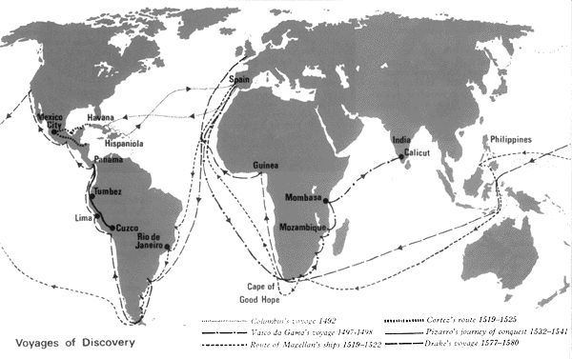
Map of Voyages 1340-1600 www.jcg.jersey.sch.uk/subjects/history/discovery.html

Slide 10
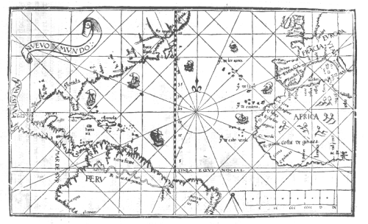
Role of Church: Pope Alexander VI
Pope Alexander VI (Borgia)
Divides ‘world’ between Spain and Portugal down Atlantic in 1493
Known as Line of Demarcation

Slide 11
Voyage of Ferdinand Magellan 1519-1522
Magellan, although Portuguese, surmised that the Line of Demarcation if completed around the world meant that most of the Spice Islands would belong to Spain
Charles V eager to claim these lands for Spain
Entered into Spanish service to claim lands in the East (i.e. Spice Islands and Philippines) for Spain
Magellan killed in Philippines during the voyage
Comparable to Apollo program in 1960s
Tremendous national pride in being the first to circumnavigate the globe
Something that only the wealthiest country could reasonable undertake

Slide 12
Economics of World Trade
With discovery of new lands, original motivation of spice trade with China and India start to take second place
Replaced by silver trade with China
Western Hemisphere filled with untapped natural resources and very sparsely populated
Unlike Asia or Africa
Spanish (and Portuguese in Brazil) start to colonize Western Hemisphere in order to develop economic resources, not as trading posts
Resources from Western Hemisphere make Spain the wealthiest country

Slide 13
Two Most Important Cash Crops
Sugarcane
Native to Southeast Asia
Imported and cultivated by Muslims in 7th C to Middle East
Quickly transplanted to Caribbean and Brazil in 16th C, especially by Jesuits
Cotton
Various types of cotton are present world-wide
India seems to be the first place to process cotton for thread
Both Sugarcane and Cotton require extensive unskilled manual labor

Slide 14
African Slave Trade
When Portuguese establish trading colonies in Africa, discover that African slavery is, and has been for centuries, a business
Arab slavery of sub Sahara Africans since 7th C
Tribal ‘slavery’ among African groups
Portuguese develop sugar plantations off coast of Africa
Very labor intensive
Use African slaves to work the plantation
System quickly exported to Brazil (16th C)
Spanish buy slaves from Portuguese
Large sugar and banana plantations in Cuba, Hispaniola
Mines in Mexico and Peru
Slavery attractive because Latin America sparsely populated, and many natives die very quickly from European diseases

Slide 15
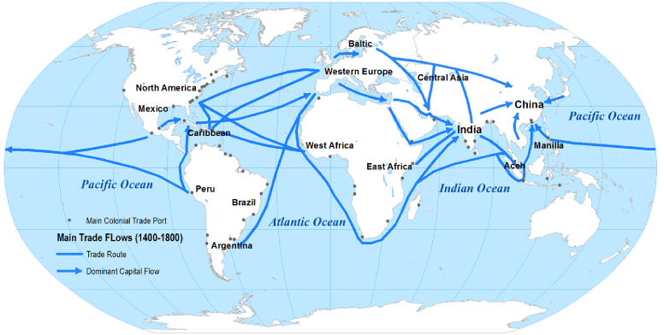
World Trade Routes http://people.hofstra.edu/geotrans/eng/ch5en/conc5en/tradeflows14001800.html

Slide 16
Impact on Science and Technology
Better navigation and mapping technologies needed to be developed
Know Latitude by Stars; advances in astronomy
Know Longitude by what time it is; but how do you accurately know what time it is
Thus being near coastline; surveying and maps very important
Astronomy becomes very important practical science
Mathematicians devote themselves to more precise models of celestial movements
Copernicus

Slide 17
Copernicus (1473-1543)
Born in Poland, studied mathematics
Attended University of Bologna where he became interested in astronomy
Astronomy was vitally important because it was key technology for navigation
By trying to make epicycles more precise, Copernicus came to believe that a simpler mathematical model put the sun at center of solar system

Slide 18
Copernicus’ Little Commentary 1514
There is no one centre in the universe.
The Earth's centre is not the centre of the universe.
The distance from the Earth to the sun is imperceptible compared with the distance to the stars.
The rotation of the Earth accounts for the apparent daily rotation of the stars.
The apparent annual cycle of movements of the sun is caused by the Earth revolving round it.
The apparent retrograde motion of the planets is caused by the motion of the Earth from which one observes.

Slide 19
Another Impact on Science by Voyages of Discovery: New Plants, Animals, Geology
Sciences of zoology, botany and geology must rethink and expand its classification systems
Voyages are launched with the purpose of scientific exploration; mapping and collecting specimens for study in Europe
Partly to see if some benefit from new species (medicine)
Partly from national pride
Partly for joy of discovery
Note: most famous such voyage was Voyage of Beagle, 1831

