Slide 1
Class 13: Missionary Activities, Western Hemisphere
Dr. Ann T. Orlando
13 February 2019

Slide 2
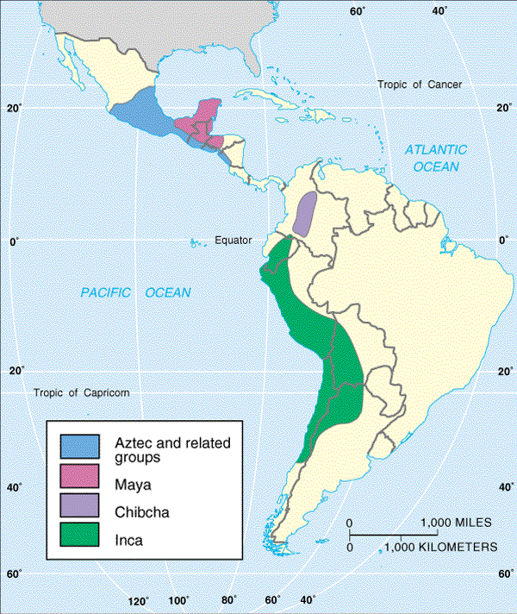
Pre-Colombian Latin America

Slide 3
Expansion of European Culture 16th C
Really expansion of Spain and Portugal
Role of Papacy
Spanish Missions (Western Hemisphere, Philippines)
Portuguese Missions (East: Brazil, Africa, Asia)

Slide 4
Role of Papacy
Recall Pope Alexander VI and Line of Demarcation, but he also
Granted Kings of Spain and Portugal extensive rights in Church affairs in newly discovered lands
Encouraged them to include missionaries in earliest voyages
Pope Paul III in 1537 affirmed the right of Indians to liberty and property and condemned slavery in general
Pope Gregory XIV encouraged ordination of native sons in 1576; even if illegitimate
Pope Gregory XV established Congregation of Faith in 1622 to encourage missions, especially process of enculturation as Spanish and Portuguese power waned

Slide 5
Beginning of Missions in Latin America
Spanish (and Portuguese in Brazil) subdue Indian cities; establish strong military presence
Western Hemisphere not densely populated
Major civilizations in decline before Spanish arrived
Spanish had superior technology (navigation, weapons, horses)
Official policy of Spanish crown (under pressure from Rome) put conversion as top priority
Letter from Crown to Cortez in 1523 encouraged conversion by kindness rather than force
During early Spanish exploration, Carmelites, Dominicans and Franciscans follow Spanish
Missionaries were products of the reforms of Ximenez
Dedicated to evangelization and dignity of potential new converts

Slide 6
Development of Missions in Western Hemisphere
As ‘easy money’ quickly removed from Latin America, conquistadors start to oppress Indians
Required cheap labor for farms and mines
Developed the encomienda system that forced Indian households to render service to individuals
One step away from slavery
In 1511 Dominican Antonio Montesinos protested against this practice
Result was that the Spanish government issued a law in 1512 that described Indians as free men, not slaves
To further protect the Indians, missionaries started to settle Indians around churches

Slide 7
Jesuit Reductions
Missions with extensive local autonomy from local Spanish or Portuguese officials
Many Indians sought out reductions so as not to forced into encomiendas
Developed throughout South and North America
Most extensive Brazil, Paraguay and Argentina, known as the Paraguay reduction
Really a separate kingdom
Indians given political and economic control, with Jesuit protection
In early 17th C, destroyed by Portuguese and Spanish colonial forces

Slide 8
Important Church Leaders in Latin America
Bartolome de las Casa (1474–1566)
Dominican
Fought for just treatment of Indians in Caribbean and Mexico
St. Peter Claver (1580–1654) Jesuit in Columbia; ministry to slaves from Africa
St. Rose of Lima (1586-1617) and St. Martin de Porres (1579-1639) in Peru
St. Junipero Serra (1713-1784) Franciscan, established California missions

Slide 9
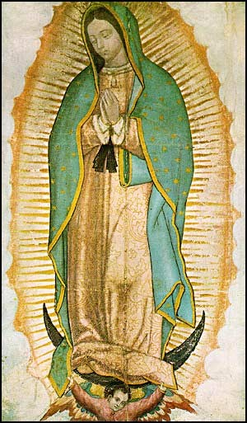
Apparition of Mary to St. Juan Diego at Guadalupe Mexico, 1531
St. Juan Diego was an Indian, new convert
In a series of apparitions, Virgin Mother asks for a shrine
1946, Our Lady of Guadeloupe declared Patroness of Americas by Pope Pius XII
2002, Juan Diego canonized by Pope John Paul II

Slide 10
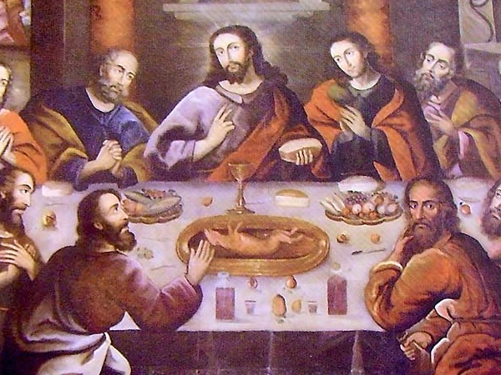
Development of Uniquely Latin Style of Catholicism
Early missionaries recognized the importance of elaborate ceremonies to Aztecs
Developed liturgy with very colorful ceremonies
Incorporated Indian artistic styles into Church decorations
Example: Cusco Cathedral in Peru, painting of Last Supper
By 1600 estimated to be 7,000,000 Indians who were calling themselves Catholic Christian

Slide 11
Africans in Latin America
Predominantly ‘imported’ by Portuguese to work in Brazilian farms and mines
Portuguese traders in Africa served as merchants to slave trade
Spanish bought African slaves from Portuguese
NB Pope Paul III issued Sublimis Deus, 1537 condemning slavery

Slide 12
Spanish Laws Governing Slavery
Owner cannot abuse slaves
Family members cannot be sold separately
Slaves to be given one-day a week off
Allowed slaves to work for themselves
Thus slaves had some limited ability to earn money toward buying their freedom
NB None of these rules applied in English dominated North America

Slide 13
Latin American Social Developments: Castas
Society divides along class lines based on race
Peninsulares are the men born in Spain and were the highest class and held the most powerful ecclesial and political positions
Creoles are Spaniards born in Latin America and often were army officers and mid-level ecclesial officials
Mestizos are mixed Spanish and Indian ancestry
Mulattos are people of mixed Spanish and African ancestry
Indians
Africans
Church hierarchy comes from Peninsulares and Creoles
In other words, Church hierarchy in colonial Spanish America implicitly supports these racial divisions and class structures

Slide 14
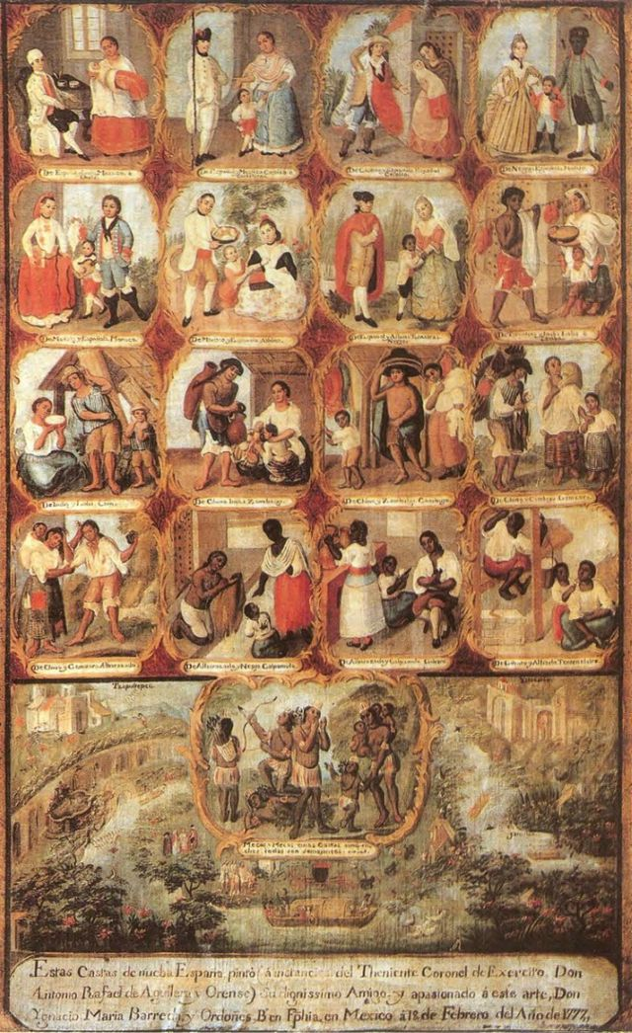
18th C Painting of Casta or Cast System in Latin America

Slide 15
Later Latin American History
Wars of Independence from Spain across Latin America in early 19th C
Example of American and French Revolutions
Napoleon’s conquest of Spain
Church hierarchy often allied with dominant political and economic powers
Liberation Theology in 20th C is reaction

Slide 16
Example: Haiti
First colonized by Columbus, given the name Hispaniola (The Spanish Island)
Later, taken over by French
Between 1791-1804 a series of revolts among various groups
Mulatto (many of whom owned slaves) against Europeans
Africans against mulattos
Success of African slave army led to withdrawal of wealthy castas from Haiti
Haitian economy has yet to recover
Clergy’s role in revolution split along hierarchical lines
Bishop supported Europeans
Missionaries and lower clergy tended to support revolutionaries
As an example, Capuchin, Fr, Philemon, worked with insurgents, was captured and hung

Slide 17
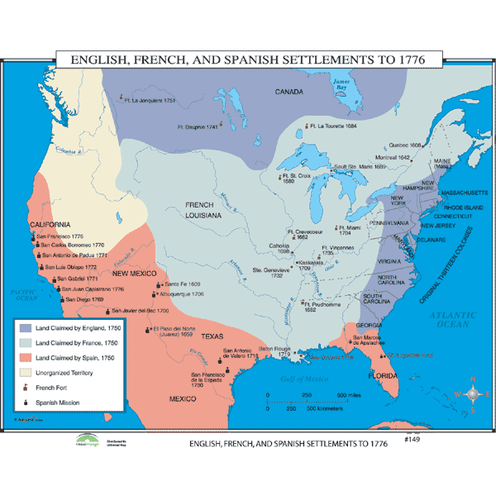
Catholic (French) Missions to North America
French establish trading colony in Nova Scotia (Acadia)
Jesuit missionaries arrive in 1620s to preach to Indians
Jesuit missionaries accompany French explorers down St. Lawrence and the Mississippi

Slide 18
Assignments
Hitchcock, Chapter 12
Juan Gines de Sepulveda and Bartolome de las Casas. On the Indians. in The European Sourcebook. ed Carter Lindberg. Malden: Blackwell, 2000. 279-281.

