Slide 1
Class 14: Missionary Activities, The Orient
Dr. Ann T. Orlando
15 February 2019

Slide 2
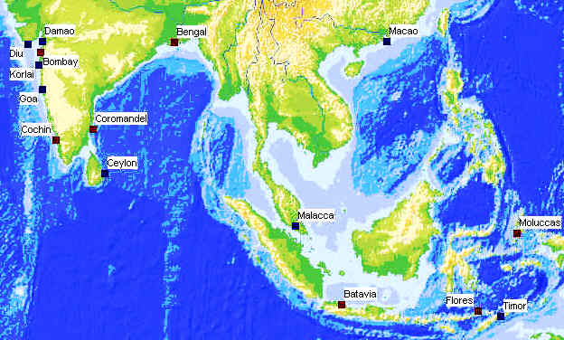
Church Missions: Orient
Dominicans, Franciscans, Jesuits followed the Portuguese
Strong oriental governments meant Europeans established trading centers
Missionaries confronted with ancient and strong religions
India
China
Japan
Question for Church: how much native culture and religious view point to incorporate into Christianity

Slide 3
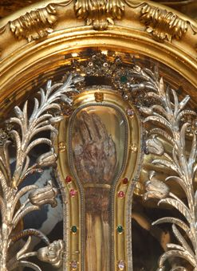
St. Francis Xavier (1506-1552)
Born in Spain
Met Ignatius Loyola at University of Paris; Francis Xavier was one of original members of Company of Jesus
At request of King of Portugal, Francis Xavier was appointed as missionary to Eastern peoples by Pope in 1541
Preached and established missions in India, Philippines and Japan. Died waiting to enter China
Remains returned to Goa, while arm sent to Rome, Church of Gesu
Feast day Dec. 3

Slide 4
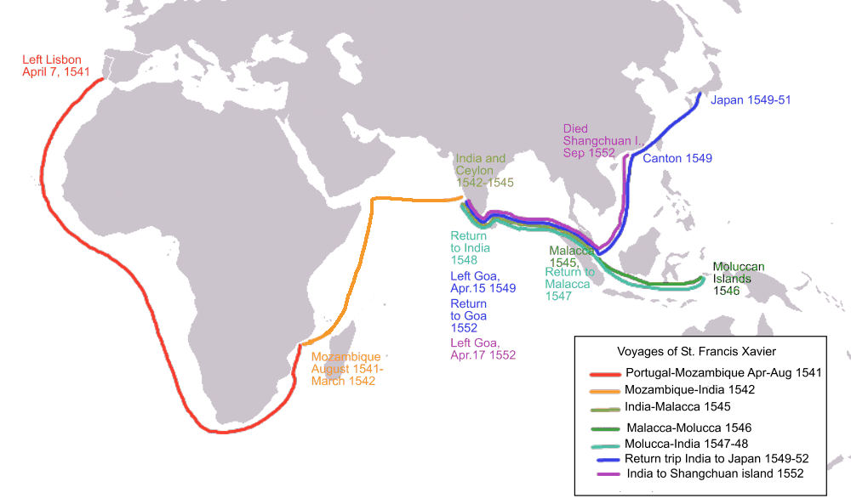
Missionary Travels of St. Francis Xavier

Slide 5
Christianity in India
Recall that there was an ancient Christian community in India, especially along the western coast and in Ceylon
Early Christians called themselves the Church of St. Thomas
Associated with Nestorian missionaries in 5th C
Liturgy in ancient Syrian
Church had over the centuries maintained contact with the Nestorian Churches in Mesopotamia
Many were incorporated into Portuguese Catholic communities
Rome recently (2001) accepted the ancient Syrian Eucharistic Prayer, which does not include words of institution

Slide 6
India 16th C
In 16th C India dominated by Muslim Moguls in North
Missionaries part of trading centers
Because of the strong caste system, most converts were from lower castes
Francis Xavier first went to India on his way to Japan

Slide 7
Robert de Nobili
Italian Jesuit, arrived in India 1605; key figure in Indian Christianity
Lived in Madurai as an Indian holy man
Dressed in ochre robes, ate no meat
Learned Tamil and Sanskrit
Refused to engage anyone but Brahmans
Nobili forced the question about enculturation

Slide 8
Early Missionaries to Vietnam
Some Portuguese missionaries at end of 16th C
Most important missionaries were French Jesuits in early 17th C
Alexandre de Rhodes (1591-1660)
Born in France, became a Jesuit missionary
Arrived in Vietnam in 1620 and remained until exiled in 1648
Returned to Rome, then was sent to Persia where he died
Contributions in Vietnam
Many thousands of converts
Wrote the first Vietnamese Catechism
Developed the first Portuguese-Vietnamese-Latin Dictionary
This dictionary is basis of written Vietnamese language with Latin characters

Slide 9
Early Missions in Japan
16th C Japan ruled by ~200 war lords (daimyos)
Francis Xavier one of the first missionaries in Japan
Succeeded by preaching to and being able to convert some of the daimyos
Appealed to cult of honor
Francis Xavier died in 1552 waiting for permission to go to China
Alessandri Valignano arrived in Japan 1579,
Developed policy that all customs not directly opposed to Christianity were to be accepted
Jesuits had status of Zen priests
Observe Japanese etiquette
By 1600 approximately 300,000 converts in Japan, mostly around Nagasaki

Slide 10
Swift Violent End to Japanese Missions
Christianity in Japan flourished due to
Political instability in Japan
Support of Portuguese trading centers in Japan
Both circumstances changed in 1600
Tokugawa Kyasu unified Japan and destroyed power of individual daimyos
English and Dutch arrived to challenge Portuguese
Christianity was viewed by Tokugawa as a threat to his regime
Edicts in 1614 outlawing Christianity
Brutal methods of execution; virtually eliminated Christianity in Japan
Closing of Japan to foreigners (missionaries and traders)

Slide 11
China
Ming Dynasty (1388-1662)
Confucianism
Scholar administrators, civil service exams
Establish Beijing as capital
Jesuit Matteo Ricci invited to Beijing in 1600
Wore robes of a Confucian scholar
Approved of ancestor worship on grounds that it was like honoring the saints
Lived at Imperial court 10 years
Impact of Ricci
Few converts (perhaps 2,000)
Chinese impressed with his scientific knowledge
Chinese held Ricci and Jesuits in high regard as educators

Slide 12
Chinese Rites Controversy
Begins in 17th C with Jesuits (Ricci) eager to include many Confucian rites
Jesuits claim these are primarily secular and can be made compatible with Christianity and included (enculturation) in Chinese Christian practice
Ancestor veneration (worship?)
Seasonal Confucian rites (paganism?)
Dominicans and Franciscans opposed this
In 1715 Pope Clement XI condemned the use of Chinese rites
Epilog: In 1939 Pope Pius XII reconsidered and relaxed many of the earlier prohibitions

Slide 13
Philippines
Because of Line of Demarcation, Spain and Portugal considered Philippines part of Spanish trading and colonial interests
One of the major reasons for Magellan’s voyage was for Spain to find a way to reach Philippines via South America, rather than having to go via Portuguese areas to the West
Main trading center between China and Spain (Latin America)
In 1561 Spanish expedition from South America firmly established Spanish rule
More like Latin America; Philippine natives not very advanced
Real colony, not just trading post in Philippines
Remains most Catholic country in Asia

Slide 14
St. Lorenzo Ruiz (1600 -1636)
Born of Chinese father and Philippine mother
Father employed by Spanish silver trading industry
Devout family, recent converts
Lorenzo joined the Dominicans as a lay brother and travelled with Dominican missionaries to Japan
Arrested and tortured for being Christians
Canonized by John Paul II in 1987
First Filipino saint and martyr

Slide 15
Africa
In this period, little missionary work in Africa
Muslims domination of north Africa and much of sub-Saharan Africa
Portuguese traders involved in slave trade with Dutch and English
Trafficking slaves from Africa to South America
Did not welcome missionaries ministering to slaves

Slide 16
End of First Wave of European Missionary Activity
Rise of English and Dutch trading and colonization
Waning of Spanish and Portuguese naval power
Armada

Slide 17
Assignments
Francis Xavier Letter from India. Available at http://www.fordham.edu/halsall/mod/1543xavier1.html
Chinese Rites Documents, excerpts at http://www.fordham.edu/halsall/mod/1715chineserites.html

