Slide 1
Class 2: 15th C Review
Dr. Ann T. Orlando
16 January 2019

Slide 2
Outline
Political Situation
Papacy
Intellectual developments

Slide 3
Political Situation: France
Philip IV (Fair) 1285-1314
  Enemy of Boniface VIII, Jews, Templars
  Strengthen French throne
Philip IV son, Charles IV, succeeds to throne
Continuation of Capetian line disputed after Charles IV dies (1328) without heir,
Most direct successor in Capetian line in King Edward III of England
French Barons instead look to Philip VI and beginning of Valois line
Caused 100 Year’s War

Slide 4
100 Years War
Hundred’s Year War Between England and France 1339-1453 over rights of succession to French Throne
  Strong overtones of French nationalism
St. Joan of Arc, 1412-1431
  Rallied French behind Charles VII (Valois line); crowned in Rheims
  Captured and burned as a heretic by English Inquisition
French kings ultimately prevailed, final battle at Castillon in 1453
Finally broke the link between English (Norman) and French thrones

Slide 5
Political Situation: England
Edward I 1272-1307
  Annexed Wales and Scotland
Edward III 1327-1377
  Sees himself as proper successor to French throne
  Starts 100 Years War with France
Henry V, Battle of Agincourt 1415
War of Roses (civil war) 1455-1485
  Henry VII and House of Tudor finally successful

Slide 6
Political Situation:
Holy Roman Empire
14th C period of weakened HRE (German monarchy), elected by duchies (Bohemia, Saxony, Luxemburg, Bavaria, Moravia, Austria)
  Three families vie for power: Bohemia, Luxemburg, Hapsburg
  Sigismund last of Luxemburg’s to rule all of Germany; called Council of Constance
  Eventually Hapsburg rule dominates
Maximilian I (Hapsburg) 1493-1519
  Son marries Spanish heiress (Joanna the Mad, daughter of Ferdinand and Isabella)
  Their son in Charles V

Slide 7
Political Situation: Spain
Throughout 14th C and 15th C Christian kingdoms of northern Spain fight against Muslims
Queen Isabel of Castile and King Ferdinand of Aragon succeed in expelling Muslims from Spain in 1492
  Charles V (their grandson) becomes king of Spain in 1516

Slide 8
Political Situation: Eastern Mediterranean
Mongol expansion in 13th and 14th C in Asia pushes Ottomon Turks Westward
  Ottomon Turks succeed Seljuk Turks for control of Persia and Syria
Mehmed II captures Constantinople 1453
  Other than a few priests, West sent no aid to Constantinople after Council of Florence
  Day before final battle, Eastern Church repudiates Council of Florence
  Hagia Sophia becomes a mosque when Mehmed II enters and prays toward Mecca
Suleyman Magnificent becomes sultan 1520
Ottoman expansion is checked by Austrians at Battle of Vienna 1533 and by Spanish at Battle of Lepanto 1571

Slide 9
Political Situation:
Italian City-States
In 13th C most important cities were Venice and Genoa
  Navy
  Trade
In 14th and 15th C other powerful city-states rise: Florence
  Banking to replace infrastructure of international banking and credit run by the Church
  Deep animosity between the papacy and some Florentines (especially the Medici family)
NB ‘Italy’ is a geographic entity, but not a unified political entity until late 19th C

Slide 10
The Medici Family
Powerful Florentine family
  Power based on banking
  Subterfuge to evade usury laws
  Adroitly developed ‘banks’ managed by family members throughout much of Europe
  Usually managed to back the ‘winning’ side in Papal-Imperial-French-Italian city state rivalries
Cosimo the Elder (1389-1464)
  Established Medici family as economic and political powers in Florence
  Humanist, patron of arts
Lorenzo the Magnificent (1449 – 1492)
  Grandson of Cosimo the Elder
  Brother Giuliano assassinated on Easter in 1478 in Pazzi Chapel; Archbishop of Pisa (present at the time) complicit in the assignation (executed in his Easter vestments)
  Lorenzo went to war with Pope Sextus IV; ends with an uneasy peace between Medici and papacy
  Lorenzo’s son Giovanni became Pope Leo X (r. 1513-1521)
  Lorenzo educated Giuliano’s son, who later became Pope Clement VII (r. 1523-1534)
  …and his granddaughter, Catherine (1519-1589) becomes Queen of France

Slide 11
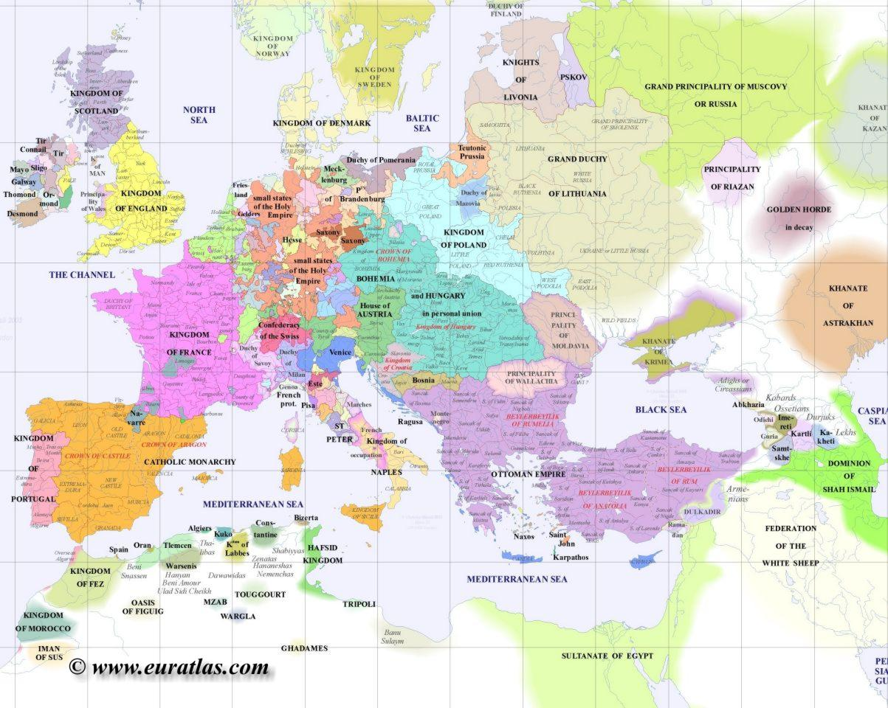
Europe 1500

Slide 12
Very Strong ‘National’ Rulers Early 16th C
Francois I of France
Charles V HRE (Spain, Germany, Netherlands)
Henry VIII in England
Sulyman the Magnificent in Ottoman Empire

Slide 13
Estates: The Structure of Society
An ‘estate’ was a broad grouping of interests within society
  Structure in most ‘nations’ in 15th – 18th C
  Based on land ownership
  The interest of an estate during the 16th and 17th C will cause complex alliances beyond simple confessional interests
First estate: clergy
Second estate: nobility, aristocracy large land owners
Third estate: peasants
Peculiar position of cities
  Rising middle class not based on land (Italian city-states)
  In most nations considered part of estate of monarchy

Slide 14
15th C Papacy
After Council of Constance (1414-1418), Martin V elected Pope (r. 1417-1431)
  End of Great Schism
  Called Council of Basel-Ferrara-Florence (1431-1439)
  Allowed payment of annuities (a way around usury)
  Tried to end Christian traffic in slavery
Eugene IV (r. 1431-1447)
  Concluded Council of Florence with reunion of Eastern Orthodoxy in return for sending troops to defend Byzantines from Ottoman Turks
  Greatly enhanced prestige of Papacy
Nicholas V (r. 1447-1455)
  Reworks and strengthens much of infrastructure of Rome: water, sewer, fortifications
  Starts Vatican Library
  Plans to pull down and rebuild St. Peters after loss of Hagia Sophia in Constantinople
Pius II (r. 1458-1464) issues Execrabilis, that no council is over the Pope, repudiates Council of Constance
Sixtus IV (r. 1471-1484) known for nepotism; leads to his nephew becoming Pope Julius II
Alexander VI (Borgia) (r. 1492-1503)

Slide 15
Popes of Early 16th Century
Alexander VI (r. 1492-1503), most notorious Borgia Pope
Julius II (r. 1503-1513), leads armies in battle to solidify Papal States, decides to rebuild St. Peter’s Basilica;
  Old St Peter’s built by Constantine in very bad condition
  What had been largest church in Christendom now a mosque
  Donation of Constantine accepted as a forgery
Leo X (Medici, r. 1513-1521), “Now that God has given us the Papacy, let us enjoy it.”
Hadrian VI (r. 1522 – 1523), Born in Utrecht; scholarly, humble, honest Pope; last pontefice barbaro until….John Paul II
Clement VII (Medici, r. 1523-1534)
Popular joke is ROMA = Radix Omnia Malorum Avaritia (Avarice the Root of All Evil)
N.B., these same Popes were also patrons for some of the most important artists of Renaissance and early Baroque
These same Popes were champions of learning and encouraged establishment of major libraries, including Vatican library

Slide 16
Situation Early 16th C
Byzantine Empire destroyed;
Powerful Ottoman Turks in control of Eastern and Southern Mediterranean
Spain newly unified after expulsion of Muslims
France and England in uneasy truce
France and HRE in occasional battles over eastern France
Popes in very weakened political situation after Avignon papacy; reliant on sale of indulgences and simony for funds

Slide 17
Migration of Greek Clerics and Scholars
Migration from 14th – 15th C
East to Moscow; after the Fall, Moscow refers to itself as ‘Third Rome’
West to Italy
  Welcomed at flourishing city-state courts of Urbino, Venice, Florence, Naples, Rome
  Fuel Western scholarship outside of university system

Slide 18
Renaissance = Rebirth
Name given by 19th C historians
Begins in Italy in 14th C, extends to mid-16th C when it becomes Baroque
  Renaissance is said to begin when Petrarch reads Confessions when he ascends Mt. Ventoux, April 26, in 1336
Catholic Intellectual and artistic movement
  Michelangelo (1475-1564) is usually considered both a Renaissance and a Baroque artist
Rejects the Aristotle of the schoolmen
Embraces rhetoric and language over philosophy
Embraces a certain pragmatism about human life and society

Slide 19
Humanism
Starts in Italy as part of Italian Renaissance
Although outside universities, very much a Catholic-oriented intellectual movement
  Therefore, not to be confused with later atheistic humanism
Wants to get back to the original religious and classical sources, ad fontes
Funding for intellectuals, scholars, artists comes from wealthy princes, merchants
  Medici’s
  Popes
In art, man becomes the ‘measure of all things’ Protagoras of Abdera ( c. 480-410 B.C.)
  Examples in architecture

Slide 20
Renaissance and Early Reformation
Simultaneous movements with many points of similarity and departure
Similarities
  Intellectual movements outside university system
  Rejection of Aristotle
  Disgust with corruption in Church
  Emphasis on language over philosophy
  Critical study of Scripture
  ‘Rediscovery’ of Augustine and Church Fathers
Points of departure
  Human nature
  Relation between Divine and physical
  Importance of art
  Importance of ancient works (pagan and Christian) in conjunction with Scripture
  Reform Church from within or revolt

