Slide 1
Class 26: John Locke
Dr. Ann T. Orlando
27 March 2019

Slide 2
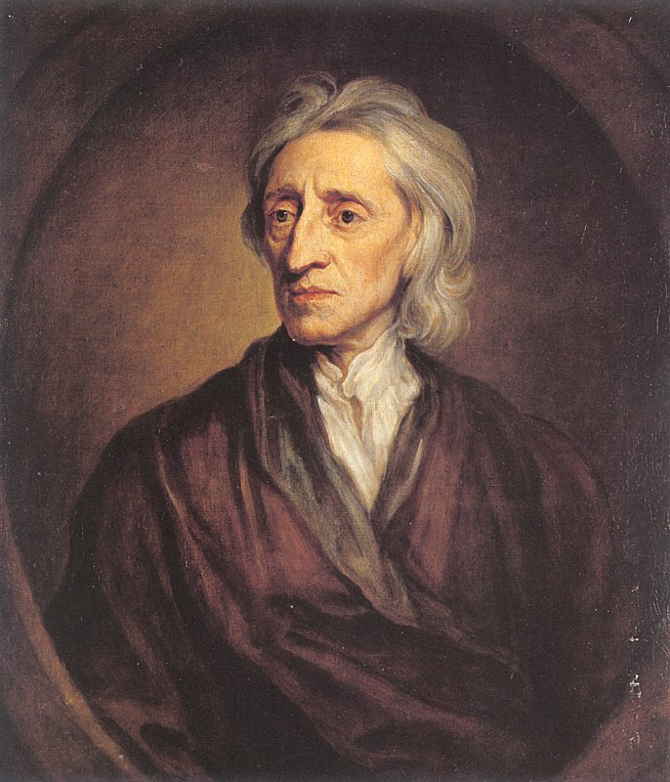
Introduction
Life
Primary Works
Epistemology
Locke’s Christianity
Political Philosophy
Religious Toleration
Influence: ‘The Great Mr. Locke’

Slide 3
John Locke (1632-1704)
Education
Father was a Puritan and lawyer;
Under Cromwell, he received an excellent education
Studied medicine
Became a student of Robert Boyle
After Restoration, Locke became physician, secretary and chief confident to Lord Ashley
Ashley was important force in Britain arguing for overseas expansion and colonies to counter Spain
But Locke was opposed to ‘Catholic’ tendencies of Charles II and James II, and went into exile in France
Divine right of kings
Returned with Princess Mary from Holland at beginning of Glorious Revolution
Locke served on Board of Trade, administering colonies and international trade until his retirement shortly before his death

Slide 4
Important Works
An Essay Concerning Human Understanding (1690)
Letter on Toleration (1685)
Two Treatises on Government (1688)
The Reasonableness of Christianity (1695)

Slide 5
Locke’s Epistemology
Based on Essay Concerning Human Understanding
All knowledge comes from sense experience, or reflection on sense experience
Mind is a tabula rasa
Ideas are built up by reflection
No innate principals, morals or knowledge
A type of corpuscular theory of building up large ideas from small ‘atomic’ ones
Words signify ideas
Language developed for communicating, thus some commonality required in naming things
Multiple ways to classify things in nature, based on
Our experience of them and
Our purposes

Slide 6
Epistemology (cont.)
What we can know with certainty
I exist
God exists
Mathematics exists
Morality exists
Revelation exists but must be consistent with reason
Opposed to ‘enthusiasms;’ that is, religious ‘experiences’ not consistent with reason or counter to reason
Miracles consistent with Jesus because of his relation with God, miracles after Jesus are not

Slide 7
Locke’s Christianity
Much debate (to this day) concerning whether Locke ended his life as
Puritan
Anglican
Latitudinarian
Arian
Deist
Certainly supported notion of religion that was ‘reasonable’ and a reasonable belief in the existence of God
Encouraged Newton to publish his most strident anti-Trinitarian work anonymously in Holland

Slide 8
Locke’s Political Philosophy
Primarily found in Two Treatises on Government
May have been written to justify revolt against Charles II
First Treatise starts with Adam and shows that no one was appointed ruler by Divine Right (against Bishop Fulmer)
God created man, and we are God’s ‘property’;
It is illicit to destroy another’s property: no suicide or murder
But must also ‘develop’ and wisely use property to claim ownership

Slide 9
Political Philosophy (cont.) Second Treatise on Government
Purpose of political power: ‘Political power, then, I take to be a right of making laws with penalties of death, and consequently all less penalties, for the regulating and preserving of property, and of employing the force of the community, in the execution of such laws, and in the defense of the common-wealth from foreign injury; and all this only for the public good’
God endowed his ‘property’ man with means of survival: life, liberty and man’s own property
If there is no government, then people live in a ‘state of nature’ example: American wilderness
But it is allowable to ‘take property’ which has not been developed
Allowable to have slaves as property who are conquered in a just war
Children are property of parents until age of reason

Slide 10
Second Treatise (cont.)
With more sophisticated development of property, man developed a money based economy which required more complex contract laws and the necessity of civil (NOT ecclesial) governments
Legitimate civil government then should derive its right to rule from the common desire of a collection of individuals to protect and legitimately administer their property
Social contract theory of government
More positive view than Hobbes
If civil government does not uphold these rights, then it is illegitimate and should be changed
Through rebellion and regicide if necessary

Slide 11
Religion in Society
Religious ‘truth,’ because it was built upon many levels of ideas was probably, not absolutely true
Many different religions demonstrate that there is no one universal Religion
Thus, religion is a private matter without connection to public life and the securing of life, liberty and property
All religions should be allowed as long as they do not adversely affect property rights and civil government
Catholicism should be curtailed because of Catholic claims to be ‘over’ temporal, civil affairs
Atheism should be discouraged because atheist may not be trusted to keep their word in a contract

Slide 12
Locke’s Influence
In my opinion, approaches that of Augustine in modern Western world
All subsequent Western thinkers will need to wrestle with Locke
Puritan ministers in early colonial America referred to ‘Great Mr. Locke’ in sermons
Many of various political and religious backgrounds will reference Locke
American Revolution
French Revolution

Slide 13
How Western Intellectual Thought Has Changed
Before Treaty of Westphalia
After Treaty of Westphalia
Human law based on natural law as a subset of God’s eternal law
Focus on individual duties as a member of society
Science means any systematic field of study, theology
Absolute truth does exist
Natural law
Religion and government NOT separable
Law based on protection of individual’s life, liberty, property
Focus on individual rights in social contract
Science means only physics, chemistry, biology
Only empirical truth exists
Laws of nature
Religion purely private; should have no place in the public sphere

Slide 14
Assignments
1. John Locke, A Letter Concerning Toleration available at http://etext.lib.virginia.edu/etcbin/toccer- reldem?id=LocTole.xml&images=images/modeng&data=/texts/english/modeng/p arsed&tag=public&part=all
2. John Locke, Constitution of the Carolinas, 1669, available at http://avalon.law.yale.edu/17th_century/nc05.asp

