Slide 1
Lecture 3: Martin Luther I
Politics
Dr. Ann T. Orlando
23 January 2019

Slide 2
Major 16th C Protestant (anti-Catholic) Movements
Lutheran
Reformed (Calvinists, Puritans, Presbyterians, Huguenots)
Radical Reformers (Anabaptists, Amish, Baptists, Congregational, Swiss Brethren, Socinians)
Anglicans (Episcopalians, Methodists)

Slide 3
Introduction
How the Reformation Started...the match that light the bonfire
  How Europe tore itself apart while…
    Turks under Suleiman the Magnificent are threatening Vienna and Spain, and while…
    Spain and Portugal are exploring the world
Sketch of Luther’s Life and Works
Key Figures in Luther’s Life
How Luther’s Reformation Affected Political Situation Beyond Germany

Slide 4
German Reformation
How it started: 1517, Albrecht of Mainz wants to be Archbishop
  Albrecht buys his archbishopric from Pope Leo X; Rome needs the money in part to help pay for rebuilding of St. Peters (simony)
  Rome authorizes the preaching of a special indulgence in Germany, with the money to go to Albrecht to repay him for having bought his office (sale of indulgences)
Martin Luther
  Responded to this situation with 95 Theses
  Went beyond denouncing sin of simony and corruption;
    fundamentally calls into question Rome’s primacy,
    theology of indulgences;
    denounces scholasticism
German princes, especially Fredrick the Wise of Saxony, support Luther against Rome and against HRE Charles V

Slide 5
Diet of Worms, 1521
Charles V calls the Diet of Worms to examine Luther
  Charles really wanted a Church Council, but Pope Leo X refused
Luther appears before Diet of Worms
  Luther is condemned by Charles V
  Luther’s Response to Diet of Worms:
    Since your majesty and your lordships desire a simple reply, I will answer without horns or teeth. Unless I am convinced by Scripture and by plain reason (I do not believe in the authority of either popes or councils by themselves, for it is plain that they have often erred and contradicted each other) in those Scriptures that I have presented, for my conscience is captive to the Word of God, I cannot and I will not recant anything, for to go against conscience is neither right nor safe. Here I stand; I can do no other. God help me. Amen
‘Kidnapped’ by Fredrick the Wise and taken to Warburg Castle to prevent capture by Charles V

Slide 6
Political/Military Responses
Pope Leo X (first estate and a Medici) did not want to cross Fredrick the Wise
  Check on Charles V power
  Wanted Germans to take up arms against Turks
Peasants revolt (third estate) in Germany in 1525, violently suppressed by Lutherans (second estate)
Cognac League formed in 1526 by Pope Clement VII (Medici) and Francois I to oppose Charles V
  Charles uses Imperial troops, including Lutherans to attack Pope and sack Rome in 1527
Schmalkaldic League formed in 1531 by German nobles opposed to Charles V (frictions within second estate)
  Sporadic Battles between them and Charles V

Slide 7
16th C political/Military Response (cont.)
Peace of Augsburg, 1555
  Cuius regio, eius religio, “whose reign, his religion”
  Only valid for Lutheran and Catholic princes
  Answer to who’s in charge
Thirty Years War, 1618-1648, continued armed struggles in Europe along political and religious lines
  France (Catholic) and Sweden (Lutheran) against Protestant (and some Catholic) German (Lutheran and Reformed) duchies
  Peace of Westphalia confirmed Peace of Augsburg, but now included Calvinists (Reformed)
  Devastating war in central Europe

Slide 8
Sketch of Martin Luther’s Life
Born 1483 in Eisleben, Germany
Attended University at Erfurt
On 30 June 1505, caught is a storm and cried to St. Anne to save him with vow to become a monk
  Enters Augustinian monastery in Erfurt
Becomes professor of Biblical studies at Wittenburg
  University of Wittenburg established by Frederick Wise in 1502
Controversy over Albrecht of Mainz ,1517
Censured by papal bull from Leo X in 1520, Exsurge Domine
Summoned before Diet of Worms 1521; ‘kidnapped’ by Fredrick the Wise, taken to Wartburg
Marries Katharina von Bora, 1527
Dies 1546

Slide 9
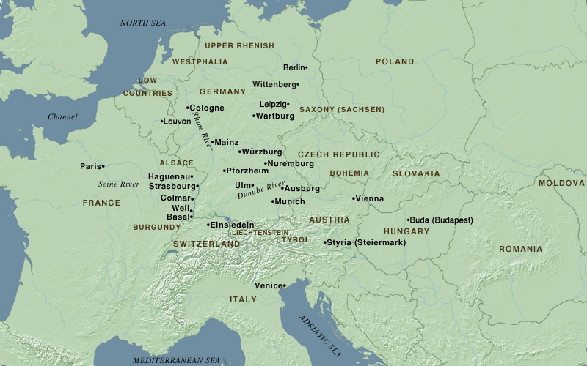
Map Central Europe 1500 www.metmuseum.org/toah/ht/08/euwc/ht08euwc.htm

Slide 10
Martin Luther’s Works
Professor of Biblical studies; sermons and commentaries 1513-1518
  Psalms
  Romans and Galatians
  Hebrews
Reform disputations, after 1517
  95 Theses, Babylonian Captivity, Appeal to German Nobility
  Freedom of the Christian
  Disputation with Erasmus
  Table Talk
  Works against peasants and Jews
  Translation of Bible into German (begun while in Wartburg)
Printing Press allowed Luther’s works to be rapidly disseminated throughout Germany and Europe

Slide 11
Martin Luther’s Personality
Charitably could be called prophetic
  Uncharitably be called bombastic
Direct talk
  Famous for use of gutter language
Unwilling to compromise
  Not with him, then against him

Slide 12
Lutheran Theologian:
Philip Melanchthon (1497-1560)
A humanist who studied classical languages very carefully
Became a close friend of Luther
Wrote the Augsburg Confession (1530)
  An apology for Reformers given to HRE Charles V
  Tried to be as conciliatory as possible, emphasizing points of common belief
  Charles V rejected it

Slide 13
Andreas Karlstadt, Carlstat (1480-1541)
Professor with Luther at University of Wittenburg
Supported Luther in indulgence controversy
Debated Dominican Johan Eck at Leipzig
Early leader in radical reformation of liturgy
  Mass in vernacular
  No images
  Eucharist under both species
  Married clergy
  Rejects all university degrees
Luther sends him to Denmark
Karlstatd believed that one could create a Christian society on earth by imposing Christian laws
Falling out with Luther; dies in Switzerland

Slide 14
Spread of Luther’s Views North
Danish King Christian II was in conflict with clergy over control of monasteries and their revenue.
He asks Luther to come to Denmark; Luther sends Karlstadt.
  Encourages married clergy
  Liturgy in vernacular
  Priesthood of all believers
  Christians should follow civil rulers
Eventually, King Christian asks Karlstadt to leave;
  King Christian marries Charles V sister
  But Denmark remains a ’Lutheran’ country

Slide 15
Impact of Reformation Outside of Germany
Luther and his protection by German princes opened the flood gates to religious/political turmoil
  Zwingli in Switzerland
  Anabaptists elsewhere in Germany
Exacerbated political conflicts
  Between Charles V and Popes (first and second estate)
  Between Charles V and his electors (within second estate)
  Between peasants and their dukes/princes/kings

Slide 16
Charles V (1500-1558)
Grandson of Ferdinand and Isabella of Spain (mother, Joanna the Mad of Spain)
  Aunt is Catherine of Aragon, married to Henry VIII
Grandson of Maximilian I of Austria (father, Philip I)
Became king of Spain (which already included Netherlands, Belgium) and Austria in 1519
Major issues during reign
  Reformation in Germany
  Battles with Francois I of France over Italy; Henry VIII allied with Charles V
  Turks threaten Vienna by land and southern Italy by sea (Francois I allies himself with Turks)
  And…exploring the world
Retires to Spanish monastery in 1555, son Philip II assumes monarchy of Spain and Netherlands, brother Ferdinand I assumes control of Austria

Slide 17
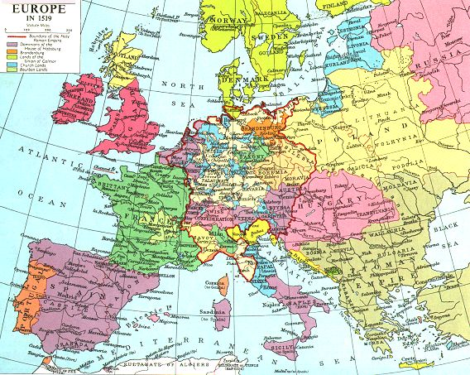
Europe in 1519

Slide 18
Francois I (1494-1547)
King of France 1515-1547
  Supported French Renaissance (Leonardo Da Vinci)
  Sent Jacques Cartier to explore Canada
Both Francois I and Charles V claim northern Italy
Both are at odds with Pope over northern Italy
Francois I allies himself with Suleiman the Magnificent (b. 1495; r. 1520-1566) against Charles and HRE
Francois also thinks he can take advantage of turmoil in Germany, and perhaps have himself declared HRE
Francois tolerant of reformers
Charles V defeats Francois I in a series of wars between them

Slide 19
Sack of Rome, 1527
In 1526, Pope Clement VII (Medici), alarmed at the growing strength of Charles V, allies himself with Francois I in Cognac League
Charles gathers a mercenary army of Germans and Spaniards; Catholics and Lutherans; to attack Rome
Clement VII becomes a virtual prisoner in Castle S. Angelo
  All of the Pope’s troops abandon him except Swiss guard
Foreign troops in Rome almost a year; a year filled with plunder
Troops finally leave Rome when they are paid off

Slide 20
Impact of Sack of Rome
When Henry VIII asks for an annulment from his wife, Catherine of Aragon (Charles V’s aunt); in 1533, Pope not anxious to cross Charles again
Last Judgment (1535-1541) behind the altar in the Sistine Chapel painted by Michelangelo at request of Pope Paul III in sorrow over sack
  Compare with Sistine ceiling (1509-1512)

Slide 21
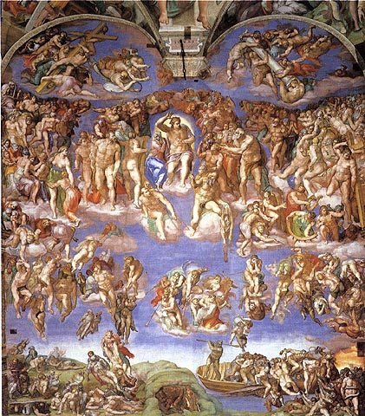
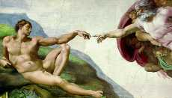
http://faculty.evansville.edu/rl29/art105/img/michelangelo_lastjudge.jpg

Slide 22
Martin Luther on the Strife in the World
Disputation with Erasmus of Rotterdam over Free Will
Erasmus accuses Luther of unleashing great strife into the world
Luther’s response: The world and its god cannot and will not bear the word of the true God. And the true God cannot and will not keep silent. Since these two gods are at war with each other, how can there be anything else throughout the whole world, but uproar? Therefore, to wish to silence this turmoil is really to want to hinder the word of God.

Slide 23
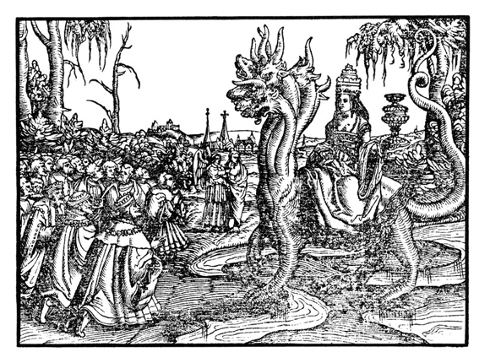
From Luther Bible, 1545
Pope as Whore of Babylon

Slide 24
Assignments
1. Archbishop Albert Mainz. The Commission of Indulgences in The European Reformations Sourcebook. ed Carter Lindberg. Malden: Blackwell, 2000. 29-30.
2. Martin Luther. 95 Theses, available at http://www.iclnet.org/pub/resources/text/wittenberg/luther/web/ninetyfive.html
3. Martin Luther. Appeal to German Nobility and Babylonian Captivity of the Church. in The European Reformations Sourcebook. ed Carter Lindberg. Malden: Blackwell, 2000. 36-39.
4. Peace of Augsburg available at http://www.uoregon.edu/~sshoemak/323/texts/augsburg.htm

