Slide 1
Class 4: Swiss (Reformed) Reformation
25 January 2019

Slide 2
Introduction
Swiss Political Situation 16th C
Outline of Life of Ulrich Zwingli
Approach to Scripture, Sacraments, Civil Government
Outline of Life of John Calvin
Holy city of Geneva
Calvin’s Legacy

Slide 3
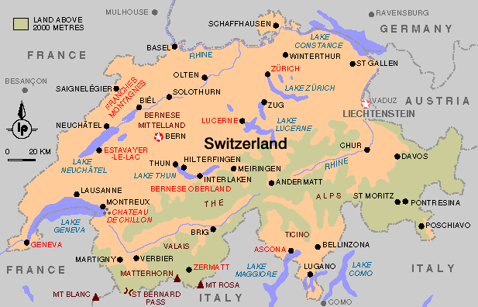
Map of Switzerland web.millersville.edu/~cpa-aatg/pages/switzerland.htm

Slide 4
Swiss Political History
Notion of Switzerland starts in 13th C with the opening of Gotthard Pass which connected north and south
Story of William Tell and fight against HRE (Austria) dates to 14th C
Ruggedness of territory, led to highly independent small towns and adjacent areas (cantons) associated with each other in a confederation
Switzerland’s main export: mercenaries
Pontifical Swiss Guards 1506
Early 16th C Switzerland becomes embroiled in politics of HRE and religious wars
Treaty of Augsburg, 1555, included Swiss Cantons; each Canton can chose its own religion
Treaty of Westphalia, 1648, recognized Swiss Confederation
Swiss Federal government officially takes stand of neutrality in European politics and wars. True today

Slide 5
Ulrich Zwingli (1484-1531)
A priest, Zwingli becomes member of Zurich city council
Key turning points in life: Bloody Battle of Marignano (1515) and plague in Zurich (1519)
Battle of Marignano fought by Swiss against Francois I for control of Milan
Swiss allied with Pope Julius II to drive the French from northern Italy
Preaches against Catholic liturgical and disciplinary practices
Sausage rebellion of 1522; opposed requirement that no one eat meat during Lent
Upholds sovereignty of Swiss cantons
Opposes practice of raising mercenary armies
But sovereignty is combination of religion and civil rule based on Bible
Dies in battle in 1531 fighting for Zurich against Catholic Cantons

Slide 6
Key points of Zwingli’s Reform Movement in Zurich
Bible is only source of authority
Rejection of priestly celibacy
Destruction of images; based on two different readings of Ten Commandments
Mass is replaced by an evangelical communion and sermon service in Zurich (1525)
Eucharist is a memorial, denial of real presence
Opposed Luther’s understanding
Key Scripture: John 6
Luther accused Zwingli of being a Nestorian
Separation of human and divine nature of Christ
Luther reiterates his support of Chalcedon and the communication of idioms
Marburg Colloquy, 1529
Attempt by Luther and Zwingli to agree on a common confession;
Reached agreement on most points except Eucharist

Slide 7
John Calvin (1509-1564)
Born in France, studied law
Humanist education;
Scholar of classics, especially Seneca and Stoics
Excellent linguist French, Greek, Hebrew, Latin (not German)
Calvin studied as a lawyer
Francois I very strong monarch; dissenters against Francois I were not tolerated and could not hide behind strong princes
Geneva became city of refuge
Calvin moves to Geneva
Theological heir of Zwingli
Geneva when Calvin arrived
Recently expelled Catholic clergy
Had not yet established a permanent governing structure

Slide 8
Calvin in Geneva
Calvin becomes a leader of reformed and evangelical movement in Geneva
In 1555 writes Ecclesiastical Ordnances describes both ecclesial and civil government
Doctors and Pastors (clergy)
Deacons and elders (lay); elders drawn from civil magistrates
Consistory: an ecclesial court which was also a civil court
Writes Institutes 1559
Massive work (1500 pages) designed to guide training of reformed clergy
Preface addressed to Francois I
A work Calvin revised often
Established a ‘holy’ city in Geneva
Both Catholic and Protestants who disagreed with Calvin were persecuted
Calvin writes Defense of Orthodox Faith to justify severe treatment of those opposed to ‘Calvinism’ or the Reformed Movement

Slide 9
Calvin’s Theology
Accepted Luther’s maxim “Sola Scriptura, Sola Fides, Sola Gratia” and extended it
Control of civic administration by ecclesial;
Emphasis on strict moral conduct by citizens
Denied true presence in Eucharist
This was the sticking point that prevented Zwingli and Luther from forming one Church
Belief in double predestination and denial of free will
Calvin’s church is often referred to as the Reformed Church
Note similarity to Augustine:
Calvin says that “Augustine is one of us.”
Institutes makes frequent reference to Augustine

Slide 10
Influence of Calvinism
As a city that welcomed Protestant refugees; Geneva became center of Protestant education
Geneva becomes a kind of ‘Protestant Vatican’ to which disputes and questions are addressed
Many of those educated in Geneva returned home as evangelical missionaries
Calvinism had an extensive influence on Protestant movement, especially in
Scotland (Presbyterians),
France (Huguenots) and
England (Puritans)
Netherlands (Reformed)

Slide 11
Calvin and Usury
Prohibitions of usury ancient and multi-cultural
Old Testament
Aristotle
Church (Constantine passes law prohibiting usury)
Luther opposed to usury
Wealth measured in land (Romans, estate system)
John Calvin first major theologian to approve of usury
NB social base of Reformed Churches is urban, money-based, not land based
See paper on website for excellent historical review of usury theory and Calvin’s impact

Slide 12
Approval of Usury in Direct Opposition to Scholasticism
Objections to Usury
Economic rights based on property rights: Money, as a medium of exchange, is not property but represents property
Natural Law: Usury seems to be selling ‘time’ which no one has a right to do; thus usury is sinful within itself
Just price: Usury would seem to undermine just price for commodities and property by increasing the price over time
Calvin
Began the separation of economics from property
Argued that the OT prohibition was legal and pertinent only to that time, not part of natural law.
Risk of loaning money is a valid argument for charging interest
Indeed, the money is ‘loaned’ and thus still in some sense belongs to the lender who should be compensated for ‘opportunity cost’

Slide 13
Assignments
1. Zwingli, selections 6.9-6.14; and 6.23 in The European Reformations Sourcebook. ed Carter Lindberg. Malden: Blackwell, 2000. p. 109-114, and p121-122.
2. John Calvin. Institutes of the Christian Religion 9.7-9.8 in The European Reformations Sourcebook. ed Carter Lindberg. Malden: Blackwell, 2000. p. 173-178.
3. John Calvin, Letter on Usury, 14.11 in The European Reformations Sourcebook. ed Carter Lindberg. Malden: Blackwell, 2000 p. 271-272.

