Slide 1
Class 7: History Later 16th C
Dr. Ann T. Orlando
30 January 2019

Slide 2
Outline
Social developments in 16th C
French Reformation
Spanish Imperial Power

Slide 3
Refresher on Great Political Leaders of 16th Century
HRE: Charles V
Spain: Charles V and Philip II
Germany: Frederick of Saxony
England: Henry VIII, Elizabeth I
France: Francois I, Henry IV
Italy: divided into parts, Pope, French, HRE
Ottoman Empire: Suleiman Magnificent

Slide 4
Social Developments of 16th C
Vernacular Languages come into their own as political language, language of culture
  Translation of Bible
  Luther’s German Bible
  English King James Bible
Significant increase in literacy
  Printing Press
  True both northern and southern Europe
Rising middle class of merchants, artisans
  Increasing importance of cities
  Calvin rethinks sin of usury

Slide 5
Political Background
Reformed Church in France
Recall that Catholic hierarchy of France tried to be at a distance from Vatican:
  Conciliarism and Gallicanism
  Sorbonne
  Francois I won right from Pope Leo X to appoint bishops
Francois I protected humanists and some reformers
  They were opposed to Pope, who opposed his plans in Italy
  Wanted to form alliances with Lutheran princes who opposed Charles V
  But persecuted anyone who threatened stability of political order in France

Slide 6
Reformation Groups in France
Earliest groups were called Huguenots; perhaps for an early French reformer exiled in Geneva, Besancon Hughues
Geneva sent many pastors-missionaries to France in order to form congregations
  Recall part of their mission was to form more holy cities like Geneva
  Appealed to rising class of artisans, small shopkeepers, bankers
Francois I son, Henry II (1547-1559) persecuted all Protestants
  Henry took over inquisition from Church
  Executed many, many Huguenots
By 1561, over 2000 Reformed Congregations in France
  Pushed for war against Spain in Netherlands to rescue persecuted Protestants in Netherlands

Slide 7
More French Politics
After death of Henry II, political turmoil in France; his widow, Catherine d’Medici really in charge
  Depending on external politics, she alternately supported or opposed Huguenots
In 1562 Huguenots try to enlist armed support of English Protestants
Catherine ‘declares war’ on Huguenots in 1563; leads to St. Bartholomew's Day massacre
Out of turmoil, Henry IV (1594-1610), first Bourbon king, is accepted as regent after he converts to Catholicism
  ‘Paris is worth a Mass’
  Edict of Nantes, 1598, made Catholicism the official religion in France; but Huguenots granted some rights to property and worship
  Assassinated in 1610 by a Catholic radical (madman?)

Slide 8
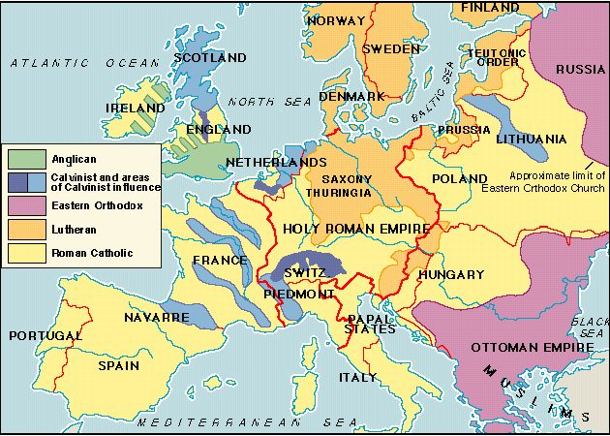
Religious Map of Europe c. 1560

Slide 9
Driving Power of Late 16th C: Philip II
Born 1527; only son of Charles V and Elizabeth of Portugal
Became king of Spain, Portugal, Low Countries, Sicily in 1556
  Remained staunchly Catholic
  Briefly married to Mary Tudor, Queen of England
  Tried to roll back tide of Protestantism
  Died 1598
Three major political enemies:
  Ottoman Empire
  English
  French

Slide 10
Philip II Against Ottoman Empire
Ottoman Empire controlled all of southern and eastern Mediterranean.
Ottoman’s threatened Italy and Western Mediterranean
Spanish Navy defeated Turkish Navy at two key battles
  Malta, 1565
  Lepanto, 1571 (Miguel Cervantes wounded in battle)
Spanish Navy was the greatest military force in Europe

Slide 11
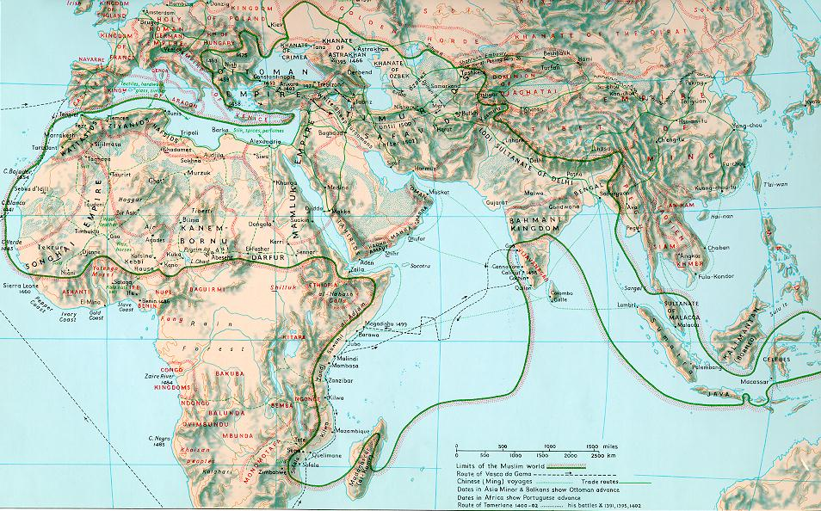
Expansion of Islam Under Ottoman Turks ccat.sas.upenn.edu/~rs143/map6.jpg

Slide 12
Philip II and the English
After Mary Tudor died, and Elizabeth became queen
  Philip tried to marry Elizabeth
  Elizabeth’s support of Protestants led to quick rejection of Philip’s offer
Elizabeth gave support to Protestants against Spain in Low Countries
Philip declared war on Elizabeth and sent a fleet to invade England
Spanish armada destroyed in storm of 1588
  Destroys most important element of Spanish might
  Limits Spain’s ability to respond to revolt in Low Countries
  Also limits Spain’s ability to counter aggression in missionary countries around the world

Slide 13
Philip II and France
Opposed to Henry IV (Bourbon)
  Protestant background
  Henry also giving aid to rebellious Low Countries
Attempts to invade France and force return to Valois dynasty (successors of Francois I); unsuccessful

Slide 14
Spain in Time of Philip II
Staunchly Catholic
Great Empire of Europe and European Expansion in Western Hemisphere
Foes not only political but also religiously different: Islam and Protestants
Spain sees herself and creates an identity for herself as the most Catholic country
  Lasts until the end of 20th Century
Creates the energy and environment for great Catholic revival

Slide 15
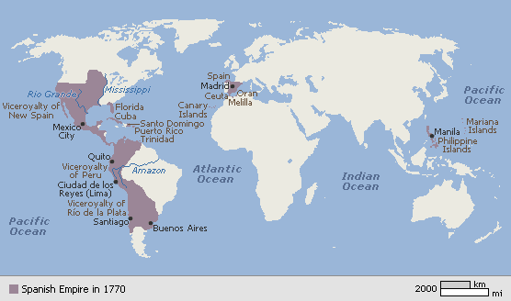
Spanish Empire From 16th to 18th Centuries encarta.msn.com/media_461518061/Spanish_Empire.html

Slide 16
Assignments
1. An account of St. Bartholomew’s Day massacre, 10.16 in The European Reformations Sourcebook. ed Carter Lindberg. Malden: Blackwell, 2000 p. 197
2. Accounts of Henry IV and Edict of Nantes, 10.19-10.22 The European Reformations Sourcebook. ed Carter Lindberg. Malden: Blackwell, 2000 p. 200-203.

