Slide 1
Episode 11: Church of the Gesu
Dr. Ann T. Orlando
Music: “A Mighty Fortress is Our God”

Slide 2
Timeline
Theme: Militant Fracturing of Western Christendom

Slide 3
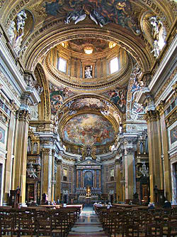
Church of the Gesu
Located on site that Ignatius of Loyola selected for his Roman headquarters
Dedicated in 1584 after 40 years of construction and 6 architects including Michelangelo
Mother Church for Jesuits
Baroque style

Slide 4
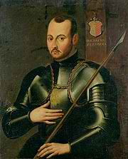
St. Ignatius Loyola (1491-1556) Founder of a New Order
Minor courtier and officer in army; 1521 severely wounded defending Pamplona from French
During recovery Loyola started reading New Testament and Lives of Saints (nothing else to read!)
Once recovered, traveled to Montserrat where he left his sword and gave away his clothes to poor
Lived in a cave near Manresa; had a series of enlightening visions
Briefly went to Holy Land
Decided to return to school, study for priesthood; first at Alcala then at Salamanca
Imprisoned by Inquisition several times for teaching without being licensed
Traveled to University of Paris to continue studies
Shared rooms with Francis Xavier, Peter Faber
Gathered a group of six, Company of Jesus, and Ignatius directed them in Spiritual Exercises
Traveled to Rome and put themselves at disposal of Pope; approval of order given by Pope Paul III in 1540
Lived in Rome remainder of his life as Director General of Jesuits, by now a world-wide order
Canonized with Francis Xavier by Pope Gregory XV in 1622; Feast day on July 31

Slide 5
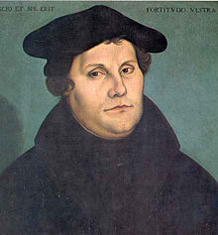
Martin Luther (1483-1546) Founder of a New Denomination
Martin Luther was German
At a time when ‘Germany’ was a collection of dukedoms
Nominally united under the HRE
As a young Augustinian monk, Luther struggled to appease God for his sins
Finally realizes that nothing he can do can appease God;
Salvation must be God’s free gift that one accepts by faith
Theological principle of justification
Disgusted at simony and nepotism of Renaissance Church
Responds to this situation with 95 Theses (1517)
Go far beyond denouncing sin of simony and corruption; fundamentally calls into question Rome’s primacy and theology of indulgences;
Denounces Medieval theology
Rejects
German princes, especially Fredrick the Wise of Saxony, support Luther against Rome and against HRE Charles V
Violent clashes and battles

Slide 6
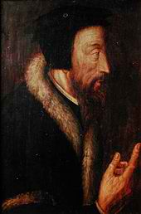
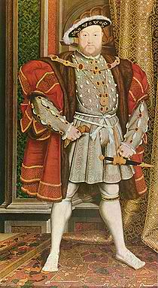
Protestant Reformation in 16th C After Luther
John Calvin (1509-1564)
French lawyer who studied Augustine
Established a ‘holy city’ in Geneva
Geneva in conflict with both Catholic and Lutheran armies
Developed ‘reformed’ approach to Christianity
Institutes
Subsequent denominations include Reformed Dutch Churches, Presbyterianism, Puritans, Huguenots
Henry VIII (1491-1547)
King of England, who opposes Luther in support of Catholic Church
But splits with Church of ‘King’s Great Matter’ and divorce of Catherine of Aragon
Establishes Church of England
Violently suppresses Catholicism; St. Thomas More and Bishop John Fisher die as martyrs
Subsequent denominations include Anglican, Episcopalian, Methodist

Slide 7
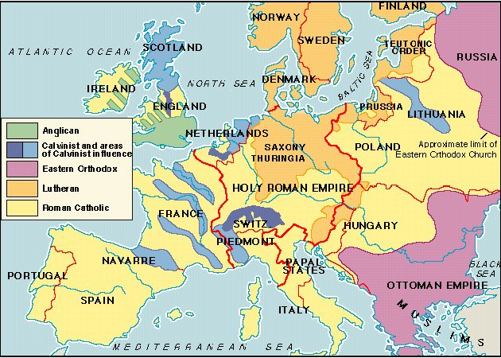
Religious Map of Europe c. 1560

Slide 8
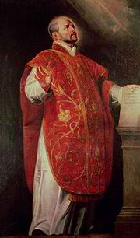
Jesuit Spirituality
Like Luther, Ignatius was overwhelmed by the profound sense of his own sin
Like Luther, does not believe that being a monk is a guarantee of salvation
But unlike Luther, believes that salvation is found by devotion to society of Church and her mission
Devotion includes attacking corruption
Society includes those below and saints above
Emphasis on engaging mind and emotions
Emphasis on critical self-analysis
Call to action and commitment

Slide 9

The Society of Jesus, The Company “Jesuits”
“To the Greater Glory of God”
Education very important component of Jesuits
Children and adults
Lay and clerical
Jesuits very focused on work among people in secular society
Jesuit life-style in many ways opposite that of a monastery
Focus on action in world, rather than contemplation in monastery
Jesuits did not have a special ‘dress’
Jesuits did not have specified times for gathering for prayer
Special relationship to papacy

Slide 10
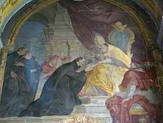
Jesuits and Papacy
Jesuit order approved by Pope Paul III in 1540
Jesuits become the Pope’s ‘Marines’
Missionaries on voyages of discovery
Intellectual leaders in Vatican
Supported new learning, new artistic techniques, in service of renewed Catholic spirituality
Spearheaded a new Catholic confidence
Saints
Religious Art
Penance
Indulgences (properly understood)

Slide 11
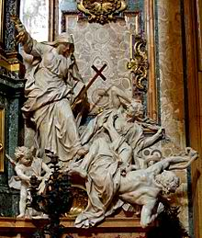
Catholic Response: Council of Trent
Called by Pope Paul III; closed by Pope Pius IV
Lengthy, intermittent (1545-1563)
Purpose was both to address reform of practice and to uphold Catholic doctrine
Developed in several sessions
Jesuits play a major theological role at Trent; encouraged explicit statement of Catholic doctrine in opposition to Protestant views

Slide 12
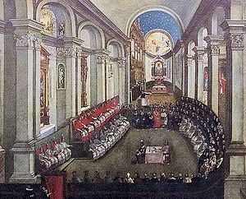
Key Theological Statements from Trent
Scripture and tradition
Sacraments are effect through performance of sacramental action, “ex opere operato”
Affirmed Mass as sacrifice and transubstantiation
Affirmed 7 sacraments
Grace and good works together with faith brings about salvation
Affirmed indulgences and intercession of saints

Slide 13
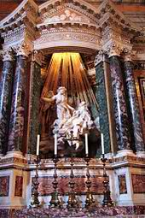
Revived Catholic Spirituality
St. Teresa of Avila 1515-1582
Pioneered major reforms of monastic orders (male and female)
Special relationship with John of Cross
Encouraged renewed devotion of Catholics in opposition to Protestants
First woman declared a doctor of Church (1970)
St. John of Cross 1542-1591
Follower of Teresa of Avila
Mystic and writer of popular devotional works
St. Francis de Sales 1567-1622
Educated by Jesuits
Argued against Calvinists; bishop in absentia of Geneva
Wrote popular devotional works; On Devout Life very influential

Slide 14
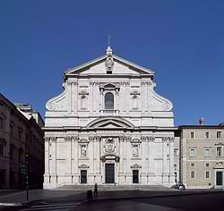
Church of the Gesu
Continues to be the mother Church for Jesuits
Location of many important relics important to Jesuits
Arm of St. Francis Xavier
A church architecture that Jesuits carried with them throughout the world

Slide 15
Next Waypoint
Basilica of Our Lady of Guadalupe

