Slide 1
Episode 12 Shrine of Our Lady of Guadalupe
Dr. Ann T. Orlando
Music: California Mission Music

Slide 2
Timeline
Theme: Voyages of Discovery, Voyages of Evangelization to the world

Slide 3
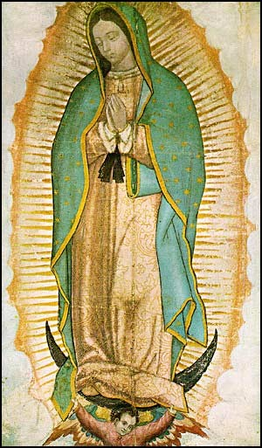
Apparition of Mary to St. Juan Diego at Guadalupe Mexico, 1531
St. Juan Diego was an Aztec Indian, new convert
In a series of apparitions near Mexico City, speaking to Juan Diego in his native language, Virgin Mother asks for a shrine
The local bishop asked for proof
The Virgin told Juan Diego to pick roses and bring them to the bishop; when he did the image of Mary was on his tunic

Slide 4
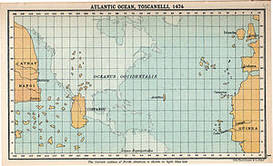
Spanish and Portuguese Voyages of Discovery
Driven by economics,
Searching for a sea route to reduce time and cost of spice trade with Orient
Disruption and increased cost of overland route by Ottomans in 15th C
In 15th and 16th C Spain and Portugal leading European ‘super powers’
Most other Western European countries preoccupied with wars and Reformation
Renewed strength after expulsion of Muslims from Portugal and Spain
No educated person in Europe thought the earth was flat (see ST Ia Q1 a1)
Real question was how to sail all the way to China from Europe
Portuguese went east around Africa
Spanish (Columbus) went west across the Atlantic
In 15th and early 16th C Dominican and Franciscans were primary Catholic missionary orders
In later 16th C Jesuits dominated missions

Slide 5
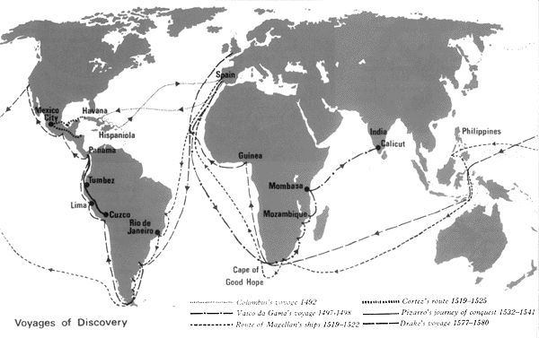
Map of Voyages 15th and 16th C www.jcg.jersey.sch.uk/subjects/history/discovery.html

Slide 6
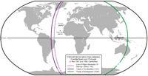
Leadership of Papacy
Pope Alexander VI and 1494 Line of Demarcation, but he also
Declared that natives have souls
Encouraged kings of Spain and Portugal to include missionaries in earliest voyages
Pope Paul III in 1537 Affirmed the right of Indians to liberty and property
Pope Gregory XIV encouraged ordination of native sons in 1576;
Pope Gregory XV established Congregation of Faith in 1622 to encourage missions, especially process of enculturation as Spanish and Portuguese power waned

Slide 7
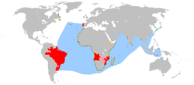
Portuguese Voyages of Discovery
Prince Henry the Navigator (d. 1460)
Encourages exploration of West Africa
Significantly improves navigation instruments
Vasco de Gama rounds Cape of Good Hope 1487
Portuguese explore much of southern Africa, especially Congo and Angola
Early 16th C Portuguese voyages to India, Japan China
Magellan’s expedition circumnavigates globe 1519 - 1522

Slide 8
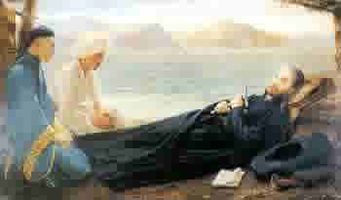
St. Francis Xavier (1506-1552)
Born in Spain
Met Ignatius Loyola at University of Paris; Francis Xavier was one of original members of Jesuits
At request of King of Portugal, Francis Xavier was appointed as missionary to Eastern peoples by Pope Paul III in 1541
Preached and established missions in India, Sri Lanka, Philippines and Japan. Died waiting to enter China
Remains returned to Goa, while arm sent to Rome, Church of Gesu

Slide 9
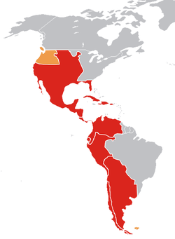
Spanish Voyages of Discovery
Columbus’ First Voyage of Discovery October 1492 to Caribbean
Second voyage he takes Dominicans with him to convert ‘Indians’
Columbus believed he had reached India
Cortez conquers Mexico, 1519-1521
Pizarro conquers Peru 1532
By 1600 Spanish had
Established footholds in much of North America (California, Arizona, New Mexico, Texas, Florida)
Thriving large communities throughout Mexico, Central and South America
Santa Fe, New Mexico is oldest capitol city in U.S.
By comparison,
Jamestown founded 1607
Quebec founded 1608
Plymouth founded 1620
Montreal founded 1642

Slide 10
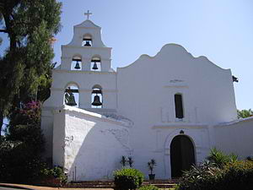
Beginning of Missions in Latin America
Spanish (and Portuguese in Brazil) subdue Indian cities; establish strong military presence
Western Hemisphere not densely populated
Major civilizations in decline before Spanish arrived
Spanish had superior technology (navigation, weapons)
Illness
Official policy of Spanish crown (under pressure from Rome) put conversion as top priority
During early Spanish exploration, Dominicans and Franciscans follow Spanish
Dedicated to evangelization and dignity of potential new converts

Slide 11
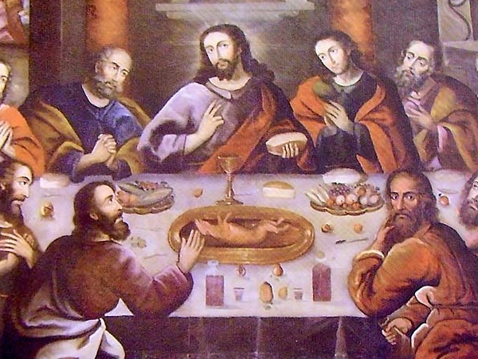
Development of Uniquely Latin Style of Catholicism
Early missionaries recognized the importance of elaborate ceremonies to Aztecs
Developed liturgy with very colorful ceremonies
Incorporated Indian artistic styles into Church decorations
Example: Cusco Cathedral (1559) in Peru, painting of Last Supper
By 1600 estimated to be 7,000,000 Indians who were calling themselves Catholic Christians

Slide 12
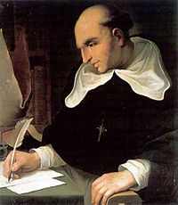
Important Church Leaders in Latin America
Bartolome de las Casa (1474–1566)
Dominican
Fought for just treatment of Indians in Caribbean and Mexico
St. Peter Claver (1580–1654) Jesuit in Columbia; ministry to slaves from Africa
St. Rose of Lima (1586-1617) and St. Martin de Porres (1579-1639), both Dominicans, in Peru
Blessed Junipero Serra (1713-1784) Franciscan, established California missions

Slide 13
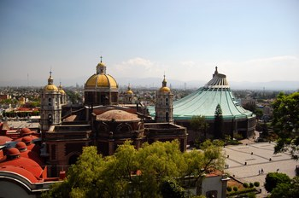
Basilica of Our Lady of Guadalupe Today
Our Lady of Guadalupe is a national symbol in Mexico
Original basilica built in 1536
But so many pilgrims come to Guadalupe that a new basilica was built in 1976
1946, Our Lady of Guadalupe declared Patroness of Americas by Pope Pius XII
Feast Day December 12
2002, Juan Diego canonized by Pope John Paul II

Slide 14
Next Waypoint
Vatican

