Slide 1
Episode 13: St. Peter’s Basilica and the Vatican
Dr. Ann T. Orlando
Music “Thou Art the Christ, O Lord”

Slide 2
Timeline
Theme: St. Peter’s Basilica and the Papacy Throughout Christian History

Slide 3
Map of Waypoints

Slide 4
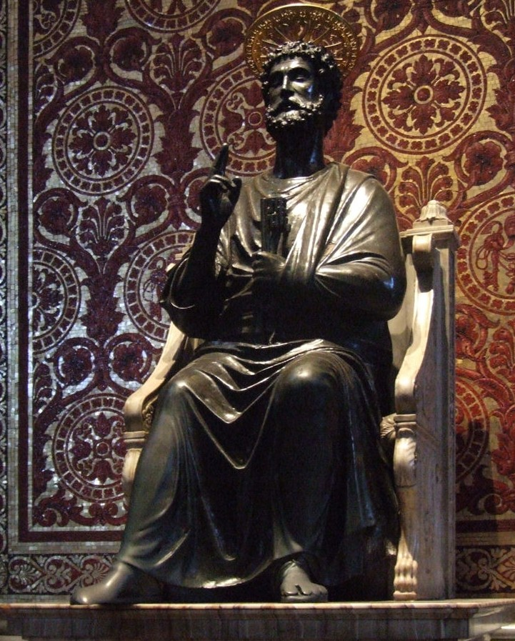
Papacy
From the First Century, the Bishop of Rome was recognized as the successor of Peter and the leader of the Christian community
Roman Empire
Europe
World-wide
Oldest continually functioning institution in the world

Slide 5
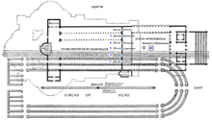
Vatican Hill in Rome
Site of ancient Etruscan town and temple, Vaticum
Outside old Roman gates, across the Tiber from the traditional ‘7 hills’ of Rome
Site of a hippodrome built be Nero
Used to execute prisoners, including St. Peter in 64 AD
Cemetery nearby where Peter was buried

Slide 6
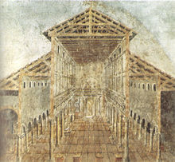
4th C: Constantine the Great and the Vatican Hill
Constantine built a Church on site of St. Peter’s martyrdom
Known as ‘Old St. Peters’
Immediately became an important pilgrimage site
Place where Pope most associated himself with Peter and leadership of entire Church as Peter’s successor
Built Lateran Church and Baptistery
Also built a Church on site of St. Paul’s martyrdom: St. Paul’s Outside the Walls

Slide 7
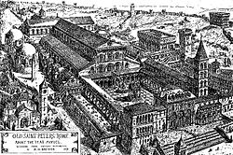
Important Events In and Around Old St. Peter’s
Pope St. Leo I (the Great) went out from the Vatican to meet Attila the Hun and divert him from sacking Rome in 5th C
Pope St. Gregory the Great sent St. Augustine of Kent to evangelize English late 6th C
Charlemagne Crowned Holy Roman Emperor in 800 by Pope Leo III
St. Francis and St. Dominic travelled to Rome to have their orders sanctioned by Pope Innocent III in late 12th C
Renaissance art blossomed under Vatican patronage in 15th and early 16th C

Slide 8
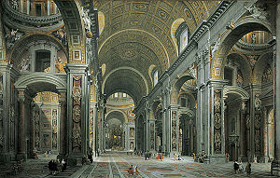
Rebuilding of St. Peter’s
Fall of Constantinople in 1453
Largest and most beautiful Christian Basilica turned into a mosque
Old St. Peter’s needed massive repairs
It was 1300 years old
Pope Julius II ordered the old basilica torn down and the new one begun in 1505
Designed to be the largest church in the world
The Coliseum used as a marble quarry for the new building
Not completed for 150 years
Vast sums were needed to finance the project
Simony
Selling of indulgences
Pope Paul III, Jesuits and Council of Trent reformed corrupt practices while promoting authentic Catholic doctrine
St. Peter’s became enshrine of Catholic vibrancy and Baroque art

Slide 9
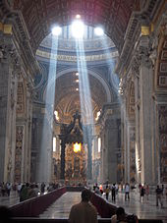
Baroque Art of St. Peter’s
Most of the greatest artists of the later Renaissance and Baroque eras worked on St. Peter’s
Goal was to make visible the truth of Catholic doctrines
The Papacy as the guarantor of the truth of the faith since the time of St. Peter
The Papacy as the world-wide leader of Christendom
Bernini’s completion, including the grand colonnade
Arms outstretched to encompass the world
Statues of saints, the Church triumphant

Slide 10
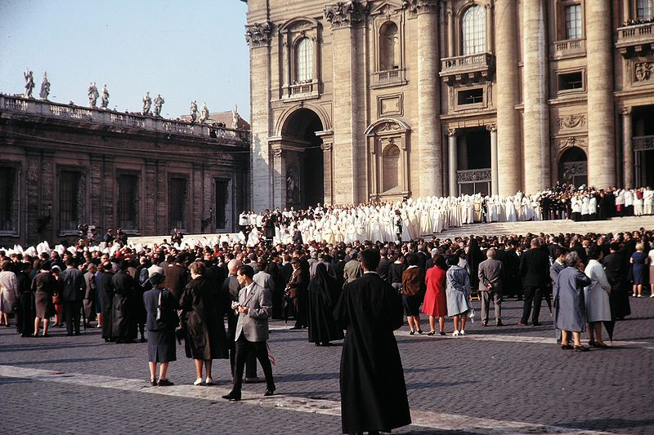
The Vatican Councils
First Vatican Council
Convened by Pope Pius IX in 1869
Concerned about errors arising from secularization in modern world
Affirmed doctrine of papal infallibility
Council was suspended in 1870 during the turmoil of the unification of Italy and loss of the Papal States
Second Vatican Council
Convened by Pope John XXIII in 1959
Concerned about errors arising from secularization in modern world, especially communism and materialism
Touched many aspects of Catholic life and relation to modern world
Council was closed by Pope Paul IV in 1965

Slide 11
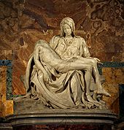
Papal Infallibility
Pope proclaims an extraordinary teaching ex cathedra, that is from the Chair of Peter in matter of faith and morals
Only two extraordinary declarations since Vatican I
Pope Pius IX and Immaculate Conception of Mary
Pope Pius XII and the Assumption of Mary

Slide 12
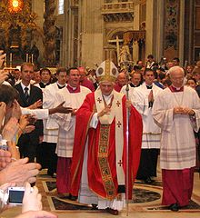
Modern Papacy
Pope Leo XIII (1878-1903)
Modern social teachings in encyclical Rerum Novarum
Pope St. Pius X (1903-1914)
Special teachings on the Eucharist, daily communion
Pope Pius XII (1939-1958)
Encyclical Mystici Corporis Christi
Quietly tried to protect Jews in Rome, Italy and Catholic countries from Nazis
Pope John Paul II (1978-2005)
First non-Italian since Hadrian VI
Theology of Body, Splendor of Truth
Fall of Communism in Europe
‘John Paul the Great’

Slide 13
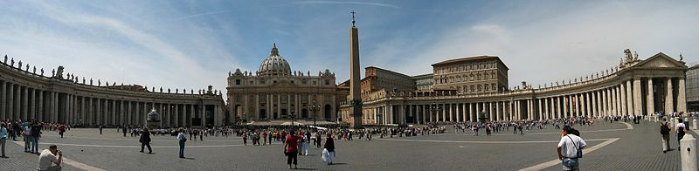
St. Peter’s Basilica Today
Remains the largest Church in Christendom
The center of Catholicism world-wide
Important place of pilgrimage

Slide 14
Other Waypoints
Church of Holy Sepulcher, Jerusalem
San Clemente, Rome
Site of Council of Nicaea, Turkey
Canterbury Cathedral, England
Santiago de Compostela, Spain
Acre, Israel
Lourdes, France
Cathedral of Cusco, Peru
Site of execution of 26 martyrs in Nagasaki, Japan
Martyrs Shrine in Ontario, Canada
Shrine of St. Charles Lwanga and Companions, Uganda
Motherhouse of Missionaries of Charity, Calcutta, India

