Slide 1
Episode 4: The Baptistery at St. John Lateran
Dr. Ann T. Orlando
Hymn: Easter Exultet

Slide 2
Waypoint timeline
Theme: Baptism

Slide 3
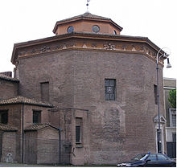
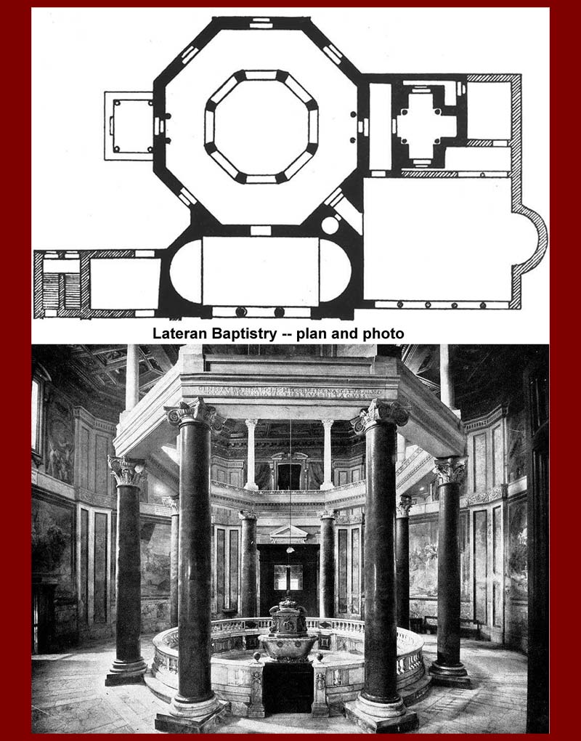
Baptistery Introduction
Built by Emperor Constantine the Great c. 312
One of the first Christian buildings in Rome
Octagonal shape
Deep pool at center for full immersion baptism
Columns around the pool added in 5th C by Pope Sixtus III (432-40)
Baptistery part of a larger complex including St. John Lateran Basilica
Original Basilica greatly renovated and changed in later centuries

Slide 4
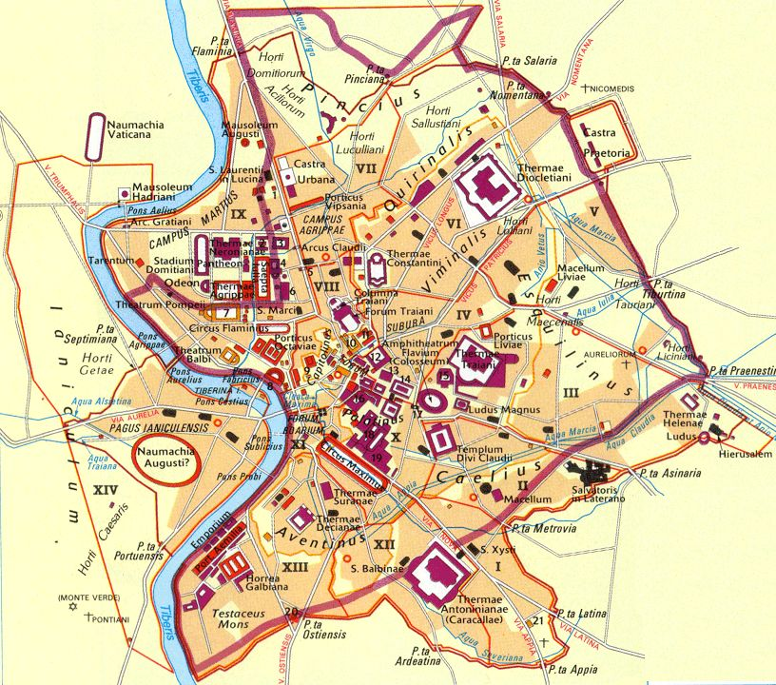
Map of Rome 4th C

Slide 5
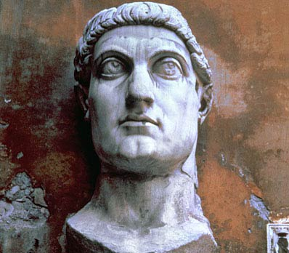
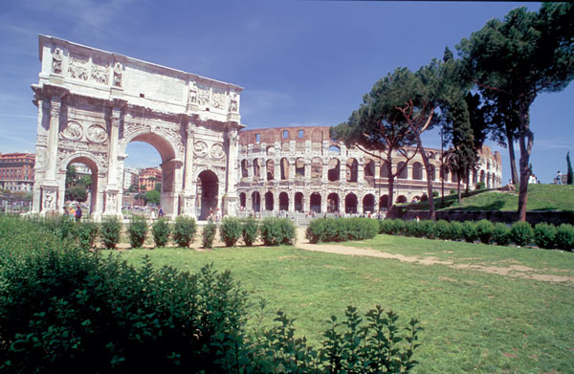
History Behind St. John Lateran Baptistery: Constantine the Great
Born in England, c. 274
His mother, St. Helena is a Christian
Fought and won a civil war in Roman Empire 311 - 313
Key to Constantine’s take-over of entire Empire was battle of Milvian bridge over Tiber in Rome.
Constantine credits his victory to a vision he had in which he was told to go into battle with the Christian symbol
Troops carry chi-rho on their shields
By 313 Constantine has captured all of the Empire and officially declared that Christianity was to be tolerated (Edict of Milan)
‘Gives’ most of Rome to the Catholic Church (Vatican, St. Paul outside the Walls, Lateran)
Establishes Constantinople (on site of ancient Byzantium) as his new capital
Dies in 337, having reigned as the first Christian Emperor for 25 years

Slide 6
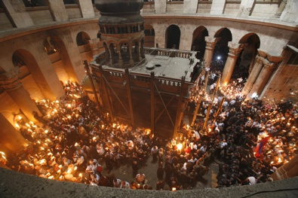
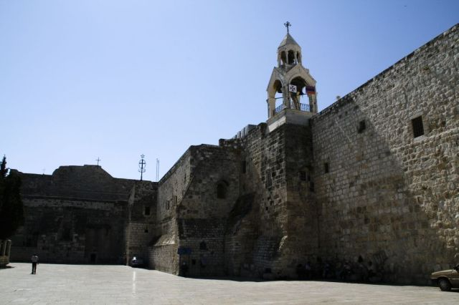
Impact of Constantine on Church
Builds Churches, with his mother St. Helen, in Holy Land
Moves against the heretics in North Africa
Calls Council of Nicea
Move against Arian heretics
The Nicene Creed
Sunday as a day of rest
Bishops become very important members of civil as well as ecclesial society

Slide 7

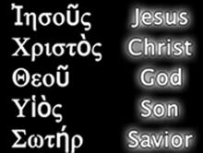
Baptism in the Early Church
In the Gospels: Conclusion of Matthew’s Gospel
Martyrdom as Baptism by Blood
Usually Baptism for adults after a long period as catechumens
Fish as one of earliest Christian symbols
Water of Baptism
Acrostic in Greek of Jesus Christ Son of God, Savior
Tertullian
Christian Theologian d. 212
Wrote many Christian works in Latin
On Baptism, “But we, little fishes, after the example of our ΙΧΘΥΣ Jesus Christ, are born in water, nor have we safety in any other way than by permanently abiding in water” Ch. 1

Slide 8
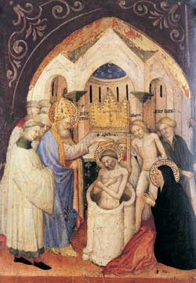
St. Ambrose
Prefect in Milan (Western Capital)
Acclaimed Bishop by the people of Milan
Baptized, Ordained Priest, Bishop in same week
Not unusual since adult baptism was the norm
Politically more important than Pope (Siricius) because Milan more important than Rome
Encouraged singing during the liturgy
Easter exultet
God the creator
Baptized St. Augustine at Easter Vigil Mass, 24 April 387
Feast Day December 7

Slide 9
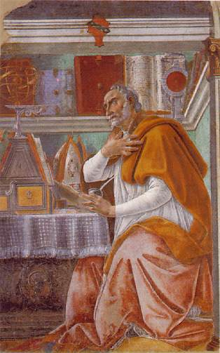
St. Augustine
Born near Carthage in 354 to a devoutly Catholic mother, St. Monica, and worldly father
In youth leads a life of worldly pleasure searching for happiness
Conversion to Catholic Christianity while visiting in Milan
Listening to St. Ambrose’s sermons
Ordained priest 391, bishop of Hippo 395
Died on 28 August 430
St. Monica’s Feast Day is 27 August
St. Augustine’s Feast Day is 28 August
St. Augustine is the most important of all Western Christian theologians or philosophers
Twice as many references to Augustine than any other theologian in CCC

Slide 10
Critical Issues for and Key Works by Augustine
Happiness
Relation between human nature and God’s grace
Trinity
Epistemology
Theory of Language
Primacy of love;
Man as a social being who should be completely motivated by properly ordered loves
“Love and do whatever you will”
Importance of friendship
Sacramental theology
Infant baptism
On Free Will
Confessions
On Trinity
On Christian Teaching
Literal interpretation of Genesis
Tractates on St. John’s Gospel

Slide 11
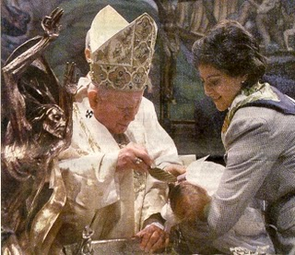
Infant Baptism
In early Church, most people were converts
Adult baptism
Baptism by Blood
After Constantine, practice of primarily adult baptism continued
St. Augustine argued forcefully that Baptism should be available to all as soon as possible
Graces from Baptism
Remedy for original sin

Slide 12
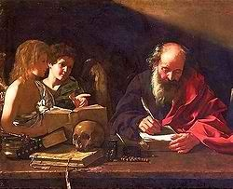
Four Latin Fathers of Church
St. Ambrose
St. Augustine
St. Jerome
Pope St. Gregory the Great

Slide 13
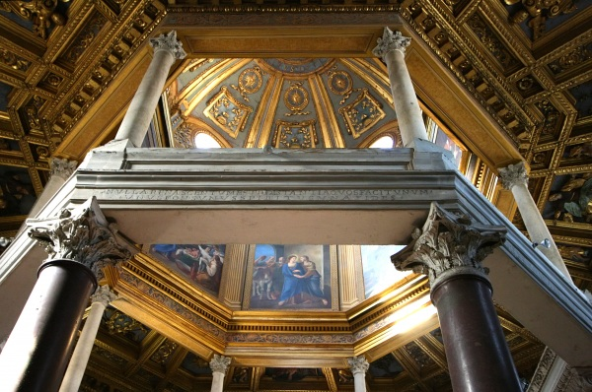
Later History of St. John Lateran Baptistery
In continuous use since 4th C
Baptisms still occur there
Basilica of St. John Lateran is Cathedral for Pope as Bishop of Rome

Slide 14
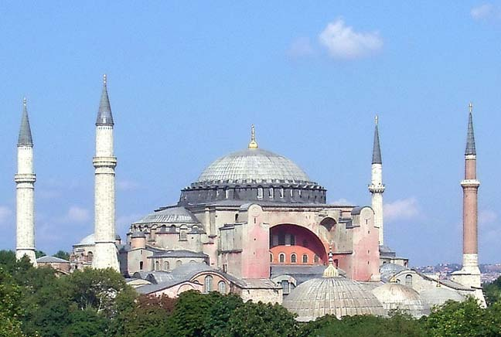
Next Waypoint: Hagia Sophia

Slide 15
Web Resources
Tertullian, On Baptism, http://www.newadvent.org/fathers/0321.htm

