Slide 1
Episode 5 Waypoint Hagia Sophia
Dr. Ann T. Orlando
Music: Byzantine ‘Kyrie Eleison’

Slide 2
Timeline
Theme: Development of Eastern (Orthodox) Christianity
‘Catholic’ and ‘Orthodox’ synonymously until early Middle Ages

Slide 3
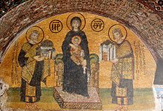
Building of Hagia Sophia
Hagia Sophia, Greek for Holy Wisdom, was first built by Constantine the Great in his new city of Constantinople (New Rome) in 4th C
St. Andrew, apostle and brother of St. Peter, as the patron
After series of calamities including an earthquake and riots, this building was destroyed in the early 6th C
Rebuilt by Emperor Justinian
Dedicated in 537
Basically building we have now

Slide 4
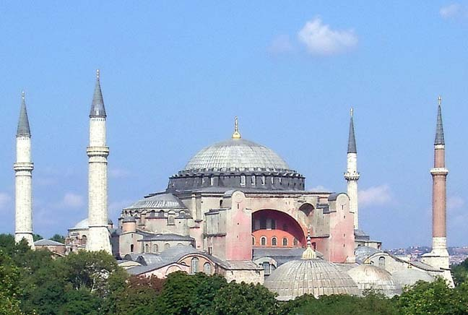
Architecture of Hagia Sophia
Most sophisticated and stunning building in the world
Remained largest Christian Church for nearly 1,000 years
Domes and vaults new dimension in architecture
Mosaics new development in Christian art

Slide 5
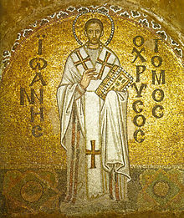
Ecclesial Importance of Hagia Sophia
Cathedral Church for most important Eastern Bishop, the Patriarch of Constantinople
Many important theologians were associated with Hagia Sophia; Greek Fathers and Doctors of the Church
St. Gregory Nazianzus (325-389, Feast Day Jan 2)
St. John Chrysostom (347-407, Feast Day Sept 13 )

Slide 6
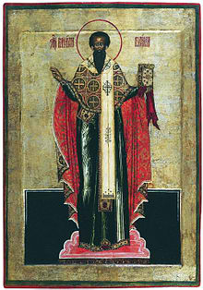
Four Greek Fathers of Church
St. Athanasius
St. Basil the Great
St. Gregory Nazianzus
St. John Chrysostom

Slide 7
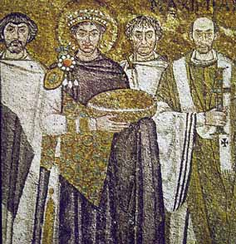
Emperor Justinian
Became emperor in 525 (b. 482-d. 565)
Briefly won back part of Italy from the German barbarians
Built ‘Byzantine’ churches throughout the Mediterranean
Famous for revising the ‘Roman’ Law Code

Slide 8
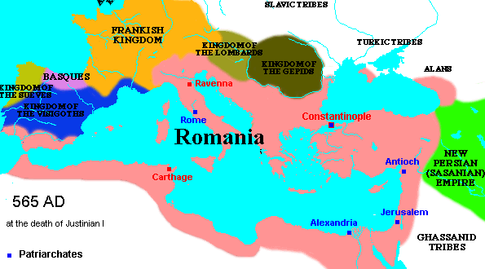
Byzantine Empire
Some historian begin the ‘Byzantine’ Empire with Justinian
Byzantine is a 19th C term
Greek-speaking, Eastern Roman Empire
Endure until 1453
Greatest enemy rises in the 7th C from the Arab deserts: Islam

Slide 9
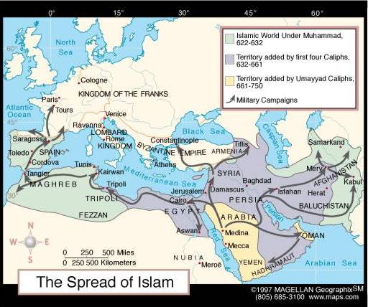
Rise of Islam
Muhammad (570-632)
The flight from Mecca to Medina (622) is beginning of Muslim calendar (prior to this time, referred to a Age of Ignorance)
Qur’an is revelation given to Muhammad; its language, Arabic, is part of that revelation
Founded a religious and political movement aimed at uniting all Arab tribes.
By 716 all of North Africa, Sicily and the Iberian peninsula was under Muslim control
By 730 France and Constantinople were threatened

Slide 10
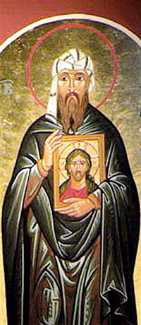
Icons and Iconoclasm
To counter Islam, some Byzantine Emperors in 8th C attempt to destroy all icons
Supported “image breaking” iconoclasm as a way to attract Muslims to Christian orthodoxy
Eastern monks vehemently opposed iconoclasts
St. John Damascene (675-749, Feast Day Dec. 4 )
Monk at St. Sabas near Jerusalem
Strong theological defense of icons
Differentiated types of worship and honor (CCC)
Doctor of Church who wrote extensively on Assumption of May

Slide 11
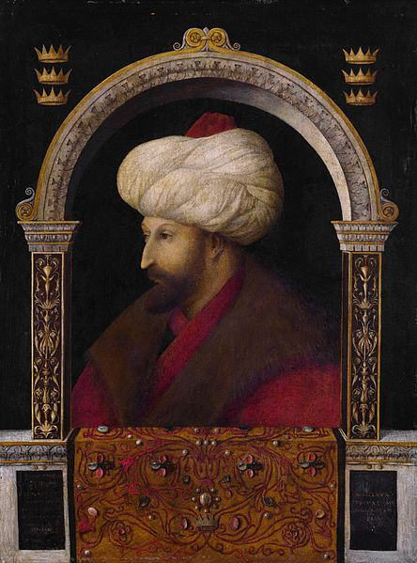
Fall of Constantinople
Turkish tribes from steppes of central Asia, though Muslims, started to invade Arab-dominated territories of Persia and Mesopotamia
As they moved West, led to conflicts with Byzantine Empire
Crusades started as an effort by the West to defend Christian East and to re-capture Holy Land
But Crusaders did irreparable harm to Byzantium, especially in 4th Crusade of 1204
Constantinople finally fell to the Turks led by Mehmet II in 1453
On entering Hagia Sopia, he stopped to pray there, turning it immediately into a mosque
Mosaics and other Christian decorations were white-washed
Name of Constantinople changed to Istanbul
Mehmet II was beginning of Ottoman Empire
Lasted until end of World War I

Slide 12
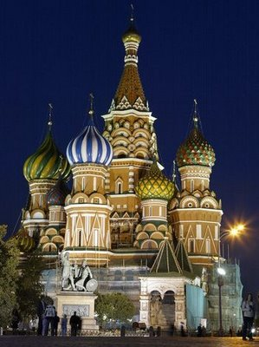
Expansion of Orthodoxy to Russia
Prince Vladimir of Kiev converts to orthodox Christianity in 989
Orthodox missionaries to Slavs and Eastern Vikings introduce Greek letters
Kiev is ‘capital’ of Russian orthodoxy until transfer to Moscow in 13th C
When Constantinople (New Rome) falls, Moscow becomes for Orthodox world ‘Third Rome’ until Russian Revolution
St. Basil’s built by Ivan the terrible in 1555 at center of Moscow
A museum today

Slide 13
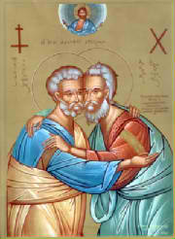
Relations Between Roman Catholic and Orthodox Churches
Over the centuries Greek-speaking East and Latin-speaking West drifted apart
Political and some theological issues
Ecclesial role of papacy
In 1054 the Pope and Patriarch of Constantinople declared each other anathema
Pope Paul VI and Patriarch Athenagoras met in Jerusalem in 1964 and lifted the anathemas

Slide 14
Hagia Sophia Today
In 1930s Ataturk became first president of secular government in Turkey, converted Hagia Sophia to a museum
The museum is one of most important tourist locations in Turkey
Many of the early Christian mosaics and frescoes are being restored
But still a very politically and religiously sensitive location

Slide 15
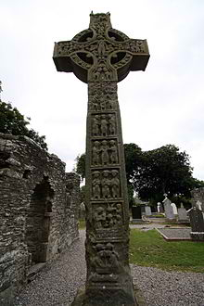
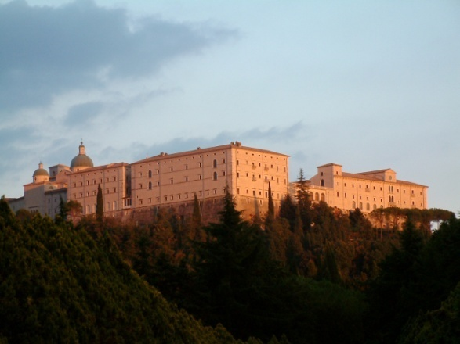
Next Waypoints: Development of Monasticism
Irish Monasticism
Benedictines

