Slide 1
Episode 7: Aachen Cathedral
Music: Theodulf, “All Glory Laud and Honor”

Slide 2
Waypoints Timeline
Theme: The Church and the Formation of ‘political’ Europe

Slide 3
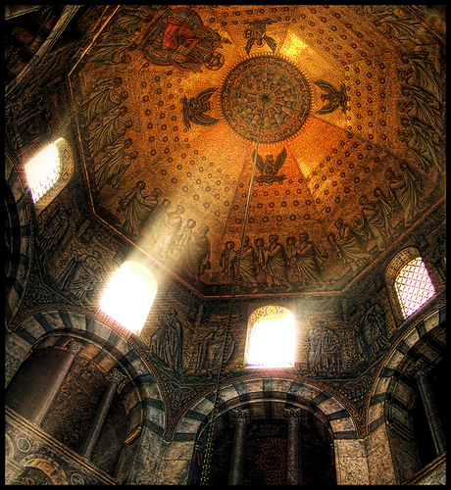
Aachen Cathedral
Built by Charlemagne in 805 at his capital in Aachen, Germany
Octagonal plan based on earlier Byzantine churches in Italy
Most ornate church in northern Europe for centuries

Slide 4
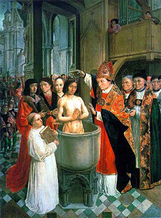
Beginning of Christianity Among Franks
Conversion of Chlodwech (Clovis) 496 in Rheims as a Catholic Christian
Clovis is beginning of Merovingian dynasty in France
Baptized by St. Remigius (437-533; Feast Day 1 October), bishop of Rheims
After Clovis, there are close ties between Frankish king and the papacy
Charlemagne’s grandfather, Charles Martel, defeats the Muslims threatening Europe at Tours
Pepin the Short, Charlemagne’s grandfather, defeats the Lombards in Italy who were threatening the papacy
Charlemagne comes from a long line of Catholic rulers in France

Slide 5
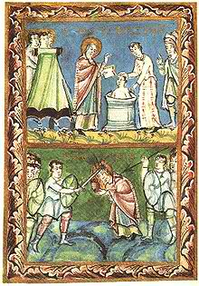
Frankish Encouragement of Continuing Missionary Activities
Boniface, aka Winifred, 672-755
Influenced by Irish monasticism
Goes to Rome in 717 to get approval of Pope Gregory II; gets mission to preach north of Rhine
May have crowned Pepin the Short, Charlemagne’s father
Martyred in northern Holland, 755

Slide 6
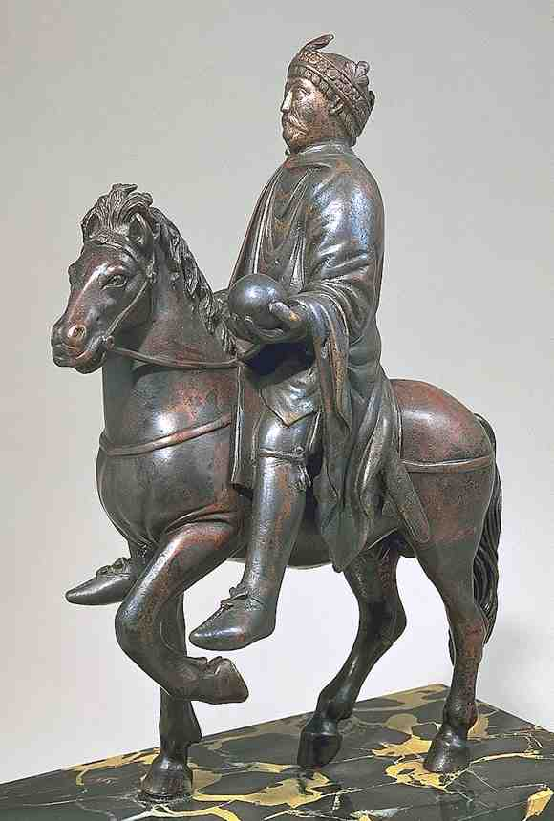
Charlemagne (747-814)
Born in Aachen in 747 to Pepin the Short and his wife, Bertha the Big Foot
Reclaimed parts of northeastern Spain from Muslims (Song of Roland)
Defeated Saxons and forced their conversion to Catholicism
Defeats Lombards in 774
United Western Europe; established capital at Aachen (Aix-la-Chapelle)
Crowned Holy Roman Emperor by Pope Leo III in Rome Christmas Day 800

Slide 7
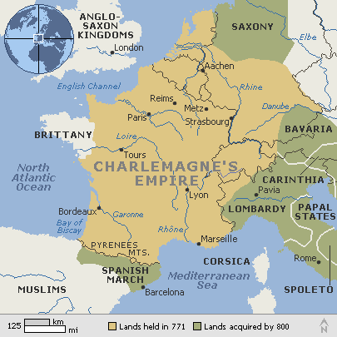
Charlemagne’s Empire
Included most of France, low countries, western Germany
Governed by a system of civil and ecclesial leaders
Bishops take an increasingly secular as well as ecclesial role;
Usually best educated
Church was a large land owners
Custom develops that the king appoints bishops
Practice of lay investiture

Slide 8
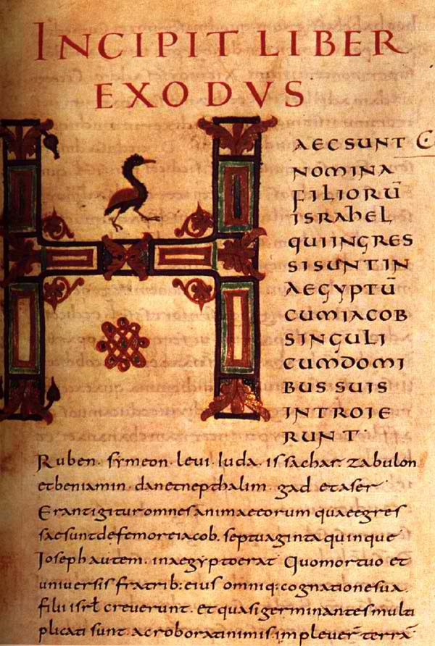
Monastic Scholarship in Charlemagne’s Court
Charlemagne established a center of learning that drew monastic scholars from across Europe
Alcuin of York (735-804)
Advises Charlemagne on religious and educational matters
Established cathedral schools and libraries
Attempt to revise and standard liturgy, and Latin in liturgy
Theodulf of Orleans (760-821)
Wrote Libri Carolini
Author of many poems and hymns, including “All Glory, Laud and Honor”
Development of Carolingian script
Capital and lower case letters
Easy to read letters

Slide 9
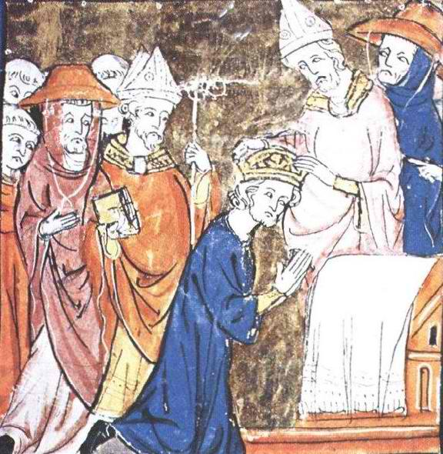
Impact of Charlemagne’s Rule
Enforced Latin, Roman liturgy
Established centers of learning for clergy and monks (although he could not read)
Set up European-wide system of administration
Establish precedent of Western Holy Roman Empire
Cemented special relationship between Pope and France
Charlemagne considered a saint in region around Aachen

Slide 10
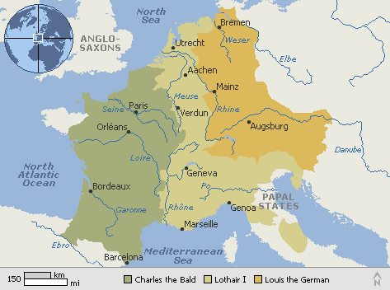
After Charlemagne
Kingdom divided among his three sons at Treaty of Verdun
Sons are weakened rulers, creating a power vacuum
Lingering problem: who’s in charge politically, Pope or King
Viking invasions begin during Charlemagne’s lifetime, and increase throughout Europe in 9th and 10th C

Slide 11
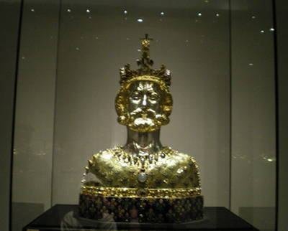
Aachen Cathedral Today
An important cathedral in Germany
An example of best architecture of early Medieval Europe
Houses Charlemagne’s throne and the later Medieval reliquary of Charlemagne

Slide 12
Next Waypoint: Assisi, Italy

