Slide 1
Episode 8: Assisi
Dr. Ann T. Orlando
Music “All Creatures of Our God and King”

Slide 2
Timeline
Theme: new types of monastic orders, the mendacants

Slide 3
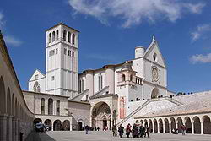
Franciscan Basilica
Begun immediately after Francis’ death in 1226
One fo Francis’ earliest followers supervised beginning of Basilica
Really two basilicas, an upper and a lower one
Site of Francis’ tomb
This is the ‘Mother House’ of Franciscan order
Many famous Italian artists, including Cimabue and Giotto, painted frescos

Slide 4
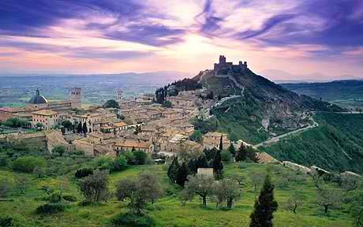
Assisi at the Time Francis was Born (1181)
Wealthy hill town in Tuscany
Francis’ father was a cloth merchant
Assisi was often at war with other nearby towns
Francis joined the Assisi troops as a young man and was captured in a skirmish with Perugia

Slide 5
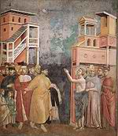
Francis Begins His Spiritual Journey
After returning to Assisi in a prisoner exchange, Francis started to pray and look for a different way of life
He went to Rome on a pilgrimage and on returning stopped to pray at the deserted church of St. Damiano
A voice tells Francis to ‘rebuild my Church’
Francis used money from his father’s business to buy materials
His Father, angered by this, brought Francis before the bishop to be admonished
Francis stripped himself naked, saying he wanted nothing from his father
Francis starts to lead a mendicant life, saying he would be poor as Christ was poor

Slide 6
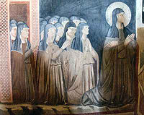
A Group Gathers Around Francis
Some people were shocked by Francis’ life-style
But some wanted to join him in his way of life
Francis’ holiness and gentleness with all God’s creatures led to many stories about Francis
Francis and the wolf of Gubbio
San Damiano became the Church for St. Clare and her followers, the ‘poor Clares’

Slide 7
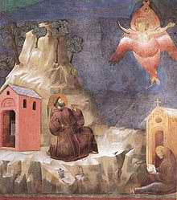
Francis’ Spirituality
Total embrace of ‘Lady Poverty’, not ‘Lady Wisdom’ as way of life
Francis’ Rule emphasizes walking in poverty in the footsteps of Jesus;
Pilgrimage to Holy Land;
Met the sultan
Rules for Franciscans to live in Holy Land with Muslims
Emphasis on tangible religious experience:
Christmas crib
Stigmata as a sign of Francis’ identification with Jesus
Francis was most famous man in Europe in his lifetime; his order grew explosively
Poet: Canticle of the Sun, Prayer of St. Francis
Feast Day is Oct. 4

Slide 8
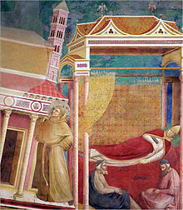
Spiritual Movements: New Orders
Franciscans
Dominicans
Both start as mendicants, very different from Benedictines
Not in a monastery
Vocation is among God’s people
Both approved by Innocent III

Slide 9
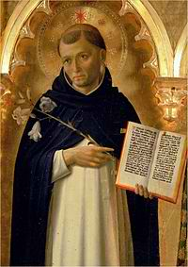
Dominic (1170-1221)
Born in Spain; he traveled to southern France to preach against the Albigensian heresy
Founded a school for French women
First order of Dominicans were nuns
Received permission from Innocent III to found an order of preachers to preach Catholic orthodoxy

Slide 10
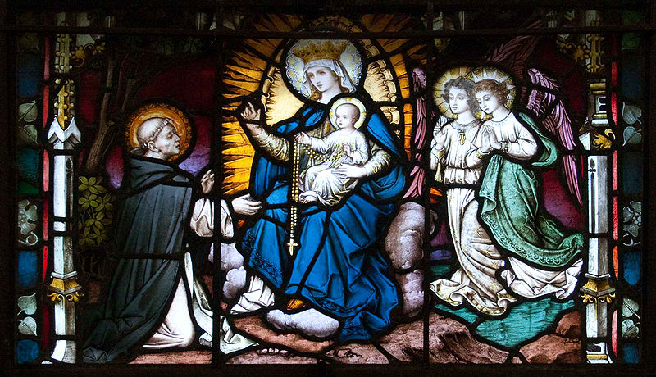
Dominican Spirituality
Rule based on Augustine’s Rule: clergy who lived together but worked among lay people
Also basis for other Medieval Orders
Dominican Rule emphasized study and preaching
Rosary was and remains especially important to Dominicans
Mary appeared to Dominic and gave him a rosary
Established the form the Rosary has today
Feast day is August 8

Slide 11
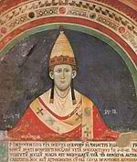
Pope Innocent III (1160 – 1216)
Born in Anagani, Italy
Studied in Rome, Paris and Bologna
Greatest universities of the time
Elected Pope in 1198
Died in Rome, 1216

Slide 12
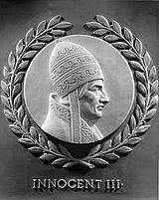
Key Points of Pontificate of Innocent III
Expanded role of papacy in secular affairs
Expanded Canon Law
Called the Fourth Crusade
Convened the Fourth Lateran Council
Approved Dominican and Franciscan orders

Slide 13
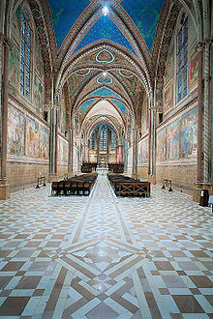
Franciscans and Dominicans
Shortly after Francis dies in 1226, the order becomes conflicted about its future
‘Conventual’ Franciscans relax some aspects of Francis’ extreme poverty
‘Spiritual’ Franciscans continued to live as Francis had
Dominicans become dominant force in early European universities
In the 16th C both orders will be missionaries to the world
Both orders continue to exercise their special gifts throughout the world today

Slide 14
Next Waypoint
Notre Dame, Paris

