Slide 1
Episode 9: Notre Dame
Dr. Ann T. Orlando
Music ‘Pange Lingua’

Slide 2
Timeline
Theme: The Church and Development of Universities

Slide 3
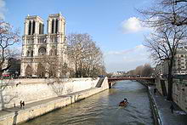
Building the Cathedral of Notre Dame
By tradition, the first stone was laid in 1163
But not completed until 1250, with additional work after that for the next several centuries
Built in the ‘Gothic’ style that became the standard for grand church architecture throughout Europe in the Middle Ages
As the primary cathedral of Paris, Notre Dame assumed an important role in Church and French political history

Slide 4
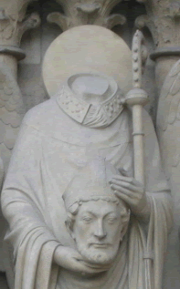
Early Paris
Paris started as a Roman town, Lutetium
Renamed Paris in 3rd C after local Celtic tribe
First Christian missionaries probably sent by Pope Fabian in 3rd C
First bishop was Dionysius, or Denis
St. Denis and his companions was martyred by the Romans on Montmarte (Mont of the martyrs)
There may have been a pagan temple where Notre Dame now stands
After Constantine the Great, several churches were built in Paris, including one on the site of Notre Dame

Slide 5
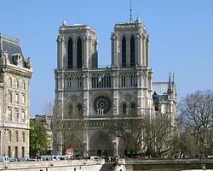
Importance of Paris in Middle Ages
During the Middle Ages, Paris was transformed from a small fishing and trading town to an important political capital
With this transformation, Church in Paris also became very important
A place of learning

Slide 6
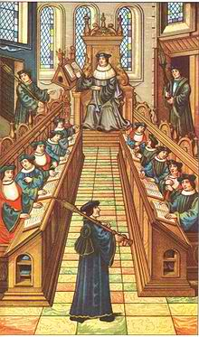
Beginning of University System
Churches, especially cathedrals, and monasteries were primary sources of education for over 1,000 years in Europe
During 11th C, Pope Gregory VII initiated many reforms, including requirements for education of secular clergy
Bishops established cathedral schools
Education focused on Canon law, administration, higher learning
Enrollment not limited to clergy
The university system as we know it today grew out of the Cathedral schools of the Middle Ages
Most famous and important was the Cathedral School of Notre Dame
Became the University of Paris, also known as the Sorbonne
Students from all over Europe sought to enter the most prestigious schools
To be an universitas an institution had to recognized as such by the Vatican
‘Nation’ was a fraternal group of students at the major universities who came from the same region and spoke the same language

Slide 7
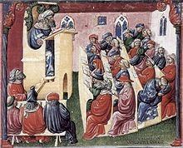
Medieval University Degrees
Bachelors degree
Six years to obtain
Study of seven liberal arts
Masters degree
Four to six more years
Specialization in Law, medicine or theology
Theology was most important and prestigious
Holder of masters degree could teach others
Doctorate
Several more years of study
Holder could teach at most prestigious universities
Two great professors, theologians and doctors of the Church in 13th C
St. Thomas Aquinas, Dominican
St. Bonaventure, Franciscan

Slide 8
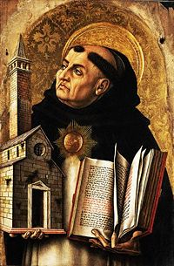
St. Thomas Aquinas (1225-1274)
Born in Italy, studied in Italy and Paris
Dominican
Student and professor at University of Paris
Key Influences
Albert the Great
Church Fathers
Aristotle
Earlier Aristotelian commentators, especially Averroes and Maimonides
Feast Day is January 28

Slide 9
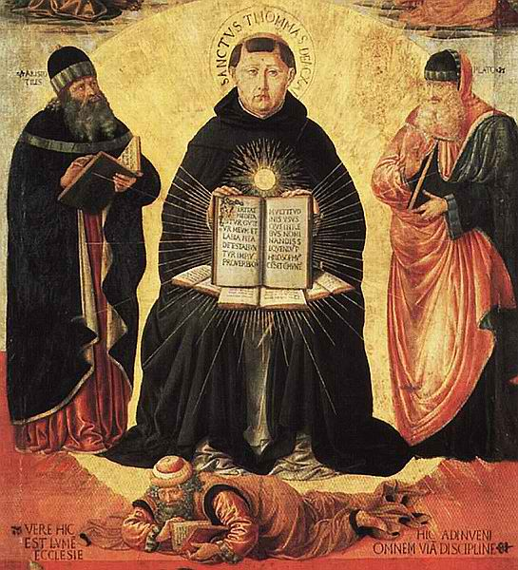
Thomas Aquinas Angelic Doctor
Developed systematic approach to theology using Aristotelian methods (Aristotle as the Philosopher in the Summa)
Relied on newly available Greek works from Jewish and Moslem sources; Moses Maimonides, Averrhoes
Very different from theological approach; Aristotelian rather than neo-Platonic
Emphasis on causes
Emphasis on categories
Two great works: Summa Theologica (theological) or Theologiae (theology); Summa Contra Gentiles
But he also wrote beautiful songs, especially in praise of Eucharist (one of which we sing at Benediction, and another during Holy Thursday)

Slide 10
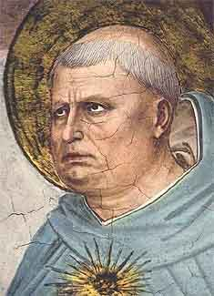
Adoro Te Devote by Thomas Aquinas
Godhead here in hiding, whom I do adore
Masked by these bare shadows, shape and nothing more,
See, Lord, at thy service low lies here a heart
Lost, all lost in wonder at the God thou art.
Seeing, touching, tasting are in thee deceived;
How says trusty hearing? that shall be believed;
What God's Son has told me, take for truth I do;
Truth himself speaks truly or there's nothing true.
From CCC translated by Gerard Manley Hopkins

Slide 11
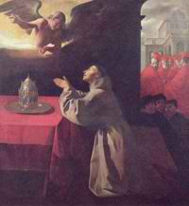
St. Bonaventure (1221-1274)
Student and professor at University of Paris when Aquinas was there
Becomes head of Franciscans shortly after Francis
Describes Franciscan way of life in philosophical terms
Very dependent on St. Augustine
Known as the Seraphic Doctor, Feast Day July 15

Slide 12
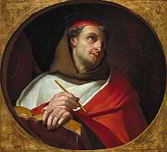
Itinerarium or Journey of the Mind to God
Written as a retreat guide for students at University of Paris
Details steps of spiritual progress
Mimics pilgrimage itinerary
Approach God by leaving world behind
Deeply mystical work

Slide 13
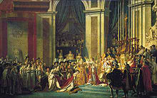
Later History of Notre Dame Cathedral
During the French Revolution, 1789-1799, Notre Dame was taken over by the enlightenment revolutionaries
Turned into a ‘temple of reason’
Most of the religious decorations and stained glass were defaced
Restored to the Church by Napoleon in 1802
Extensive restoration efforts
Re-dedicated in 1864
Remains the primary Cathedral of Paris today
And the University of Paris, remains one of the most important universities in the world

Slide 14
Next Waypoint
The Renaissance and the Sistine Chapel

