Slide 1
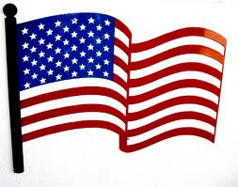
The American
Presidential Election
Process
3 October 2012

Slide 2
Introduction
Types of American Democratic Elections
  Direct
  Indirect
Presidential Elections
  Defined in U.S. Constitution
  Electoral College Makeup
  Rationale for this system
American Party System
  NOT in the U.S. Constitution
  But part of American politics since 1800

Slide 3
Direct Democratic Elections
Elected Officials are decided by a majority of voters
  Requires > 50% of vote
  If more than 2 candidates, with no one candidate getting > 51% of vote, then there is a run-off
Almost all U.S. State offices
  Governors, City Mayors, Senators, Congressmen

Slide 4
Indirect Democratic Election
Voters do not actually vote for candidates, but instead vote for representatives who will vote for candidates
Examples
  Parliamentary prime ministers
  President of Germany
  President of United States

Slide 5
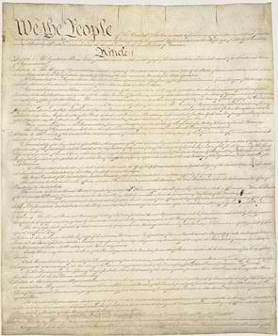
U. S. Presidential Elections
Election Process defined in U.S. Constitution (1791) and the 12th and 24th Amendments.
  President must be native born citizen, older than 35 and been a resident within the United States for 14 years
  Elections every 4 years for President and Vice-President
A separate body, the Electoral College, is elected by each State
  Total number of electors for each State is equal to the number of representatives (proportional to population) and senators (2 for each state)
  But no sitting senator or representative and be an elector
Elector College convenes to elect President and Vice-President by majority vote
  In 2012 race 270 electoral votes out of a total of 538 are need to win presidency

Slide 6
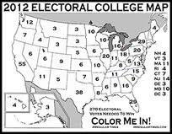
Electoral College Vote Distribution 2012 Election

Slide 7
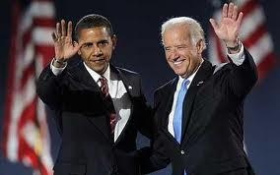
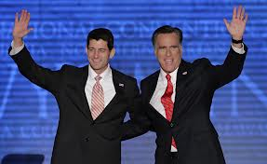
Who Do Americans Vote For…
The names on the ballots will be
  Barack Obama and Joseph Biden, Democrats
  Mitt Romney and Paul Ryan, Republicans
But actually voting for a slate of electors (11 in MA)
  One slate pledged to Democratic candidates
  Other slate pledged to Republican candidates
  But, pledge electors are not required to cast vote for their pledged candidate

Slide 8
Implications of Electoral System
To increase a State’s importance in election, all States (except Nebraska) have a winner take-all system
Elected President does not have to receive most popular votes
  Happened four times (Bush v Gore in 2000 most recently)
  Favors smaller States
Focus of election is on perceived ‘swing’ States, especially those with large numbers of electors

Slide 9
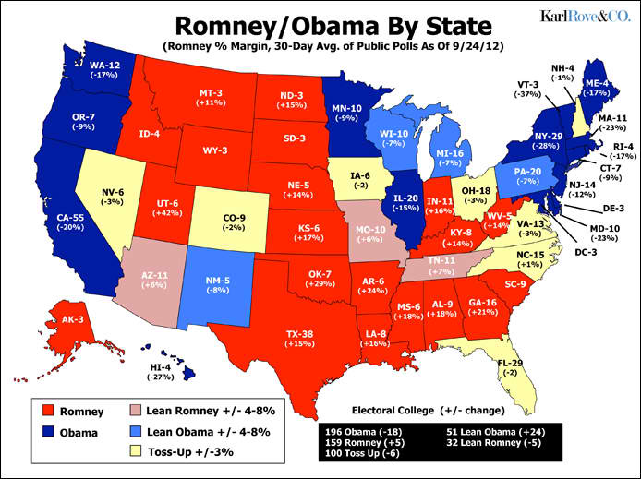
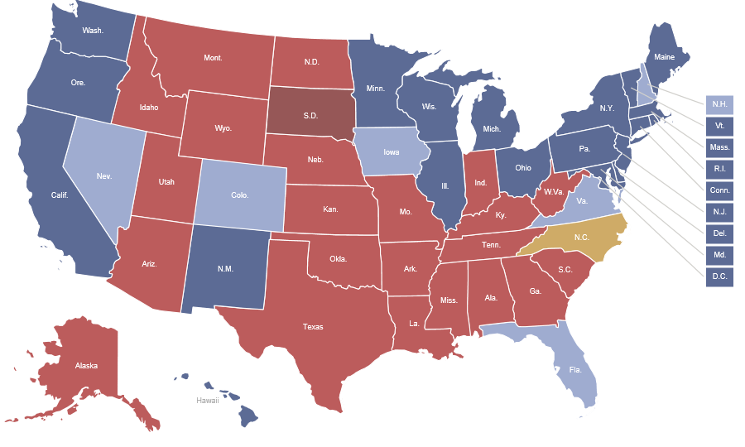
Two Current Poll-Based Expected Distribution of Electoral Votes
Source: Karl Rove (Republican)
Source: Huffington Post (Democratic)

Slide 10
American Political Parties
A Very Brief History
Parties (Republican, Democratic, Green, etc.) are NOT mentioned in U.S. Constitution
Earliest Parties (1790-1826) develop around candidates seeking to succeed George Washington (1st President)
  Federalist, stronger Federal Government (John Adams, 2nd President)
  Democratic-Republican, stronger support for individual and State’s rights (Thomas Jefferson, 3rd President)
Mid-19th C Foundation of Republican Party in opposition to slavery and opposition to State secession
  Lincoln (Republican candidate) victory precipitated American Civil War
Aftermath of Civil War
  Strong regional attachment of especially white population to Southern States to Democratic Party
  Strong North-Eastern States attachment to Republican Party
  This way until 1970s
Major shift in Party politics and alliances due to American depression (1930s), Civil Rights movement (1960s), war in Vietnam (1970s) and dramatic social changes (ongoing)
Now many views held by Republicans would have been more like views previously held by Democrats

Slide 11
How Parties Select
Presidential Candidates
Determined by each Party
  But always State-based
  At Party convention, delegates from each State vote for candidates
  Majority vote determines party candidate
Methods to choose convention delegates varies by State
  Caucus of party members
  Primaries
    Votes by registered party members
    Sometimes independents

Slide 12

Conclusion
Electing President not straight forward in U.S.
Constitution and Party system implies a tiered set of indirect votes
  First at the State Party level
  Then in general election (6 November this year)
  Always tilts toward favoring smaller States

