Slide 1

monogamy of non-signalling correlations
Aram Harrow (MIT)
Simons Institute, 27 Feb 2014
based on joint work with
Fernando Brandão (UCL)
arXiv:1210.6367 + εunpublished

Slide 2
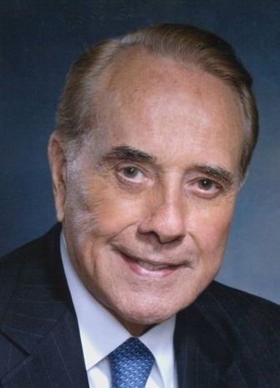

“correlations”
(multipartite conditional probability distributions)
a
b
x
y
local | p(x,y|a,b) = q_{A}(x|a) q_{B}(y|b)
LHV (local hidden variable) | p(x,y|a,b) = ∑_{r} π(r) q_{A}(x|a,r) q_{B}(y|b,r)
quantum | p(x,y|a,b) = hÃ| Aª_{x} ⊗ B^{b}_{y} |Ãi with ∑_{x} Aª_{x} = ∑_{y} B^{b}_{y} = I
non-signalling | ∑_{y} p(x,y|a,b) = ∑_{y} p(x,y|a,b’) ∑_{x} p(x,y|a,b) = ∑_{x} p(x,y|a’,b)

Slide 3

why study boxes?
Foundational: considering theories more general
than quantum mechanics (e.g. Bell’s Theorem)
Operational: behavior of quantum states under
local measurement (e.g. this work)
Computational: corresponds to constraint-satisfaction problems and multi-prover proof systems.

Slide 4

why non-signalling?
Foundational: minimal assumption for plausible theory
Operational: yields well-defined “partial trace”
p(x|a) := ∑_{y} p(x,y|a,b) for any choice of b
Computational: yields efficient linear program

Slide 5
the dual picture: games
Non-local games:
Inputs chosen according to µ(a,b)
Payoff function is V(x,y|a,b)
The value of a game using strategy p is
∑_{x,y,a,b} p(x,y|a,b) µ(a,b) V(x,y|a,b).
Complexity:
classical (local or LHV) value is NP-hard
quantum value has unknown complexity
non-signalling value in P due to linear programming

Slide 6
monogamy
p(x,y|a,b) is k-extendable if there exists a NS box
q(x,y₁,…,y_{k}|a,b₁,…,b_{k}) with q(x,y_{i}|a,b_{i}) = p(x,y_{i}|a,b_{i}) for each i
LHV correlations can be infinitely shared.
This is an alternate definition.
Applications
Non-shareability ≅ secrecy
can be certified by Bell tests
Gives a hierarchy of approximations for LHV correlations
running in time poly(|X| |Y|^{k} |A| |B|^{k})
de Finetti theorems (i.e. k-extendable states ≈ separable)

Slide 7
results
Theorem 1: If p is k-extendable and µ is a distribution on A, then there exists q∈LHV such that
cf. Terhal-Doherty-Schwab quant-ph/0210053
If k≥|B| then p∈LHV.
Theorem 2: If p(x₁,…,x_{k}|a₁,…,a_{k}) is symmetric, 0<n<k,
and µ = µ₁ ⊗ … ⊗ µ_{k} then ∃νsuch that
cf. Christandl-Toner 0712.0916
with q independent of µ

Slide 8
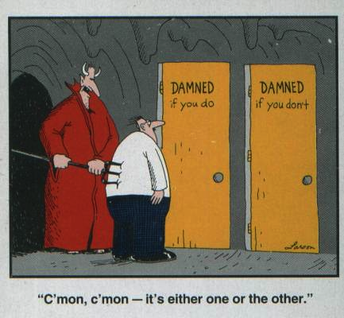
proof idea of thm 1
consider extension p(x,y₁,…,y_{k}|a,b₁,…,b_{k})
case 1
p(x,y₁|a,b₁) ≈
p(x|a) ⋅p(y₁|b₁)
case 2
p(x,y₂|y₁,a,b₁,b₂)
has less mutual
information

Slide 9
proof sketch of thm 1
∴ for some j we have
Y₁, …, Y_{j-1} constitute a “hidden variable” which we can
condition on to leave X,Y_{j} nearly decoupled.
Trace norm bound follows from Pinsker’s inequality.

Slide 10
what about the inputs?
Apply Pinsker here to show that this is
& || p(X,Y_{k} | A,b_{k}) – LHV ||₁²
then repeat for Y_{k-1}, …, Y₁

Slide 11
interlude: Nash equilibria
Non-cooperative games:
Players choose strategies p^{A} ∈ Δ_{m}, p^{B} ∈ Δ_{n}.
Receive values ⟨V_{A}, p^{A} ⊗ p^{B}⟩ and ⟨V_{B}, p^{A} ⊗ p^{B}⟩.
Nash equilibrium: neither player can improve own value
ε-approximate Nash: cannot improve value by > ε
Correlated equilibria:
Players follow joint strategy p^{AB} ∈ Δ_{mn}.
Receive values ⟨V_{A}, p^{AB}⟩ and ⟨V_{B}, p^{AB}⟩.
Cannot improve value by unilateral change.
Can find in poly(m,n) time with linear programming (LP).
Nash equilibrium = correlated equilibrum with p = p^{A} ⊗ p^{B}

Slide 12
finding (approximate) Nash eq
Known complexity:
Finding exact Nash eq. is PPAD complete.
Optimizing over exact Nash eq is NP-complete.
Algorithm for ε-approx Nash in time exp(log(m)log(n)/ε²)
based on enumerating over nets for Δ_{m}, Δ_{n}.
Planted clique reduces to optimizing over ε-approx Nash.
New result: Another algorithm for finding
ε-approximate Nash with the same run-time.
(uses k-extendable distributions)

Slide 13
algorithm for approx Nash
Search over
such that the A:B_{i} marginal is a correlated equilibrium
conditioned on any values for B₁, …, B_{i-1}.
LP, so runs in time poly(mn^{k})
Claim: Most conditional distributions are ≈ product.
Proof: 𝔼_{i} I(A:B_{i}|B_{<i}) ≤ log(m)/k.
∴ k = log(m)/ε² suffices.

Slide 14
application: free games
free games: µ = µ_{A} ⊗ µ_{B}
Corollary:
The classical value of a free game can be approximated
by optimizing over k-extendable non-signaling strategies.
run-time is polynomial in
(independently proved by Aaronson, Impagliazzo, Moshkovitz)
Corollary:
From known hardness results for free games, implies
that estimating the value of entangled games with √n
players and answer alphabets of size exp(√n) is at least
as hard as 3-SAT instances of length n.

Slide 15
application: de Finetti theorems for local measurements
Theorem 1’: If ρ^{AB} is k-extendable and µ is a distribution over quantum operations mapping A to A’, then there exists a separable state σ such that
Theorem 2’: If ρ is a symmetric state on A₁…A_{k} then there exists a measure ν on single-particle states such that
improvements on Brandão-Christandl-Yard 1010.1750
1) A’ dependence. 2) multipartite. 3) explicit. 4) simpler proof

Slide 16
ε-nets vs. info theory
Problem | ε-nets | info theory
approx Nash max_{p∈Δ} p^{T}Ap | LMM ‘03 | H. ‘14
free games | AIM ‘14 | Brandão-H ‘13
max_{ρ∈Sep} tr[Mρ] QMA(2) | Shi-Wu ‘11 Brandão ‘14 | BCY ‘10 Brandão-H ’12 BKS ‘13

Slide 17
general games?
Theorem 1: If p is k-extendable and µ is a distribution on A, then there exists q∈LHV such that
Can we remove the dependence of q on µ?
Conjecture?: p∈k-ext → ∃q∈LHV such that
would imply that non-signalling games (in P) can be used to
approximate the classical value of games (NP-hard)
(probably) FALSE

Slide 18
general quantum games
Conjecture: If ρ^{AB} is k-extendable, then there exists a separable state σ such that
Would yield alternate proofs of recent results of Vidick:
NP-hardness of entangled quantum games with 4 players
NEXP⊆MIP*
Proof would require strategies that work for quantum states
but not general non-signalling distributions.

Slide 19
application: BellQMA(m)
3-SAT on n variables is believed to require a proof of size
Ω(n) bits or qubits according to the ETH (Exp. Time Hypothesis)
Chen-Drucker 1011.0716 (building on Aaronson et al 0804.0802)
gave a 3-SAT proof using m = n^{1/2}polylog(n) states each with
O(log(n)) qubits (promised to be not entangled with each other).
Verifier uses local measurements and classical post-processing.
Our Theorem 2’ can simulate this with a m² log(n)-qubit proof.
Implies m ≥ (n/log(n))^{1/2} or else ETH is false.

Slide 20
other applications
tomography
Can do “pretty good tomography” on symmetric states instead of on product states.
polynomial optimization using SDP hierarchies
Can optimize certain polynomials over n-dim hypersphere using O(log n) rounds.
Suggests route to algorithms for unique games and small-set expansion.
multi-partite separability testing
can efficiently estimate 1-LOCC distance to Sep

Slide 21
open questions
Switch quantifiers and find a separable approximation
(a) independent of the distribution on measurements
(b) with error depending on the size of the output.
We know the non-signalling version of this is false. Can we find a simple counter-example?
Can one proof of size O(m²) simulate two proofs of size m?
i.e. is QMA = QMA(2)?
Better de Finetti theorems, perhaps combining with the exponential de Finetti theorems or the post-selection principle.
5. Unify ε-nets and information theory approaches.

