Slide 1
Using cryptography in databases and web applications
Nickolai Zeldovich
MIT CSAIL
Joint work with Raluca Ada Popa, Stephen Tu, Emily Stark, Jonas Helfer, Steven Valdez, Hari Balakrishnan, Frans Kaashoek, Sam Madden

Slide 2
Problem: private data breaches
server
clients
Secret
Secret
Secret
no computation
computation
storage
databases, web applications, mobile applications, machine learning, etc.
??
encryption
(encrypted files, email)

Slide 3
Common approach: prevent break-ins
server
clients
Secret
Secret
Enforced at many levels: operating system, hardware, network, programming language, …

Slide 4
Bad guys find ways to break in
Complex software has bugs
Attackers find and exploit vulnerabilities
Many people have access to infrastructure
Server administrators
Cloud / data center employees
Anyone that breaks into their accounts
Compromises are inevitable

Slide 5
New approach: practical processing of encrypted data
server
client
??
Strawman:
Result
Secret
Secret
Result
Secret
Secret

Slide 6
CryptDB setup
trusted client-side
under attack
transformed query
plain query
Database server
Proxy
Application
encrypted DB
decrypted results
encrypted results
Secret
Secret
Stores schema
and master key
Minimal or no query execution

Slide 7
Example
Application
Randomized encryption (RND) - semantic
x4be219
SELECT * FROM emp
x95c623
table1/emp
x2ea887
col1/rank
col2/name
col3/salary
x17cea7
Proxy
SELECT * FROM table1
x4be219
60
x95c623
100
x2ea887
800
x17cea7
100

Slide 8
Example
Application
Randomized encryption (RND)
Deterministic encryption (DET)
SELECT * FROM emp WHERE salary = 100
table1/emp
SELECT * FROM table1 WHERE col3 = x5a8c34
col1/rank
col2/name
col3/salary
Proxy
x934bc1
x4be219
60
x5a8c34
100
x95c623
x84a21c
x2ea887
800
x5a8c34
?
?
x5a8c34
x5a8c34
x17cea7
100
x5a8c34
x5a8c34

Slide 9
Example
Application
“Summable”
encryption (HOM) - semantic
Deterministic encryption (DET)
SELECT sum(salary) FROM emp
table1 (emp)
Proxy
SELECT cdb_sum(col3) FROM table1
col1/rank
col2/name
col3/salary
x934bc1
x9eab81
60
x5a8c34
x638e54
100
x84a21c
x122eb4
800
x5a8c34
1060
x72295a
x578b34
100

Slide 10
Example
Application
SELECT sqrt(sum(salary)) FROM emp
table1 (emp)
Proxy
SELECT cdb_sum(col3) FROM table1
col1/rank
col2/name
col3/salary
x934bc1
x9eab81
60
x5a8c34
x638e54
100
x84a21c
x122eb4
800
x5a8c34
1060
x72295a
x578b34
100

Slide 11
Example
Application
SELECT sqrt(sum(salary)) FROM emp
32.55
table1 (emp)
Proxy
SELECT cdb_sum(col3) FROM table1
col1/rank
col2/name
col3/salary
x934bc1
x9eab81
60
x5a8c34
x638e54
100
x84a21c
x122eb4
800
x5a8c34
1060
x72295a
x578b34
100

Slide 12
Techniques
Compute on encrypted data at the server
Use SQL-aware set of efficient encryption schemes
Adjust encryption of data based on queries
Compute on decrypted data at the proxy
Can decrypt → can perform any computation
Choose optimal split to reduce bandwidth, proxy load

Slide 13
SQL-aware encryption schemes
Security
Scheme
Construction
Function
SQL operations:
e.g., SELECT, UPDATE, DELETE, INSERT, COUNT
RND
AES in UFE
data moving
≈ semantic security
HOM
Paillier
addition
e.g., SUM, +
SEARCH
Song et al.,‘00
word search
restricted ILIKE
e.g., =, !=, IN, GROUP BY, DISTINCT
reveals only repeat pattern
DET
AES in CMC
equality
JOIN
our new scheme
join
e.g., >, <, ORDER BY, ASC, DESC, MAX, MIN, GREATEST, LEAST
reveals only order
OPE
our new scheme
order

Slide 14
Onion of encryptions
security
+
RND
DET
OPE
value
+
functionality
Adjust encryption: strip off layer of the onion

Slide 15
CryptDB works well in practice
Supports many database applications
Web sites, transactional processing, data analytics
Never reveals plaintext data on database server
Modest performance overheads
20-30% throughput loss for typical benchmarks
Approach now used by Google (among others)
Encrypted BigQuery service

Slide 16
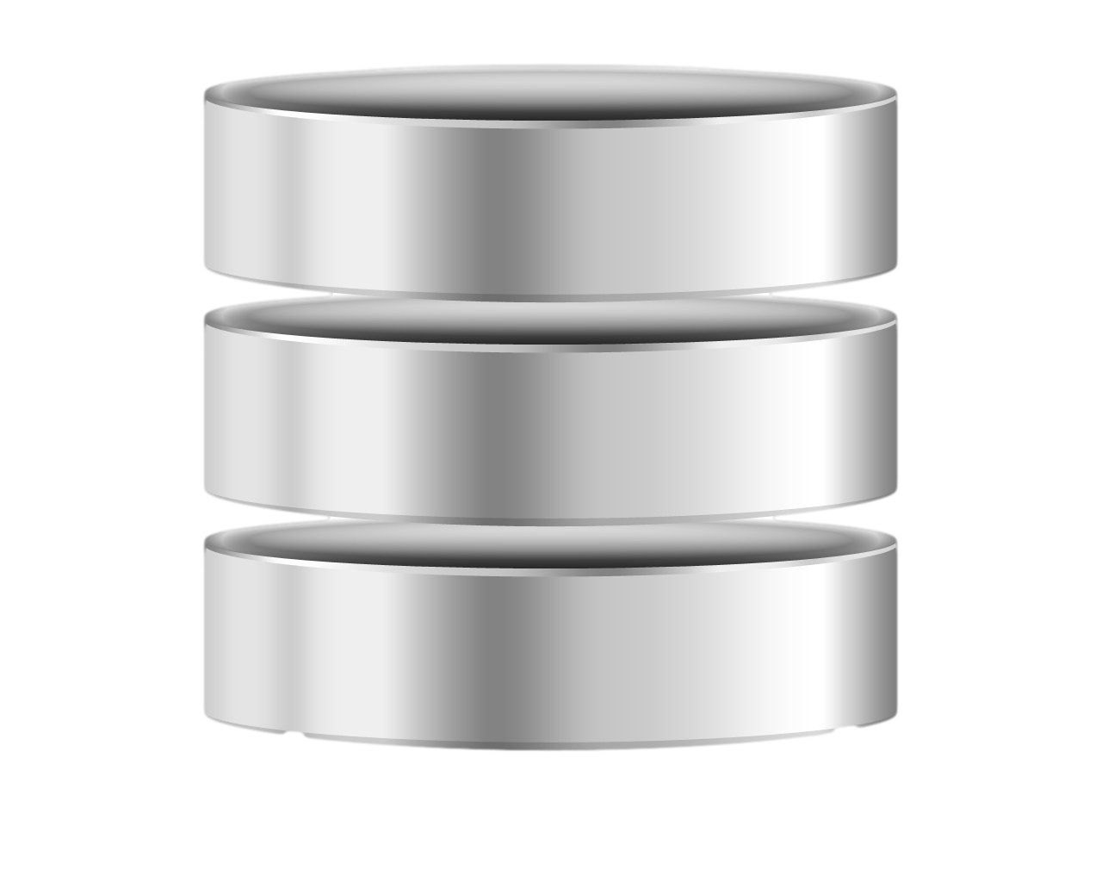
Compromised app. server?
users
CryptDB proxy
DB
server
application
Secret
CryptDB
SQL queries on encrypted DB

Slide 17
Compromised app. server?
CryptDB proxy
users
CryptDB proxy
DB
server
Secret
Secret
Secret
application
Secret
Secret
Secret
CryptDB proxy

Slide 18
Mylar: browser-side encryption
browser
Secret
Secret
Secret
web application
DB
server
Secret
Secret
Secret
Secret
Decrypted data exists only in users’ browsers

Slide 19
Challenge: computation in web applications
Client-side application framework
Most computation happens in client’s web browser (Javascript code)
2. Non client-side computation:
Data sharing – need a way to manage keys
Keyword search – need new cryptosystem: documents encrypted with many keys

Slide 20
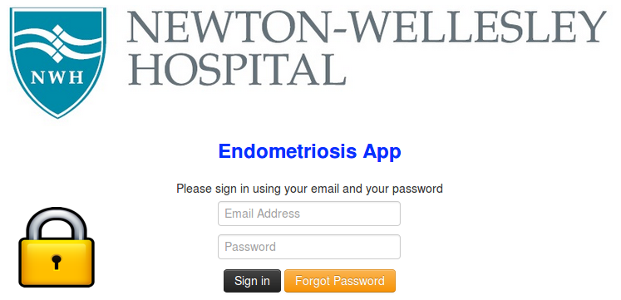
Mylar supports many applications
Ported 6 applications to Mylar
Performance overheads are modest
Data privacy despite server compromises

Slide 21
Future research directions
Practical cryptography
Computing on data encrypted w/ many keys
Delegating limited functions over encrypted data
Practical systems
Auditing for data disclosures
Protecting end-user computers

