Slide 1
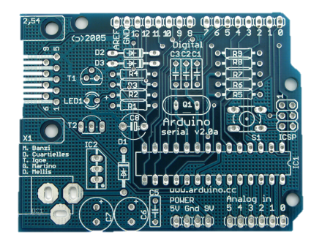
Expt. Monitoring /
Data Analysis
Local UI
Image Data
Actuation
Cell Database
Via CC Labeling

