Slide 1

Initial Calculations of Intrabeam Scattering life times in ELIC lattices by Betacool code
Chaivat Tengsirivattana
CASA, Jefferson Lab
University of Virginia
The 4th Electron-Ion Collider Workshop
Hampton University, VA
May 20,2008

Slide 2
ELIC Conceptual Design
Ion ring
30-225 GeV protons
15-100 GeV/u ions
Pre-booster
12 GeV CEBAF
Upgrade
3-9 GeV electrons
3-9 GeV positrons

Slide 3
Figure-8 Ring with 80 deg. Crossing
(2100 m circumference)
150 m
330 m
80 deg
Courtesy of Dr. Alex Bogacz

Slide 4
Figure-8 Ion Ring (half) - Lattice at 225 GeV
Courtesy of Dr. Alex Bogacz
8 empty cells
3 transition cells
30 full cells
3 transition cells
8 empty cells
Arc dipoles::
$Lb=170 cm
$B=73.4 kG
$rho =102 m
Arc quadrupoles:
$Lb=100 cm
$G= 10.4 kG/cm

Slide 5
ELIC design parameters of ion ring
Parameter | Unit | Ion Ring
Beam energy | GeV | 225 | 150 | 100 | 30
e/A ring circumference | km | 2.1
Bunch collision frequency | GHz | 1.5
Number of particles/bunch | 10¹⁰ | 0.42 | 0.4 | 0.4 | 0.12
Beam current | A | 1 | 1 | 1 | 0.3
Energy spread, rms | 10⁻⁴ | 3
Bunch length, rms | mm | 5
Beta* | mm | 5
Horizontal emittance, norm | μm | 1.25 | 1 | 0.7 | 0.2
Vertical emittance, norm | μm | 0.05 | 0.04 | 0.06 | 0.2
Beam-beam tune shift (vertical) per IP |  | 0.006 | 0.01 | 0.01 | 0.009
Peak luminosity per IP, 10³⁴ | cm⁻² s⁻¹ | 7.4 | 7.7 | 5.5 | 0.8
Number of IPs |  | 4
Courtesy of Dr. Yuhong Zhang

Slide 6
Touschek Effect and Intrabeam Scattering
Touschek Effect
Large angle
transformation of a small transverse momentum into a large longitudinal momentum, due to relativistic effect
Both particles are lost immediately
Intrabeam Scattering
Small angle
Multiple scattering
Diffusion in all three dimension, change the beam dimensions

Slide 7
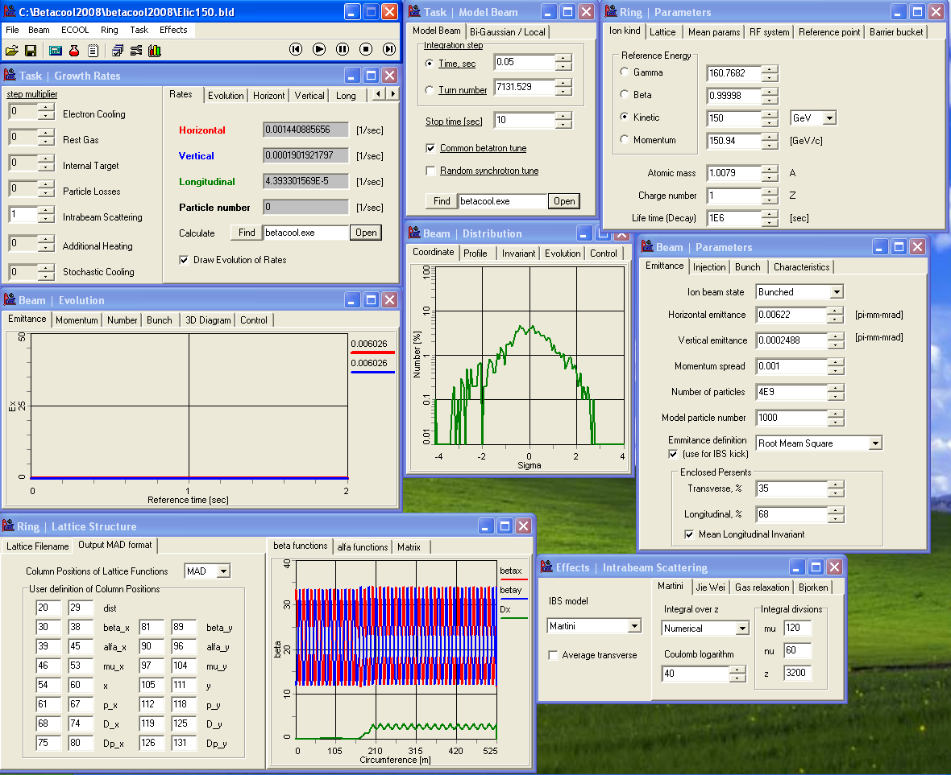
BETACOOL code – LEPTA lab, JINR, Russia
Lattice structure
ELIC lattice
Beam parameters
Set values
Ring parameters
Set values
Courtesy of Dr. Anatoly Sidorin

Slide 8
Case I: Beam Energy 30 GeV
Parameter | Unit
Beam Energy | GeV | 30
Ring circumference | m | 2,100
Number of bunches |  | 10,509
Horizontal rms emittance | µm | 0.006026
Vertical rms emittance | µm | 0.006026
Number of Particles |  | 1.2 × 10⁹
RF Voltage | MV | 100

Slide 11
Coulomb logarithm
Definition :

Slide 12
Case I: Beam Energy 30 GeV
Model | Horizontal | Vertical | Longitudinal
Martini – Numerical | 3.4 min | 2.6 hr | 82.3 hr
Martini – Analytical | 3.4 min | 2.6 hr | 82.3 hr
Martini – Coulomb Log | 3.4 min | 2.6 hr | 82.3 hr
Bjorken – Mtingwa | 26.2 sec | 26.2 sec | 8.2 min

Slide 13
Case II: Beam Energy 100 GeV
Parameter | Unit
Beam Energy | GeV | 100
Ring circumference | m | 2,100
Number of bunches |  | 10,509
Horizontal rms emittance | µm | 0.006511
Vertical rms emittance | µm | 0.0005581
Number of Particles |  | 4 × 10⁹
RF Voltage | MV | 350

Slide 16
Case II: Beam Energy 100 GeV
Model | Horizontal | Vertical | Longitudinal
Martini – Numerical | 5.97 min | 51.5 min | 3.98 hr
Martini – Analytical | 5.97 min | 51.5 min | 3.98 hr
Martini – Coulomb Log | 5.97 min | 51.5 min | 3.98 hr
Bjorken – Mtingwa | 5.39 min | 27.7 sec | 93.6 min

Slide 17
Case III: Beam Energy 150 GeV
Parameter | Unit
Beam Energy | GeV | 150
Ring circumference | m | 2,100
Number of bunches |  | 10,509
Horizontal rms emittance | µm | 0.006220
Vertical rms emittance | µm | 0.0002488
Number of Particles |  | 4 × 10⁹
RF Voltage | MV | 520

Slide 20
Case III: Beam Energy 150 GeV
Model | Horizontal | Vertical | Longitudinal
Martini – Numerical | 10.4 min | 78.7 min | 5.68 hr
Martini – Analytical | 10.4 min | 78.7 min | 5.68 hr
Martini – Coulomb Log | 10.4 min | 78.7 min | 5.68 hr
Bjorken – Mtingwa | 16.2 min | 38.8 sec | 4.90 hr

Slide 21
Case IV: Beam Energy 225 GeV
Parameter | Unit
Beam Energy | GeV | 225
Ring circumference | m | 2,100
Number of bunches |  | 10,509
Horizontal rms emittance | µm | 0.005194
Vertical rms emittance | µm | 0.0002078
Number of Particles |  | 4.2 × 10⁹
RF Voltage | MV | 100

Slide 23
Case IV: Beam Energy 225 GeV
Model | Horizontal | Vertical | Longitudinal
Martini – Numerical | 20.6 min | 6.2 hr | 10.2 hr
Martini – Analytical | 20.6 min | 6.2 hr | 10.2 hr
Martini – Coulomb Log | 20.6 min | 6.2 hr | 10.2 hr
Bjorken – Mtingwa | 32.9 min | 80.0 sec | 11.93 hr

Slide 26
Electron Cooling Rates
Cooling rates
E-Cooling | 30 GeV | 150 GeV
Initial Cooling rate | -1.1 x 10⁻³ | -1.7 x 10⁻³
Cooling rate at Equilibrium | -5.6 x 10⁻² | -1.7 x 10⁻²
Growth rates
 | Horizontal | Vertical | Longitudinal
30 GeV
Martini | 4.8 x 10⁻³ | 1.0 x 10⁻⁴ | 3.4 x 10⁻⁶
Bjorken – Mtingwa | 3.8 x 10⁻² | 3.8 x 10⁻² | 2.0 x 10⁻³
225 GeV
Martini | 8.1 x 10⁻⁴ | 4.5 x 10⁻⁵ | 2.7 x 10⁻⁵
Bjorken – Mtingwa | 5.1 x 10⁻⁴ | 1.3 x 10⁻² | 2.3 x 10⁻⁵

Slide 27
Summary
- Growth rates of new ring, 2100m, has been calculated.
Horizontal and Longitudinal life times are agreed between different models.
Discrepancy of life times in vertical (small) direction between models, trying to understand.
Beam could be cooled by electron cooling for longer life times

