Slide 1
MIT 3.071 Amorphous Materials 13: Optical Fibers and Waveguides
Juejun (JJ) Hu
hujuejun@mit.edu

Slide 2
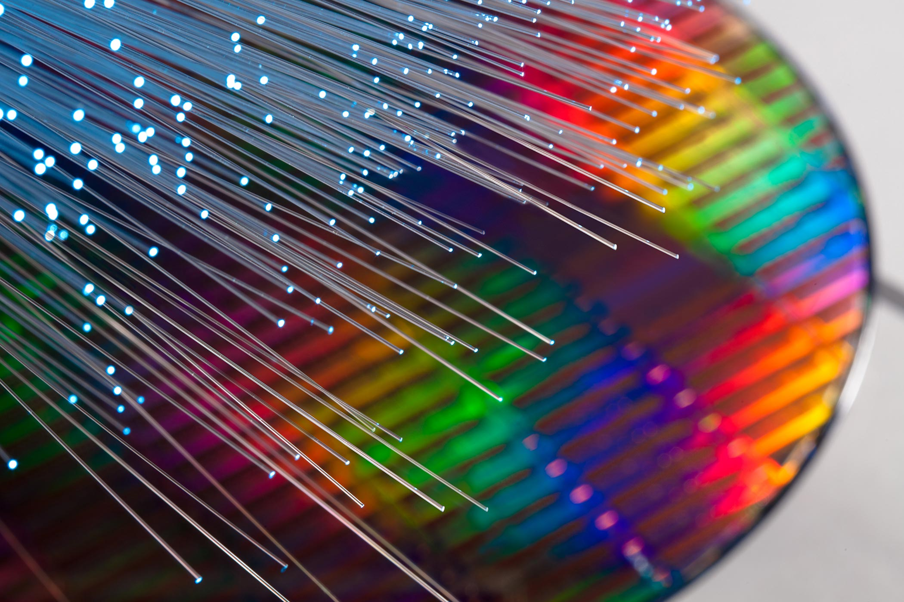
The masters of light
“If we were to unravel all of the glass fibers that wind around the globe, we would get a single thread over one billion kilometers long – which is enough to encircle the globe more than 25,000 times – and is increasing by thousands of kilometers every hour.”
2009 Nobel Prize in Physics
Press Release

Slide 3
Light confinement via total internal reflection
n_{low}
Light
Condition for TIR:
n_{high}
θ
Core
n_{low}
Cladding
PMMA
Snell is right
by Ulrich Lohmann
Air

Slide 4
Waveguide cross-section geometries
2-d optical confinement
1-d optical confinement
cladding
n_{low}
core
n_{low}
n_{low}
core
n_{high}
n_{high}
n_{high}
cladding
n_{low}
cladding
n_{low}
Slab waveguide
Channel/photonic wire
waveguide
Rib/ridge waveguide
cladding
core
Step-index fiber
Graded-index (GRIN) fiber

Slide 5
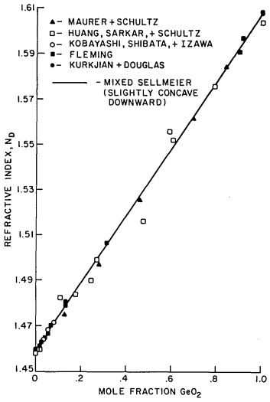
Optical fiber materials
Glasses: silica and other oxides, chalcogenides, halides, polymers
Metals, crystalline oxides and semiconductors, etc.
Dopants in silica glass
Increase index: GeO₂, P₂O₅, TiO₂
Decrease index: B₂O₃
Luminescent centers: rare earth (e.g. Er)
Refractive index n_{D} of SiO₂-GeO₂ glass
Appl. Opt. 24, 4486 (2004)

Slide 6
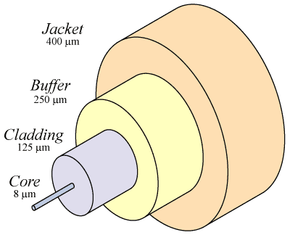
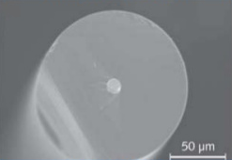
Standard single-mode silica optical fiber structure
Core/cladding: low loss light propagation
Buffer/jacket: protection against mechanical damage and the environment (UV radiation, humidity, etc.)
Cladding
Core

Slide 7
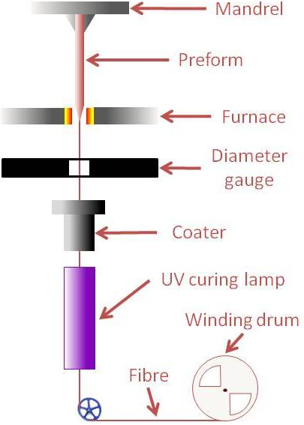
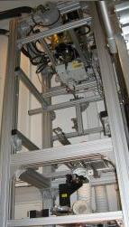
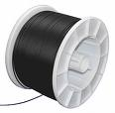
Fiber drawing process
Fiber preforms
Viscosity window for fiber drawing:
10⁴ to 10⁶ Pa·s
Drawing tower
Fiber spool
Notes:
https://www.technologyreview.com/s/401266/drawing-optical-fibers/

Slide 8
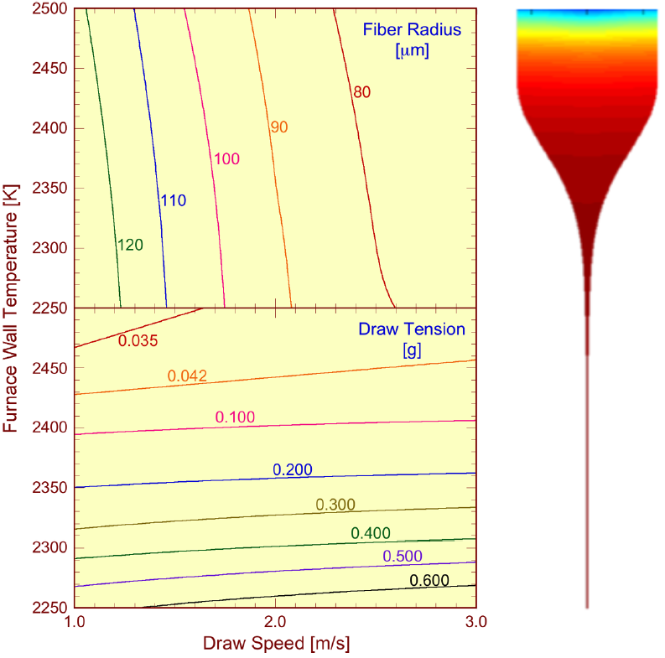
Fiber drawing: diameter control
Drawing tension:
Fiber diameter is determined by the drawing speed
Fiber diameter is feedback loop controlled in real time during drawing
Candy fiber drawing
Preform
A
Neck-down region
IEEE Photon. J. 2, 620 (2010)
J. Appl. Phys. 49, 4417 (1978)
F

Slide 9
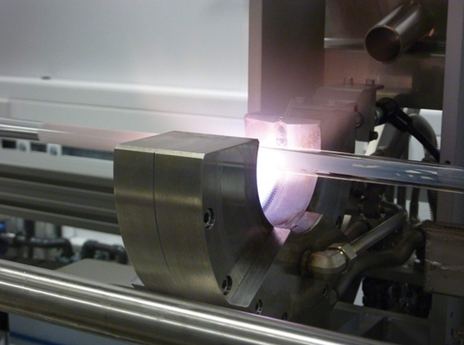
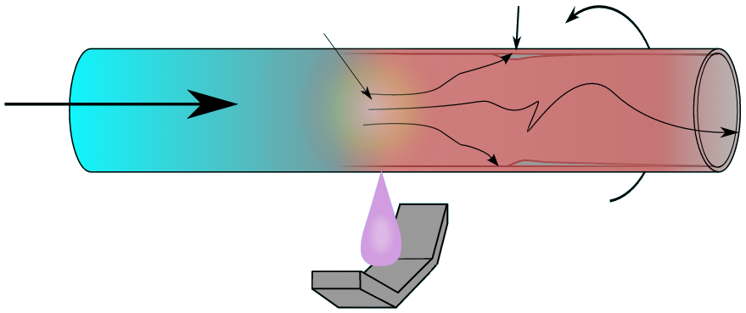
Standard silica fiber preform fabrication
Modified chemical vapor deposition (MCVD)
SiCl₄ + O₂ → SiO₂ (soot) + Cl₂
GeCl₄ + O₂ → GeO₂ + Cl₂
Layer composition and thickness controlled in each torch sweep
Water-free reaction: minimal -OH contamination
High temperature reaction zone
Soot
Reactant gases
Rotating silica tube
Traversing torch
MCVD lathe, University of Southampton
Notes:
Silicon tetrachloride has a boiling point convenient for purification by repeated fractional distillation

Slide 10
Optical fiber manufacturing and testing
Notes:
Optical Time-Domain Reflectometer (OTDR)

Slide 11
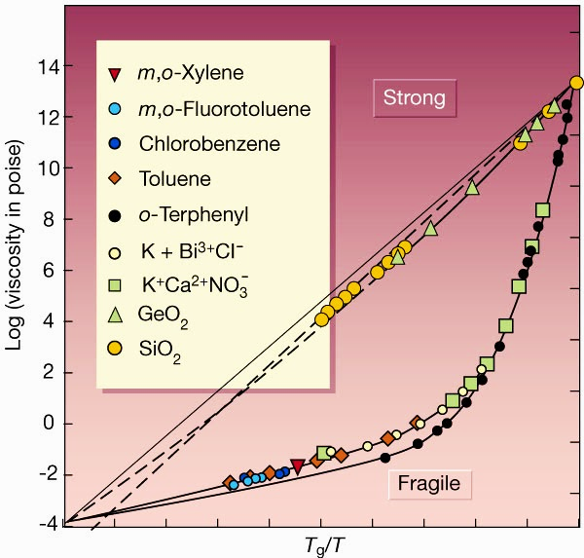
Glass properties impact fiber processing
Glass forming ability
Processing window
Liquid fragility
Fragility parameter
Temperature sensitivity

Slide 12
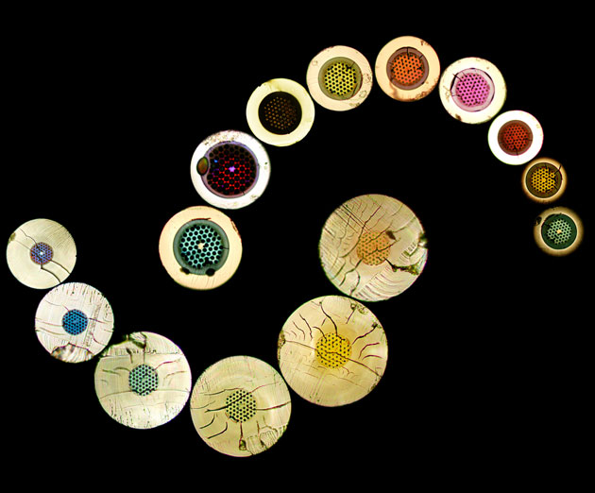
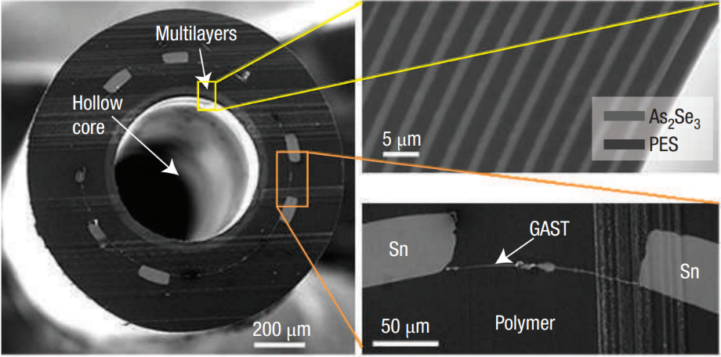
Multi-material, microstructured optical fibers
Nat. Mater. 6, 336, (2007)
Optical mode shaping
Dispersion engineering
Broadband transmission
Multi-functional sensing
Microstructured optical fibers: photonic bandgaps and various sizes of the rings give rise to the different colors
A. Argyros, the University of Sydney

Slide 13
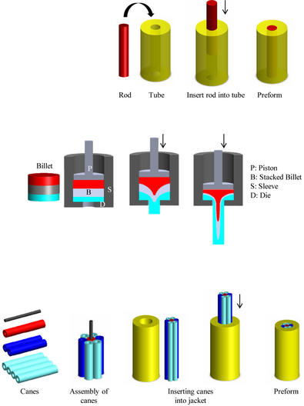
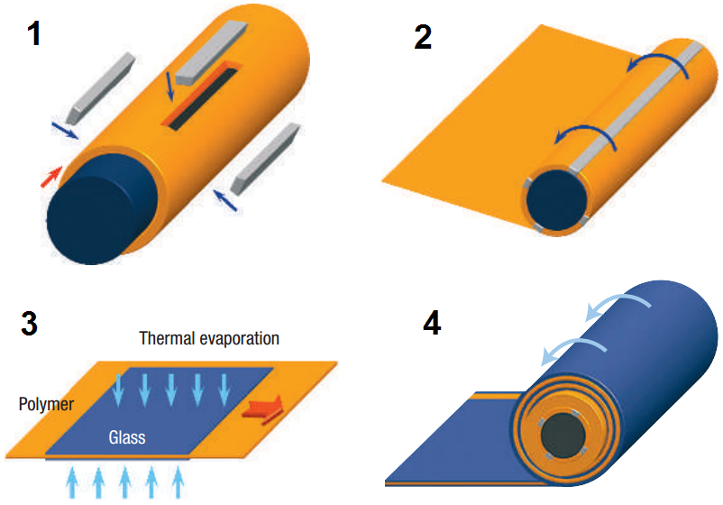
Multi-material, microstructured optical fibers
Rod-in-tube
Extrusion
Stack-and-draw
Int. J. Appl. Glass Sci. 3, 349 (2012)
Adv. Mater. 18, 845 (2006)

Slide 14
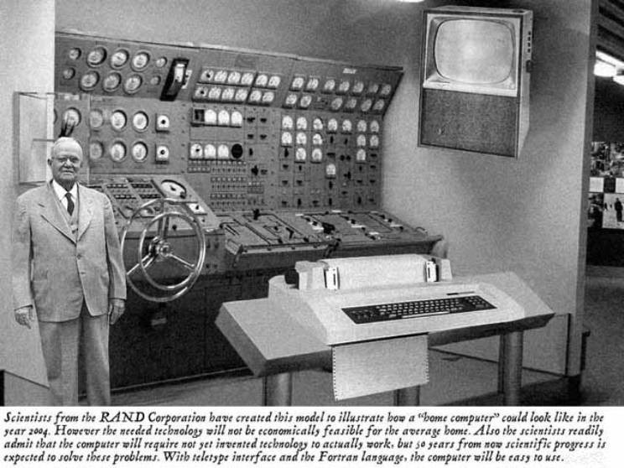

Slide 15
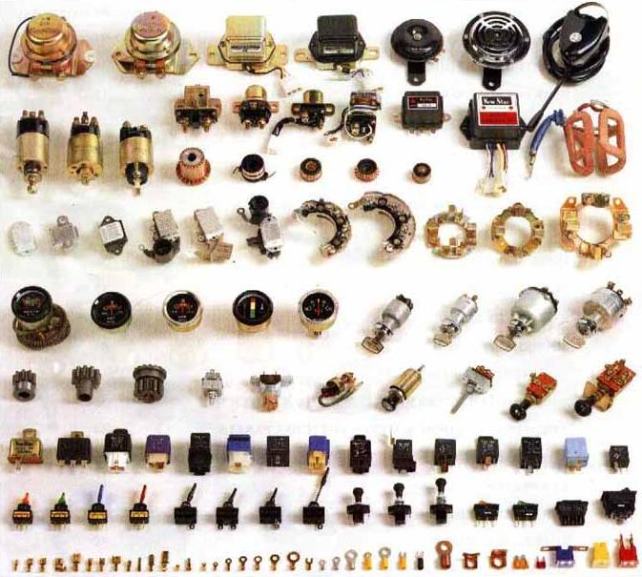
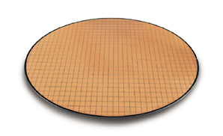
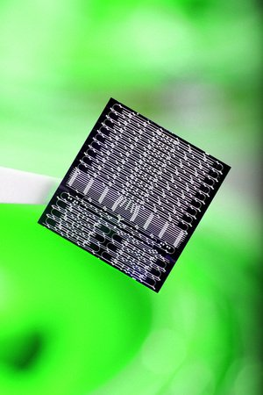
Planar integration: the paradigm shift
The OLD way:
discrete devices
The NEW way:
integrated circuits
Integration
Smaller, faster cheaper & greener

Slide 16
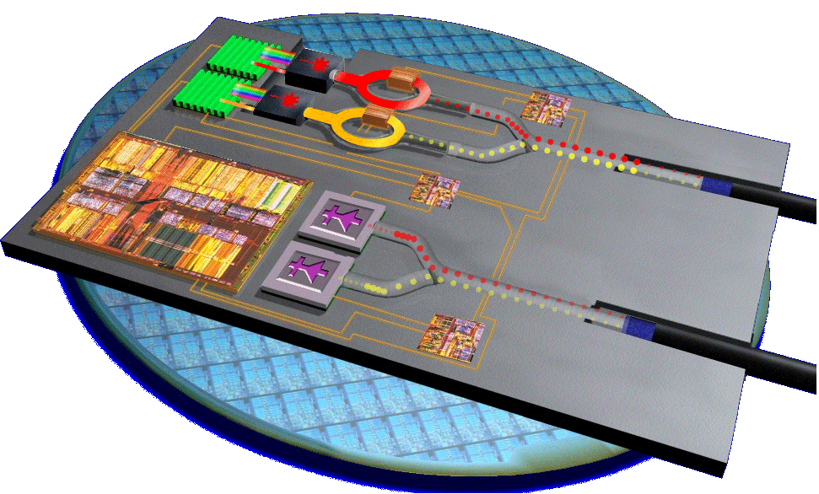
Photonic integrated circuit (PIC)
Source
Modulator
Waveguide
Detector
Isolator
Semiconductor lasers
Optical diodes
E-to-O signal encoders
Optical “wires”: signal routing
O-to-E conversion
Lasers: hybrid laser, Ge laser
Isolators: magneto-optical isolator
Modulators: III-V/Si ring and MZI
Waveguides: SOI, nitride, glass, polymer
Detectors: III-V and Ge detectors

Slide 17
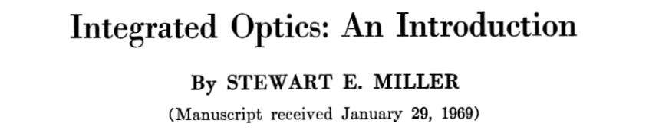
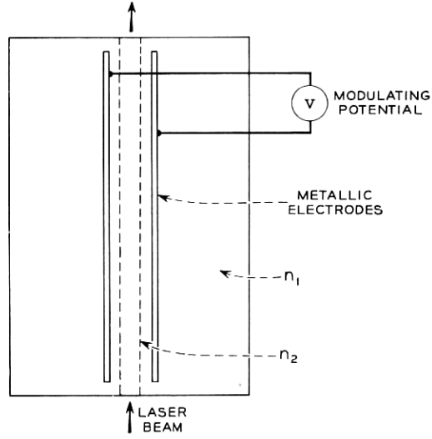
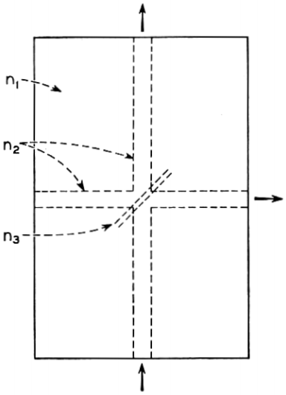
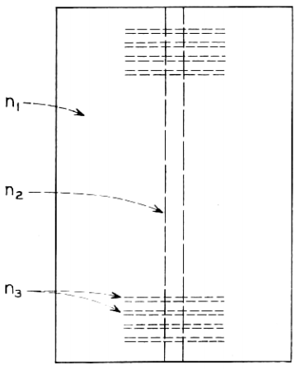
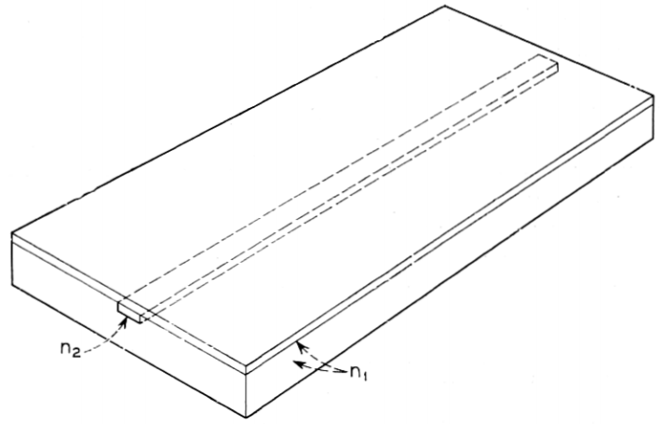
Waveguide
Waveguide
Laser cavity
Optical switch
Photodetector
All optical components integrated on a glass substrate

Slide 18
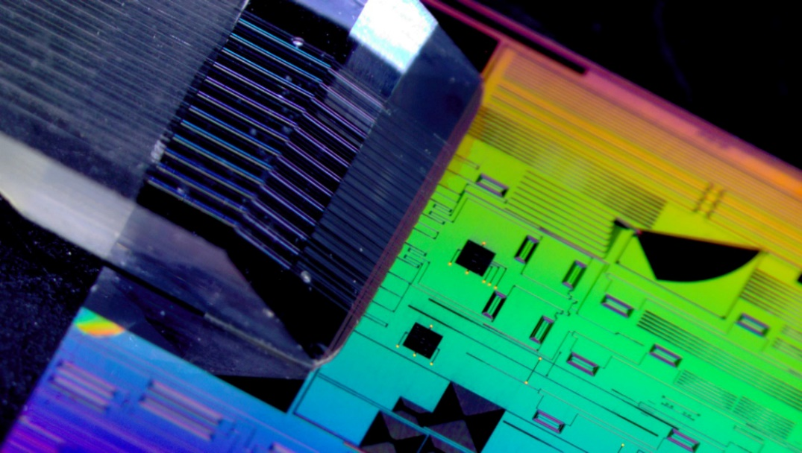
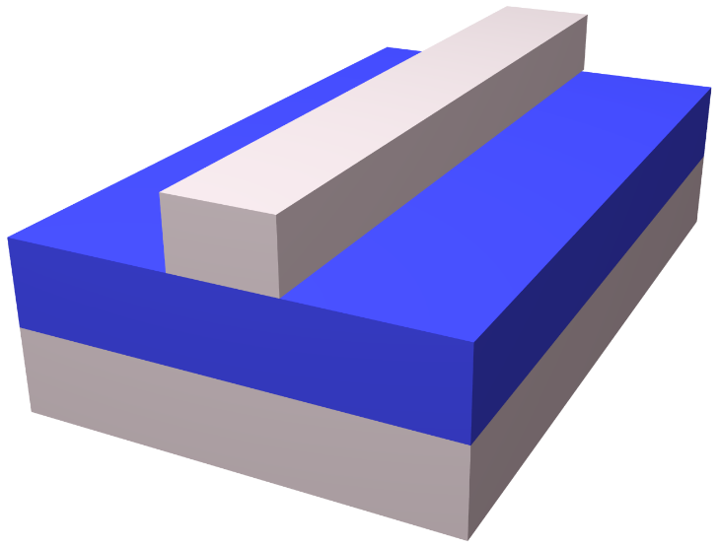
State-of-the-art integrated photonics
Light
Optical fiber interface
Core
Cladding
Substrate
Photonic chip
IMEC photonic chip & Tyndall fiber array packaging
Integrated planar waveguide
Substrate platforms: Si, III-V semiconductors, glass, LiNbO₃, polymer
Core material: c-Si, III-V, a-Si, SiO₂, SiN, ion exchange glass, polymer

Slide 19
Planar waveguide fabrication
Substrate
Cladding layer
Core layer
Amorphous waveguide material: ease of deposition, low optical loss
Planar waveguide platform: massively parallel low-cost fabrication, geometry/material diversity, interfacing with other on-chip components

Slide 20
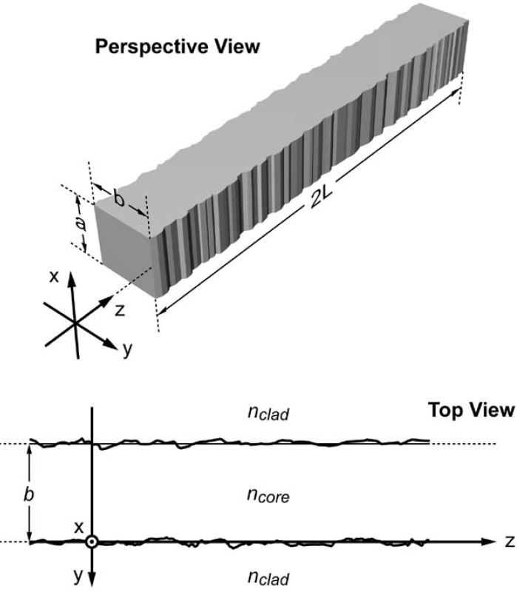
Optical loss in fibers and waveguides
Material attenuation
Surface roughness scattering
Optical fiber
Frozen surface capillary waves due to energy equipartition
Usually small in optical fibers
Planar waveguide
Surface roughness resulting from imperfect patterning
A major loss mechanism
σ : RMS roughness
J. Lightwave Technol. 23, 2719 (2005)

Slide 21
Optical communication system
0 = peace
1 = invasion

Slide 22
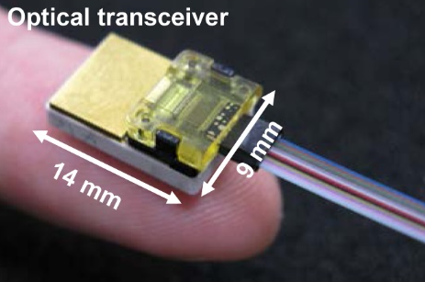
Optical communication system
1
0
1
0
1
Transmitter driver circuit
Optical transmitter (Tx) / transceiver
Electronic digital signal
1
0
1
0
1
Optical fiber / waveguide
Optical digital signal
1
0
1
0
1
Receiver circuit
Optical receiver (Rx) / transceiver
Electronic digital signal
Fiber ribbon
Opt. Express 19, B777 (2011)

Slide 23
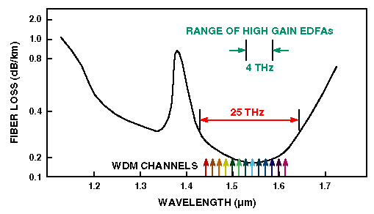
Wavelength division multiplexing (WDM)
Single-core fiber communication speed record 2011 (NEC):
370 channels × 273 Gbps data rate = 101 Tbps
Optical channel
Single optical fiber

Slide 24
See what the “FiOS boy” says about WDM!

Slide 25
Inside Google’s data center

Slide 26
Notes:
http://natick.research.microsoft.com

Slide 27
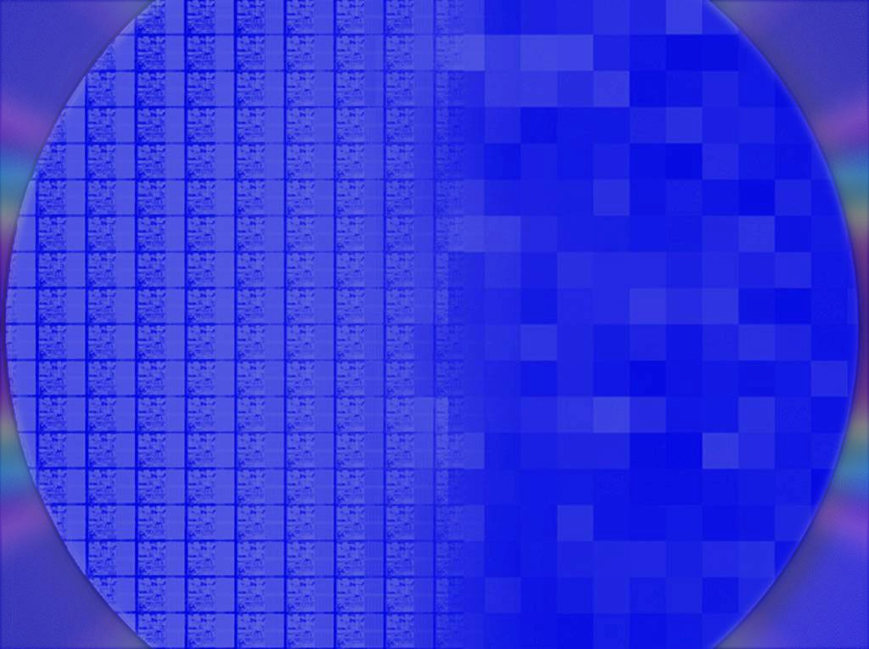
Electrical to optical interconnect
Enterprise Distance: 0.1-10km
Rack-Rack Distance: 1-100m
Board-Board Distance: 50-100cm
Chip-Chip Distance: 1-50cm
Integrated
photonics?
10G >= 40G
OPTICAL
3.125G 10G 40G
Optical Tech
3.125G 5-6G 10G 20G
Copper Tech
ELECTRICAL
Transition Zone
3.125G 5-6G 10G 15-20G
 | 2004 |  |  | 2010+

Slide 28
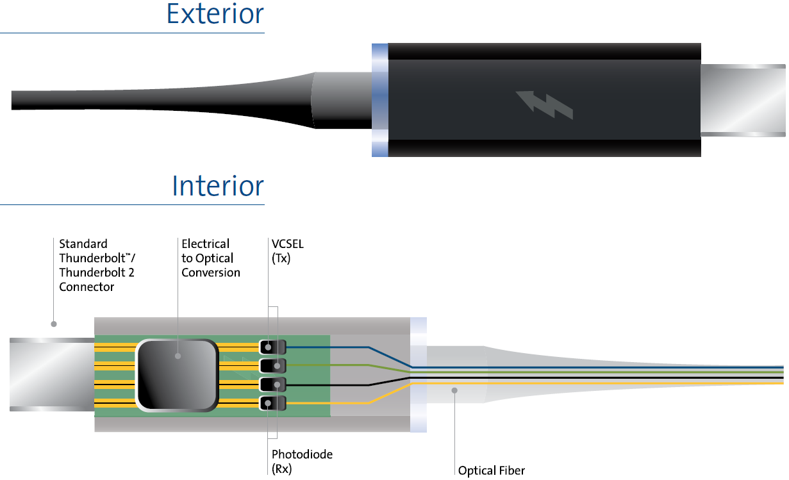
Active optical cable (AOC)

Slide 29
Summary
Device fabrication
Fiber drawing
Preform fabrication: MCVD process
Drawing parameter control: fiber diameter & draw tension
Multi-material fiber and microstructured fiber processing
Planar waveguide fabrication
Optical loss in fibers and waveguides
Material attenuation
Surface roughness scattering
Optical communications
Digital communication systems & WDM

