Slide 1
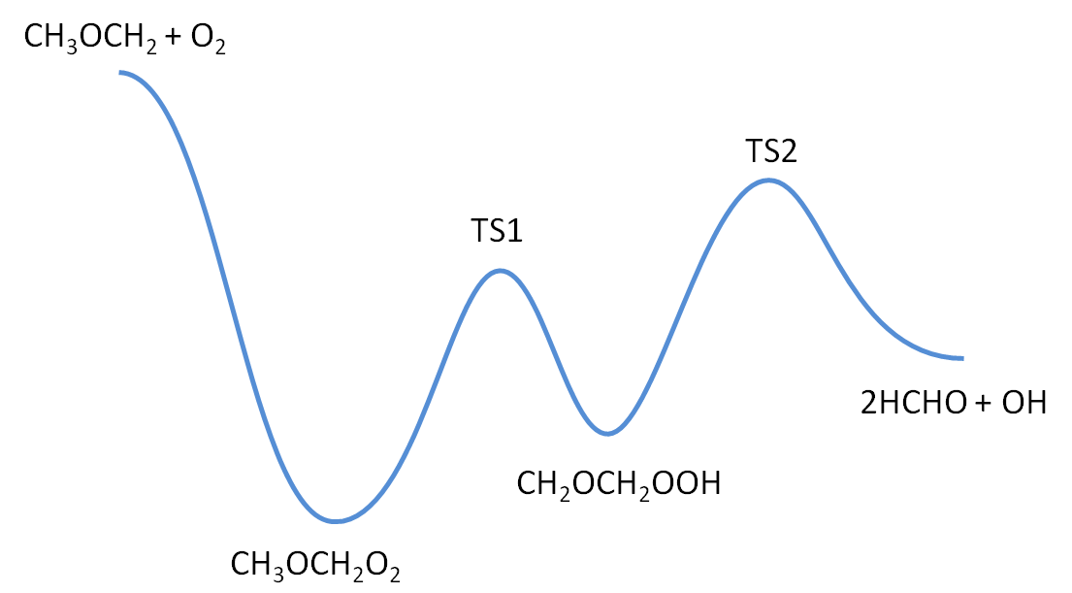
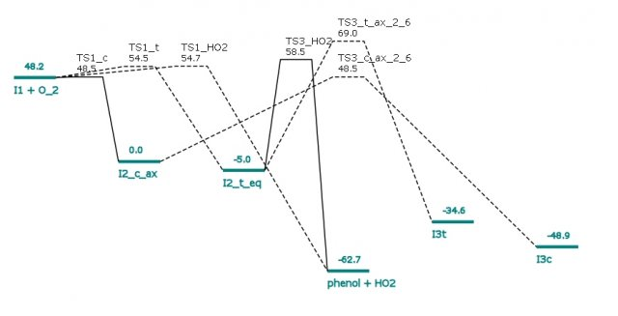
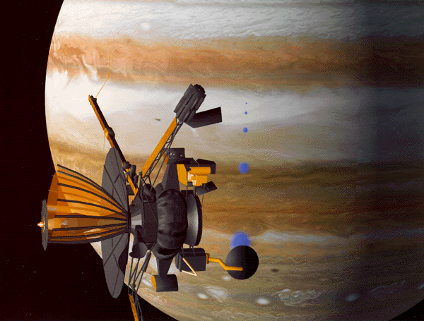
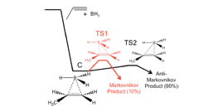
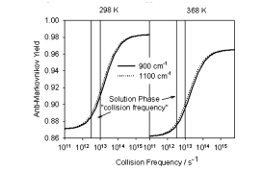
Recent Developments in the Master Equation Program MESMER
(Master Equation Solver for Multi-Energy well Reactions)
Mark Blitz, David Glowacki¹, Mo Haji, Jeremy Harvey¹, Chi-Hsiu Liang, Chris Morley, Mike Pilling, Struan Robertson, Paul Seakins and Robin Shannon
Rationale
Reactions involving complex formation have pressure dependent kinetics and product yields.
Need to extrapolate kinetic data beyond laboratory conditions to higher/lower temperatures and pressures.
Need to understand competition between reactive and stabilizing channels in both gas and liquid phases.
MESMER
Implemented in C++ at http://sourceforge.net/projects/mesmer/
Variable source terms – reactions with defined TS or barrierless (treated via ILT)
Vibrational density of states via Beyer-Swinehart.
Rotational dos and treatment of internal rotations.
XML input file specifies connections between species, properties of species, conditions, experimental data for comparison.
Intersystem Crossing
¹CH₂ + C₂H₂ → C₃H₃ + H is an important precursor to benzene formation and soot in flames.
In competition with ¹CH₂ + C₂H₂ → C₂H₂ + ³CH₂ generating relatively unreactive ³CH₂ ground state.
Harvey and Glowacki have implemented a routine in MESMER to account for ISC using non-adiabatic transition state theory.
Microcanonical rate coefficients, k(E), for surface crossing given by:
Where: ρ(E) = reactant state density, N_{MECP} = dos x spin hopping probability.
Predicts observed negative temperature dependence of surface crossing in reactive systems– promotes ¹CH₂ reactions in flames, ³CH₂ in low temperature planetary atmospheres.³
Graphical User Interface
Currently input to MESMER is generated in an XML file. Whilst giving flexibility it limits uptake by ‘black-box’ users.
Funding obtained from EPSRC to start construction of GUI and to generate libraries of reagents.
Example of interface screen shown below.
RO₂*
QOOH*
M
M
M
M
TS
Example of PES and connectivity
generated from XML input file
Master Equations
Divide energy of species into grains.
Generate a set of coupled differential equations involving source terms, reaction forward/backward and energy transfer.
Solve where p = vector of populations, and M is the matrix containing source, energy transfer and reaction terms.
Low temperatures
Exponential down model used for energy transfer
Upward transition calculated by detailed balance.
At low temperatures/deep wells probability for upward transition exceeds machine precision.
Running in higher precision overcomes problems but at computational cost and restricting applications such as fitting.
Use reservoir state (RS) approximation² -truncate collision matrix at where transition up is rare, typically a few k_{B}T below lowest threshold.
Treat RS as single grain with Boltzmann distribution.
Chemical Activation
Currently MESMER considers reactions of thermalized reagents.
Increasing evidence that non-thermal reagents generated on different PES can play important roles in practical issues:
1) OH + CH₃COCHO → H₂O + CH₃COCO
CH₃COCO → CH₃CO + CO
CH₃COCO retains sufficient energy such that the acetyl fragment can also dissociate.⁴
2) OH + C₂H₂/O₂ → (HCO)₂ + OH
→ HCOOH + HCO
OH yield dependent on fraction of O₂, i.e. whether O₂ reacts with chemically activated OH adduct.⁵
New class of reactions being introduced to MESMER to allow for a Boltmann distribution of reagents, but offset with exothermicity of generating reaction.
Outlook and references
Develop GUI, increase libraries and provide links to other databases to enhance uptake.
Apply to chemically activated systems and reactions in solution.⁶
References
Centre for Computational Chemistry, University of Bristol.
Gannon et al. J. Phys. Chem. A 2010, 114, 9413
Gannon et al. Faraday Discuss. 2010, 147, 173
Romero et al. PCCP 2007, 9, 4114
Siese and Zetsch, Z. Phys Chem 1995, 188, 75
Glowacki et al. JACS 2010, 132, 13621
C**
A* + B
C*
D*
A + B
G + H
E + F
C
D
Schematics of Reservoir State, Full Master Equation and comparison
of calculations for the H atom yield from ¹CH₂ + C₂H₂

