Slide 1
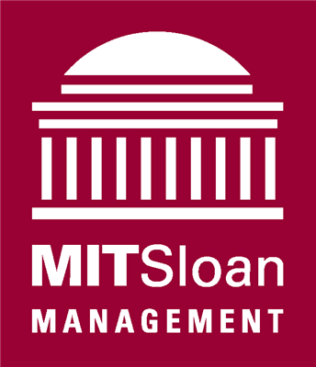
MIT Sloan: Virtual Desktop Project
Joseph Farrell
Client Systems Administrator
Adlar Su
Windows Server and Active Directory Administrator
IT Partners Conference
June 13, 2012

Slide 2
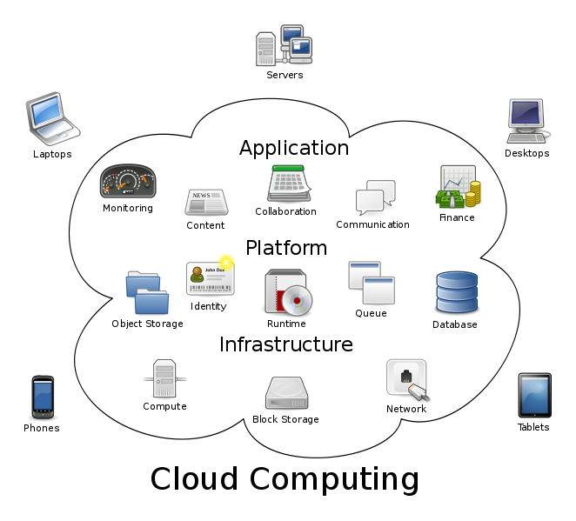
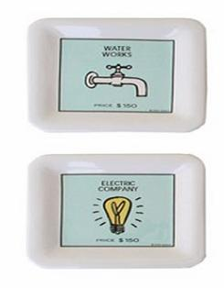
Our experience of introducing virtual machines to our users and environment
A mildly technical discussion and completely open forum
~ What IT Partners conference is all about
Please feel free to interrupt at any time for clarification, input, or questions.
How does this picture above represent our future strategy and my view of IT?
Technology as a utility

Slide 3
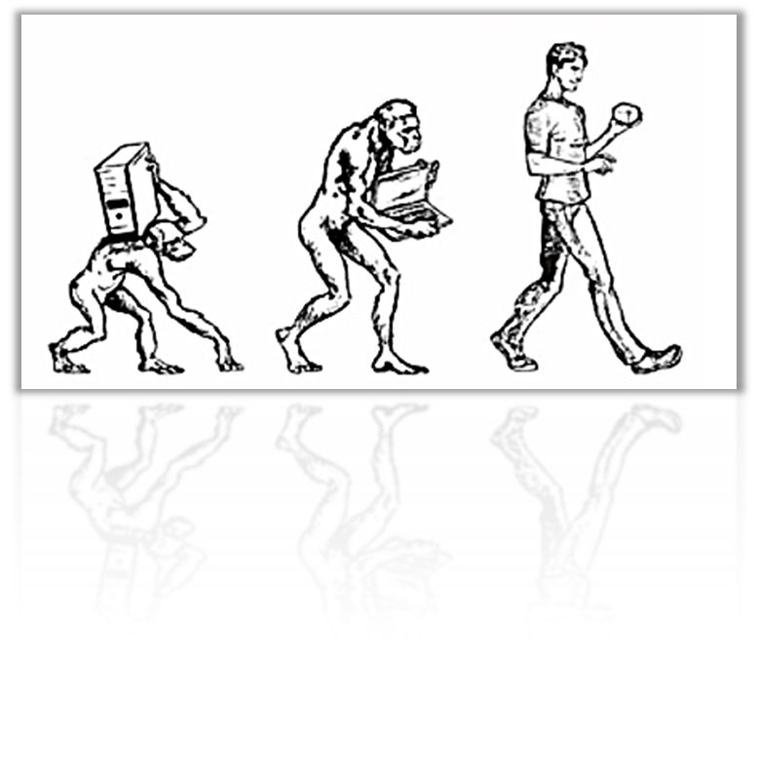
Why virtual? Why now?
In short, we believe this is the direction computing is evolving
We don’t want to play catch up with our peers
When people are at MIT, they expect to see technology
Increase productivity and minimize risk
PCs’ data and Application expose our organization to risk.
The need to offer a Managed Desktop solution
Reduced risk of failure due to hardware
Reduced burden of management
Centralization of Anti-Virus
Trend Micro Deep Security Manager 7.5
Runs at Hypervisor level instead of at the OS level without compromising performance
Easier deployment of applications and patches
Less time wasted troubleshooting hardware failure
Individual PCs and laptops pose highest security threat
Separation of a user’s personal and professional digital existence

Slide 4
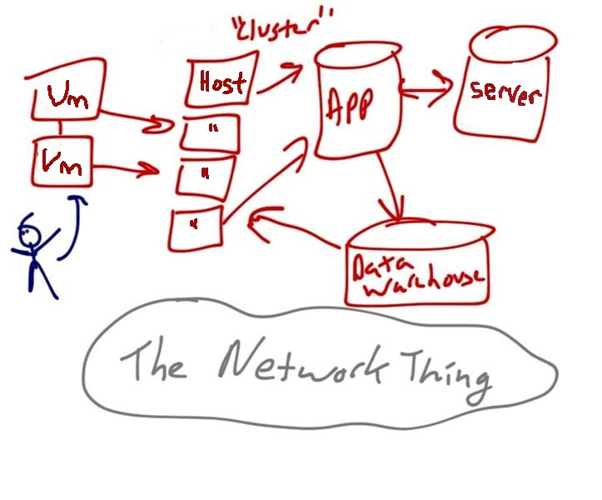
Nuts and Bolts: Backend
Hardware Hosts
2 x Dell PowerEdge R710, Dual Quad Core, 96 GB RAM
2 x Dell PowerEdge R710, Dual Hex Core, 96 GB RAM
1 x Dell PowerEdge R710, Dual Hex Core, 192 GB RAM
Storage
EMC Clariion CX4-480, 6TB allocated
Software Hosts
Currently VMware ESXi 4.1 Update 2
Upgrading to ESXi 5.0 Update 1
Servers
All server VMs built on Windows Server 2008 R2
Currently VMware vCenter Server 4.1.0
Will be upgrading to 5.0
Database instance for vCenter
a separate VM running SQL 2008 R2
2 x VMware View View 5.0 brokers
A load balanced pair behind F5 LTM 1500

Slide 5
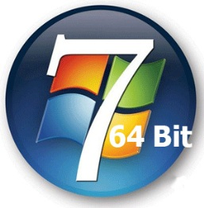
Typical client VM
Initially created from the same image built for Hardware Independent Imaging
Benefit: Familiarity to users
Already well tested
Adjustments made based on best practices from VMware
All Windows 7 Enterprise X64-Bit
All physical machines deployed the same beginning February 2011
Staff virtual machines
3 GB Ram
1 Processor
20 GB of Data ~ 10 GB of free space = 30GB Disk Thin Provisioned
All basic software pre-installed
Classroom virtual machines*
*Overkill
4 GB Ram
2 Processor
Full software package for all licensed products

Slide 6
What began with labs…
Currently two labs and 12 classrooms connecting to virtual machine pools with zero / thin client devices:
50 Staff Members with individually assigned VMs
Connect Via:
VMware View Client on their current supported machine
Pano Logic G2
No CPU, no OS, no storage, no memory
Wyse P20
Thin Client – Teradici chipset
PCoiP
VMware View
Repurposed PCs – Wyse PC Extender
Based on SUSE Linux
Connects via VMware View client

Slide 7
Benefits
Reduced total cost of ownership – Cradle to grave
Average desktop we purchase today is ~$1000
Vs. Zero-client cost of < $400
Conservatively realize an approximate 80-90% reduction in power utilization.
Pooling of hardware resources
Does the typical user really need a dual quad core with 8GB of Ram? I don’t.
Nothing to dispose of. Hardware or data
Longer refresh cycle for hardware.
5-7 years for a thin-client vs. 3-4 years for desktops and laptops today
Device and Location Independence
Allows our staff to chose their own devices
Mac, PC, Tablet….even a smartphone!
Work from home, a library, a café…anywhere there is WiFi.
VPN is not needed to connect
Old devices get new life
Especially true for home users

Slide 8
Benefits: Continued Flexibility from an end-user standpoint
Non-Draconian approach: Our users are Admins on their own VM just like on a physical machine.
Pooled desktops are the exception
We can monitor performance and add more resources as necessary
Adding RAM and CPU
Additional disk space can be added “hot”
Secure central storage on a network drive that is completely private to the user
Performed via Group Policy Folder Redirection to network storage (SATA)
Improved Security and Data Control
The PCoIP protocol compresses, encrypts, and encodes the entire computing experience at the data center then transmits it ‘pixels only’ across any standard IP network to stateless PCoIP zero clients.
Data never leaves the network
Less reliance on users to control and backup their data

Slide 9
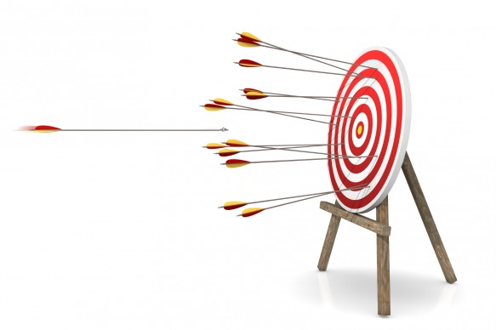
The Hard Lessons: Take the time to get it right Eat your own cooking
“There are known knowns….There are known unknowns.…But there are also unknown unknowns. ~Donald Rumsfeld
Having a small corridor of time to deploy it all
We needed to stand up a completely new domain in a matter of weeks
Mouse / Cursor issue in the classroom
Understanding Windows search
Indexing and Offline Files
User resistance. Clinging to the Physical
USB 1.1 Slowness
Chose your first users wisely
The Techie Evangelist: Find users who will want to make it work – build trust
Utilize their patience and curiosity to find the problems and solutions
The “Naysayers” are just as valuable
Personal aside: Virtualization is a rapidly developing & competitive space. Beware of PR
Centralization means refocus of customer anger from third party (i.e. Microsoft, Lenovo, Dell) back to the source of the VM
User perspective: Whose butt do I need to kick?!
Most issues are still just Windows and not virtualization - Adobe example

Slide 10
Challenges Ahead Where do we ultimately want to be? Ratcheting up the level of complexity Blurring the line between physical an virtual
Large scale migration of user data
Support structure and training
Not only the training of end users but support personnel will need a new skill set
How will we deliver applications? A mixed approach using emerging technologies
To achieve more optimal license use
Streaming of applications with tools like VMware ThinApp
Local Installation – controlled with Keyserver?
Self-Serve Portal? Via SCCM or Altiris 7.x
Flex App - stores user installed applications separately from the Windows OS in more cost effective SAN
Virtualizes the installation of an application location, not the application itself.

Slide 11
Challenges Ahead Where do we ultimately want to be? Ratcheting up the level of complexity Blurring the line between physical an virtual
Economies of Scale
Linked Clones – A linked clone is a copy of a virtual machine that shares virtual disks and system files with the parent virtual machine
Achieves conservation and concentration of expensive fiber-channel
Via FlexApp and Profile Unity
Profile Unity – an expansion to Group Policy. “Blur the lines”
Help to achieve consistency of user experience
Make user settings portable by abstraction

Slide 12
Questions and Answers
Joseph Farrell & Adlar Su
IT Partners Conference
June 13, 2012

