Slide 1
Fun Side of Mechanics:
Momentum (Collision) energy
By Jonathan

Slide 2
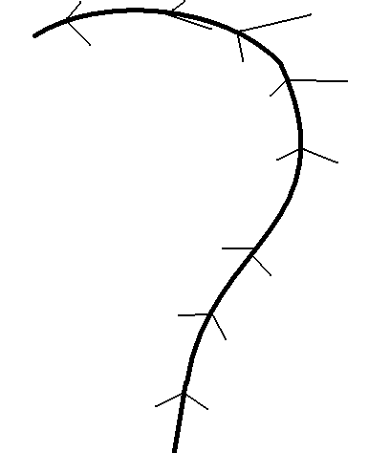
Recap:
Last week we talked about countersteering. What was countersteering?
  Turn in the other direction in order to complete a turn.
A while back we mentioned velocity. What was velocity?
  scalar or vector?
    Vector: has the magnitude and direction
  Units?
    m/s (length/time)
v

Slide 3
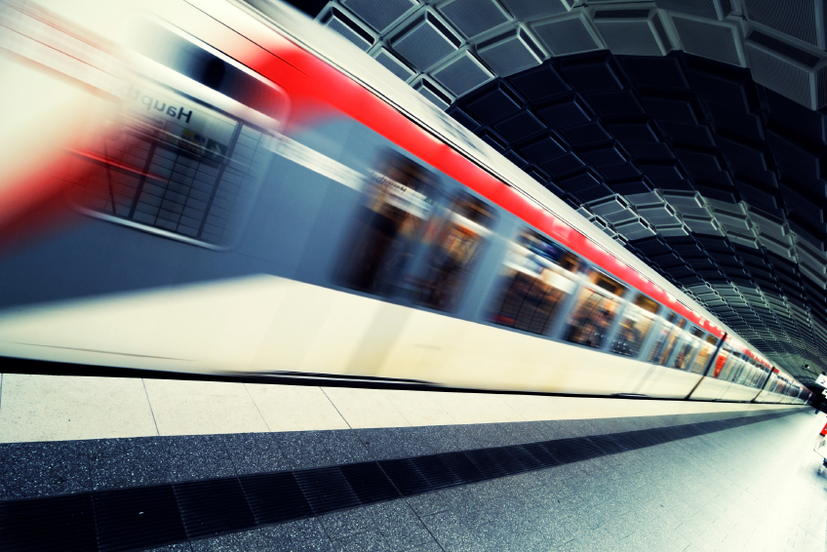
Momentum:
Momentum = Mass * Velocity
P = m * v
Big mass moving fast

Slide 4
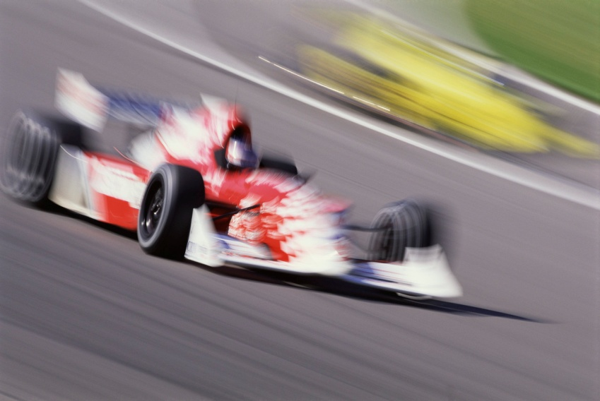
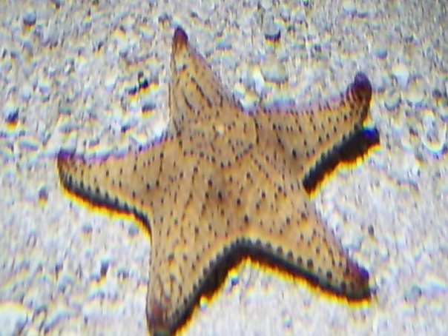
What is the momentum?
No momentum
No momentum

Slide 5
Why is momentum important
Because it is often conserved
Especially in collisions

Slide 6
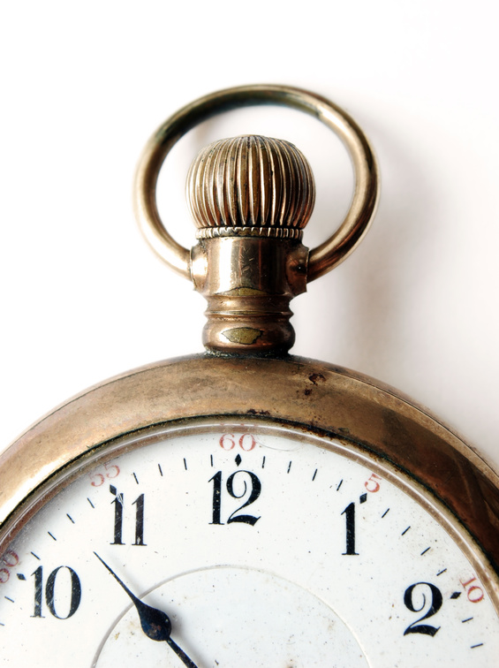
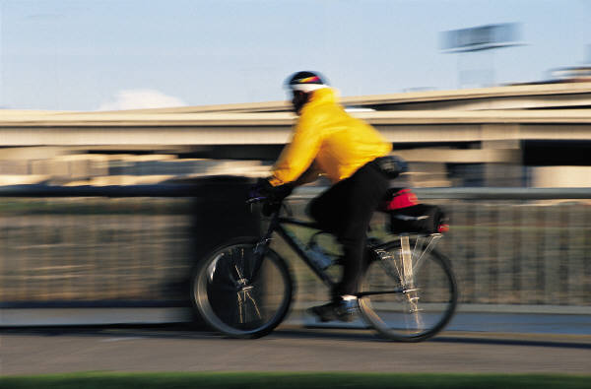
When is momentum conserved
When there is no force (no net force).
Or at least when there is no time.
  What might this mean?

Slide 7
Collision
In a collision, it happens so fast, we say momentum does not have any time to change
There are forces, but they are internal.
The SYSTEM
F_{push}
F_{push}

Slide 8
Collision Question
A red car of mass 1000 kg traveling with a velocity 10 m/s to the right hits a blue car of mass 500 kg traveling with a velocity 5 m/s to the left. Then the cars deform and stick together. What is their final velocity?
P_{i} = 1000 * 10 + 500 * (-5)
P_{i} = 7500 ‘Combined momentum
P_{i} = P_{f} ‘Conservation of mom.
P_{f} = 7500 = 1500 * v_{f}
v_{f} = 5 m/s to the right

Slide 9
Energy
Can’t be created or destroyed. Can only change form.
What are some examples of energy? What form?
There are two classifications of mechanical energy that are important in physics
Kinetic
translation
rotation
Potential
height
elastic
Other

Slide 10
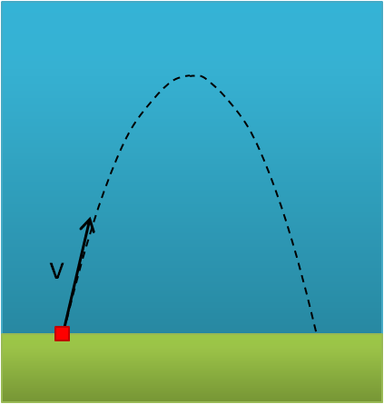
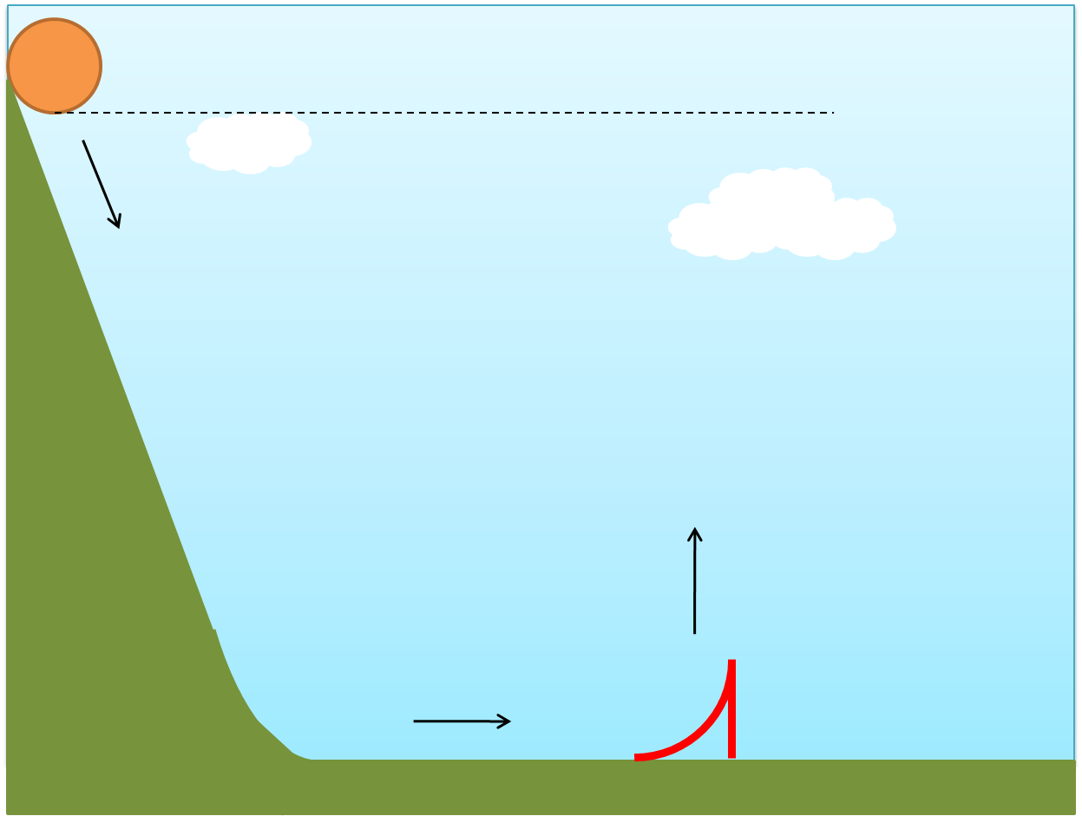
Conservation of Energy
Energy is conserved: only changes form
So if we know what forms of energy exist we can find out cool information about the motion of objects.
For instance: what forms of energy are present in these pictures?

Slide 11
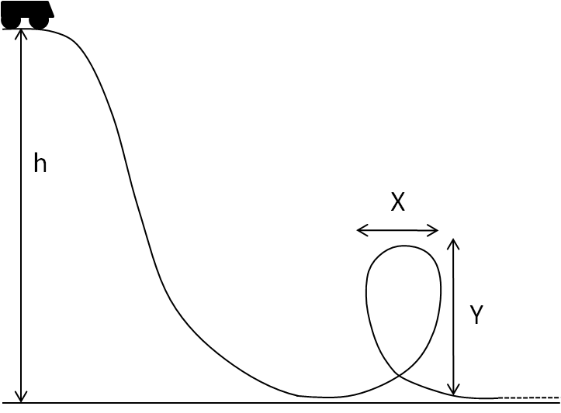
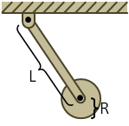
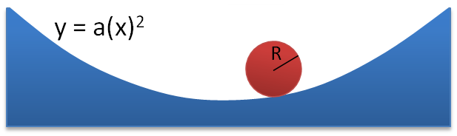
What energy is here?

Slide 12
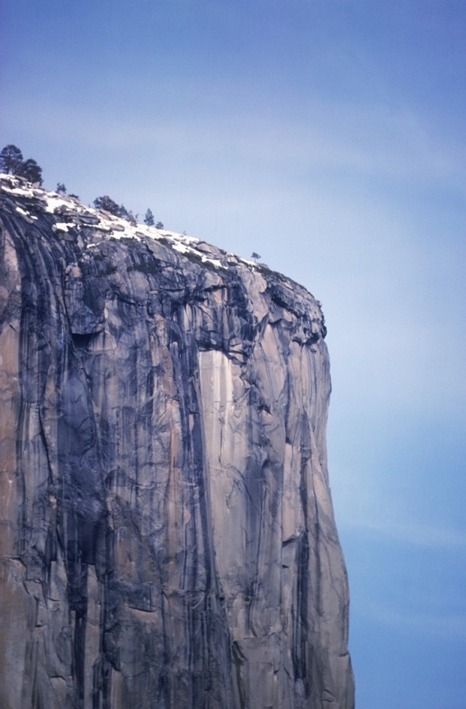
We can use energy to find out about motion
Kinetic Energy (translation): KE = ½ m (v)²
  m is the mass
  v is the speed
Gravitational Potential: PE = m g h
  m is the mass
  g is gravity
  h is height

Slide 13
Energy question
A egg is dropped off a 100 m building.
How fast will it be going when it lands?
Identify types of energy
  Start: gravitational potential energy
  End: kinetic energy
Set up equations and solve
  m * g * (100m) = ½ m * (v)²
  g * 100 = ½ * (v)²
  200 g = (v)²
  v = sqrt (200 g) ≈ sqrt(2000)
  v = 45 m/s
100 m

Slide 14

Revisit collisions
In collisions:
  Momentum is always conserved
  Mechanical energy is only sometimes conserved
When mechanical energy is conserved we call this an elastic collision (think springy)
When mechanical energy is not conserved we call this an inelastic collision (crushed)

Slide 15
(Perfectly) Elastic collision
Both energy and momentum are conserved!
Ex: two blocks sliding on ice collide elastically. The red block of mass 3 kg was traveling 6 m/s to the right. The blue of mass of mass 6 kg was originally stationary. What happens to each block?
6 m/s
6 kg
0 m/s
Momentum:
p_{i} = 3 kg * 6 m/s + 6 kg * 0 m/s = 18 kg*m/s
1) p_{f} = 18 kg*m/s = 3kg * v₁ + 6kg * v₂
Energy:
E_{i} = KE = ½ (3kg) * (6m/s)² = 54 J
2) E_{f} = 54 J = ½ (3kg) (v₁)² + ½ (6kg) (v₂)²
1) and 2) → v₁ = -2 m/s, v₂ = 4 m/s
3 kg

Slide 16
Perfectly inelastic collision
Remember when we had the objects stick together?
That’s an example of a perfectly inelastic collision

Slide 17
So much! What did we learn?
Momentum
  p = mass * velocity
  Conservation of momentum
Energy:
  Mechanical Energy
    Kinetic (like translational kinetic energy) (1/2 m v²)
    Potential (like gravitational potential energy) (m g h)
Collisions: (p is always conserved)
  Perfectly inelastic collisions
  inelastic
  Perfectly elastic collisions (energy is conserved)

Slide 18
Conservation of Energy
How high will a skateboarder get on the other side of a half pipe? (ignore air resistance)

Slide 19
Conservation of Energy
In which case will the child (sliding on a frictionless slide) end the fastest?

Slide 20
Work: A Change in mechanical energy
Work = Force * Displacement
W = F * D
Work:
No Work

Slide 21
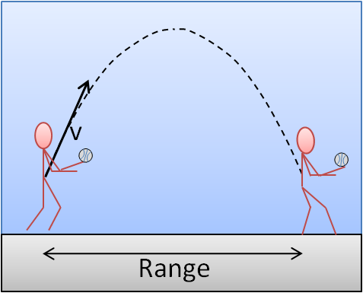
Friction does work too!
Does kinetic friction do work on an object?
Does static friction do work on an object?
v

Slide 22
Analysis of Skateboard ollie
http://youtu.be/dFl2CQ8xaXs
First think about just the skateboarder.
  Why does the skateboarder have to crouch?
Think about the skateboard.
  What are forces on the skateboard?
  What is the skateboard’s momentum?
  Is there a collision? Internal or external?
Think about the system?
  What is an appropriate system?
  Is mechanical energy conserved?
  Is work done? By who?

Slide 23
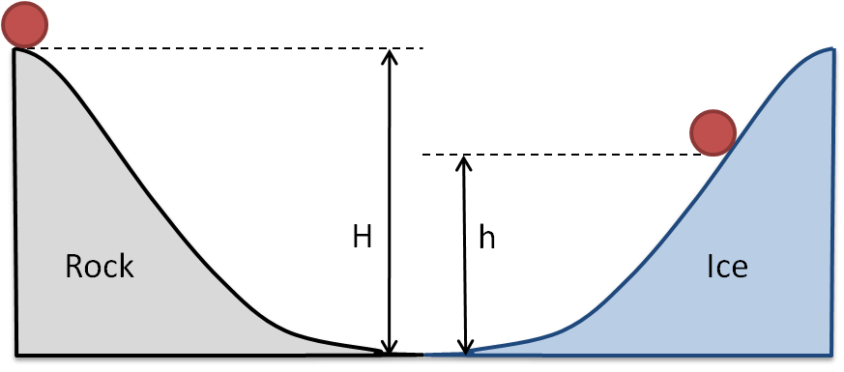
Conceptual Question
Why is h less than H?

Slide 24
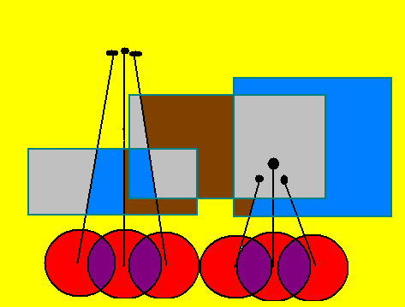
How high will the ball go?
On the giraffe there is less up and down motion. Which means less change in potential energy and less work. This is why performers always juggle on tall unicycles.
Plus, there is less acceleration on a giraffe.

