Slide 1
Fun Side Of Mechanics: Day 5
Rotation:
Angular Momentum Torque
Jonathan Abbott

Slide 2
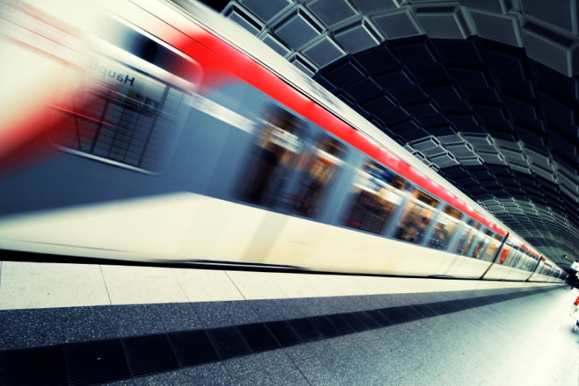
Review from last week
What type of motion did we talk about last week? Hint: it starts with a “T”.
  Translation: move from one
  point to another
What was momentum?
  momentum = mass * velocity
  p = m * v.
What types of energy did
mechanical energy include?
  Kinetic
  Potential

Slide 3
Translation → Rotation
Translation
(A to B)
Force
Momentum
Rotation
(Spin)
Torque
Angular Momentum
Kinetic Energy of Translation
Kinetic Energy of Rotation

Slide 4
Torque!
Torque is a force that causes rotation.
In which of the following pictures, would there be torque about the axis?

Slide 5
There is torque when…
The force has a tangential (not just radial component).

Slide 6
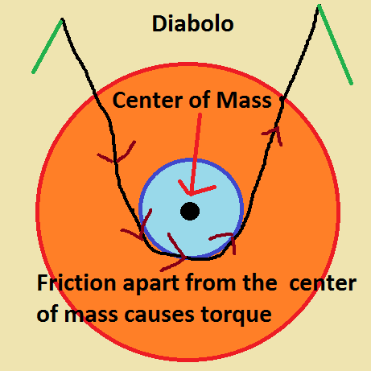
Diabolo and Torque

Slide 7
Torque in action:
Try to stop on a Unicycle and you roll!
If I try to stop immediately on a unicycle, I will not only fall forward, but I also will begin to roll forward.
Hence I would land face first.
Or I would “dismount,” land on my feet, and catch the seat :D
There is torque from friction that causes the object to rotate.

Slide 8
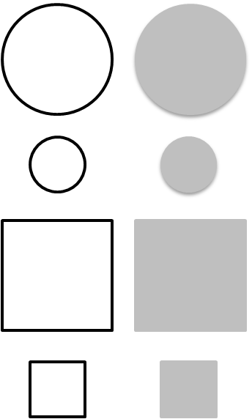
moment of inertia
(mass, but for rotation)
Find the shape with the largest and smallest moment of inertia
Each shape has the same mass. A shaded shape means the mass is evenly distributed across the shape.
Smallest: mass is near center
Largest:
mass is far from center

Slide 9
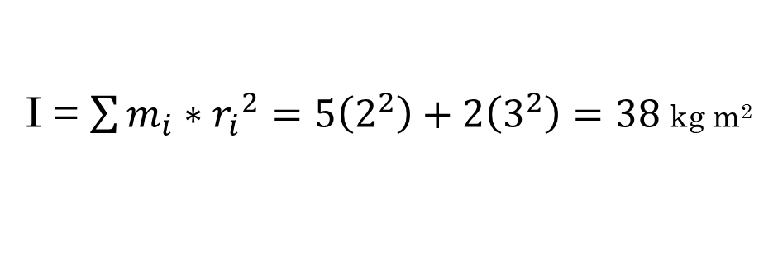
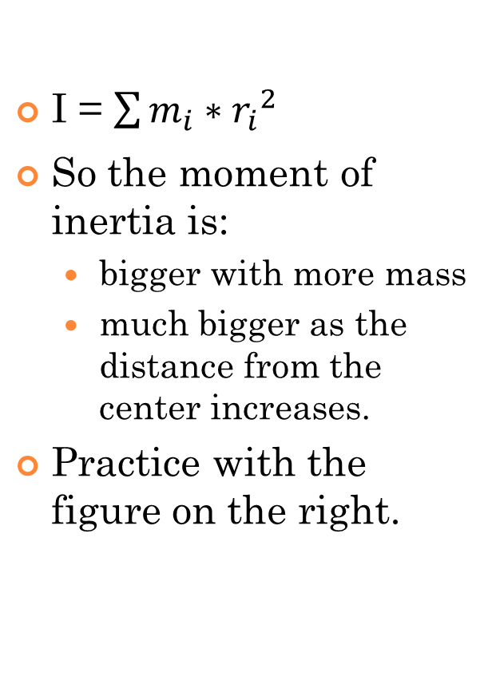
moment of inertia
5 kg
2 m
I = $\sum{m_{i}∗{r_{i}}_{}^{2}}$
So the moment of inertia is:
  bigger with more mass
  much bigger as the distance from the center increases.
Practice with the figure on the right.
3 m
2 kg
I = $\sum{m_{i}∗{r_{i}}_{}^{2}}=5\left(2^{2}\right)+2\left(3^{2}\right)=38$ kg m²

Slide 10
Now we will discuss another type of kinetic energy: Rotational Kinetic Energy
Kinetic
translation
rotation
Potential
height
elastic
Other

Slide 11
Rotational Kinetic Energy
The faster I spin, the more kinetic energy
The greater my moment of inertia, the more kinetic energy
+Kinetic Energy of Rotation
Larger Moment
of Inertia
Spin Faster

Slide 12

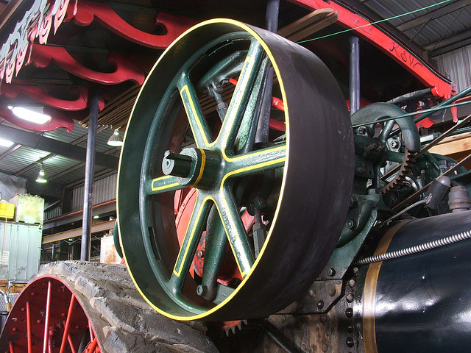
Rotational Kinetic Energy
KE_{r} = ½ I (w)²
I is the moment of inertia
w is the angular velocity (or angular speed)
(Oooh, looks a lot like KE_{t}= ½ m v² )
http://www.flickr.com/photos/cfarivar/2143702841/

Slide 13
Angular Velocity
Curl your fingers in the way in the way the object rotates.
X
“Into the page”
A longer arrow means it is spinning faster
•
“Out of the page”

Slide 14
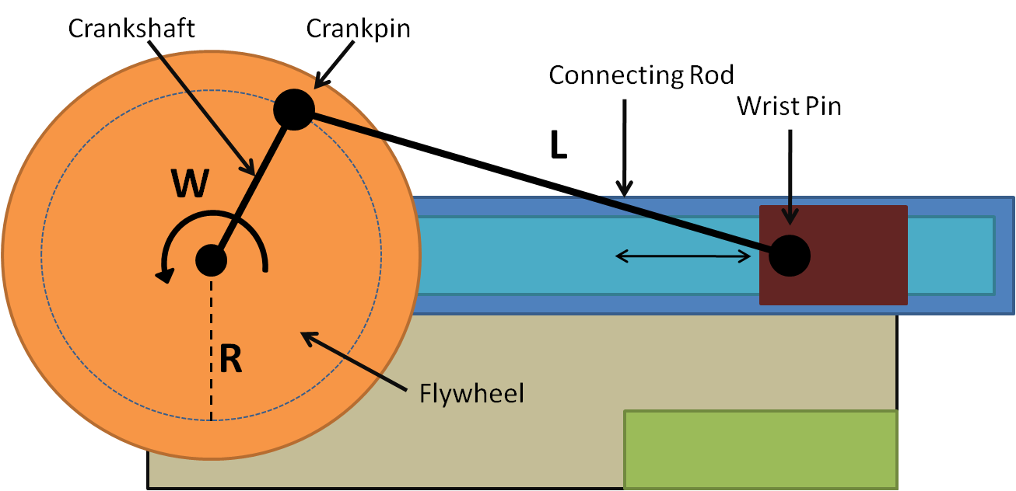
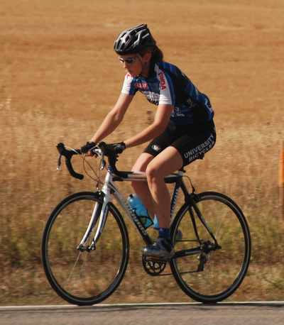
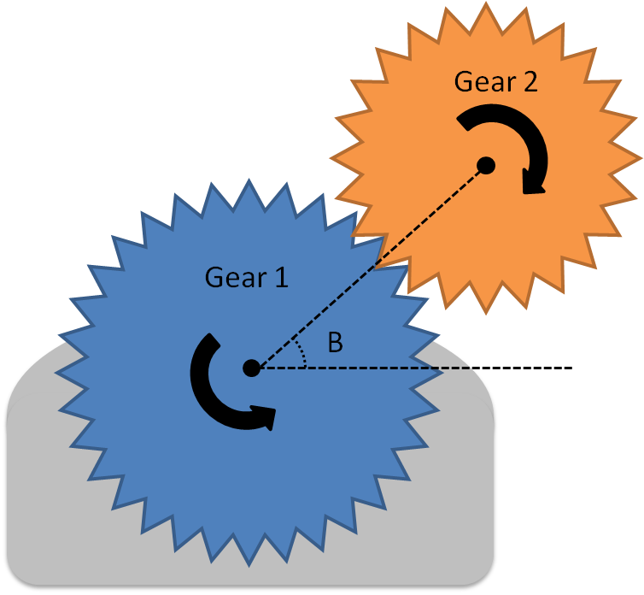
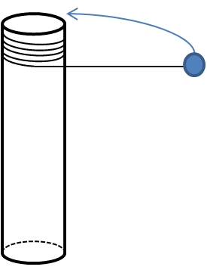
Let’s do some practice
Curl your fingers and figure out which way to point with your thumb
•
X
•
www.flickr.com/photos/question_everything/3893946197/.

Slide 15
Recap: Two ways to balance
Countersteering
Continuum
Twist body
Change Point of Contact
Change Shape of
Body
Translation
Rotation
Use both techniques to balance best

Slide 16
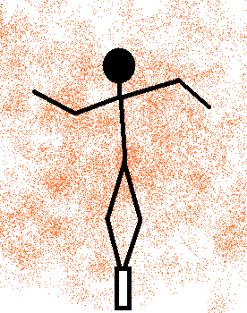
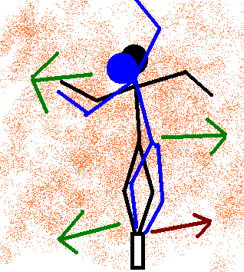
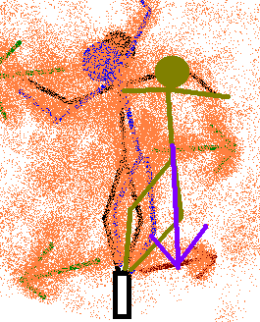
Balance Beams: using your ARMS
Twisting your arms on way twists you body the other way.
As your body twists, there is friction at your point of contact.
This friction:
  1. Causes rotation (stay upright)
  2. Causes translation (shift over to “countersteer”)

Slide 17
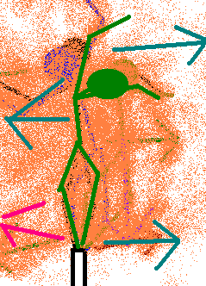
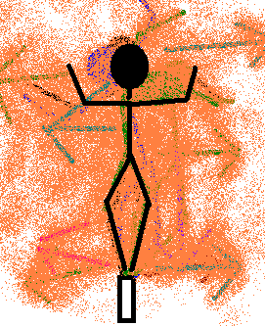
The “Countersteering”- a correction of rotation
Now that you are too far one way, twist back.
You will not be upright momentarily.
Eventually twist upright once your center of mass has shifted far enough over.

Slide 18
Quick Question:
Why might a long pole with weights at the end help someone to balance?
Increase moment of inertia proportionally faster than increasing mass. This way, it takes longer to twist and fall- giving you more time for balance corrections.

Slide 19
Technically it’s possible
While it’s easiest to balance with a long beam, it is possible to balance even without hands.
(Yes, wear a helmet)…

Slide 20

How might putting spin on a bowling ball relate to all we have talked about?
The friction between the ball and the alley is a force and a torque on the ball.
The friction is a force in that it changes the translational motion of the ball (makes it slow down or curve)
  The momentum and kinetic energy of translation change.
The friction is a torque on the ball because the ball’s rotation changes over time
  The angular momentum and kinetic energy of rotation change.
http://youtu.be/YUKeY_NubFM

Slide 21

Conservation of Angular Momentum
Spinning Chairs –dizzy but much fun
You can see angular momentum is conserved by pulling your arms in as you spin around in a chair.
This is like an ice skater who does a spin and pulls in to spin faster.
http://youtu.be/AQLtcEAG9v0

Slide 22
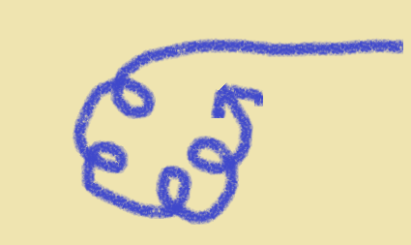
Angular Momentum applies to Unicycling too!
It’s difficult to start rotating.
One you start a turn you just keep spinning!
Think about spinning on a pogo-stick.
There is such a thing as spinning on a unicycling!

