Slide 1
Presentation Skills
Brought to you by
your friendly neighborhood UTFS

Slide 2
Overview
Presentation Details
Before Presentation Day
Presentation Tips
Questions
Presentation Details Before Presentation Day Presentation Tips Questions

Slide 3
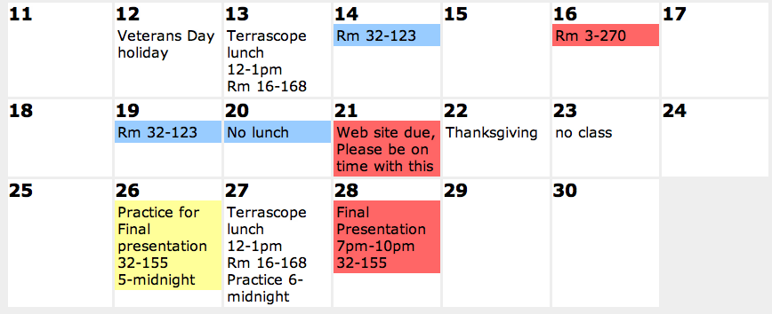
Presentation Details
Wednesday November 28 at 7PM in 32-123
(3 days after Thanksgiving weekend)
Presenters and Q&A call at 6PM
Everyone else call at 6:30PM
32-123
Presentation Details Before Presentation Day Presentation Tips Questions

Slide 4
Preparation
Choose Q&A and presenters ASAP
Write speech a few days before
Memorize your speech (notecards can help)
Practice in 32-155: 5PM-midnight on Monday
6pm-midnight on Tuesday
Presentation Details Before Presentation Day Presentation Tips Questions
Notes:
Each presenter will have a UTF coach

Slide 5
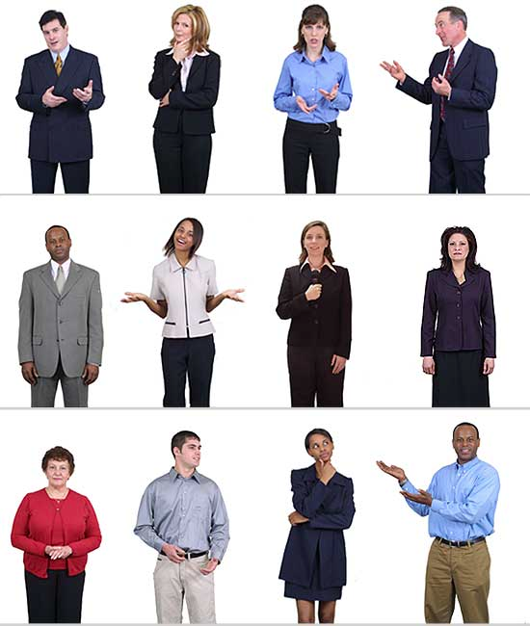
Clothing
Business casual for everyone (including non-speakers)
Only wear shoes you can walk in properly
Presentation Details Before Presentation Day Presentation Tips Questions
Notes:
Coordinate clothes, comb your hair, wear appropriate, only wear heels you can walk in, get your clothes checked by the UTF's the day before (dress pants/skirts, nice button down shirts/blouses, ties/jackets optional) http://washingtonprogram.ucdavis.edu/BusinessCasualWomen.htm

Slide 6
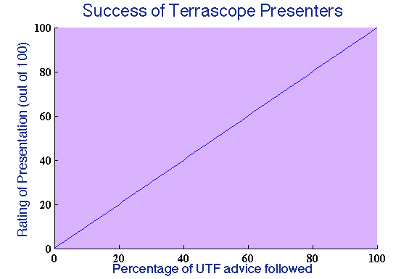
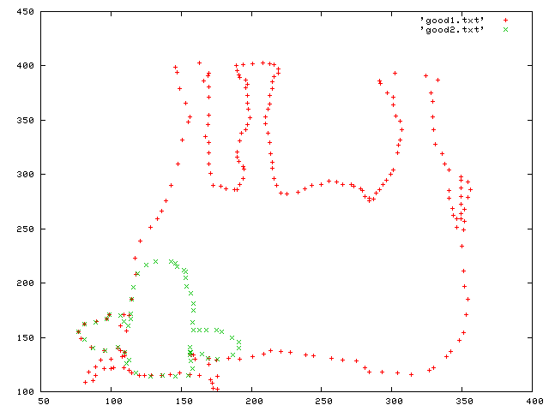
Slides
Minimal text
Key points only
Legible graphs
This is good
This is not good
Presentation Details Before Presentation Day Presentation Tips Questions
Notes:
Should reinforce what you're saying, graphics should require minimal explanation, outline at bottom, understand your graphs, images will be much larger on actual screen so make sure they're sharp

Slide 7
Bad Presenting
Looking at the screen behind you
Pacing (Simple Harmonic Oscillation)
Smile inappropriately
Talk too fast
Ums/uhs/likes/stuff
Stupid jokes
Sarcasm
Up-talking
Hands in pocket
Playing with jewelry/hair
Don't wing it
Presentation Details Before Presentation Day Presentation Tips Questions

Slide 8
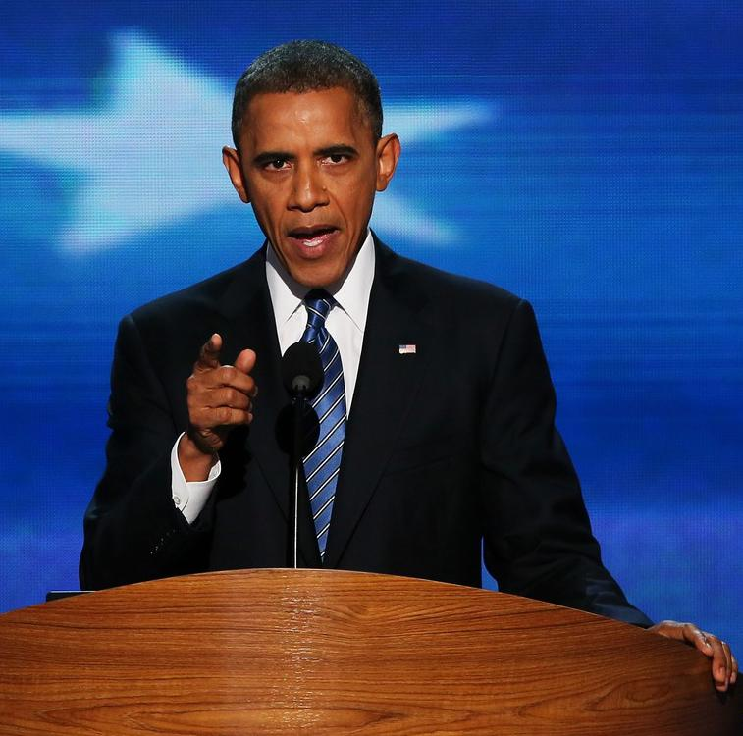
Good Presenting
Look at audience
Control your motion
Talk slowly and clearly
Project!
Presentation Details Before Presentation Day Presentation Tips Questions
Notes:
Gestures should have a purpose. Tone and facial expressions should match content.

Slide 9
Questions?
Presentation Details Before Presentation Day Presentation Tips Questions
Notes:
Did you guys notice anything missing from these slides? CITATIONS!!!!

