Slide 1
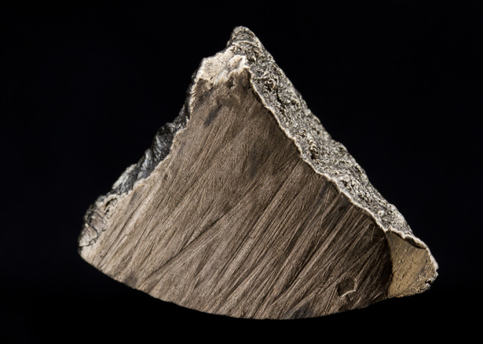
Mission 2016:
The Future of Strategic
Natural Resources

Slide 2
What is Terrascope?
First year learning community
You will tackle big problems without simple solutions
You will develop friendships and bonds that last for your time at MIT and beyond

Slide 3
Terrascope: Academic Structure
First Semester
12.000: Mission 2016: Solving Complex Problems
Second Semester
1.016: Communicating Complex Environmental Issues: Building Solutions and Communicating Ideas
Terrascope Field Experience (Spring Break)
Terrascope Radio

Slide 4
Solving Complex Problems
Multidisciplinary, project-based learning experience
Students work toward a solution to a deceptively simple problem related to Earth’s environment
Each year’s theme is different and referred to as “Mission 20XX”, where 20XX refers to the graduation year of the class involved

Slide 5
Solving Complex Problems: Motivation
To build in you the capacity to tackle “big” problems that confront society
To encourage you to take charge of the learning process
To show you how to do independent research, to evaluate the quality of information sources, and to synthesize different information streams

Slide 6
Solving Complex Problems: Motivation
To encourage you to think about optimal solutions rather than correct solutions
To help you learn to work effectively as part of a team
To improve your communication skills: web site and formal oral presentation
To convince you of your potential!!

Slide 7
Past Missions
To develop strategies for developing countries in the Pacific basin to cope with tsunami hazards and disasters. Due to the unique needs of each country, we specifically focused on developing plans for Peru and Micronesia.
To develop a plan for the reconstruction of New Orleans and the management of the Mississippi River and the Gulf coast.

Slide 8
Past Missions
To develop strategies to deal with the collapse of the global fisheries and the general health of the oceans
To develop a plan to ensure the availability of fresh clean water for western North America for the next 100 years.
Propose an integrated global solution to the rapid rise in atmospheric CO₂ that will stabilize concentrations at an economically viable and internationally acceptable level.
Notes:
8

Slide 9
Subject Structure
Problem divided into 5-10 subtopics and students divided into teams
Each team assigned a Undergraduate Teaching Fellow and Alumni Mentors
Each team will also have access to the library staff.

Slide 10
Subject Deliverables
Each team will communicate through wiki-based structure
The entire class will describe and justify its overall plan in a comprehensive web site
Each class explains the design in a 60-90 minute presentation before a panel of experts and a general audience. Presentation will be webcast around the world
“The whole world is watching, the whole world is watching…..”

Slide 11
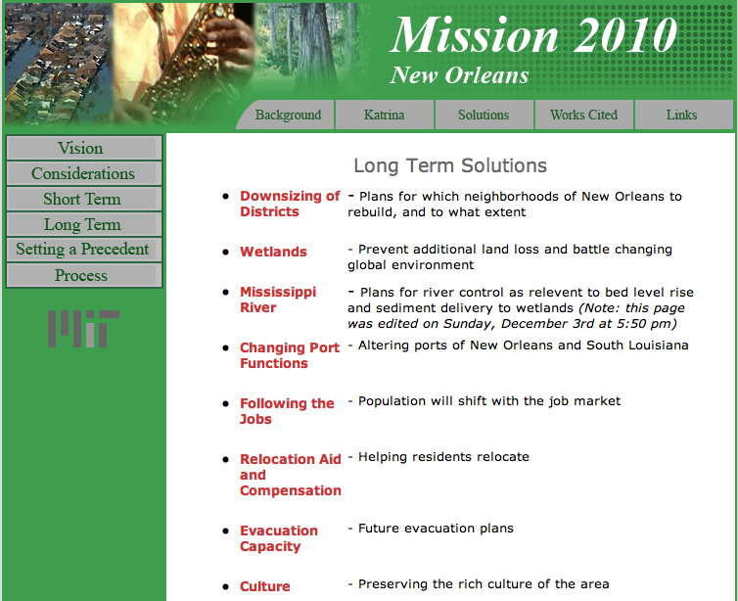
Mission 2010

Slide 12

Mission 2011

Slide 13
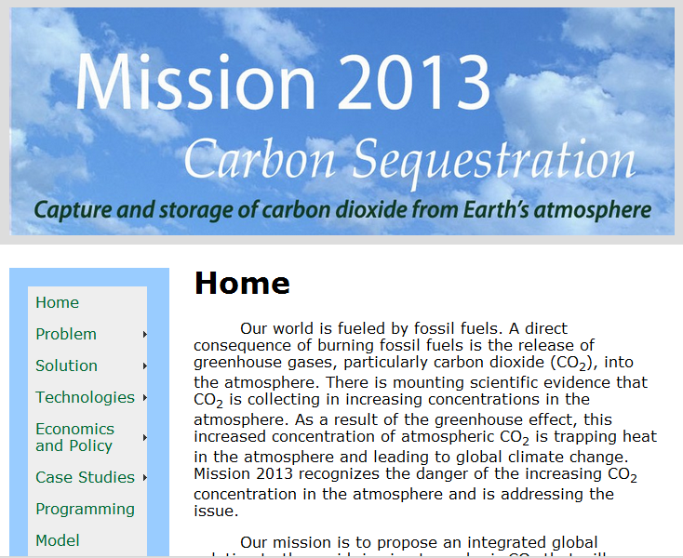
Mission 2012

Slide 14
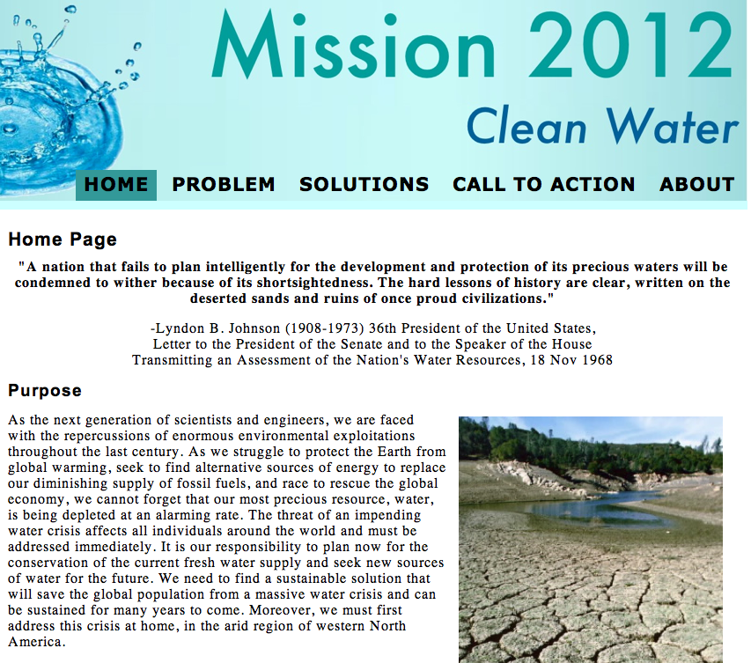
Mission 2013

Slide 15
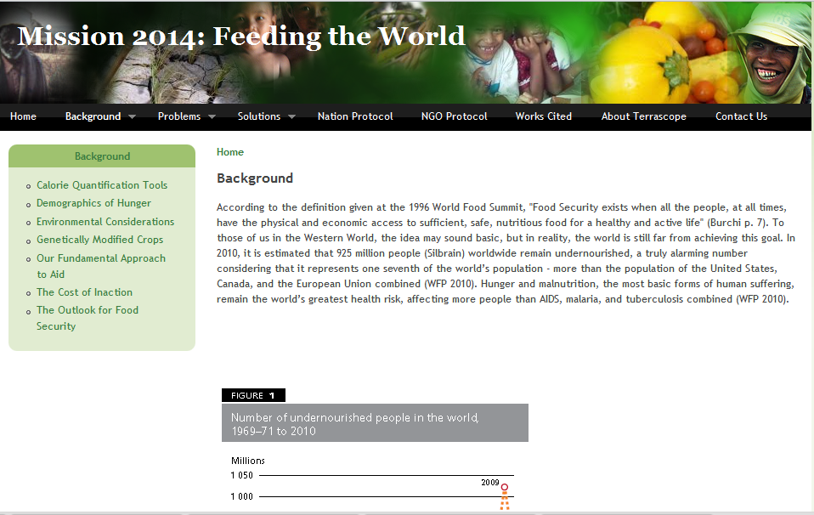
Mission 2014

Slide 16
Subject Grading
Pass/No Record but……
we do assign “hidden grades”
Individual performance (30%)
Team performance (30%)
Class accomplishment (40%)

Slide 17
Your Mission is to....
Devise a plan to ensure that all nations, including those that aspire to be developed, have access to ever decreasing strategic natural resources by implementing recycling technologies, searching for non-traditional sources, and developing an environmentally sensitive global management plan

Slide 18
Strategic Metals and Minerals
Often defined as minerals required to supply the industrial, military, and essential civilian needs of a country, and not found in or produced by that country in sufficient quantities to meet its need.
Any interruptions in the flow of these minerals will affect not economic stability, technological competitiveness, and national security.
Highly variable global distribution typically controlled by a small number of countries

Slide 19
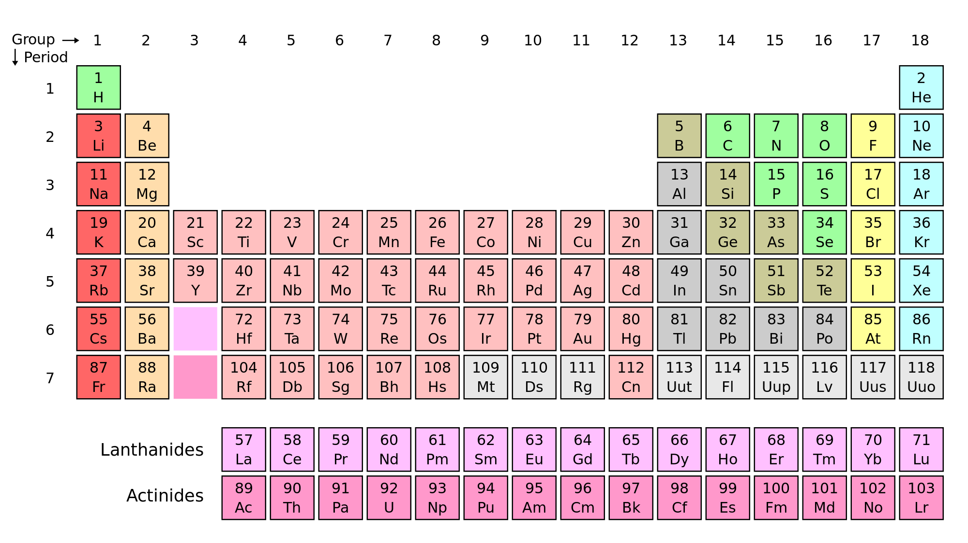
Periodic Table
Rare earth elements
Nb, Ta, Ga, In
Platinum group elements
P
Notes:
Emphasize that you will have to narrow down your choices

Slide 20
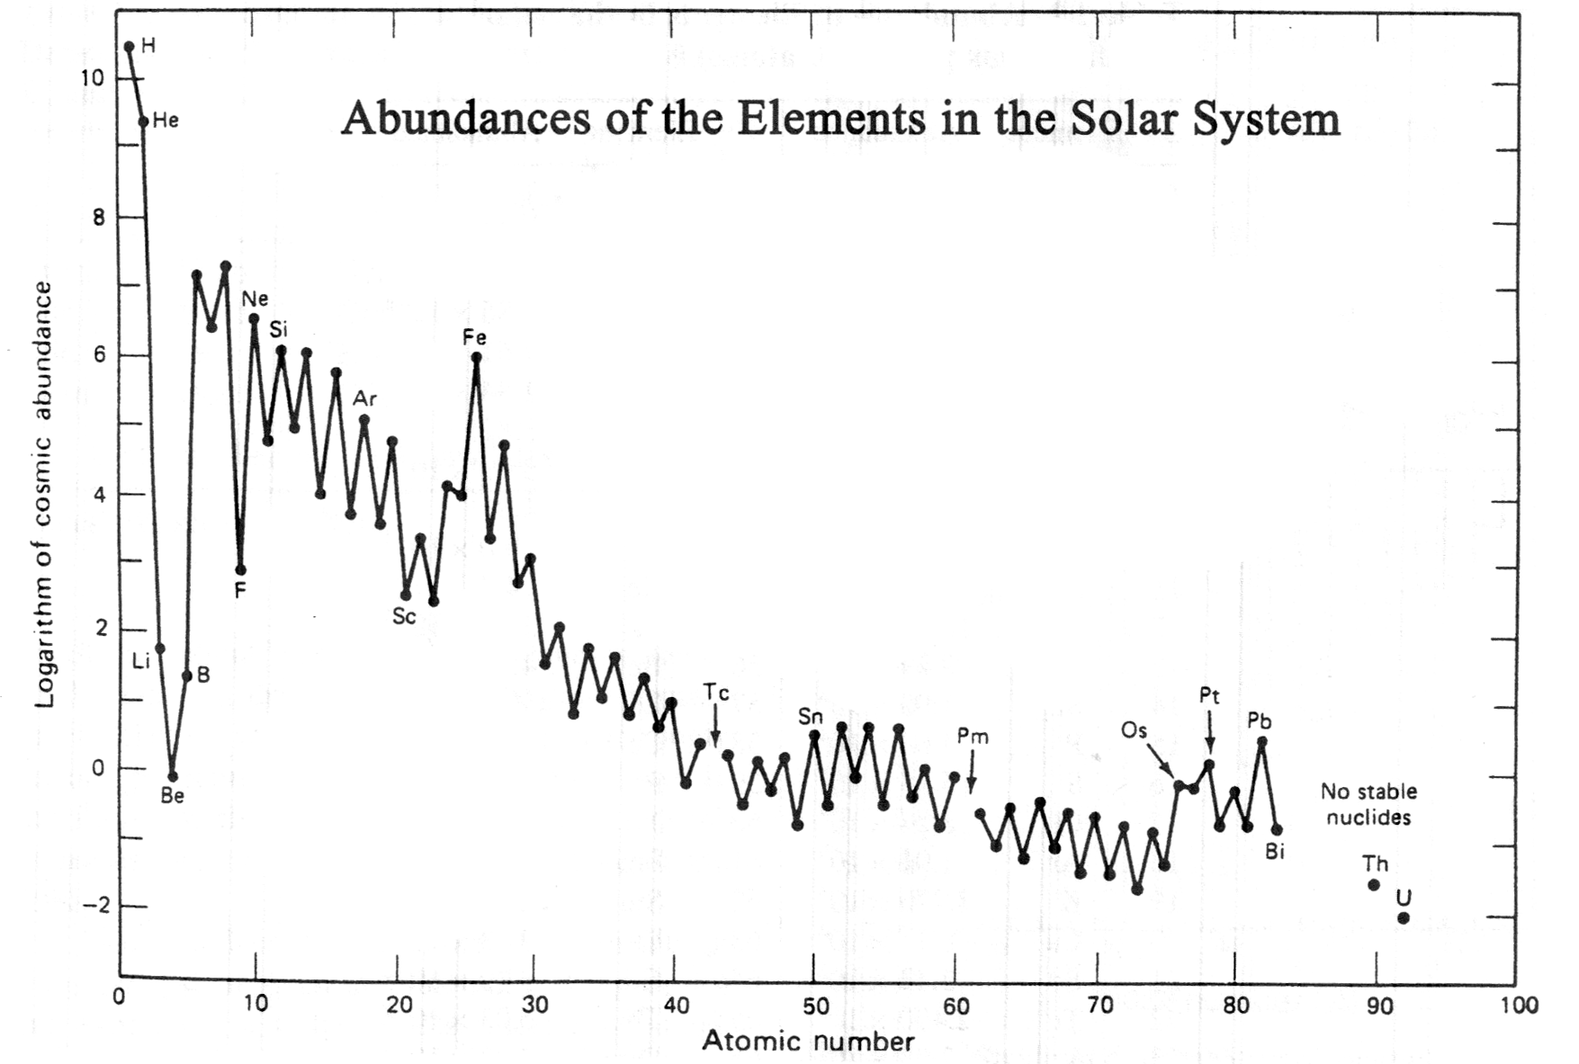
Abundances of Elements in the Solar System
10⁴
Rare earth elements
Platinum group elements
100
Nb, Ta, Ga, In
C
O
P
Mg
Si
1
N
S
Al
Na
0.01
Abundance (atoms per Si atom)
P
K
Ga
10⁻⁴
Ru
Y
Pd
10⁻⁶
Nb
La
Ta
Ir
Rh
In
10⁻⁸
Lu
Anders and Grevasse (1989)

Slide 21
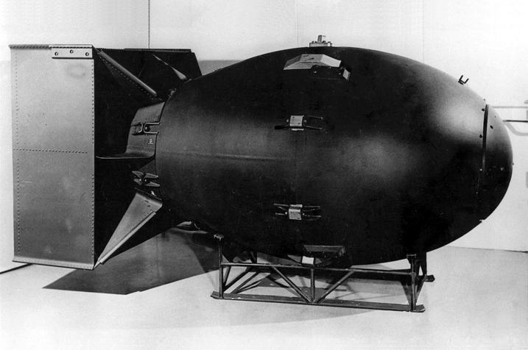
Example: Gallium
Fat Man
First became strategic metal in decade after WW II: critical component in Pu “pit” in atomic bombs
Today: critical for high speed electronic switches, solid state lasers and optoelectronic sensors
The U.S. imports 100% of its Ga needs

Slide 22
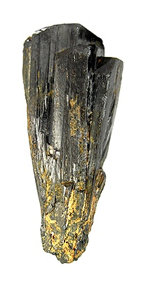
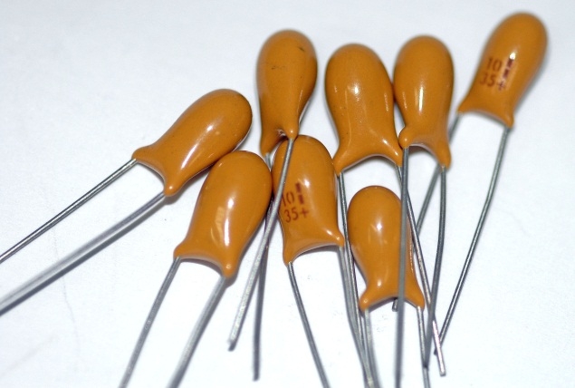

Coltan
(Nb, Ta)₂O₆

Slide 23
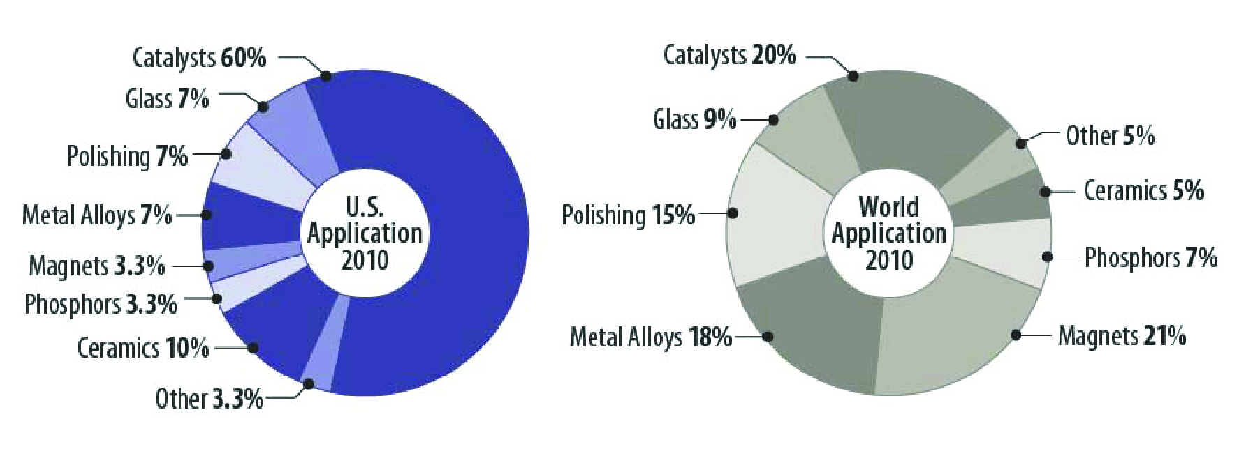
Rare Earth Elements
A Prius electric motor requires 2 pounds of neodymium and twenty 22-33 pounds of lanthanum for its battery!
Humphries (2012)

Slide 24
Neodymium Super Magnet

Slide 25
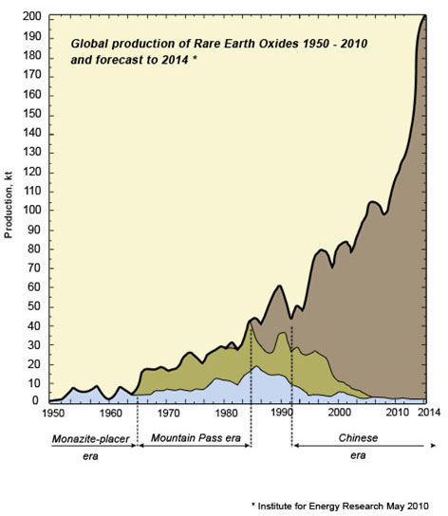
History of Rare Earth Oxide Production
China
Others
USA
Institute for Energy Research (2010)

Slide 26
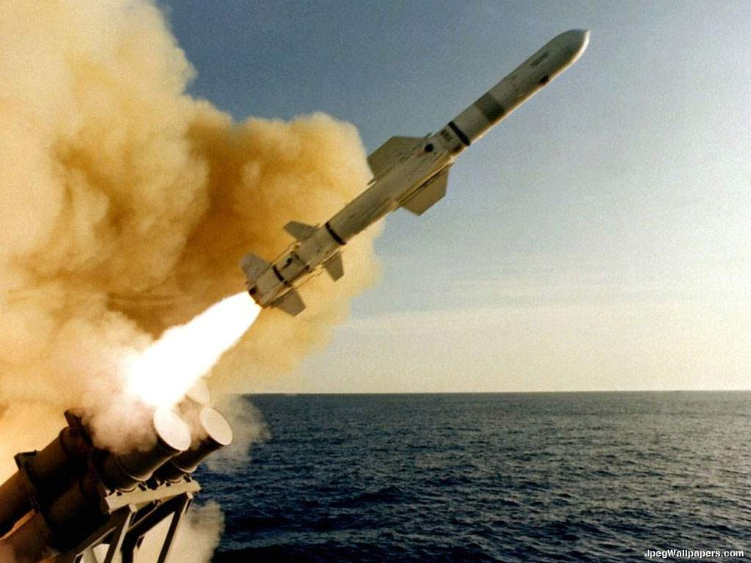

Are rare earth elements critical to defense industry?
Should they be stockpiled?
Implications for National Defense
Magnets:
Tomahawk Cruise Missile
Energy amplification:
The Laser Avenger

Slide 27
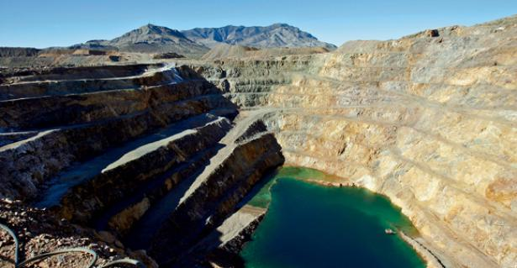
Strategy for Mining
Mountain Pass Mine, California
Is outsourcing mining to other countries a net gain for environment?
What mines should be opened?
Better approaches: new mining technologies? recycling? substitution of other minerals?

Slide 28
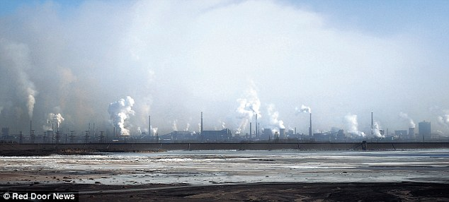
Do Rare Earth Elements Enable
“Green” Technology?
Acid lake, Baotou, China
Notes:
Local man: “In the Yellow River, in Baotou, the fish all died … They dump the waste— the chemicals into the river. You cannot eat the fish because they are polluted.” Some 150 million people depend on the river as their primary source of water.
In September 2008, villagers in Pitou county blocked lorries carrying chemicals and picketed the council. These villagers were angry because their fields had been ruined by the acid pumped from a rare earth processing plant...

Slide 29

Are Current Uses of Strategic Metals
Good for the World?
Catalytic converters destroy toxins but yield greenhouse gases!
2NO_{x} → 1/2 N₂ + xO₂
2CO + O₂ → 2CO₂
2C_{x}H_{y} + (2x+y/2)O₂ → 2xCO₂ + yH₂O
Could they be replaced with something better?
Brenan (2008)

Slide 30
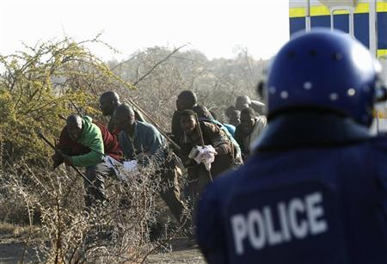
What are Human Costs of Strategic Mineral Mining?
Dozens of striking platinum miners were massacred last
month in South Africa
Brenan (2008)

Slide 31
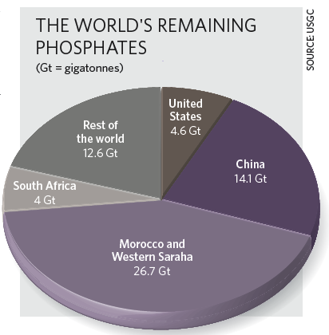
Phosphates
Phosphate-based fertilizers have helped grow agriculture in the past century, but supplies are limited.
Phosphate is often THE limiting nutrient to plant growth
Reserves may vanish within century if growth continues at 3%/year
China does not export

Slide 32
Important Questions to Address
    What are the consequences of doing nothing?
    Is access to strategic metals a basic human right?

Slide 33
Class Structure
We will present possible team topics and allow you to “self-organize”
Each of you → team,
Each team → UTF, library liaison, alumni mentors
Each team will be responsible articulating the nature of the problem and developing a range of strategies and options to deal with it
Just a way to get started

Slide 34
Terrascope Social Structure Outside Class
Terrascope room 16-xxx: a place to study, hang out, interact, cook, eat, SLEEP, always someone around to talk to
Terrascope lunches: see calendar—eat, listen (or not), learn
Special activities: movie nights, special dinners, and ideas?

Slide 35
Important Contacts
Ben Weiss (bpweiss@mit.edu)
(12.000 Professor)
Erin Shea (nuptse@mit.edu)
(Teaching Assistant)
Anne Bauer (annbauer@mit.edu)
(Teaching Assistant)
Chris Sherratt (gcsherra@mit.edu)
(Library staff)
Ari Epstein (awe@alum.mit.edu)
(Terrascope staff and Terrascope Radio)
Debra Aczel (daczel@mit.edu)
(Terrascope Administrator)
Sam Bowring (sbowring@mit.edu)
(Terrascope Director)

Slide 36
This Friday’s Class
Meet in 3-270

