Slide 1
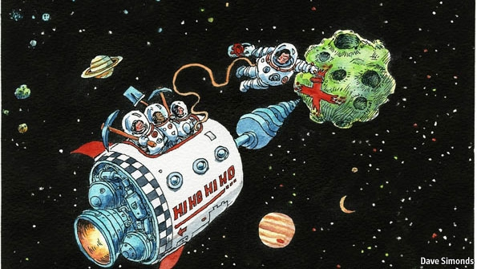
Mission 2016: The Future of Strategic Natural Resources

Slide 2
Nano Assignment
Due Wednesday, September 12
Part 1: Team
Each team will get 5 minutes on Wednesday to introduce themselves and make a statement about their topic. Could be a few factoids, statement of major issues with possible links to other teams.
Each team should appoint a temporary leader and put together 1-3 Powerpoint slides. Bring them on a USB stick to class on Wednesday.

Slide 3
Nano Assignment
Due Wednesday, September 12
Part 2: Individual
Each person in the class should chose an element (REE, PGE, Nb, Ta, Ga, In, P, Be, Co, Ge, W, Sb…) that has strategic, military and/or industrial importance. On your personal wiki page, explain your element’s importance to humankind and existing limitations on its usage.

Slide 4
Classrooms
Next Monday: Everyone meet in 32-123
In future, check syllabus on http://web.mit.edu/12.000/www/m2016/
Terrascope room (for lunches, lounge, kitchen) 16-168. See UTF or office in 16-177 for combo.
First lunch next Tuesday 9/11, 12-1 pm. Guest speaker: Julie Soriero, Director of Athletics and Department Head of the Department of Athletics, Physical Education and Recreation
Classrooms for team meeting: E25-117 and 32-155 (MWF 3-4 pm)

Slide 5
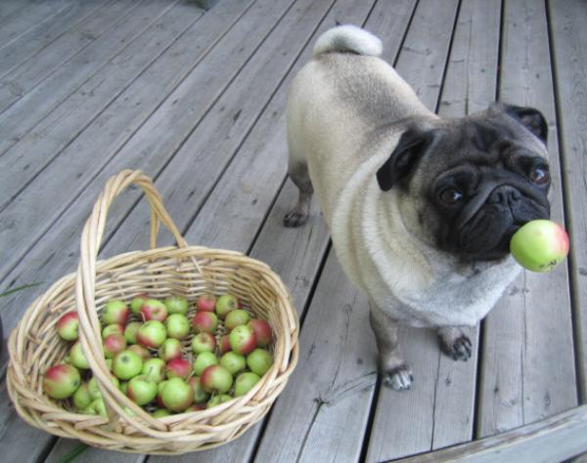
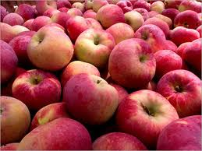
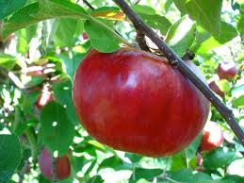
Terrascope Apple Picking
Saturday September 15
Leave at 8 am, return by noon

Slide 6
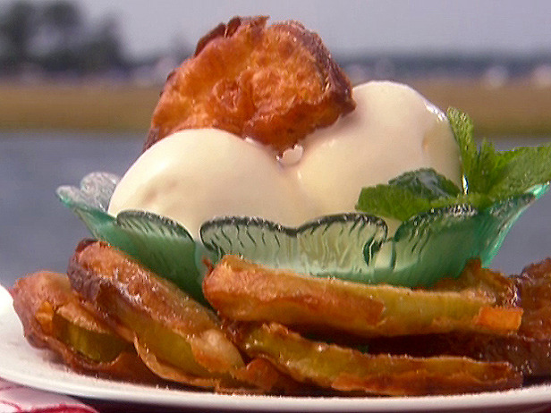
Terrascope Apple Bake-off
Sunday September 16 at 6 pm in 16-168
Reimbursement: $10
Cider and apple foods for all
Winners receive prizes and infinite honor

Slide 7
Summary of Teams
Economics and Global Politics
Locations of Deposits
Mining and Supply Chain
Industry and Manufacturing
Alternate Technologies and Resources
Military Uses and Implications
Environmental Impact

Slide 8
Mission 2016 Teams
Team 1: Economics and Global Politics. Is it possible to change the way our planet utilizes natural resources? Is it feasible to have a regulatory body that monitors the distribution of strategic metals? Does current economic theory allow us to place realistic value on natural resources? Is there a country or international body that could and should take the lead?

Slide 9
Should the World Trade Organization Play a Role?

Slide 10
Mission 2016 Teams
Team 2: Locations of Deposits. What are the top ten strategic metals/minerals today? Where are they distributed and what might be the new strategic metals of the future? Which elements have reached peak production and which are virtually inexhaustible? How do labor costs and safety regulations vary and control prices? Should countries and multinational corporations be allowed to buy mineral rights from nations unable to produce mines and refine their own? Which elements need regulation? Should all natural resources be managed?

Slide 11
Peak Selenium?

Slide 12
Mission 2016 Teams
Team 3: Mining and Supply Chain. What are the critical links in the supply chain from mining to ore processing to production of strategic elements? How can these steps be improved and how are they subject to shocks and uncertainty? How do individual countries control this supply chain? Mining laws are often antiquated. Human history has involved extraction of mineral wealth by the richest nations from the poorest. Can this ever be changed? Should it be changed?

Slide 13
92% of World’s Nb Comes from Brazil: Implications?
Araxá niobium mine in Brazil

Slide 14
Mission 2016 Teams
Team 4: Industry and Manufacturing. Where do strategic metals end up? What products are they used in? How do these industries play a role in the health of the global and local economies? What would the impact on these industries be from a decreased supply of critical strategic elements? Why is manufacturing often done in countries that do not have mines?

Slide 15
Which Technologies are Critical to World Civilization Today and in the Future?
Solar Cells

Slide 16
Mission 2016 Teams
Team 5: Alternate Technologies and Resources. Is there a finite supply of these metals extractable at reasonable prices? How can we decrease our dependence on them? Are there cheaper, better ways to develop the same technologies? What about extraterrestrial resources? Many are discussing the mining of asteroids within the next few decades. Is this a viable solution? What metals could be mined and used economically?

Slide 17
Is Asteroid Mining Economically Feasible?
Planetary Resources homepage

Slide 18
Mission 2016 Teams
Team 6: Military Uses and Implications. Many metals are being used in advanced, often secret, military applications throughout the world: How important is this demand? How dependent is global security on strategic metals? How can we avoid conflict resulting from control of these resources for military use?

Slide 19
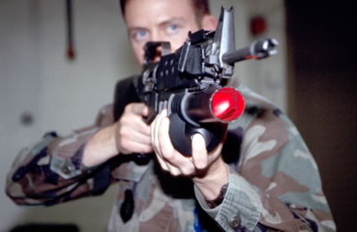
How do High-Tech Weapons Affect Global Security?
Saber Shot Photonic Disruptor

Slide 20
Mission 2016 Teams
Team 7: Environmental Impact. What are the environmental impacts of mining and subsequent ore processing of the strategic metals you have chosen to focus on? What is the impact of their use in industry and manufacturing? What is the impact from disposal of products made of these elements? What regulations should be put in place to control their exploration and use? How different are countries in their approach to environmental impacts and can it be controlled? Can these metals be recycled? Should it be required?

Slide 21
Is There Way to Sustain Agriculture
Without Phosphate Runoff?
Red tide, Texas coast

Slide 22
Entire Class
In the first few weeks, teams must work together to define a list of 10-20 metals/compounds that you will focus on for the semester.
What characteristics make each valuable (atomic structure, physical properties, purity and chemical properties)?
This knowledge is essential for all teams. Remember that research into these metals is a large field of research.

Slide 23
Think on the 100 Year Timescale!

Slide 24
Summary of Teams
Economics and Global Politics
Locations of Deposits
Mining and Supply Chain
Industry and Manufacturing
Alternate Technologies and Resources
Military Uses and Implications
Environmental Impact

