Slide 1
Mission 2017 Water Security
Friday September 6, 2013
“tragedy of the commons”

Slide 2
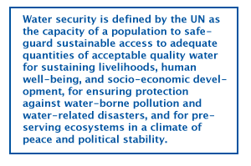
First “assignment”
Re-write this definition and email to
sbowring@mit.edu before 2 PM Friday

Slide 3
A) Water security is a population’s capacity to ensure a sufficient amount of good quality water for supporting human needs and
socio-economic development, for offering protection against water-related dangers and threats, and for maintaining healthy and
prosperous ecosystems in a well-balanced political climate.”
B)Water security- the population's ability to use and subsequently conserve and replenish a steady water supply in order to sustain life,
human well-being, development and protection and to preserve a peaceful, environmental and political climate

Slide 4
Water security is a peoples' ability to maintain a constant and sufficient supply of safe, clean water without negatively impacting the peoples and environment around them.
Water Security is a population's ability to protect and maintain enough access to clean, use-able water necessary for human health, economy, safety, and stability.

Slide 5
WIKIS
Take it away Annie

Slide 6
Additional Exercise for
Monday, September 9
On the class website under “reading& info” there is a list of news articles as .pdfs. Chose at least one, read it, and write about it. Briefly summarize it and then write your reaction to it. No need to be lengthy
On the Wiki page, make a child page for the article you selected (or add to an existing one) and post what you have written. Make sure to include your name so we know you did it!

Slide 7
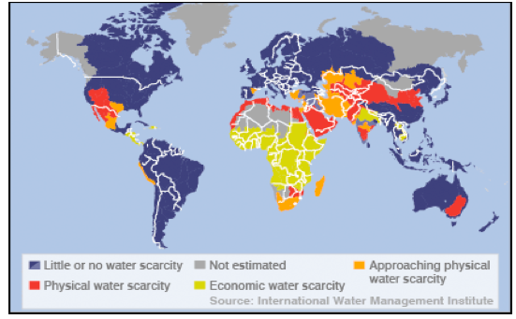
PEAK WATER ?

Slide 8
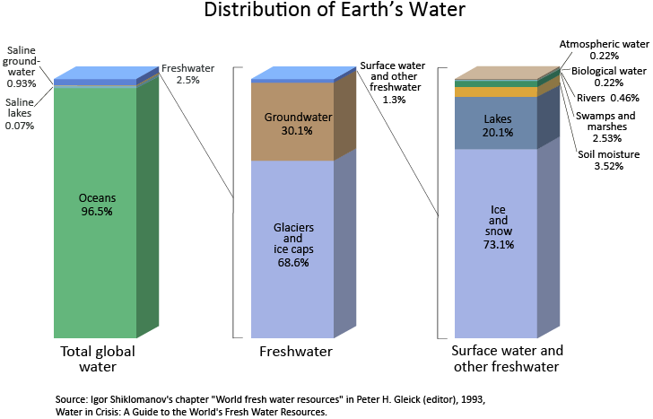
http://ga.water.usgs.gov/edu/earthwherewater.html

Slide 9
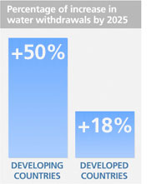
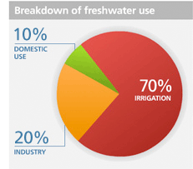
Global water use

Slide 10
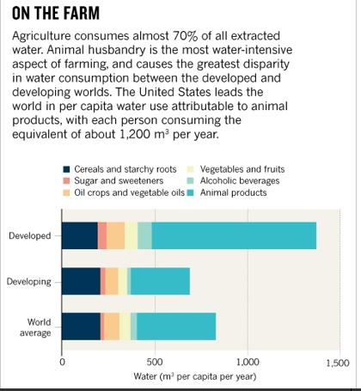

Slide 12
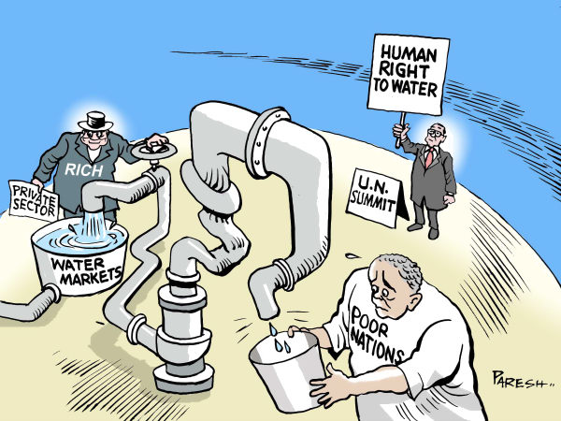

Slide 13
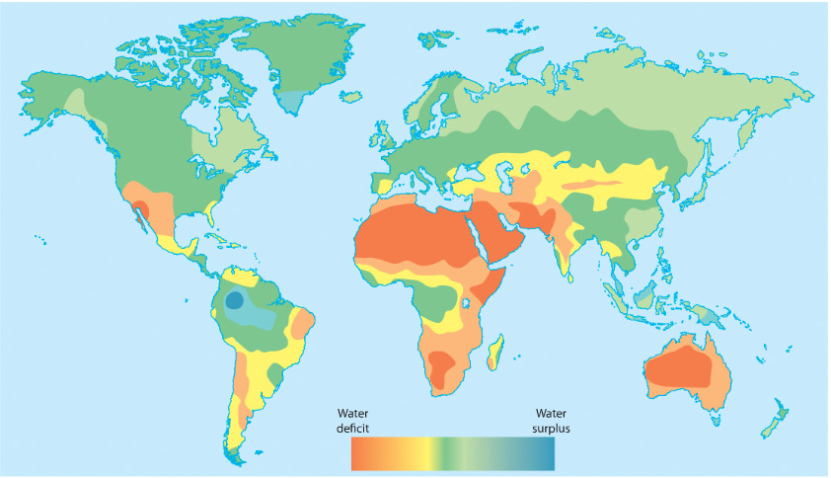

Slide 14
Problem areas and examples
China and Trans-boundary issues
Nile River
Aral Sea

Slide 15
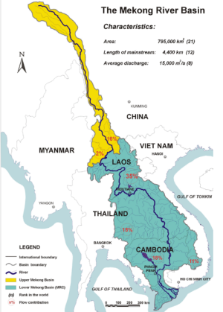

Slide 16
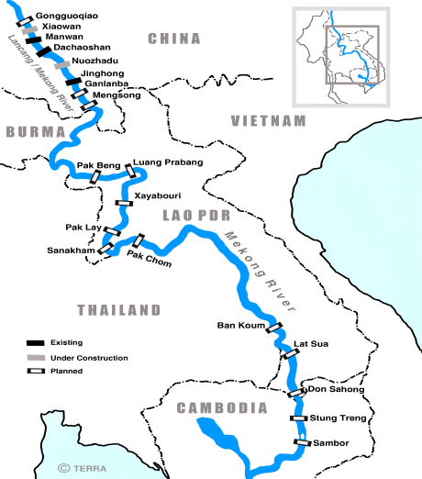

Slide 17
CHINA and TRANSBOUNDARY RIVERS
Headwaters: China is the largest source of transboundary river flows, including many, such as the Brahmaputra River, that flow from the Tibetan Plateau to much of South Asia.
Dams: No country in history has built more dams than China, and it has built more dams than the rest of the world combined. Having saturated its internal rivers with dams, China is increasingly orienting its dam building toward rivers that flow out from China into neighboring countries
Environmental practice: China’s use of rivers has been ecologically unsafe, which has had devastating consequences for the environment.

Slide 18
Unilateral approach: China has increasingly taken a unilateralist approach to its use of rivers and its dam construction, Chellaney noted, as shown by its unwillingness to consult with other countries about how a new dam might affect them.
Water agreements: While Chinese participation is critical to establishing any multinational water management institutions, and while almost all of China’s neighbors have water agreements among themselves, not one has a water agreement with China. China is involved in water disputes with almost all of its neighbors, including friendly states such as North Korea and Pakistan.

Slide 19
CHINA AND INDIA: POTENTIAL FOR CONFLICT
Brahmaputra River: Although denied for many years—many fear the Chinese still plans to build a mega-dam on the Brahmaputra River, one of the major rivers in Asia. This river is one of India’s and Bangladesh’s largest sources of water, and any water diversions could be devastating to both countries. Brahmaputra River supplies water to the Indian state of Arunachal Pradesh, which is China’s largest territorial dispute.

Slide 20
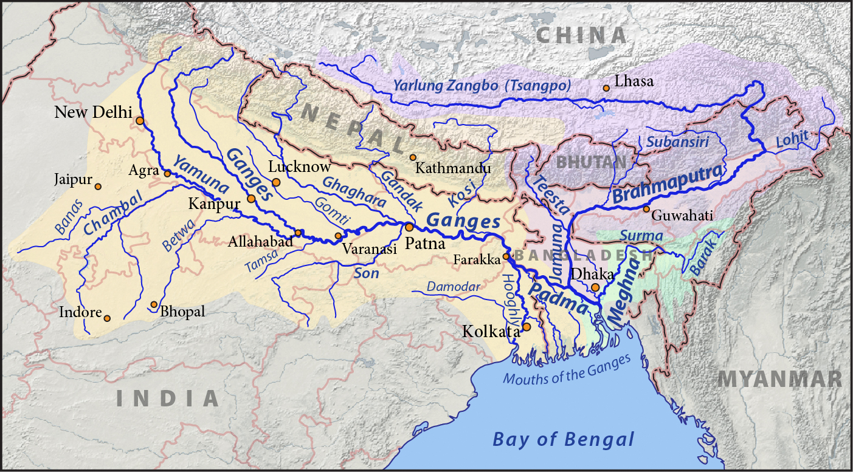

Slide 21
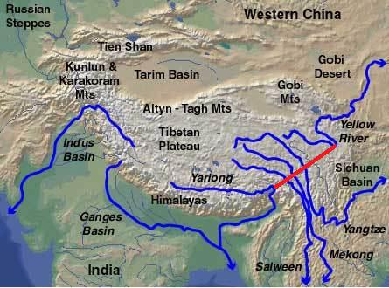

Slide 22
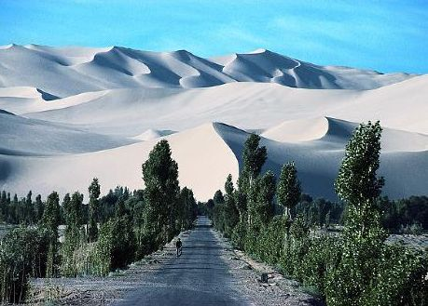

Slide 23
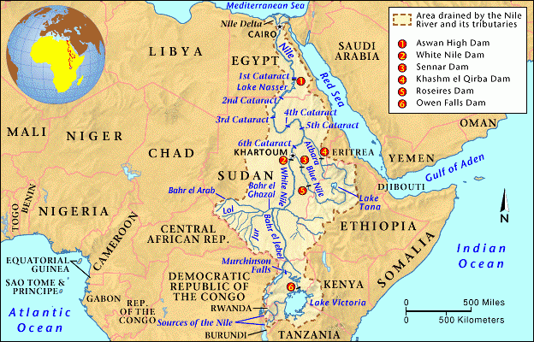

Slide 24
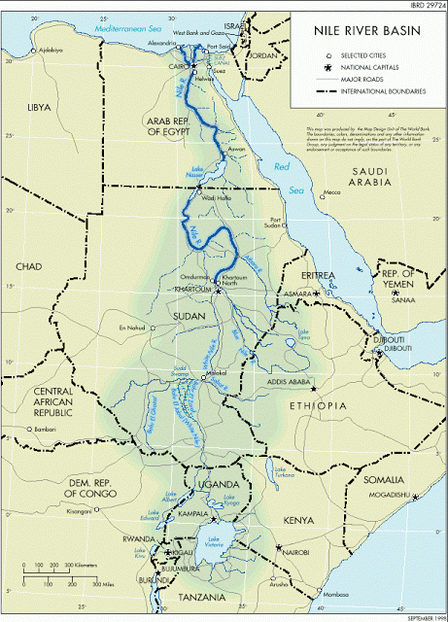

Slide 25
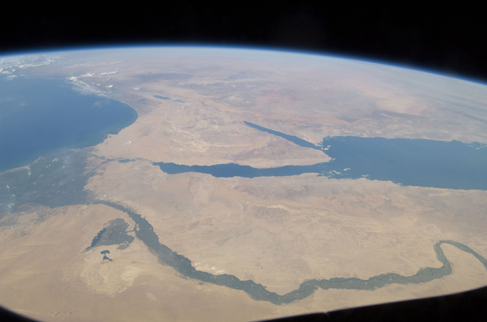

Slide 26
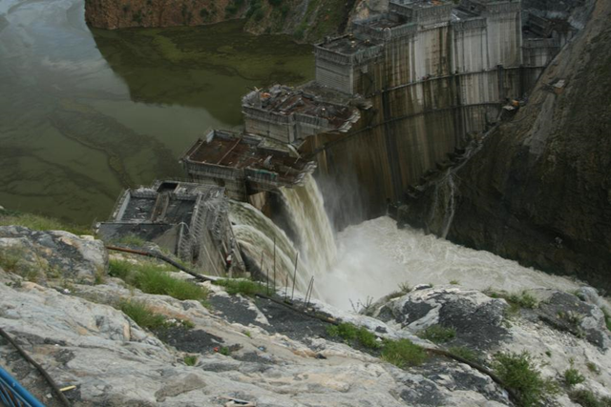

Slide 27
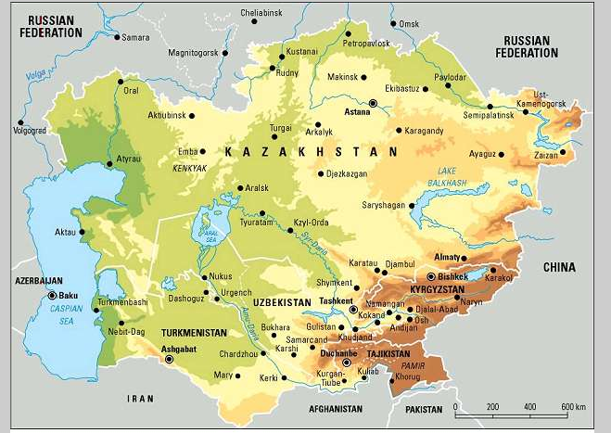

Slide 28
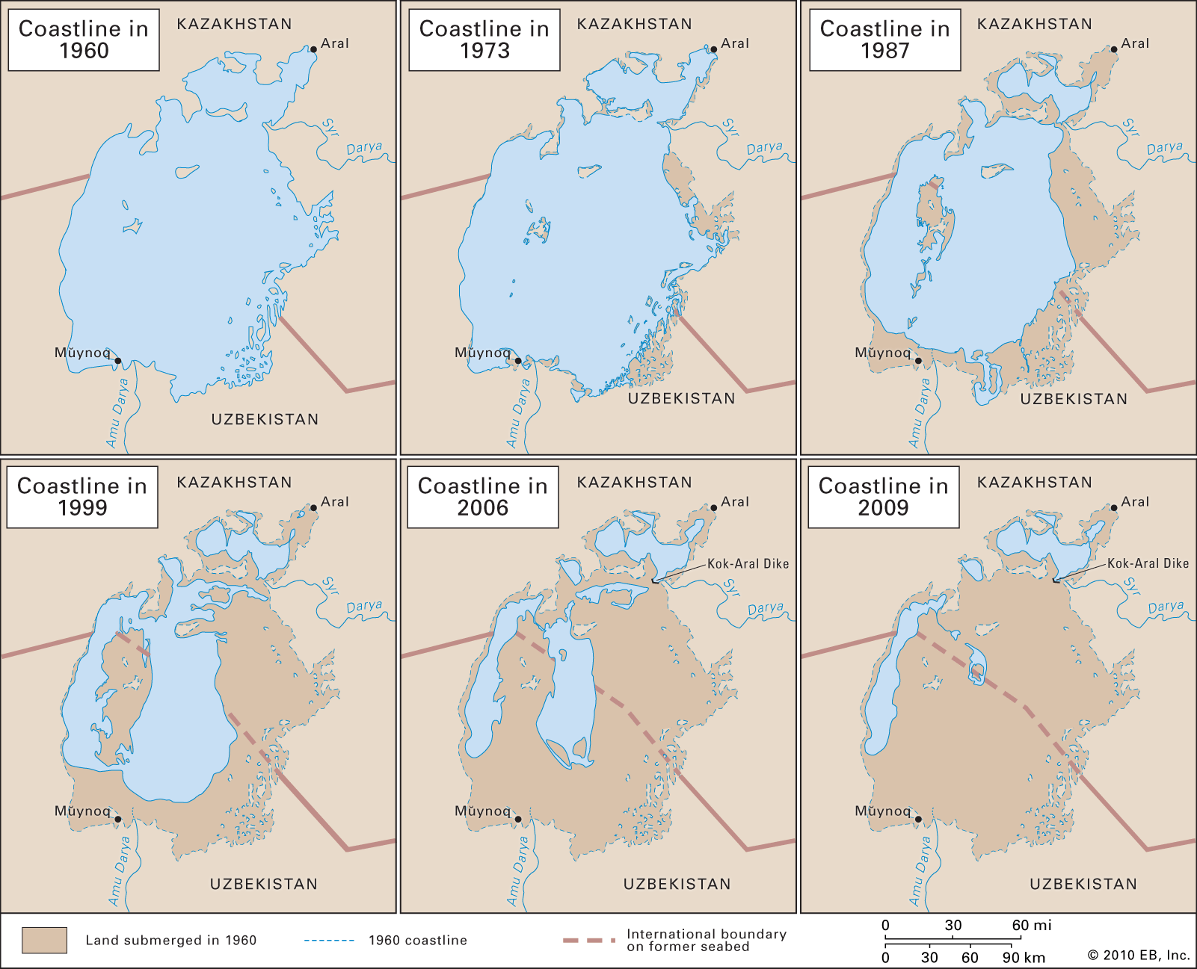
Notes:
1999

Slide 29
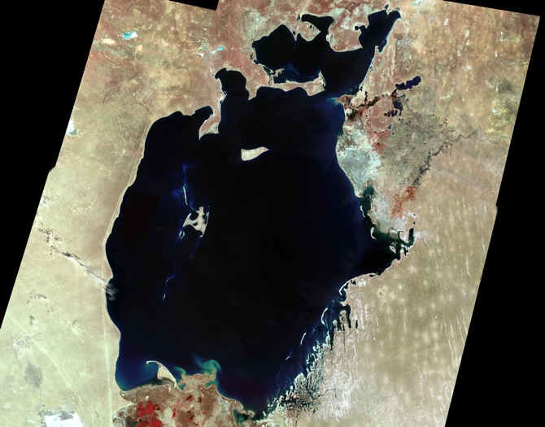
Notes:
1960

Slide 30
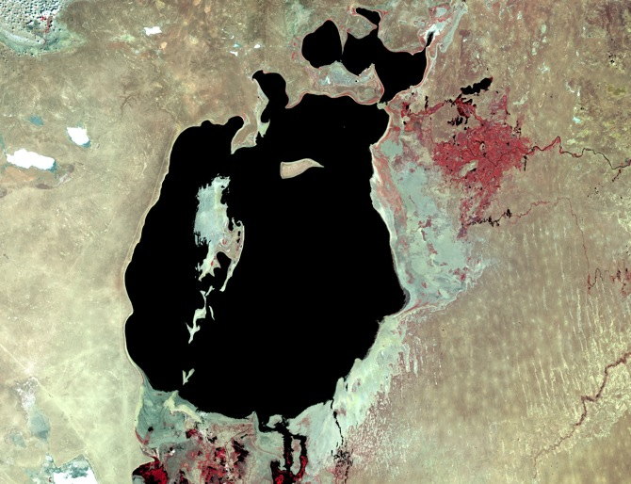
Notes:
1987

Slide 31
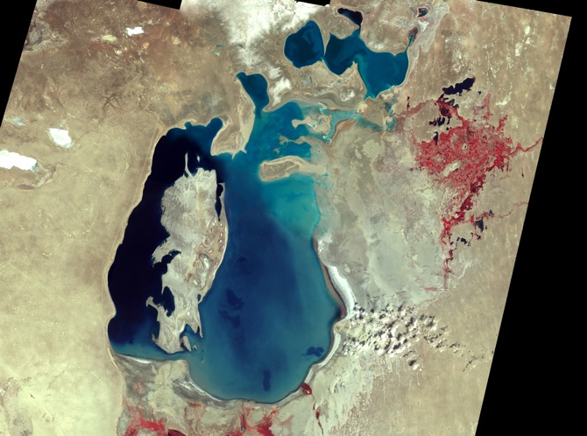
Notes:
1999

Slide 32
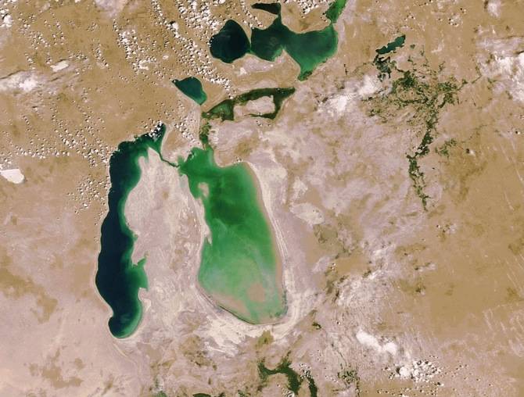
Notes:
2006

Slide 33
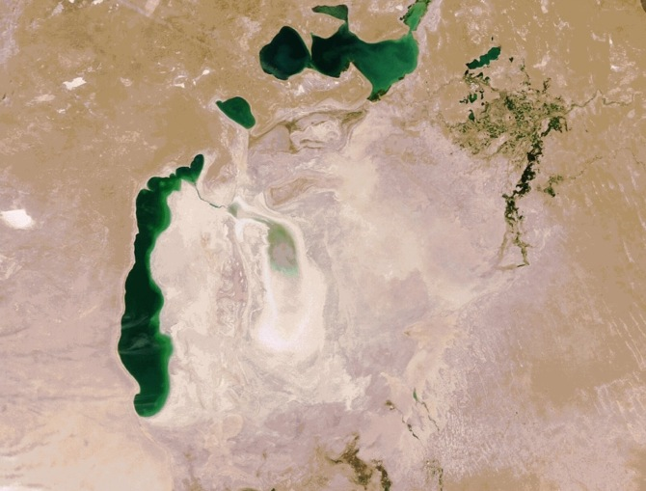
Notes:
2011

Slide 34
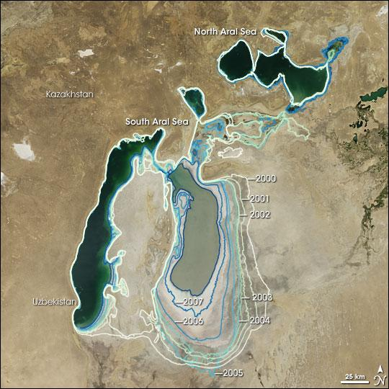

Slide 35
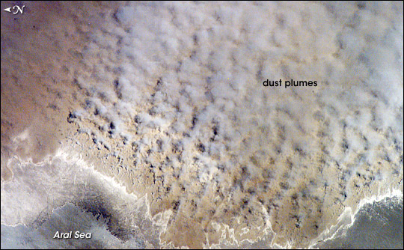

Slide 36
