Slide 1
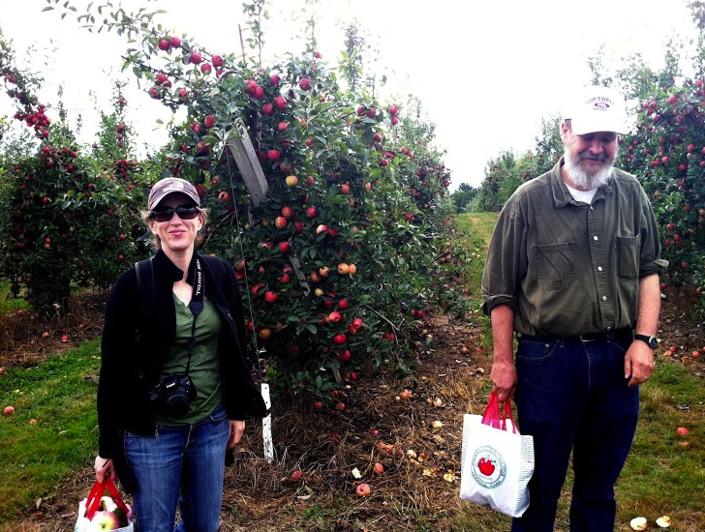
Terrascope Apple Picking
Sunday, September 15
bus leaves 11:30AM, returns ~4PM
e-mail sent out with sign-up for bus

Slide 2
Mission 2017
Tragedy of the Commons
and
Teams
Monday September 9, 2013

Slide 3
Stockholm Statement
SIWI—Stockholm International Water Institute
Bridging the gap between science and policy, the Stockholm Statement is a one page document highlighting current key issues and governance advice from the water community.
The main purpose of the Stockholm Statement in 2013 is to inform and influence the General debate of the sixty-eighth session of the United Nations General Assembly (UNGA 68) in Sept 2013 as the initial findings of the Sustainable Development Goals and Post-2015 consultative processes are presented. SIWI aims to elevate water on global and local political agendas, both as a human right and as an essential productive resource.

Slide 4
A Call for A Sustainable Development Goal on Water
Water is at the core of sustainable global development and is a cross cutting resource. Within the post-2015 development agenda water should be considered and integrated into all relevant areas, such as energy and food security.
Given the centrality of water for individuals, ecosystems and economic development, water is a powerful tool for cooperation across borders, sectors and communities.

Slide 5
A doubling of global water productivity
Allocating water equitably and efficiently within the ecological constraints will require improved management of water quality, use and reuse of water resources.
Through stronger and smarter incentives for water use and innovative governance, it is possible to globally double the value from each litre of water used.

Slide 6
A realisation of the human right to safe drinking water and sanitation
Investing in water and sanitation is a moral imperative, a basic requirement for safety and dignity and is compelling from an economic reality.
Political leadership and innovative governance are of critical importance to the realisation of the human right to safe water and sanitation.

Slide 7
Increased resilience to water-related disasters.
Water is the fundamental link between the climate, the human society and the natural environment. Water- related disasters such as floods and droughts are the worst and most frequent natural calamities.
Integrating water resource management at all levels in the planning, building and governing of our societies will save lives, livelihoods and assets.

Slide 8
Your Mission is to....
Your Mission is to devise and plan the implementation of bold new strategies to ensure that all nations — including those considered to be underdeveloped — have access to clean fresh water while preserving fresh water ecosystems. Your plan should include incentives to get people to act on your solutions. This issue cannot be ignored and quite simply, the future of humankind hangs in the balance.

Slide 9
Teams for Mission 2017
A starting Point

Slide 10
TEAM 1: Organizations concerned with global water security
What do they do? Do they communicate with one another? Is there a better way to organize?
How should multi-national efforts be coordinated
Data acquisition and sharing
Is the United Nations the best way forward?
United Nations
http://www.unwater.org/index.html
http://www.un.org/waterforlifedecade/

Slide 11
Team 1 (continued)
World Water Council
http://www.worldwatercouncil.org/about-us/vision-mission-strategy/
International Rivers
http://www.internationalrivers.org/
'Water in the Anthropocene: Challenges for Science and Governance. Indicators, Thresholds and Uncertainties of the Global Water System’
Global Water System Project: http://www.gwsp.org/

Slide 12
Teams 2-3: Water security in Asia
More than 60% of global population and rapid rise in population
Growing middle class with increasing dependence on irrigation, meat production, and appliances
More reliance on groundwater
Megacities (e.g. Beijing) cannot provide enough water from within city

Slide 13
Team 2: China and Transboundary Rivers
Borders with India, Pakistan, Myanmar, Vietnam, Laos etc.
Water quality, water storage and flows, ecological issues
Are agreements possible and enforceable?

Slide 14
TEAM 3: China’s River systems:
Quality, flow rates, effects of large dams
Limits to growth?
Groundwater supplies for megacities?
Large-scale water diversion projects?

Slide 15
Team 4: Water, Energy and Natural Resources
Water will outstrip oil as the scarcest vital resource
Fossil fuel production, especially new sources, such as shale gas, tar sands, require abundant water and generate much waste. Is water properly valued? Develop guidelines ?
Mining pollution of major water resources – e.g. acid mine drainage. Externalities huge—Africa especially big issue

Slide 16
Team 4 cont. : Biofuels
Global Biofuel Production: set to increase dramatically
Water use: potentially enormous
Less food production more for fuels..
Sustainable??
Cost of water vs. oil

Slide 17
Team 5: Water in Africa
Surface water: The Nile River Basin—too many dams?
Groundwater: The Karoo basin: water vs. shale gas
The Karoo is unique as unlike the US, it still has the potential to create a natural baseline before shale gas exploration starts; but the time line is less than 5 years

Slide 18
Africa (cont.)
Using water resources to grow food on leased land in Africa by China and many other counties: exporting water, controlling the water resources on these lands with negative effects on indigenous food production

Slide 19
Team 6??: Economics of Natural Resources
Nature’s Services—valuing nature
Roles of private enterprise and government
regulation in assuring all basic right to clean
water and sanitation

