Slide 1
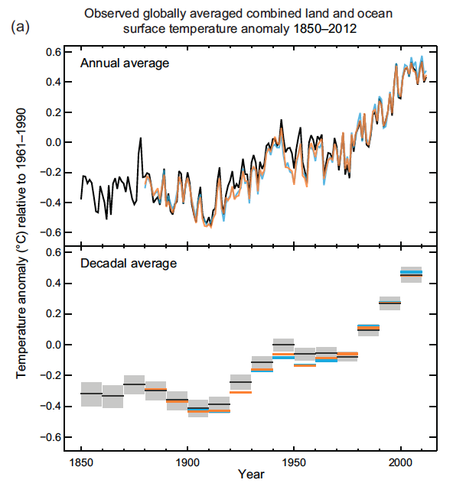
Notes:
From IPCC 2013 report on climate change, “Summary for Policy Makers”
http://www.ipcc.ch/

Slide 2
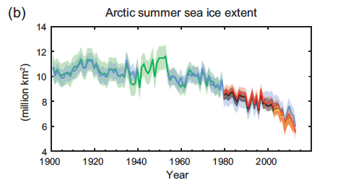
Notes:
From 2013 IPCC report on climate change, “Summary for Policy Makers”. Different colors represent different data sets, and the shading represents uncertainty.
http://www.ipcc.ch/

Slide 3
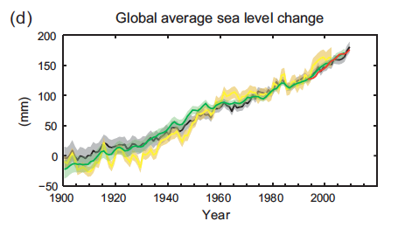
Notes:
From 2013 IPCC report on climate change, “Summary for Policy Makers”. Different colors represent different data sets, and the shading represents uncertainty.
http://www.ipcc.ch/

Slide 4
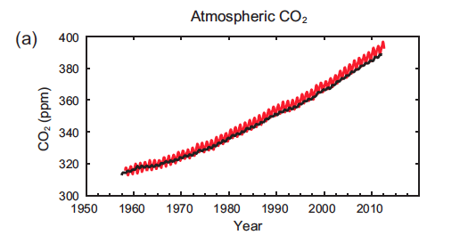

Slide 5
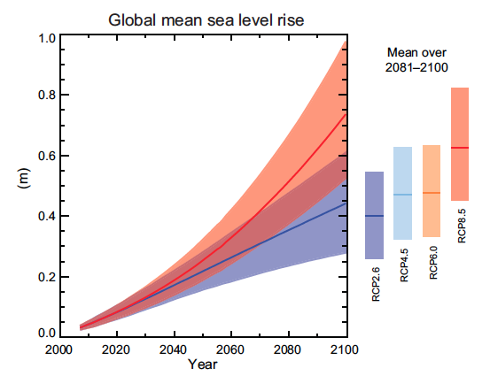
Notes:
Different models of sea level rise. Average run results are solid lines, full range of results is represented by shading. The change in sea level is relative to 1985-2005 data.
From 2013 IPCC report on climate change, “Summary for Policy Makers”
http://www.ipcc.ch/

Slide 6
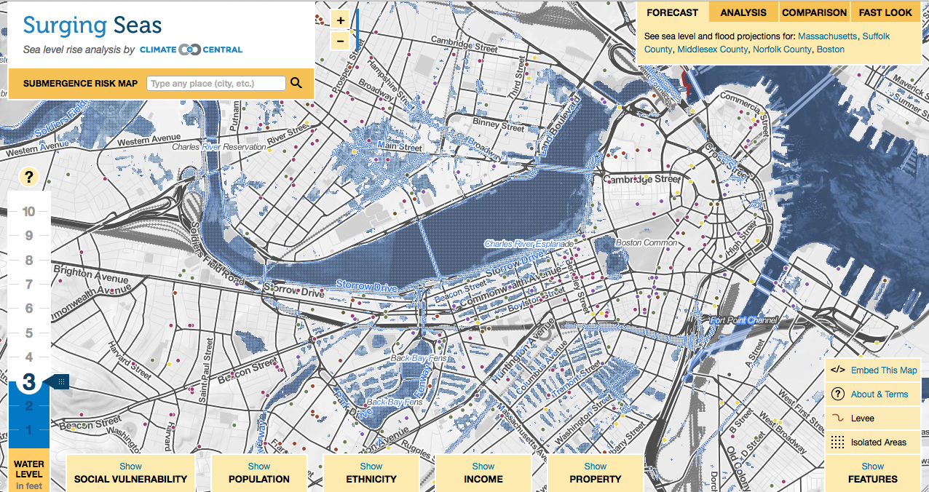
Notes:
Map of Boston showing areas that would be inundated with a 3 foot rise in sea level. Not that much of central Cambridge is underwater, as well as Back Bay, and the South End. This website is a good source. You can overlay many different variables on maps that show areas affected by sea level change.
http://sealevel.climatecentral.org/

Slide 7
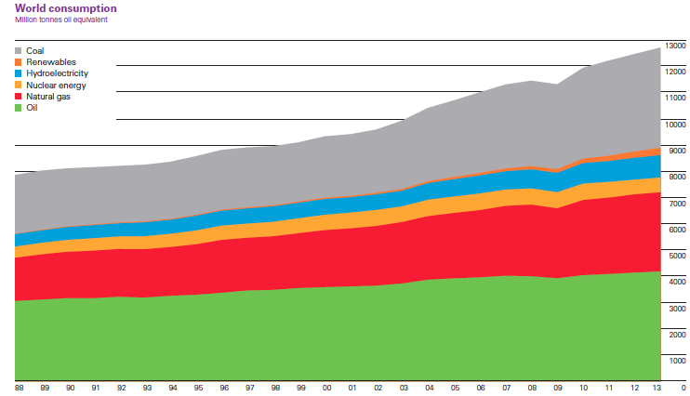
Notes:
World Consumption of energy based on source. Y axis is million tons of oil equivalent. Figure is taken from BP statistical review of world energy.
http://www.bp.com/en/global/corporate/about-bp/energy-economics/statistical-review-of-world-energy.html

Slide 8
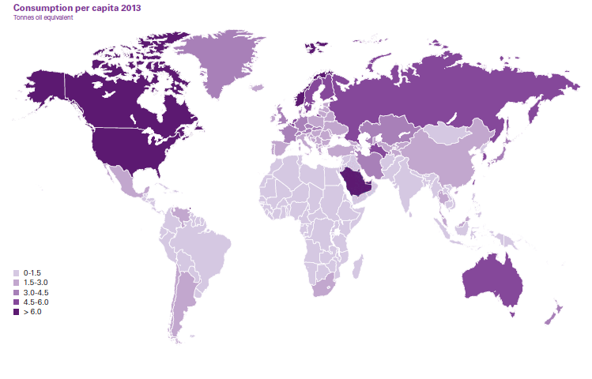
Notes:
World Consumption of energy per capita in tons of oil equivalent. From BP statistical review of world energy 2013.
http://www.bp.com/en/global/corporate/about-bp/energy-economics/statistical-review-of-world-energy.html

Slide 9
12.000 HW1 Questions
What is your opinion of the role nuclear power should and will play in our future? Explain.
At home, how is the household power you consume generated? Any idea what it costs?

Slide 10
Question 1 Responses
“I feel that nuclear energy will play a large role in our energy future… Nuclear power is so efficient for power production that it would be a shame not to exploit its potential as a mostly clean power source.”
“I do think that nuclear power should be more prevalent as a source of power -- but not without regulation.”

Slide 11
Question 1 Responses
“I think that nuclear is our energy future and I think it has the potential to meet all the world's energy needs for a very long time, at least until we find out how to produce energy from nuclear fusion.”
“I believe that the use of nuclear power will increase as people focus on green technologies and as we begin to run out of fossil fuels. I don't believe we will ever rely on it fully, because of our limited resources of uranium and the issue of toxic waste…”

Slide 12
Question 1 Responses
“I believe that nuclear power would become more in use in the future. Although tragedies such as the Fukushima meltdown have occurred in the past, technology will only progress forward and scientists will soon likely to develop a plan that can terminate nuclear reaction before meltdown.”

Slide 13
Question 1 Responses
“The energy crisis has no clear resolution. While fossil fuels create harmful emissions that immediately impact the environment, nuclear energy creates a myriad of its own problems… Nuclear power should be minimally used as more time, money, and research should be put into the cleanest alternatives.”

Slide 14
Question 1 Responses
“I believe that nuclear power should not play a critical role in the future of our planet… the waste products of nuclear reactions are very dangerous, and it is incredible expensive and hazardous to store radioactive waste. We have seen through the disasters of Chernobyl and Fukushima that accidents in nuclear power plants can be catastrophic and have devastating consequences.”

Slide 15
Question 1 Responses
“Nuclear power will likely play a significant role in the future and it should… By the time more nuclear plants are being built, the disposal spots will exist. There needs to be a change in the way we are getting our energy, and nuclear looks like the way to go.”
“Nuclear power is the future of energy in industrialized countries. With the high energy density of nuclear fuels very little feedstock is needed to produce a large amount of energy as compared to crude oil.”

Slide 16
Question 1 Responses
“So, do I think nuclear power should play a major part in our energy future? I'd still need to do some research, but based on what I know, hell yes.”

Slide 17
Question 1 Responses
37 Total Responses
33 in favor of nuclear energy playing a large role in our planet’s energy future.
4 believe nuclear energy should play a small or nonexistent role.

Slide 18
Responses per Time Period

