Slide 1
Mission 2018 September 8, 2014
Tragedy of the commons
Wikis

Slide 2
Tragedy of the commons
Individualism vs Regulation
Population growth: can it be limited?
without cries of fascism etc.

Slide 3
Omission of “unmanaged” Hardin, 1998
A “managed” commons describes socialism or privatism of free enterprise.
“Either one may work, wither one may fail and the devil is in the details”
With an unmanaged commons you can forget about the devil: As overuse of resources reduces carrying capacity, ruin is inevitable”

Slide 4
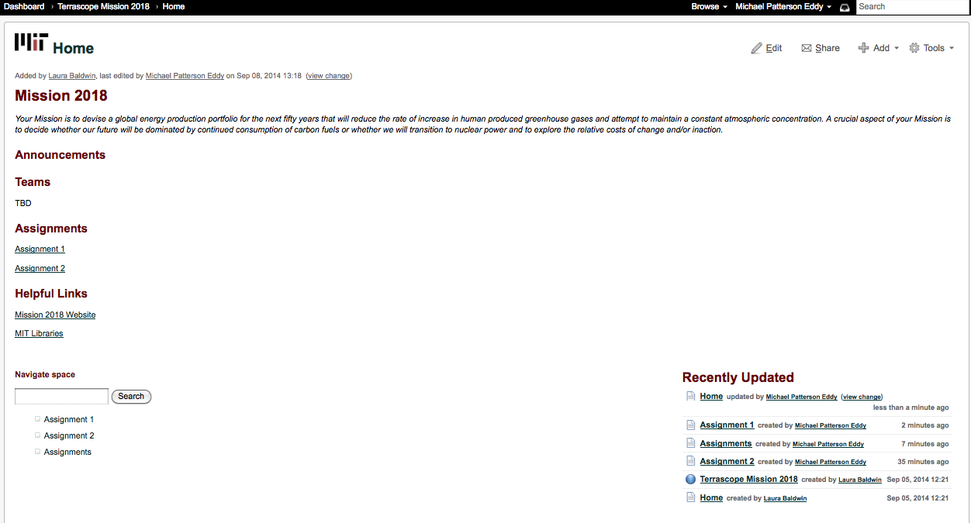
Mission 2018 Wiki Page

Slide 5
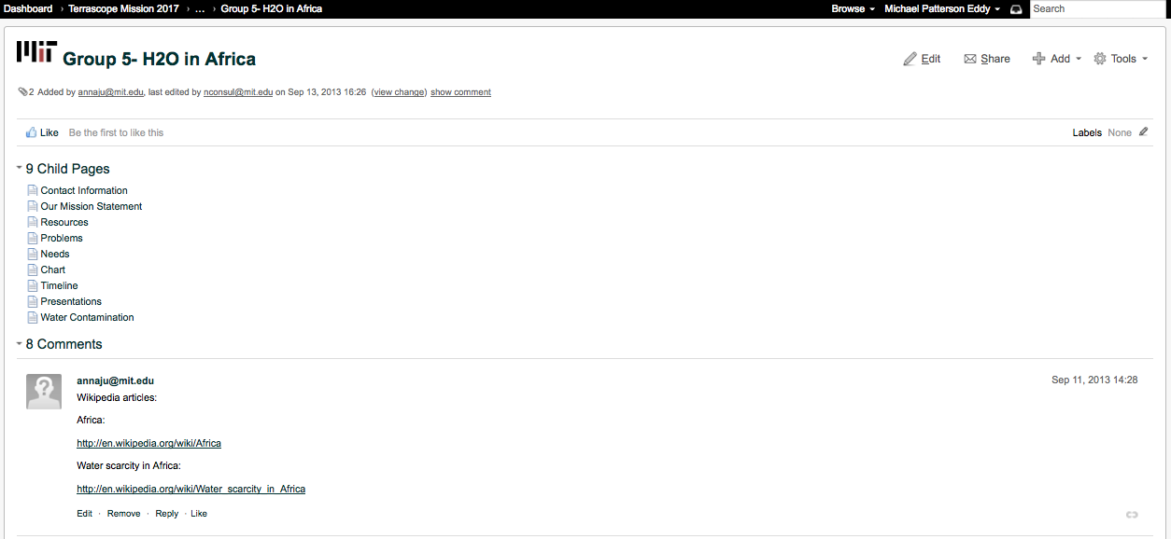
Example of a Past Group Page

Slide 6
Assignment 2

Slide 7
Assignment 2

