Slide 1
Mission 2018 “Miniproject”
Assigned October 8
Due October 15

Slide 2
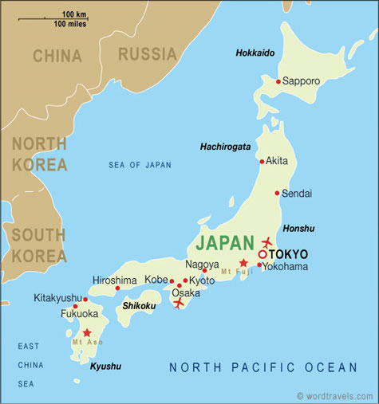
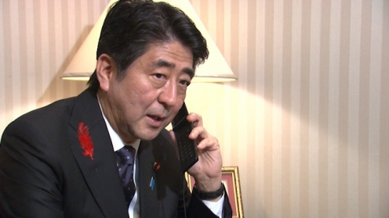
Emergency request from Japanese Prime Minister’s office
We ask the Mission specialists of Terrascope to assess Japan’s post-Fukujima energy future
Specifically—what mix of energy production will set us on a path to energy sustainability while mitigating greenhouse gas emissions.

Slide 3
Japan’s Energy Future
The future should include a mix of renewable energy, fossil fuels, and nuclear—but in what percentages?
How do we regain public confidence in nuclear power?
Japan must set an example for the rest of the world

Slide 4
Report
You will have 40 minutes to present your findings that should cover current energy usage, future projections of demand, and an integrated, sustainable, portfolio.
Are there sufficient reserves of hydrocarbons, nuclear fuels, and infrastructure for renewables?
A successful plan should be useful as a template for other small countries.

Slide 5
Recommended Approach
Synthesize information from all groups
Make unified presentation with 3-5 speakers
40 minute presentation will be strictly enforced and followed by questions from a panel
Visual aids should be clear and not too numerous

Slide 6
Relevant Material to Help Get You Started is on the Website.

